Slide 1
Analysis of Gender Impact On Life Expectancy

Slide 2
Overview and problem statement
Advances in healthcare, nutrition, and living conditions increase life expectancy.
Do gender differences impact life
By how many years on average?

Slide 3
Data analyzed
Approximately 2,800 sample records distributed by half in gender.
Data includes Year, Gender , household , Gender and Life expectency.
Raw data available here

Slide 4

Does gender have a significant impact on life expectancy?

Slide 5
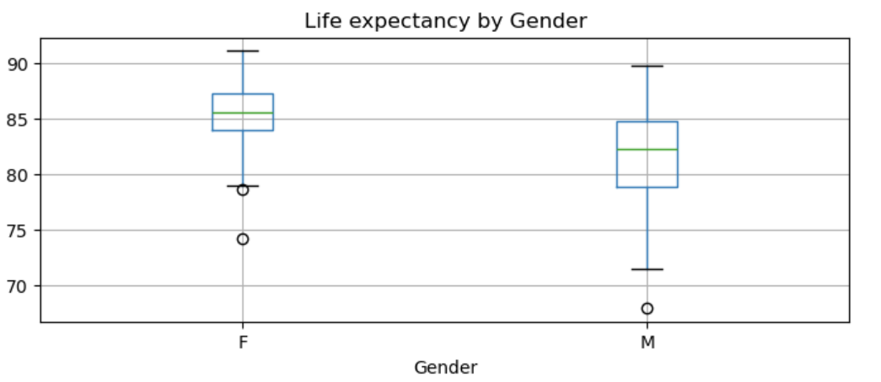
Statistically, there is a significant difference in life expectancy between males and females
With 95% confidence, on average Females have 3.62 to 4.08 years more life expectancy than Males

Slide 6
With Females have Long life expectancy
Further study of Female household income, life style routine and other factors will further confirm biological difference have significant effect on Life expectancy.
Further study of specific biological factor in Females contributing to life can be used to improve Life expectancy in humans.

Slide 7
Questions?

Slide 8
Thank You

