Slide 1

Estimation Model for Housing Prices in Houston

Slide 2
Overview and problem statement
Owning a home is considered a central part of the American Dream.
Houston is one of the hottest housing markets. What features of a house are most valuable in terms of price?
As a buyer or investor or a real estate agent how do I estimate a price of home?

Slide 3
Data analyzed
Approximately 13,191 sample housing data with price.
Data includes Bedrooms, Bathrooms, sqm_house, Car, Balcony, Year_built, Address, Latitude, Longitude,Zipcode and target variable Price.
Data sourced from Kaggle and is available here

Slide 4
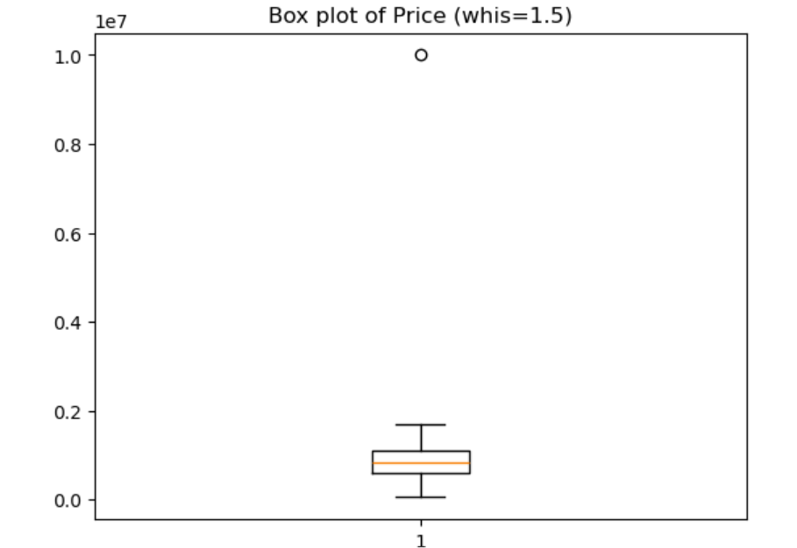
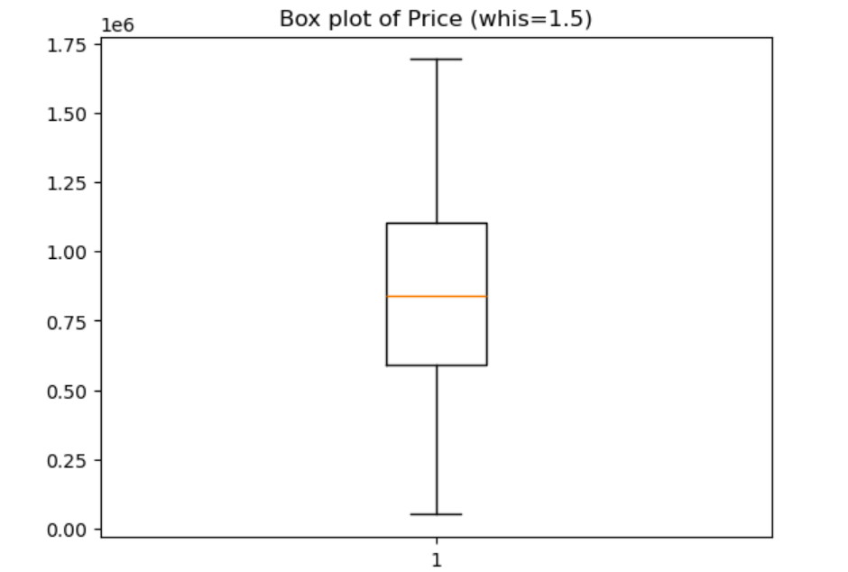
Exploratory Data Analysis.
Handling Missing data.
Analysis of categorical value Address.
Outliers.
Before
After

Slide 5
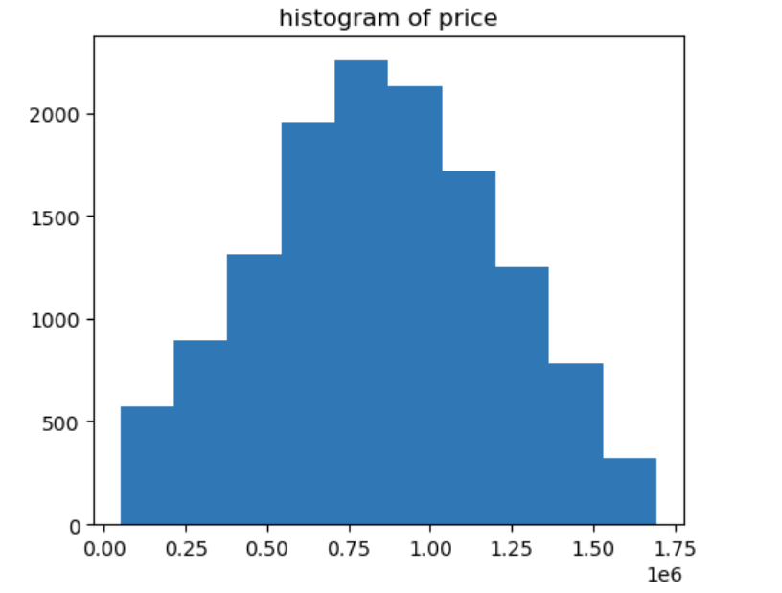
Exploratory Data Analysis contd..
Target variable distribution
Jarque-Bera test statistics is 203.9582965161614 and p value is 5.1406571765353766e-45
Normality test statistics is 446.1071126471122 and p value is 1.346081389217146e-97

Slide 6
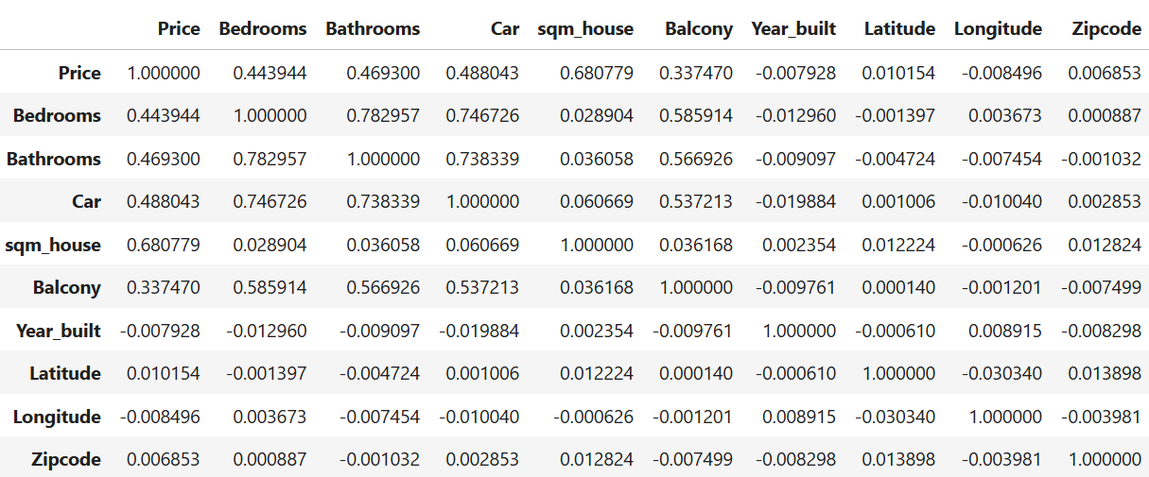
Feature Engineering
How Features are correlate with price?

Slide 7
Feature Engineering contd..
Data distributions
Standardization and normalization
Dimensionality reduction

Slide 8
Model selection
Target variable is continuous variable and normally distributed.
Start with simple Linear regression.
Improve model fit and reduce the bias in linear regression with Lasso and Ridge regression.
Move to ensemble model of Random Forest regression with bagging technique.

Slide 9
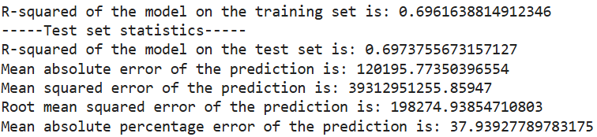
Linear, Lasso and Ridge regressions
Linear regression model performed better with r-square 0.7 , lasso and ridge regressions does not improve much on the model performance.
So picking simple regular linear regression, below are the model performance stats

Slide 10
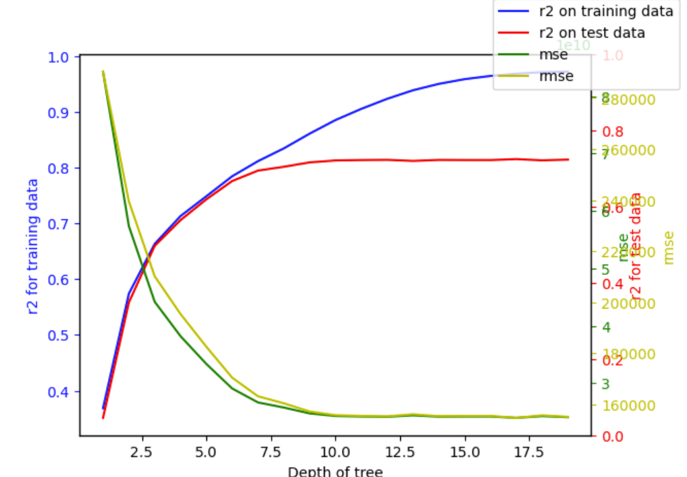
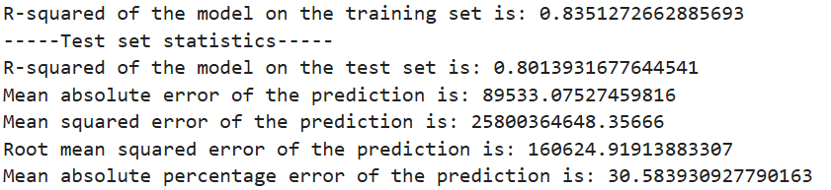
Random Forest regression and Tuning
Random forest regression performance is better by default.
Tuning the model with estimators and depth.
Best model is at estimators with 100 and depth with 8

Slide 11
With Random Forest regression pricing model
Home buyer, investor or Real estate agent can predict base price of a home in Houston with the features used in model build.
Extra features of the home that are not included in the model need to be considered to estimate actual price of the home.
Model reference
- https://github.com/krupakar010/DATA-401/blob/main/Supervised_learning_captoneII_added_graphs.ipynb

Slide 12
Thank You

