Slide 1
Unsupervised Learning for emails spam detection

Slide 2
Overview and problem statement
Emails are a part of everyday life for millions of people, serving as a primary communication tool in both personal and professional settings.
Statistics show that around 45% of emails are classified as spam, indicating a large number of potential victims.
What if we can categorize the emails as spam before even the email user not even opening it ?

Slide 3
Data analyzed
Approximately 5172 sample email data with spam label on them.
Data includes 3000 features, the mostly refer to existance of specific words.
Data sourced from Kaggle and is available here

Slide 4
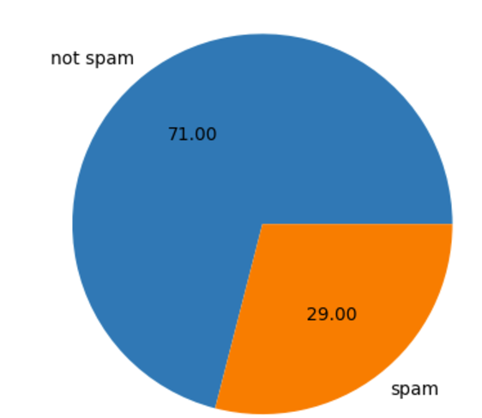
Exploratory Data Analysis.
Handling Missing data.
No missing data, zero values are valid
Analysis of categorical value email id.
This is unquie id , so this will get dropped from the features.
Outliers.
Labels
Lable is 0 or 1 indicate email is spam or not

Slide 5
Feature Engineering
Features are huge and are 3000
Standardization and normalization
Standardization will be done on the 3000 features
Dimensionality reduction
PCA
T-SNE
UMAP

Slide 6
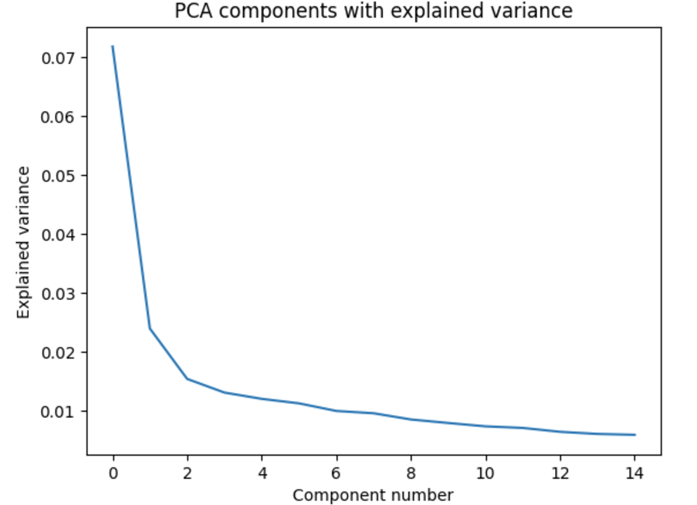
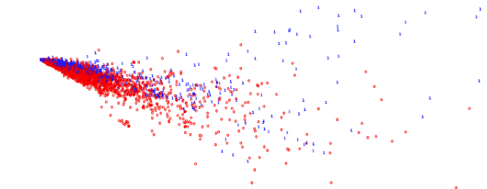
PCA
PCA components
PCA component plot representing clusters
PCA clearly separating spam and non spam emails

Slide 7
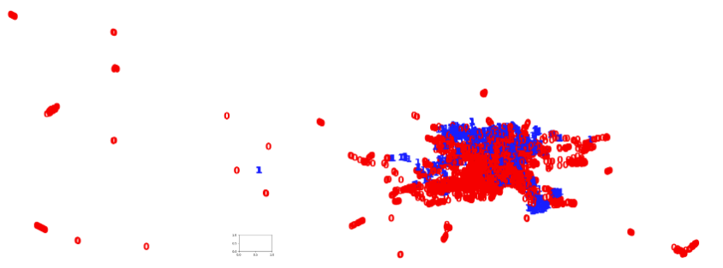
UMAP
UMAP component plot representing clusters
UMAP not clearly representing the clusters for spam and non spam emails

Slide 8
Model selection
.
Start with simple K-means clustering with know number of clusters as 2.
Move to Soft clustering model Gaussian Mixture.
Tune model with hyper parameters.

Slide 9

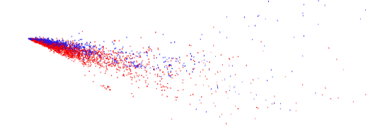
K-means
Model performance Metrics.
Cross tab for clustering

Slide 10
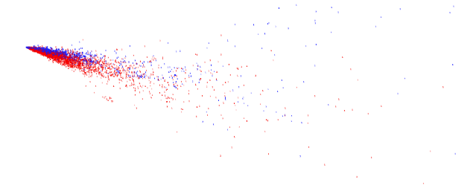

Gaussian Mixture clustering
Model performance Metrics.
Cross tab for Gaussian Mixture clustering

Slide 11
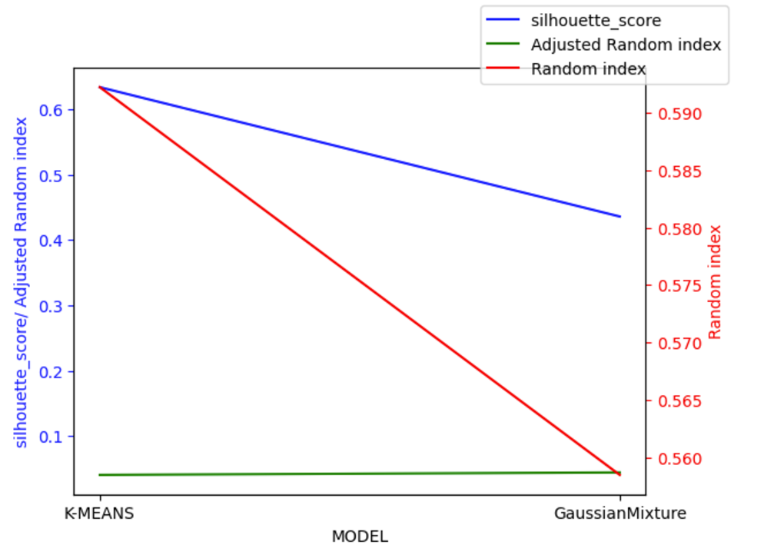
Model comparisons
K-means is better in clustering spam and non spam emails.

Slide 12
Conclusion and next steps
K-means Clustering can be used to identify the spam email, the model is good. The model metrics and performance is better compared to other unsupervised learning models.
Data selected is labeled data, so as next step I strongly recommend try supervised learning models like decision trees with ensemble techniques. After the try and based on model performance select the best model.
Model reference
- https://github.com/krupakar010/DATA-401/blob/main/CapstoneIII_unsupervised_learning1.ipynb

Slide 13
Thank You

