Slide 1
Max_weight
File created on: 7/1/2025 12:32:32 PM

Slide 2
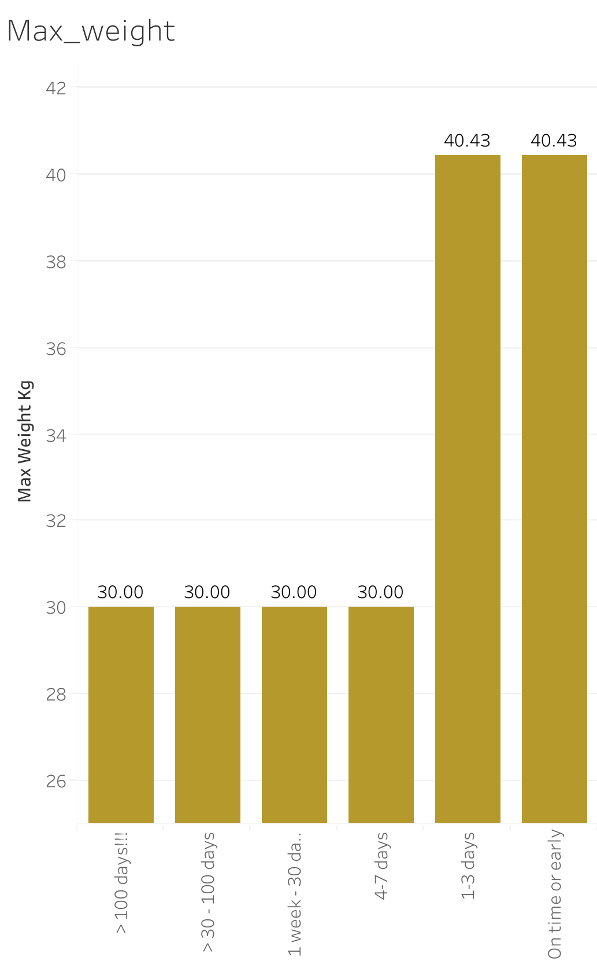

Slide 3


Slide 4
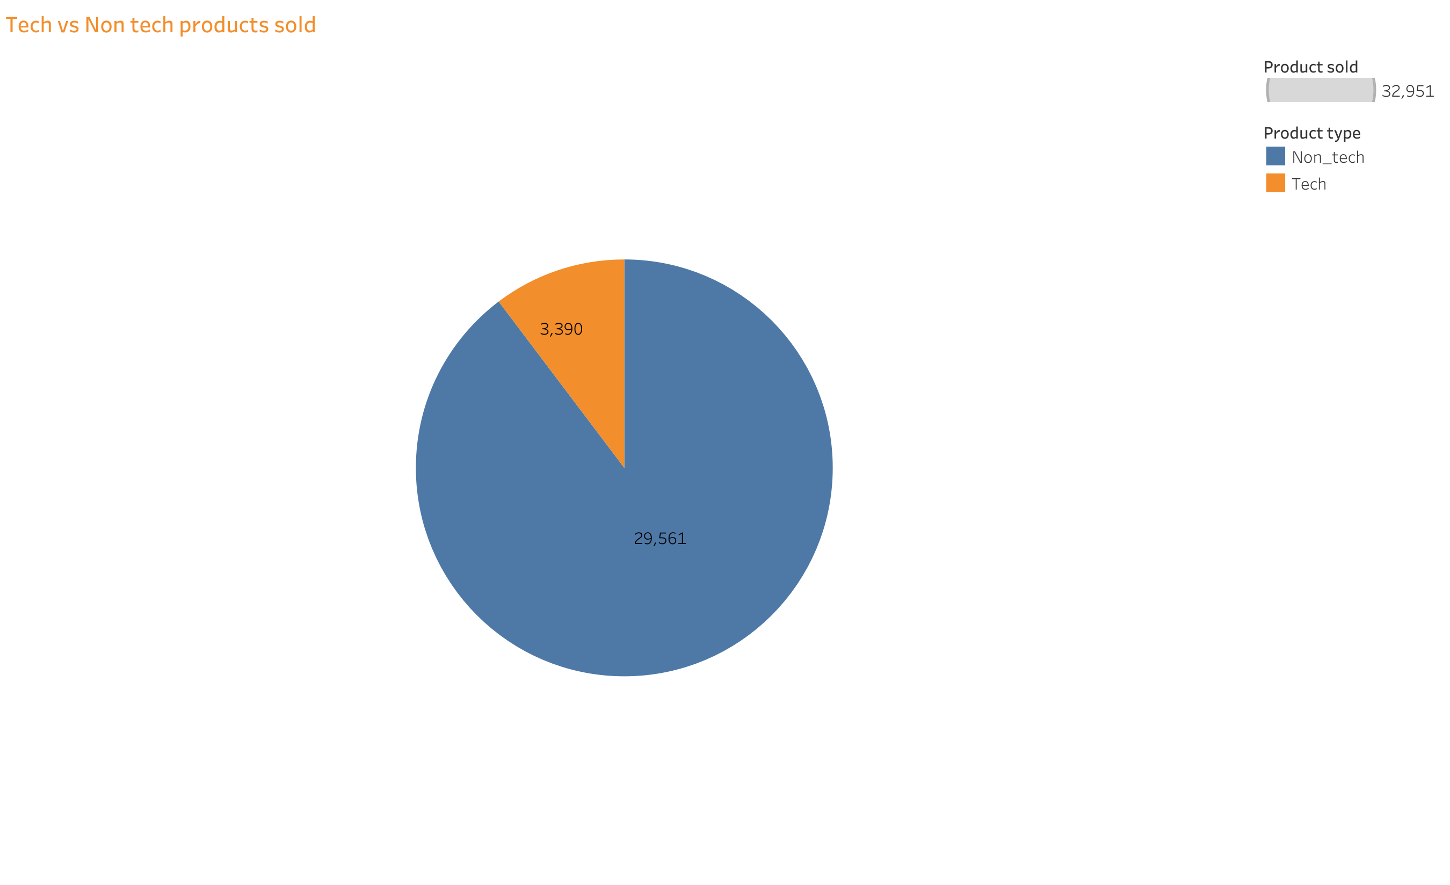

Slide 5
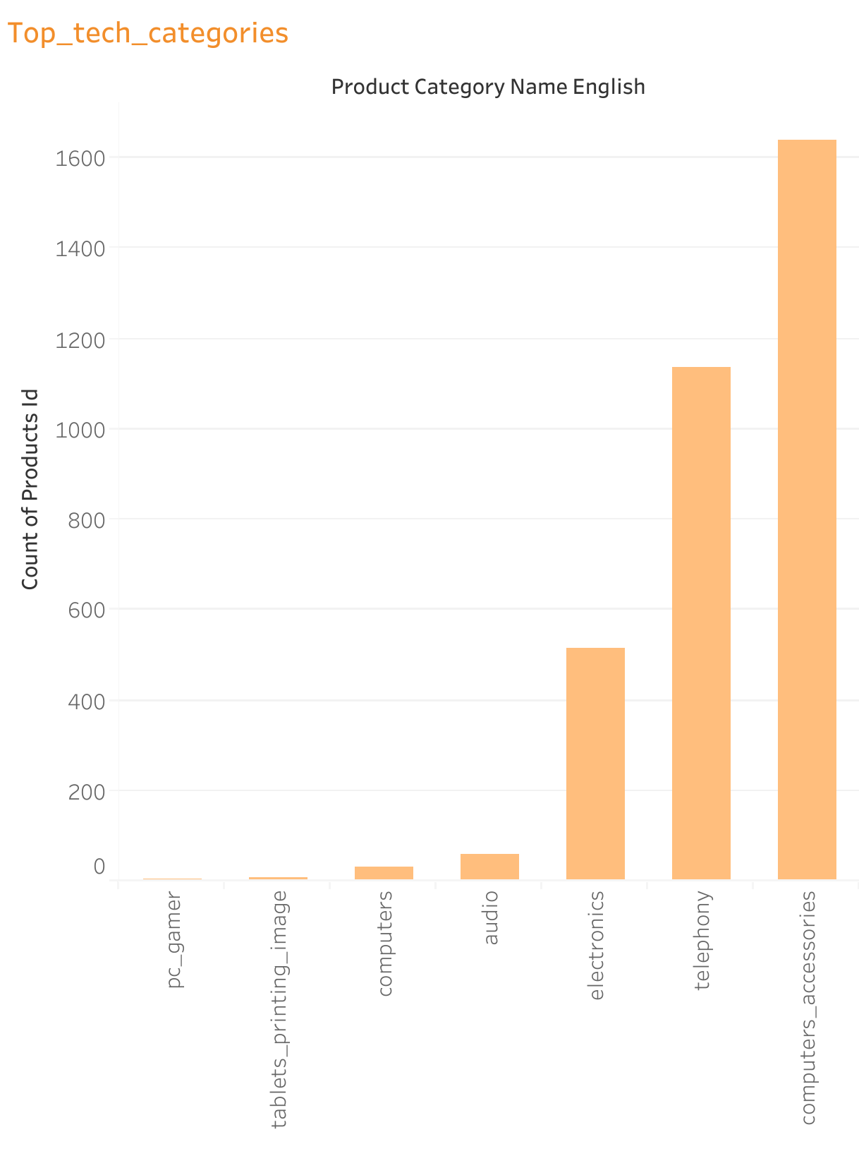

Slide 7


Slide 8


Slide 9


Slide 11


Slide 12
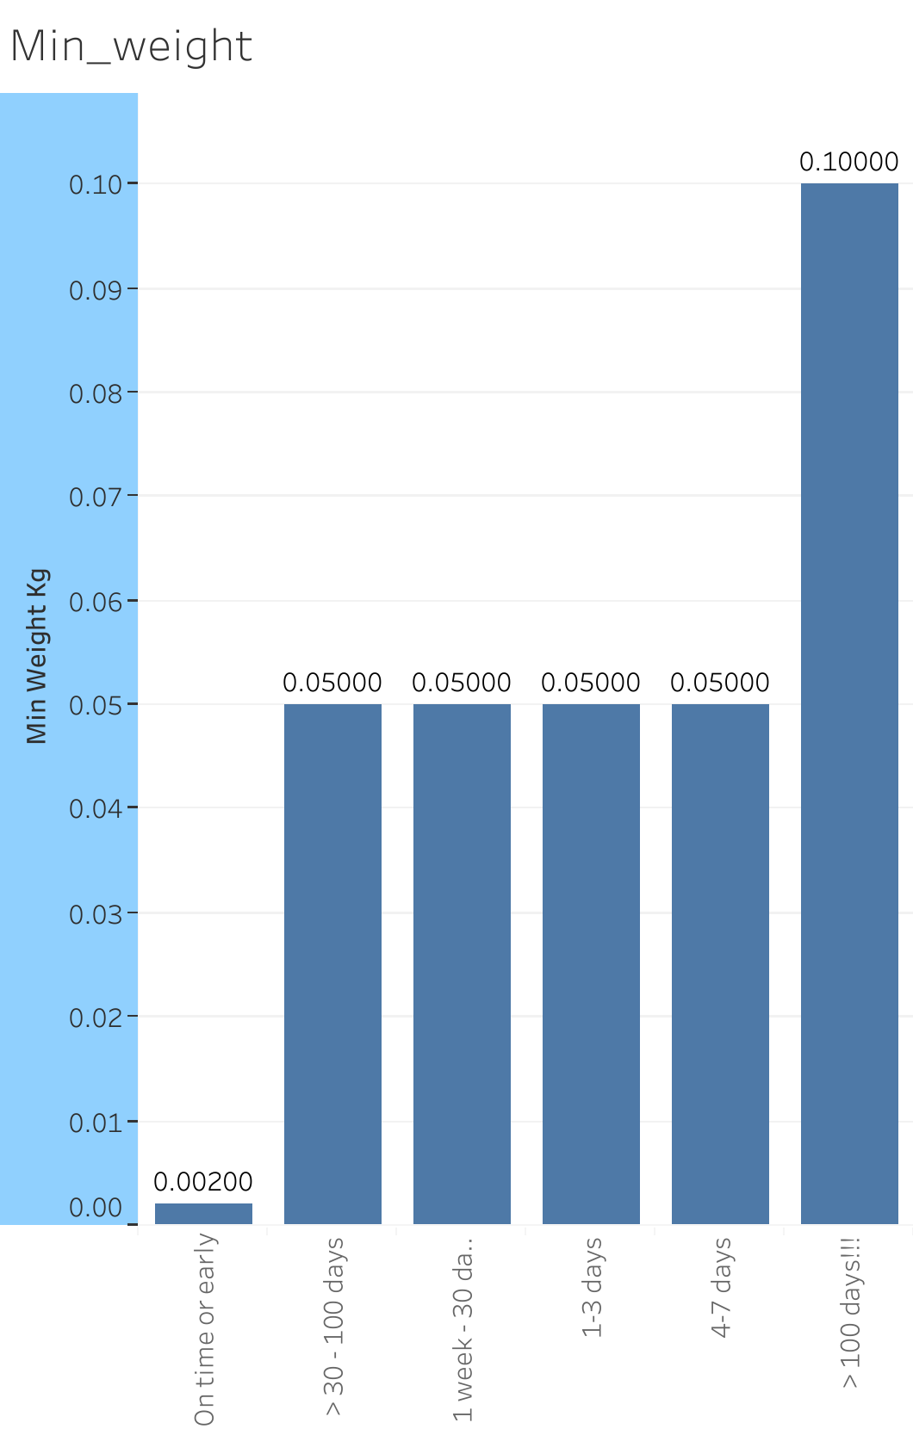

Slide 13
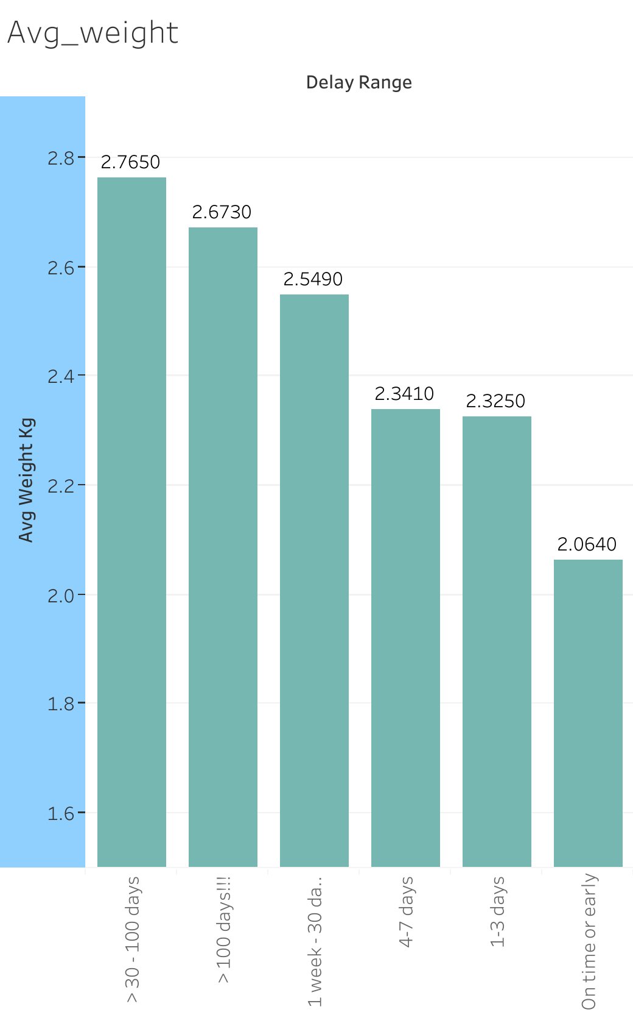

Slide 14
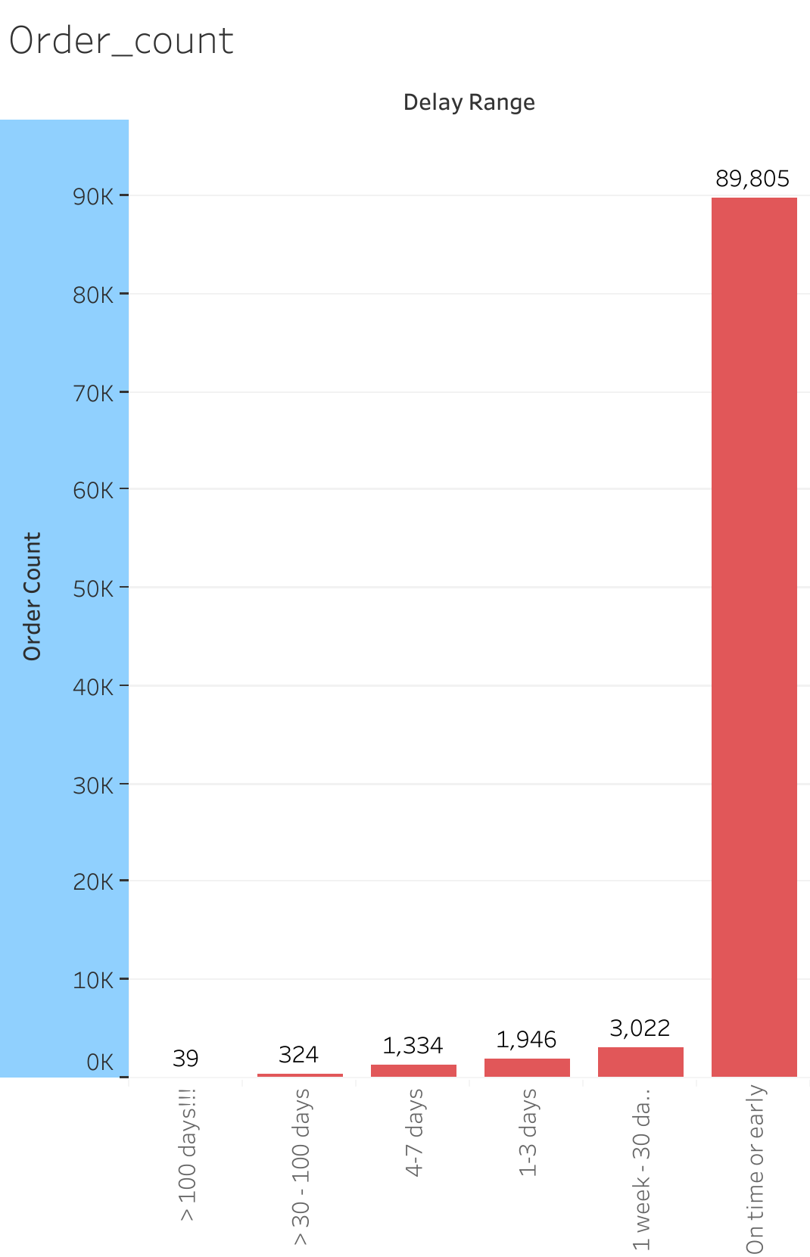

Slide 15
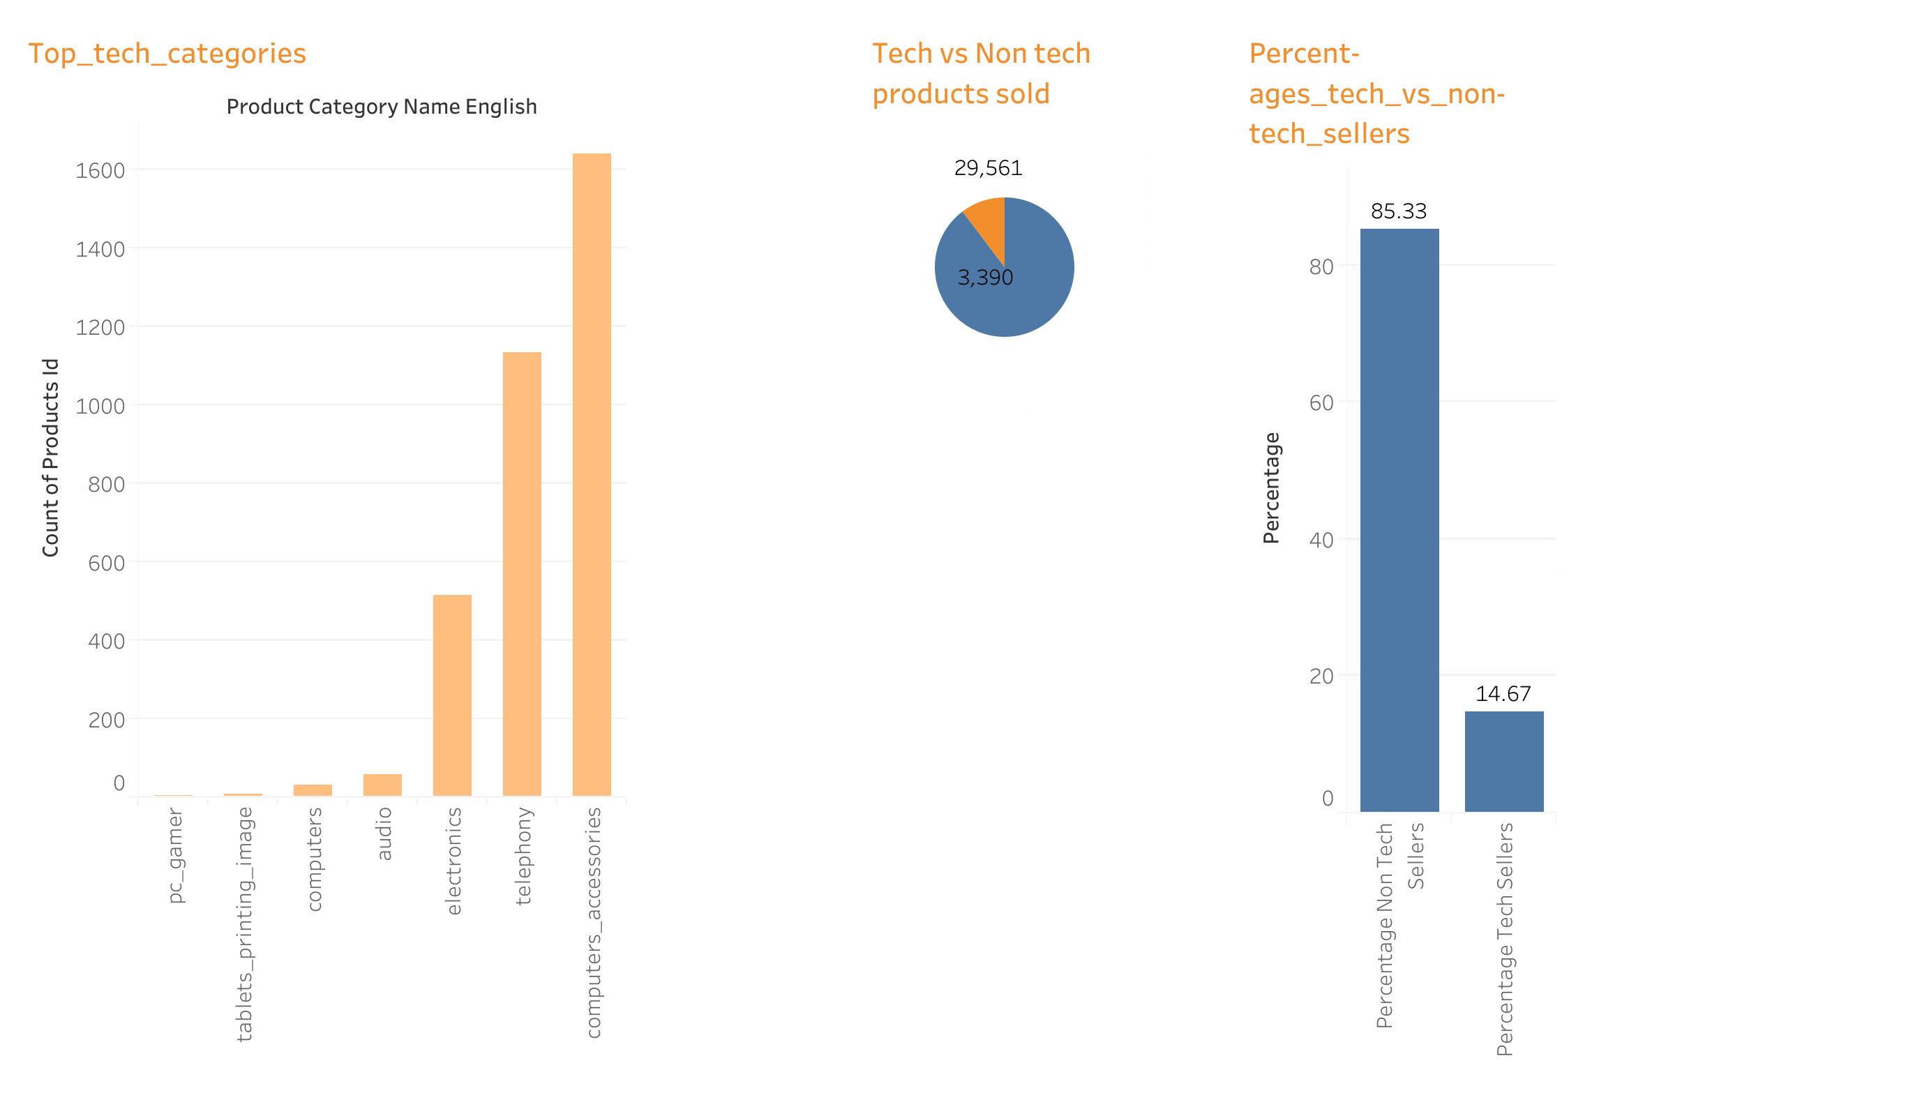

Slide 16
