Slide 1
Analysis: Magist Partnership
by
Krupali, Miral and Pascal
July 2nd 2025 -confidential-

Slide 2
Relevant KPIs
9.6%
of products sold are tech

Slide 3
Relevant KPIs
9.6%
of products sold are tech
33 EUR
average tech order value

Slide 4
Relevant KPIs
9.6%
of products sold are tech
33 EUR
average tech order value
12 days
average order fulfillment time

Slide 5
Relevant KPIs
9.6%
of products sold are tech
33 EUR
average tech order value
12 days
average order fulfillment time
Stagnant
user growth

Slide 6
Order Value
710 EUR
33.4 EUR
Eniac
avg. order
Magist
avg. order

Slide 7
Magist’s tech portfolio
Audio products
Telephony
Gaming consoles
General electronics
IT accessories
Gaming equipment
PCs

Slide 8
Magist’s tech portfolio
Audio products
Telephony
Gaming consoles
Comparable freight values
General electronics
IT accessories
Gaming equipment
PCs

Slide 9
Order Fulfillment
Average weight | Average fulfillment time
2.06kg | on time | 90.3%
2.33kg | 1-3 days | 9.3%
2.76kg | 30 days | 0.4%
>2.76kg | up to +100 days
Conclusion: There is a positive correlation between product weight and delivery delays.

Slide 10
Order Fulfillment
Mostly efficient

Slide 11
Order Fulfillment
Mostly efficient
Potential massive outliers

Slide 12
Order Fulfillment
Mostly efficient
Potential massive outliers
Especially with heavy accessories, this could be potentially harmful to our reputation.

Slide 13
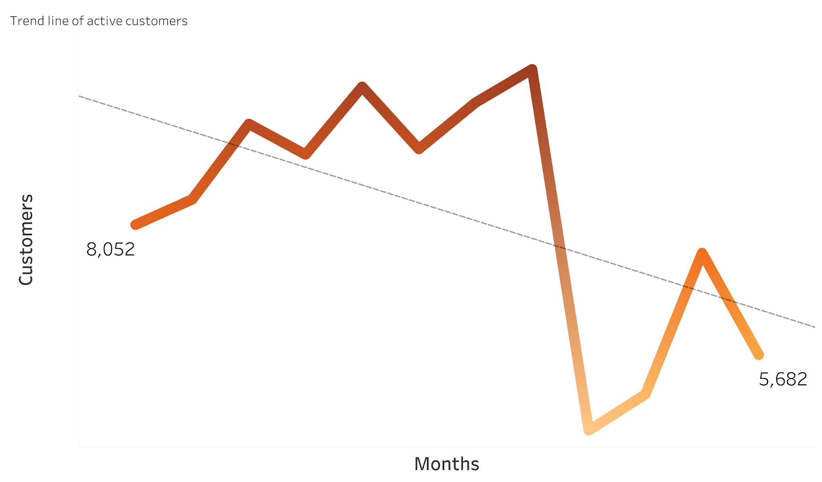
User growth

Slide 14
Conclusion

Slide 15
Conclusion
❌ Low Tech Sales

Slide 16
Conclusion
❌ Low Tech Sales | ❌ Low Tech Revenue

Slide 17
Conclusion
❌ Low Tech Sales | ❌ Low Tech Revenue | ❌ Delays for Heavy Tech

Slide 18
Conclusion
❌ Low Tech Sales | ❌ Low Tech Revenue | ❌ Delays for Heavy Tech | ❌ Not Brand-Aligned

Slide 19
Conclusion
❌ Low Tech Sales | ❌ Low Tech Revenue | ❌ Delays for Heavy Tech | ❌ Not Brand-Aligned
While Magist performs well in general e-commerce fulfillment, its market behavior, revenue trends, and brand alignment do not support the launch of premium tech products.

Slide 20
Thank you!

