Slide 1



E-BOOK DICTIONARY
Information Technology (Semester - 5)
Guided by:
-Prof.Mohammed Bohra
Prepared By:
Krupali Dobariya (18DIT014)
Priyal Ramani (D19DIT082)

Slide 2

Problem Statement
To find meaning of selected word from any e-document or any other desktop applications without active internet connection.

Slide 3
Current System and its limitations Consolidated list of Requirements:
Copy & search on internet
Time consuming & boring
Internet is mandatory.
Python
NLTK
Pyperclip
Tkinter

Slide 4
Project Definition
Just copy the word (Ctrl + c).
It shows lots of meanings and synonyms.
NLTK(Natural Language ToolKit) – Searching of meaning and synonyms.
Pyperclip – Use the functionality of clipboard (i.e Copy).
Tkinter – Displaying result in pop up box.

Slide 5
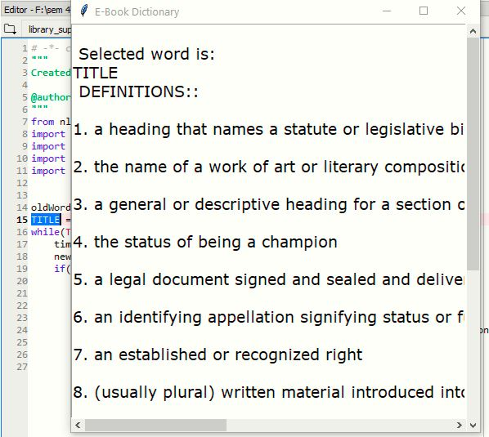
Snapshots

Slide 6
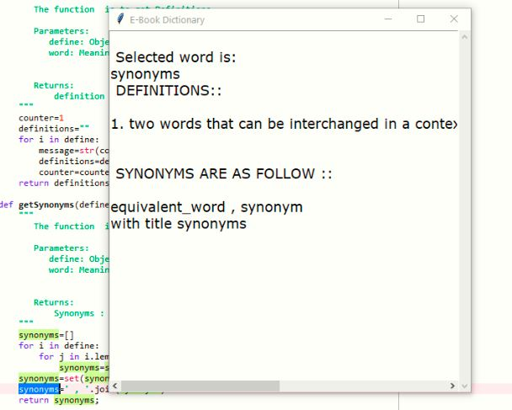

Slide 7
Thank you!

