Slide 1
Web Technologies – Part B Consolidation (Weeks 1–10)
MSc Computer Science – Web Technologies
Student Name:-Krupal Solanki
Student ID:-413976

Slide 2
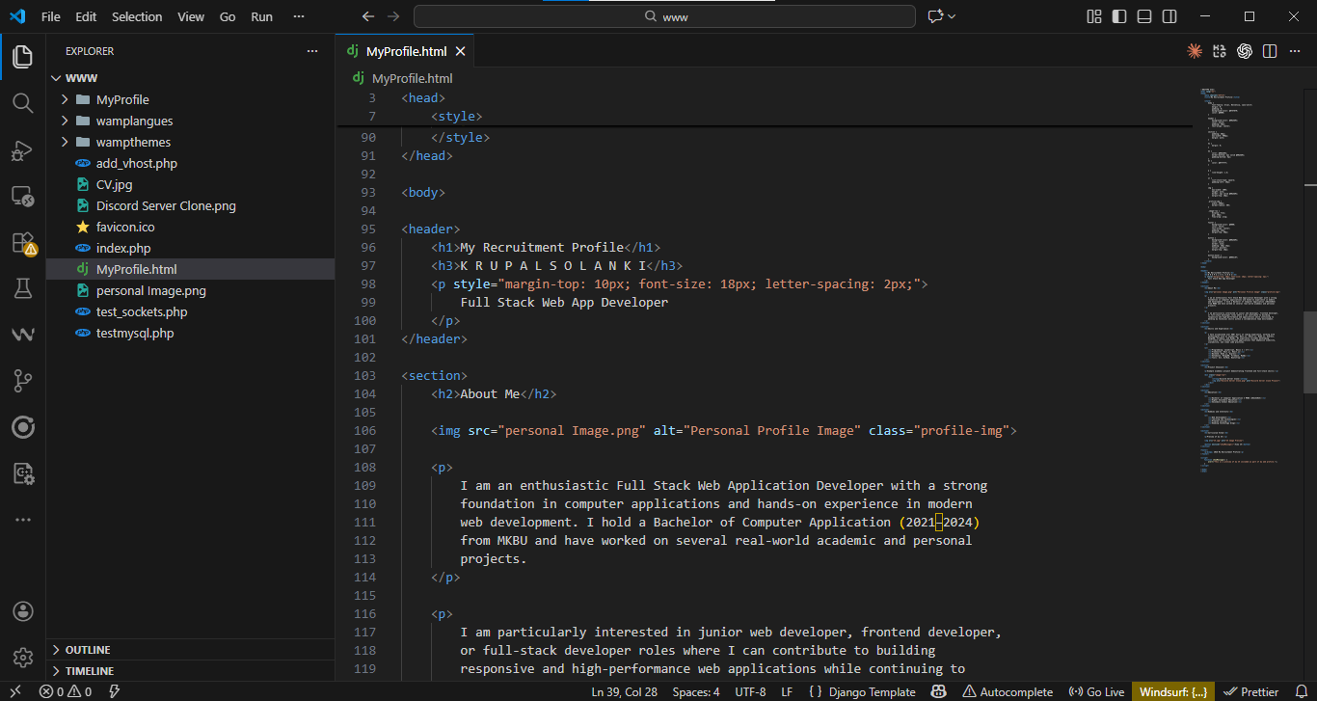
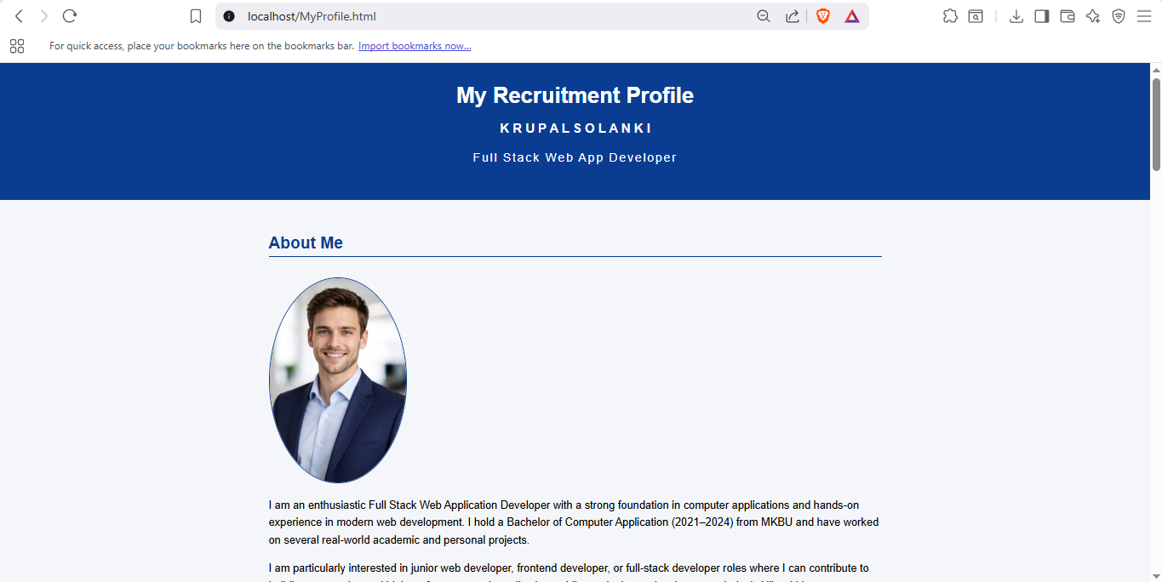
Week 1: HTML Foundations and Web Presence
Developed basic HTML structure using headings, paragraphs, and lists
Created personal recruitment profile webpage using semantic HTML elements
Understood importance of correct file structure and browser rendering (Hoseini, 2023)
Demonstrated ability to deploy static HTML pages locally
Notes:
The initial topic discussed in Week 1 is the basic principles of web technologies with the help of HTML. I acquired the ability to organize a simple web page in with fundamental compositions like headings, paragraphs and list. The assignment of developing personal recruitment profile also made me realise how the content is arranged to real users. I also had experience in proper saving of HTML files and trying them in a browser. This week provided a solid base regarding future web development activities and has helped the learning outcome of familiarizing with the basic web application structures.

Slide 3
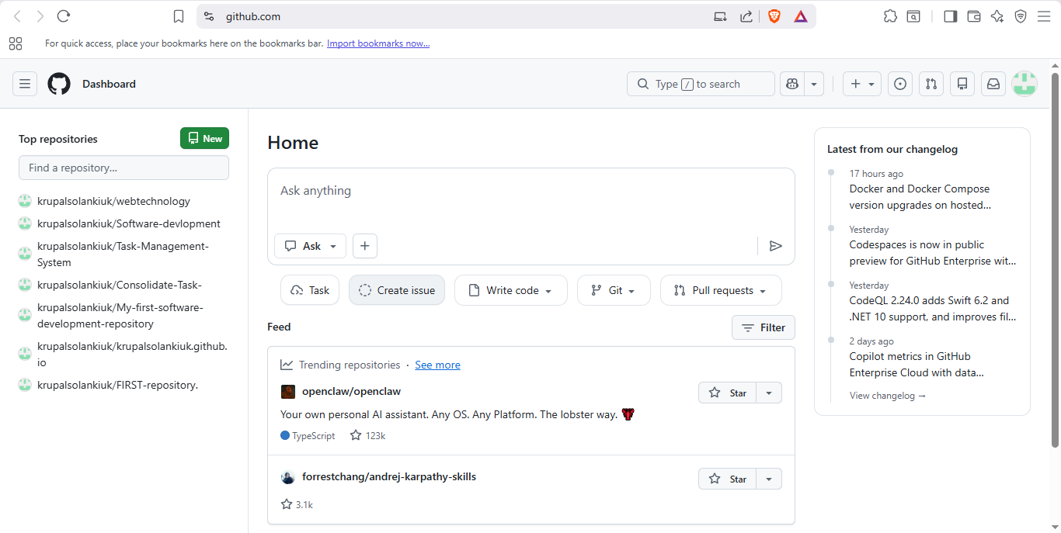
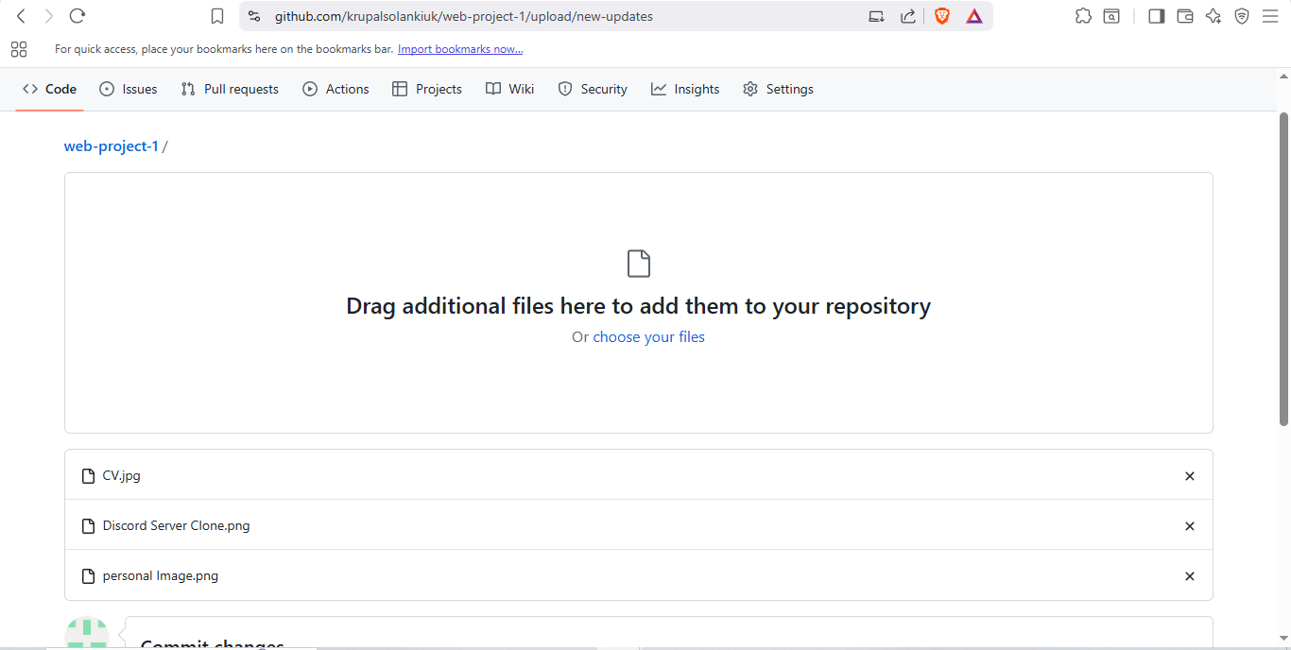
Week 2: Version Control and GitHub Usage
Used GitHub repositories to manage web project source files
Created branches to safely implement updates without affecting main code
Uploaded media assets and tracked changes using commit history
Demonstrated collaborative development principles through pull requests
Notes:
Week 2 was dedicated to version control with the help of GitHub that is a must in collaborative web development. I have been taught to make and maintain repositories, open new branches and post more files of the project. The ability to commit development progress changes with meaningful messages helped me to realize how progress is monitored. The development of a pull request exemplified the way of how the updates could be checked before the transfer to the main branch. The direct learning outcome that was addressed in this week was the professional development practice and source code of web application management.

Slide 4
Week 3: Content Management Systems and Blogging
Explored WordPress as a content management system for dynamic websites
Created and published blog posts using visual content editors
Organised content using categories, tags, and featured images (Miltner and Gerrard, 2022)
Understood role of CMS platforms in modern web development
Notes:
During Week 3, I studied the application of WordPress as a content management system. I came to know that CMS platforms are easy to use in creating content without having a solid understanding of codes. The idea of creating and publishing a blog post showed me to be aware of assessing content organisation based on categories and tags. The addition of featured images and visual presentation and usability. This assignment showed the ability of CMS technologies to improve users experience and efficiency. The week helped me to comprehend the existence of other approaches to web development, as opposed to the utilization of statical HTML and this fact concurred with learning outcomes, associated with reviewing various web technologies.

Slide 5
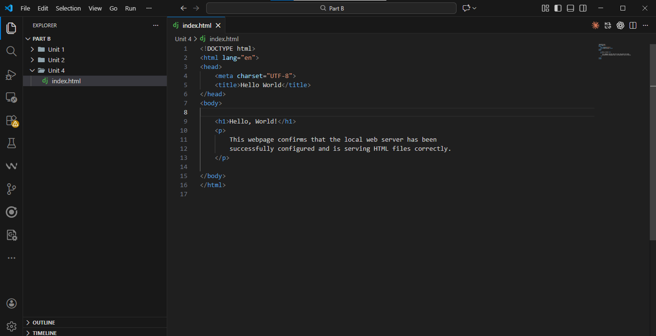
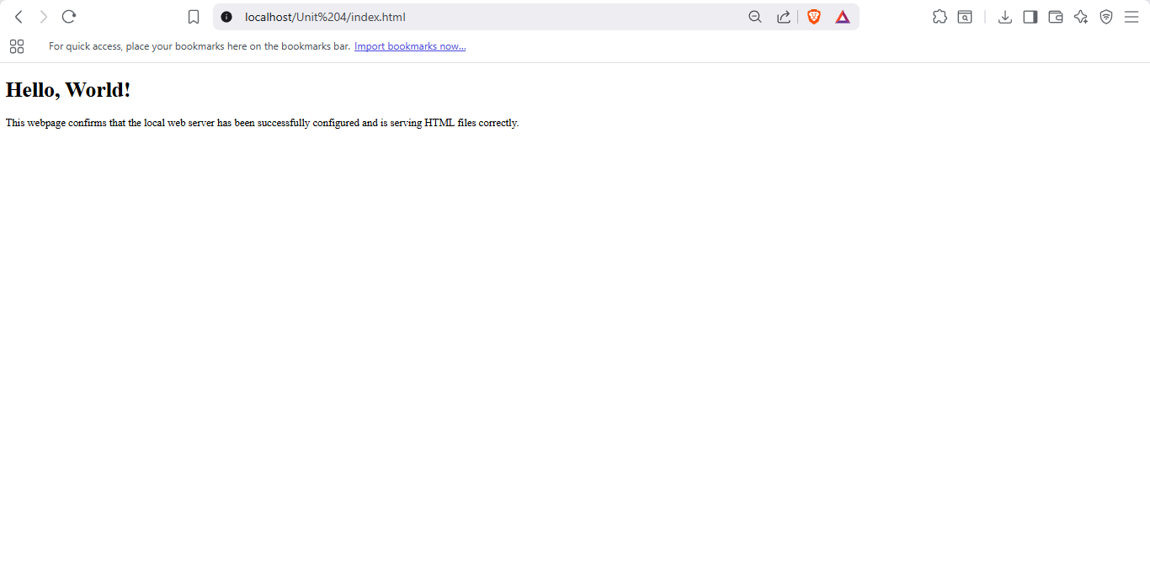
Week 4: Local Server Configuration
Configured local web server using WAMP environment successfully
Tested server functionality using simple Hello World webpage
Understood relationship between browsers, servers, and web files (Acharya, 2024)
Verified correct deployment through localhost testing
Notes:
Week 4 presented basics on server side with the set up of a local web server using WAMP. I was able to learn how servers are used to pose web content via browsers, as well as how files are served via localhost. To ensure that the server is functioning properly, a simple page/server of Hello, World! was created and tested. This fieldwork exercise has enabled me to appreciate the dynamics between a client and a server environment. It helped to achieve the learning outcome connected with the implementation and practice of web applications in a controlled development environment.

Slide 6
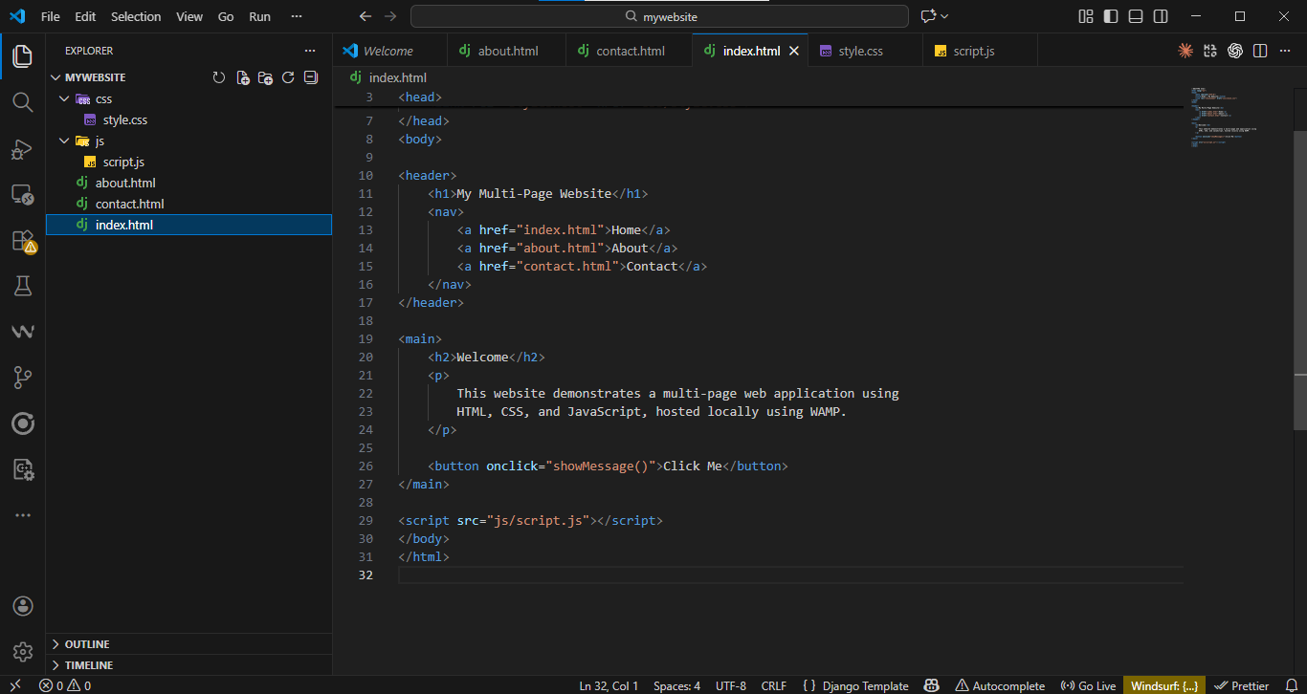
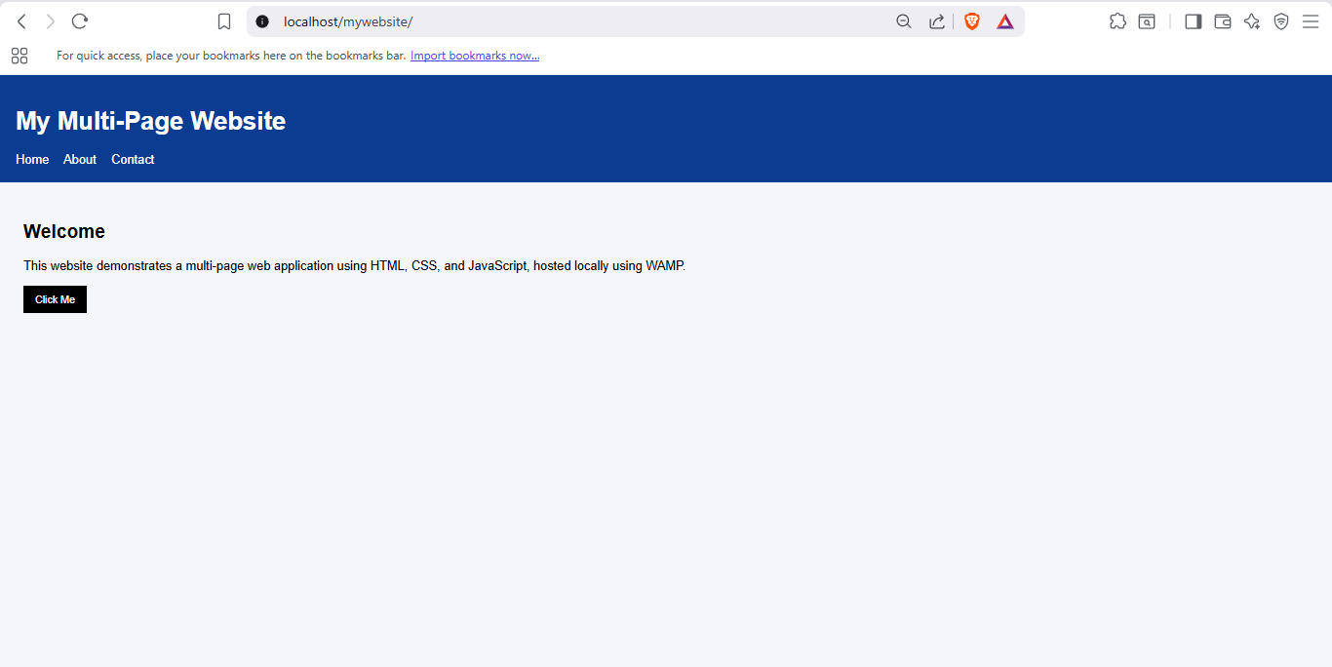
Week 5: Multi-Page Websites and JavaScript Interaction
Designed multi-page website using structured HTML file organisation
Applied CSS styling to enhance layout and visual consistency
Implemented JavaScript for interactive features and form validation
Hosted dynamic website locally using WAMP server
Notes:
In Week 5, I designed a multi-page website, which combined HTML, CSS, and JavaScript. I was taught about efficient organisation of files and creation of navigation between pages. JavaScript was implemented in order to provide interactivity including alerts and form validation to enhance the user experience. By having the site hosted on local server, prior knowledge of server configuration was strengthened. This week provided evidence of my capability to design and build working web applications and was a direct contribution towards the learning outcome of giving the front-end technologies integration.

Slide 7
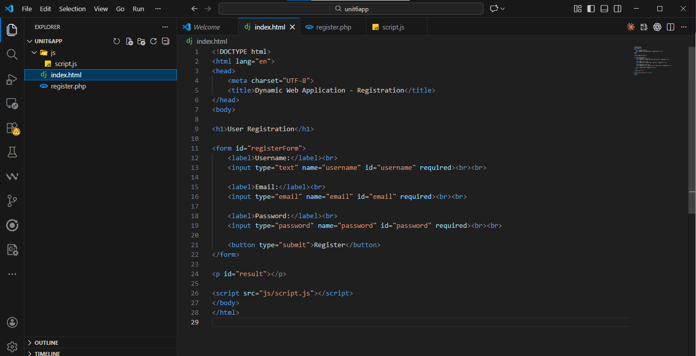
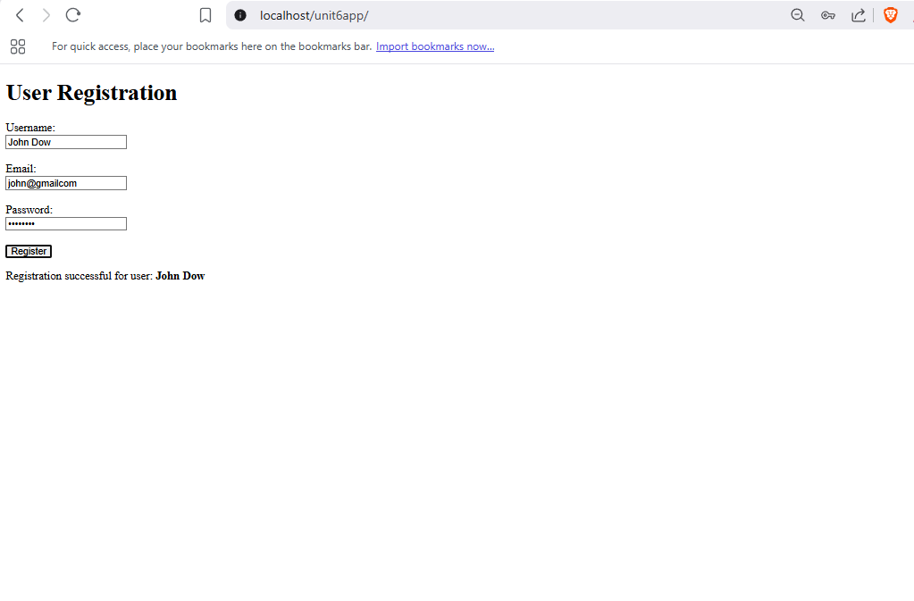
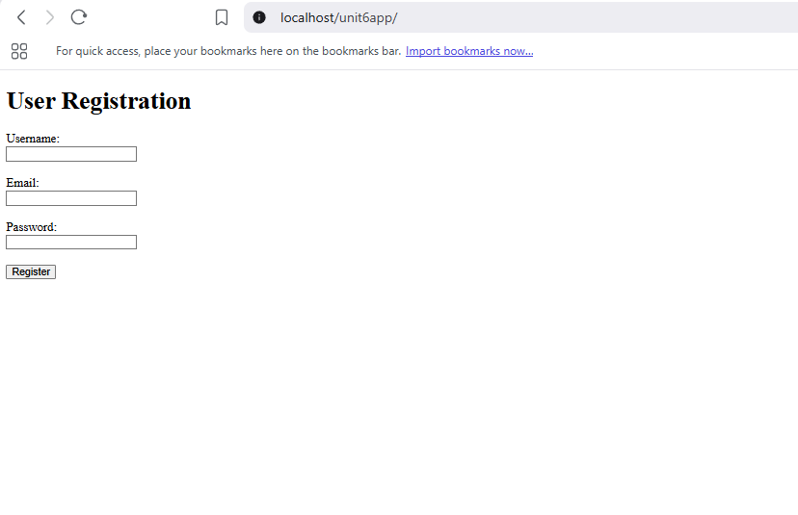
Week 6: Dynamic Web Applications and Server-Side Processing
Designed dynamic web application using server-side scripting language PHP
Created interactive registration form with client-side validation
Implemented AJAX submission to update content without page reload
Demonstrated interaction between frontend and backend components
Notes:
The week 6 was devoted to the testing of the dynamic web application based on PHP and JavaScript. My registration form was able to confirm the user input with the help of a user-friendly validation form and then send the data asynchronously via AJAX. This enabled the page to be updated dynamically without having to refresh the page in order to enhance ease of use. Request handling and data sanitisation were some of the concepts brought out by server-side processing. This assignment enhanced my intellect of the dynamics between client and server technologies, and achieved the learning outcome, which concerned the development of a dynamic web application.

Slide 8
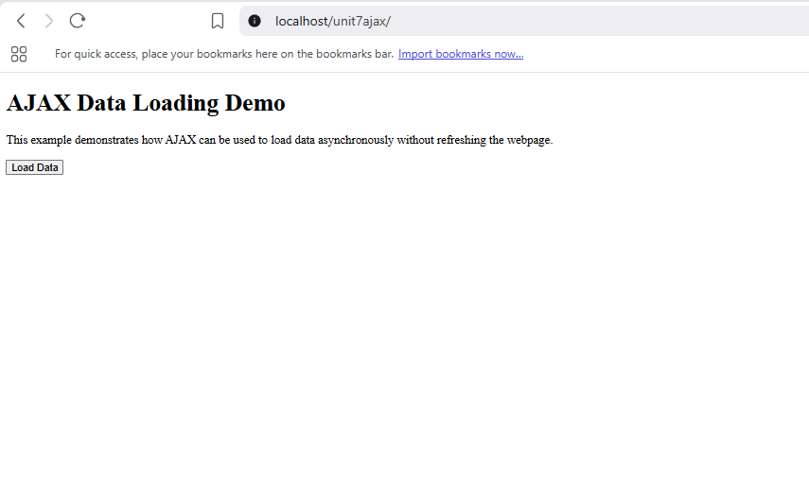
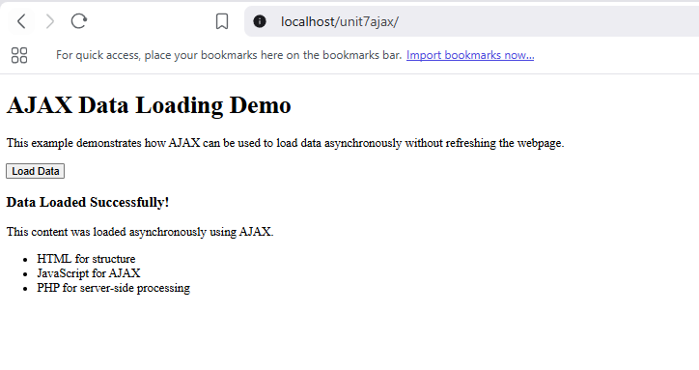
Week 7: WordPress and Asynchronous Data Loading with AJAX
Implemented AJAX to load server data asynchronously on user request
Combined HTML, JavaScript, and PHP within single web application
Improved user experience by avoiding unnecessary page reloads
Demonstrated practical understanding of asynchronous web communication
Notes:
During Week 7, I investigated asynchronous communication based on the AJAX. I used a feature whereby information was retrieved in the server on-demand when a button was pressed. This activity demonstrated the enhancement of AJAX in the performance and user experience through the loading of data without updating the page. The integration of more than one technology in a single application strengthened the previous knowledge. This week assisted in the learning outcome of critically understanding how the various web technologies can be integrated to make web technologies more responsive and interactive.

Slide 9
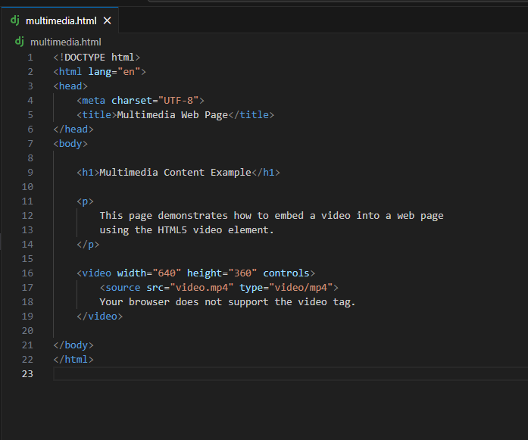
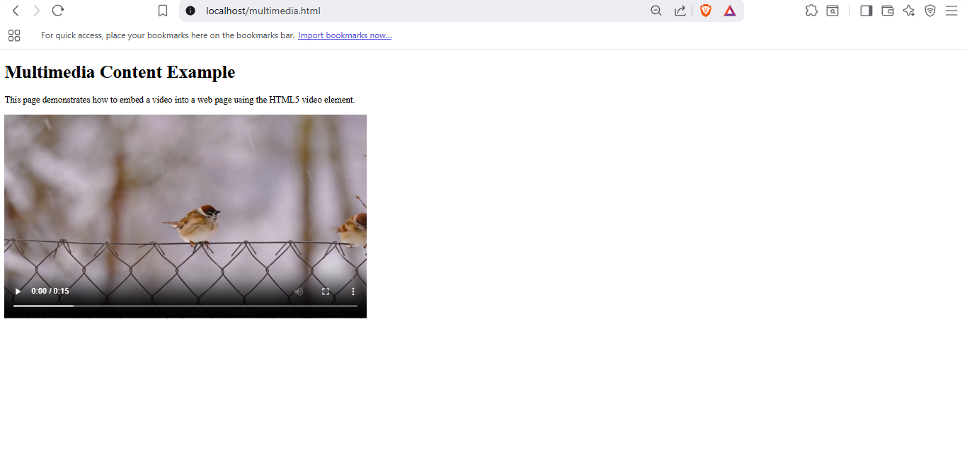
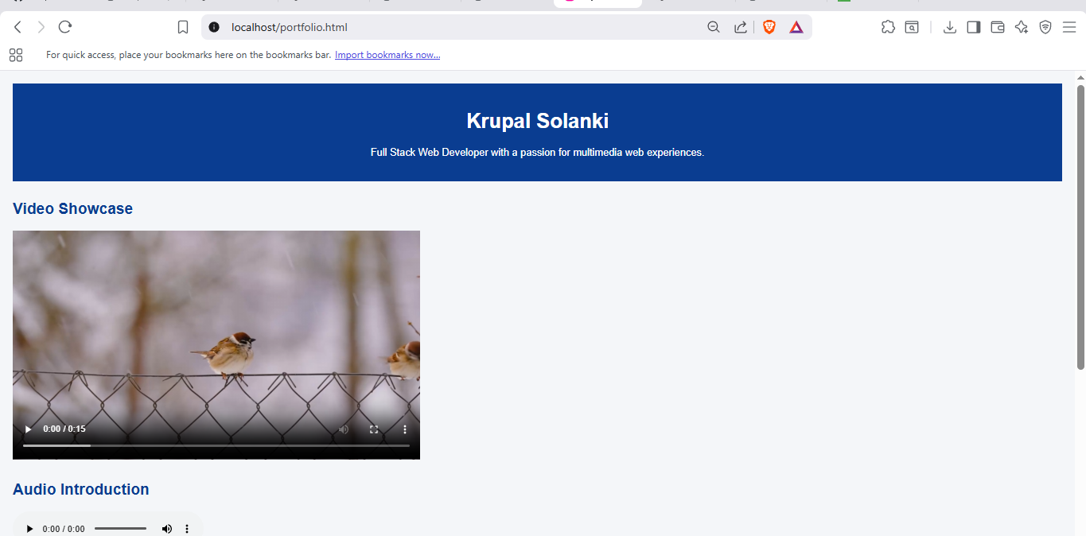
Week 8: Multimedia Integration and Animations
Embedded video and audio elements using HTML5 multimedia tags
Created image galleries to visually showcase projects and skills
Applied CSS animations to highlight key web development skills
Ensured multimedia content displayed correctly across browsers
Notes:
Week 8 involved improvement of web pages by incorporation of multimedia components. I added video and audio files with the tags of HTML5 and made an image gallery to present the content on an image basis. CSS effects were used to emphasize key skills to enhance interest. This assignment showed the ability of multimedia in enhancing communication and experience of online users. It favored the learning outcome of creating attractive web interfaces and being ready to know how the various types of media are incorporated in the contemporary web applications.

Slide 10
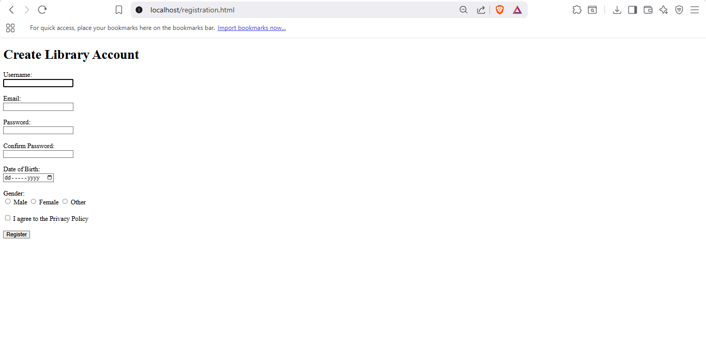
Week 9: User Registration, Security, and Validation
Analysed flawed registration form to identify security weaknesses
Explained importance of validation, privacy, and password protection (Wadzani, 2022)
Designed improved registration form for fictional application
Applied security principles to protect user data effectively
Notes:
Week 8 was concentrated to improve the web pages using the proper use of multimedia elements. I used HTML5 tags video and audio, and the video and audio were embedded with the right playback controls and compatibility with the browsers. The gallery of images was developed to demonstrate the projects and the skills visually enhancing the way the content is presented and interacted by the users. Besides, CSS animation was used to emphasize major skills and attract attention to the user to important columns of the webpage. This assignment has shown that multimedia can contribute to communication, accessibility and general experience of the user. It facilitated the educational goal of coming up with an attractive web interface design and the concept of integrating various types of media into the contemporary web applications.

Slide 11
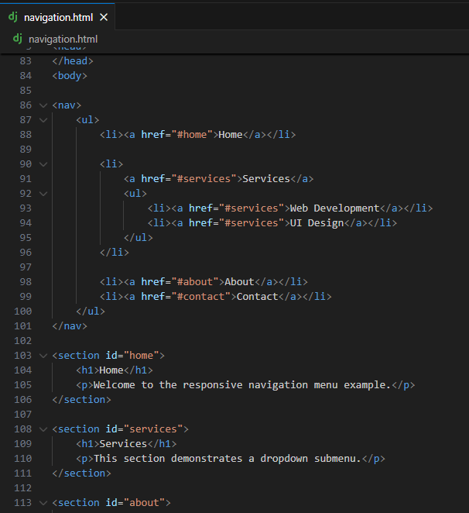
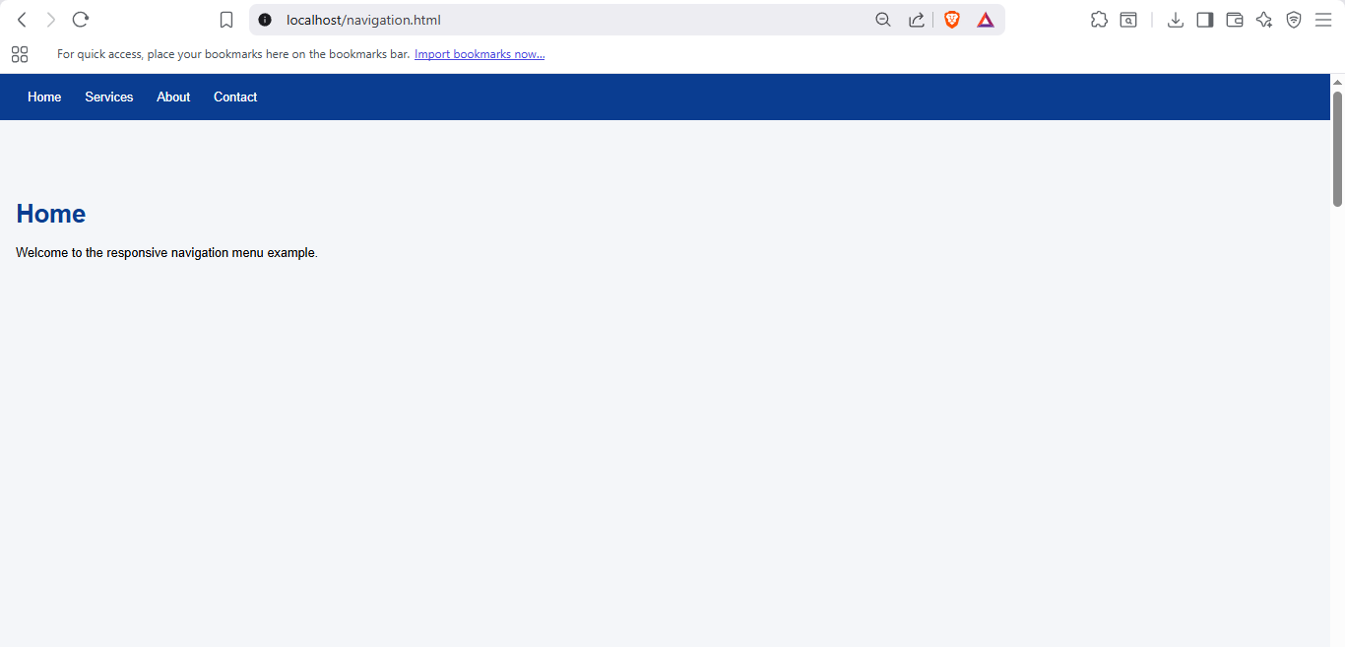
Week 10: Responsive Design and Website Security
Designed responsive navigation menu with dropdown functionality
Implemented smooth scrolling to enhance navigation usability
Explained security measures protecting websites from common threats (Edegbe and Onianwa, 2022)
Evaluated importance of updates and security plugins
Notes:
The week 10 synergized the concepts of usability and security. I used a smooth scrolling and dropdown responsive navigation menu which enhanced the ease of accessing the menu regardless of the tool. I was also able to discover important security steps on websites and how the use of plugins can ensure protection of WordPress websites. The knowledge of frequent software updates advocated good web maintenance. The last week facilitated the learning outcomes that were targeted towards evaluating the usability, performance, and security of web applications.

Slide 12
References
Hoseini, J., 2023. E-Commerce by WordPress: e-commerce by WordPress & content management system comparison.
Wadzani, M., 2022. Web-based statement of result verification system for Federal Polytechnic.
Edegbe, G.N. and Onianwa, C.U., 2022. The imperative of technical skilled staff in legacy information system management. International Journal of Innovative Computing, 12(2), pp.37-44.
Miltner, K.M. and Gerrard, Y., 2022. “Tom had us all doing front-end web development”: a nostalgic (re) imagining of Myspace. Internet Histories, 6(1-2), pp.48-67.
Acharya, K., 2024. Web development system project report. Authorea. November 12, 2024. DOI: https://doi. org/10.22541/au. 173144769.91595244/v1.

Slide 13


