Slide 1
AngularJS

Slide 2
What is AngularJS?
Open source library which is developed and maintained by Google.
It is a MVC framework.
Enables developers to create, test and maintain SPA (Single page web applications)
MIT license.

Slide 3
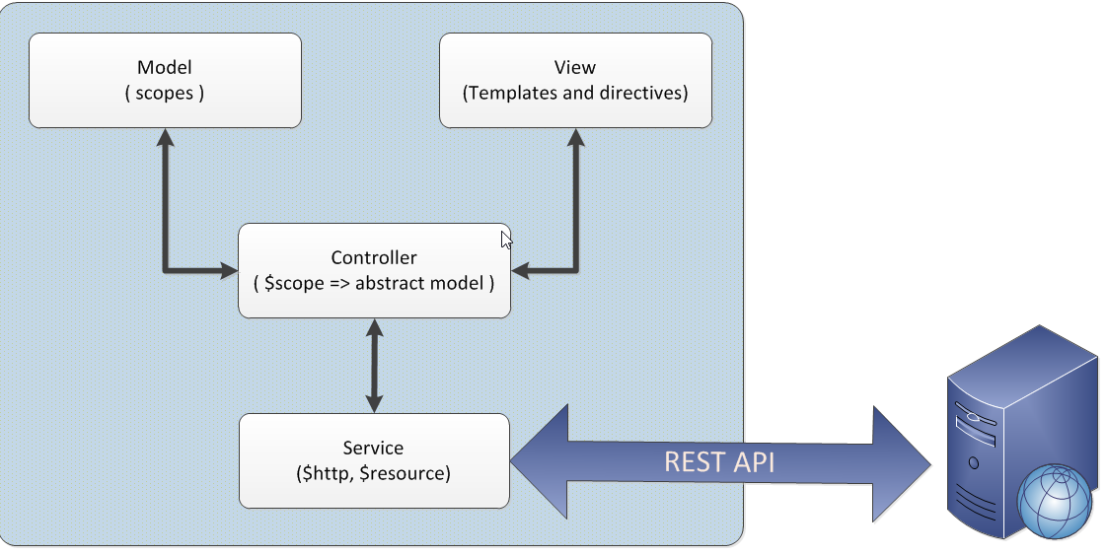
MVC

Slide 4
Course Agenda
Bootstrapping (ngApp, app.js)
Data Binding (Two way, one way)
Controllers
Routing and ng-view
Built in directives
Creating Modules
$rootscope vs $scope
AngularJS Events
Filters
Services
Dependency Injection
Custom Directives
Test case writing

Slide 5
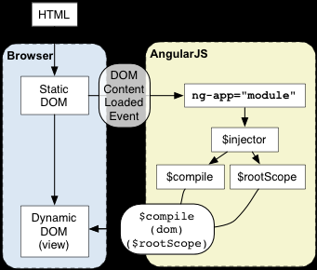
Bootstrap
Once the ‘DOMContentLoaded’ event occurs and document.readyState is set to ‘complete’, angular looks for ngApp directive. On finding, it does following:
load the module associated with the directive.
create the application injector
compile the DOM treating the ngApp directive as the root of the compilation. This allows you to tell it to treat only a portion of the DOM as an Angular application.

Slide 6
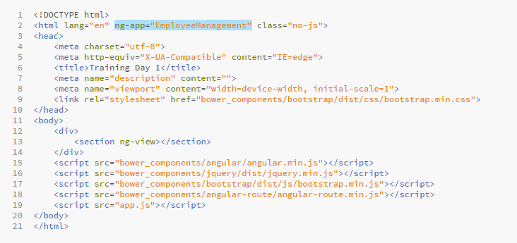
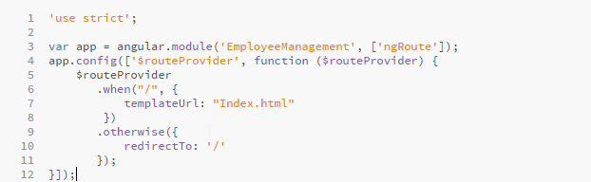
index.html
app.js

Slide 7
Data Binding
One way binding: Changes in the model are reflected on the view
Interpolation:
{{ 5 + 1 }} = 6
ng-bind:
<p ng-bind=“firstname”>
Two way binding: Changes in the model are reflected on the view; vice versa changes on view are percolated to the model
ng-model:
<input type=“text” ng-model=“firstname” />

Slide 8
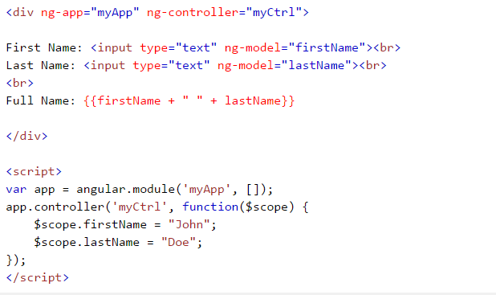
Controllers - ngController
Each controller is invoked with a scope object. Anything that is added to this scope object is available in view for display and manipulation.
Dependencies can be injected in controller like services, filters etc. The injector object created at the bootstrapping of application is used to inject these dependencies.

Slide 9
Built-in Directives
AngularJs lets you extend HTML with new attributes called Directives.
It has varied built-in directives that offer wide range of functionalities. Few of them are below:
ng-app
ng-controller
ng-show
ng-if
ng-repeat
ng-model
ng-bind
ng-src
ng-class

Slide 10
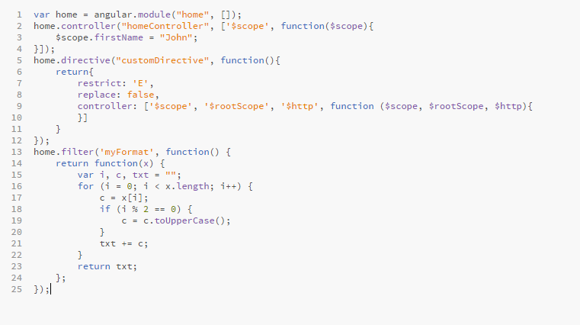
Creating modules
Modules define an application or part of an application.
Controllers, directives, filters belong to a module.
Module creation:

Slide 11
AngularJS Events
The event directives allows us to run AngularJS functions at certain user events.
An AngularJS event will not overwrite an HTML event, both events will be executed
ng-blur
ng-change
ng-click
ng-copy
ng-cut
ng-dblclick
ng-focus
ng-keydown
ng-keypress
ng-keyup
ng-mousedown
ng-mouseenter
ng-mouseleave
ng-mousemove
ng-mouseover
ng-mouseup
ng-paste

Slide 12
Filters
currency: Format a number to a currency format.
date: Format a date to a specified format.
lowercase: Format a string to lower case.
uppercase: Format a string to upper case.
filter: Select a subset of items from an array.
json: Format an object to a JSON string.
limitTo: Limits an array/string, into a specified number of elements/characters.
number: Format a number to a string.
orderBy: Orders an array by an expression.

Slide 13
Services
In AngularJS, a service is a function, or object, that is available for, and limited to, your AngularJS application.
AngularJS has about 30 built-in services. Few are mentioned below:
$location
$http
$q
$timeout
$interval

Slide 14
Rootscope vs Scope
Rootscope is the scope of the application module.
Anything present in rootscope is available in entire application (i.e all modules and its controllers)
Scope however are restricted to the controller. A new instance of scope is created when the controller is instantiated.
Information in scope is available only in that scope (i.e controller). It is not available in other controllers.

Slide 15
Broadcasting events
Events can be broadcasted on scopes (both $rootscope and $scope).
Message broadcasted on $rootscope is received by all the child scopes.
However, message broadcasted on individual scopes in available on those scopes only.
$rootScope.$broadcast(“EventName”, obj);
$rootScope.$on("EventName", function (obj) {
//code goes here
});

