Slide 1
AN INTRO TO CSS REPROCESSING
Authored by : Presented by : Harshal Sawant

Slide 2
Course Structure
Target audience
Level
Pre-requisites | Basic Knowledge of CSS
Training methods
Evaluation

Slide 3
Agenda
    What is CSS preprocessing
    Tools
    SCSS
      Installation
      Use

Slide 4
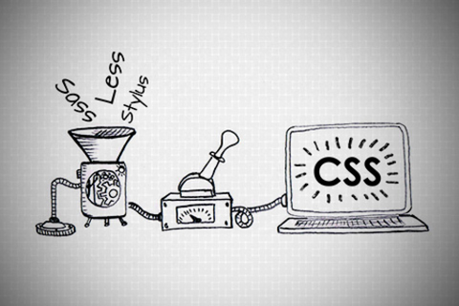
AN INTRO TO CSS PREPROCESSING

Slide 5
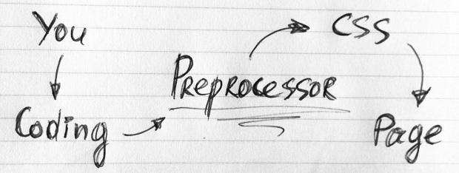
What is CSS Preprocessor
Primarily intended to make authoring CSS more dynamic, organized and productive

Slide 6
WHY WHY WHY??
First, they don’t break browser compatibility
Another advantage is preprocessors make our CSS DRY

Slide 7
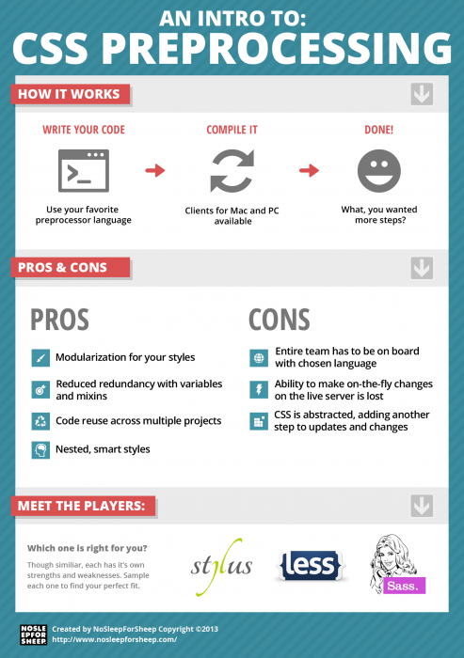

Slide 8

There are a number of CSS Preprocessor.
The question is, which of them does the Job best?

Slide 9
SCSS
Sass stands for Syntactically Awesome Stylesheets.
SASS & SCSS - two ways of writing the code which produce the same output.
SASS provides some new functionality: variables, nesting, mixins as well as a number of convenience features.
It's worth pointing out that though SASS is written in ruby, ruby doesn't need to be running on your server, only on your local machine

Slide 10
Installation
Install Ruby
  Set Environment Variables ( Only for windows OS user )
  In the System variables section, press New. For variable name enter RYBUOPT and for variable value rubygems
gem install sass
gem install compass
Create config.rb file in root directory
To check if SASS and Compass are working, type in
sass –v
compass –v
compass watch

Slide 11
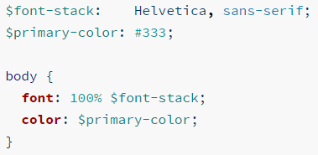

Calculations
Variables
Sass uses the $ symbol to make something a variable.
You can use all standard operators (*, /, +, -) for example:

Slide 12

Importing
You can import other Sass files into your main stylesheet using @import.

Slide 13
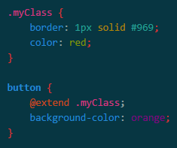
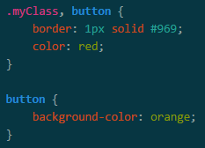
Extend
All this does is repeat properties in the compiled CSS.
Output

Slide 14
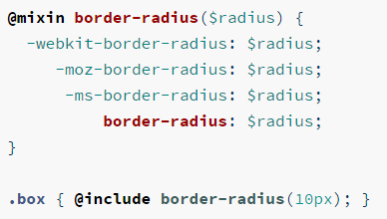
Mixin
A mixin lets you make groups of CSS declarations that you want to reuse throughout your site. You can even pass in values to make your mixin more flexible.

Slide 15
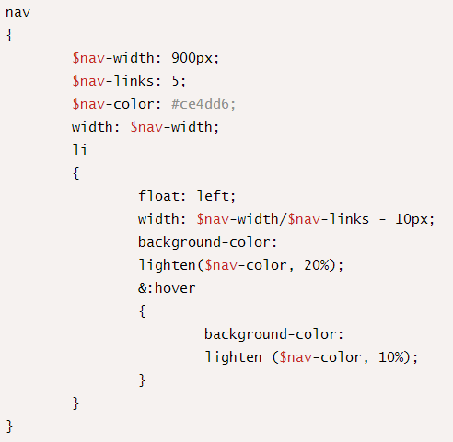
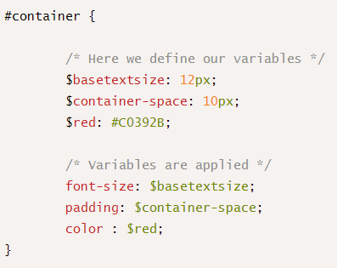
Examples of Import, Variable and Nesting

Slide 16
Compass
Compass is a Sass framework
Compass is a collection of helpful tools and battle-tested best practices for Sass.
@import 'compass/css3';
.shadow {
@include box-shadow(#000 5px 5px 5px);
}

Slide 17
Spriting
The simplest way to use these icon sprites is to let compass give you a class for each sprite:
@import "compass/utilities/sprites";
@import "my-icons/*.png";
@include all-my-icons-sprites;
**Note: The use of my-icons is only for this example, "my-icons" represents the folder name that contains your sprites.

Slide 18
Bibliography, Important Links
http://www.webdesignerdepot.com/2013/11/the-beginners-guide-to-sass/
http://www.gayadesign.com/diy/how-to-start-using-sass-and-compass-in-10-minutes/
http://awordpress.net/blog/ruby-is-not-recognized-as-an-internal-or-external-command-operable-or-batch-file-error/

Slide 19
Assignments
Convert simple css to scss
Create a sprite image of 5 icons
Learn more about config.rb

Slide 20
Thank you!

