Slide 1
ALPA BLOG

Slide 2
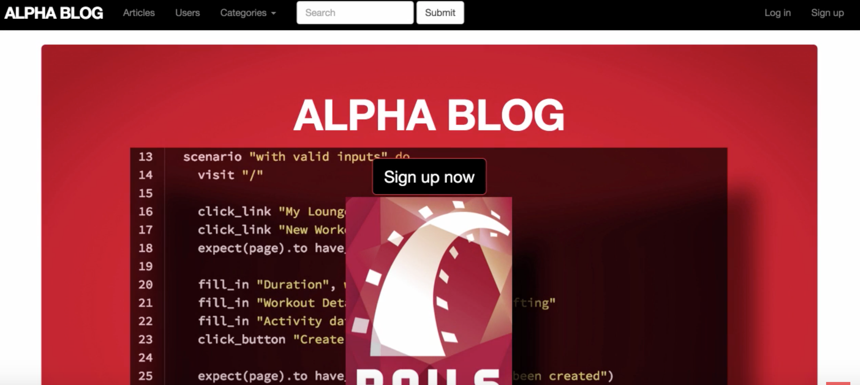
BEFORE ENHANCEMENT

Slide 3
FIRST ENHANCEMENT
Create a button to create article

Slide 4
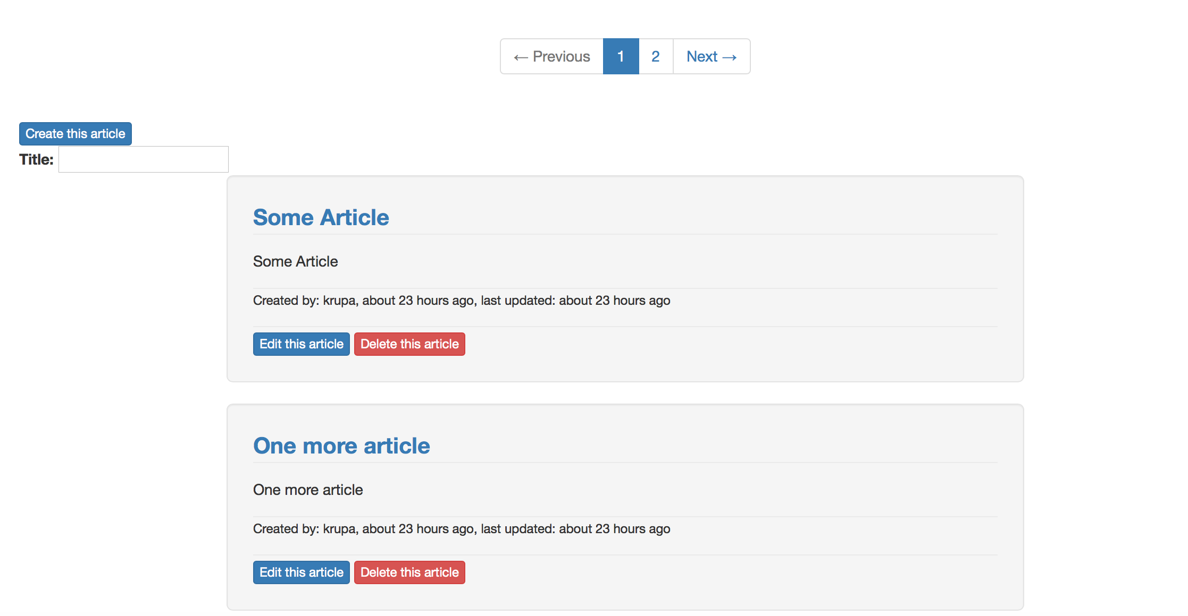
SCREENSHOTS

Slide 5
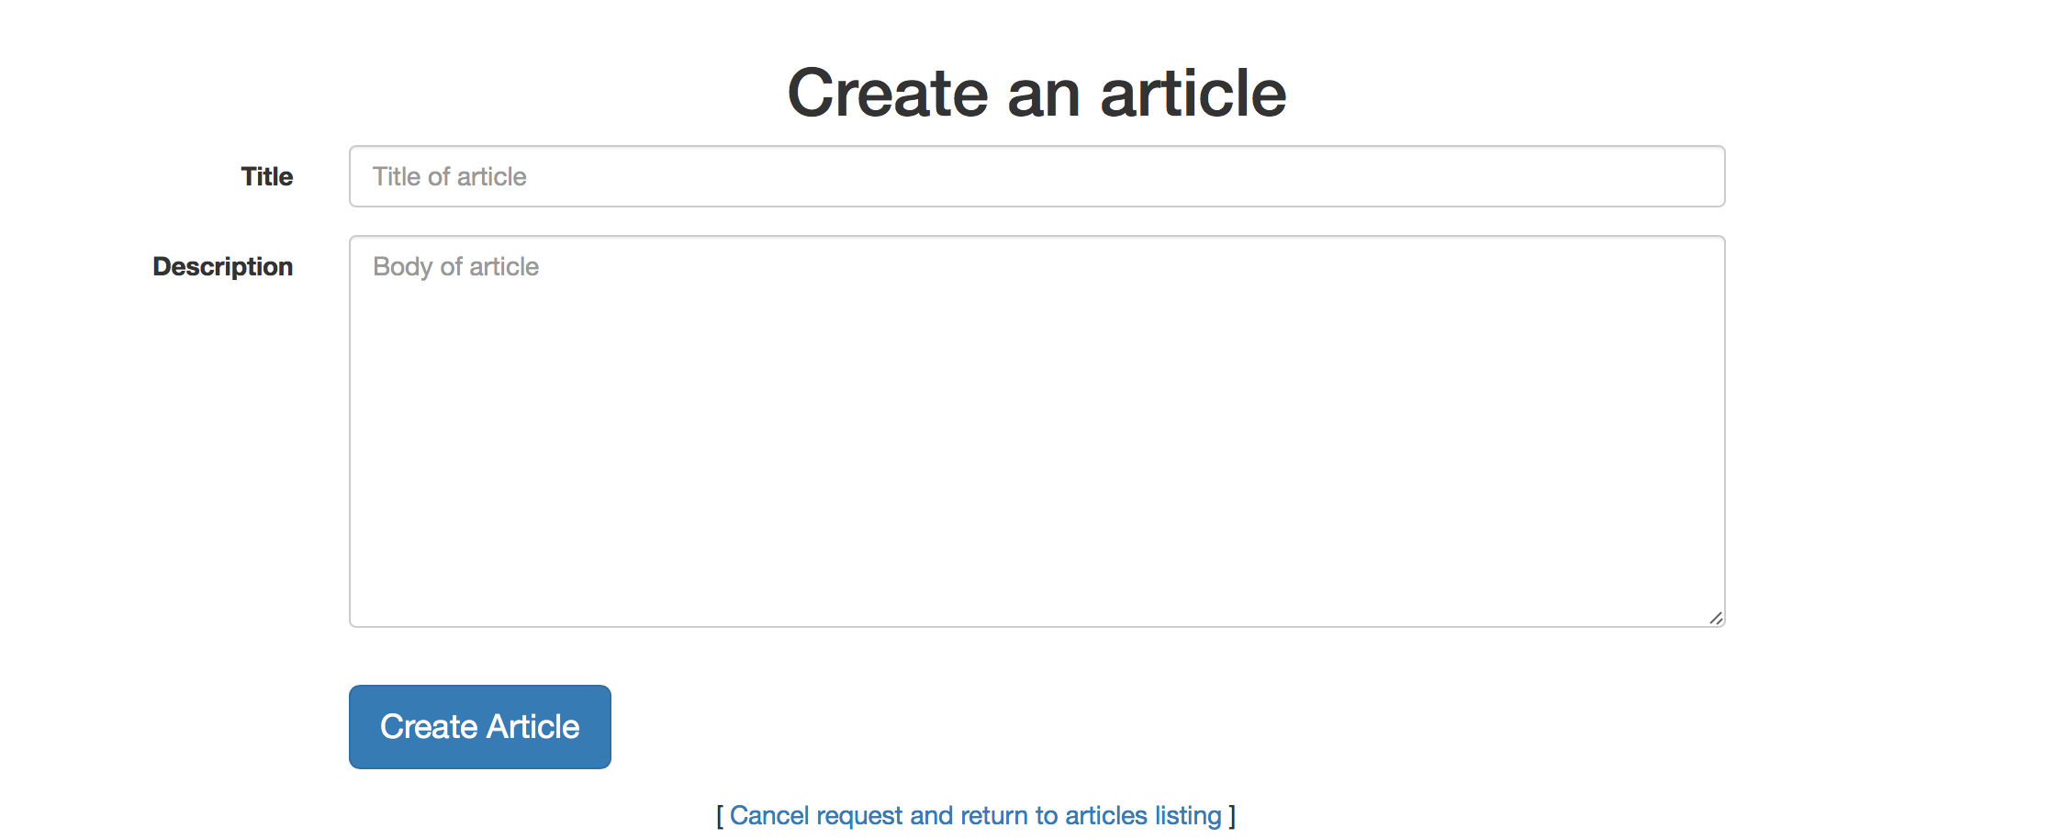
SCREENSHOTS

Slide 6
SECOND ENHANCEMENT
When We click on the Company name or Logo it gives the complete stock details about company.

Slide 7
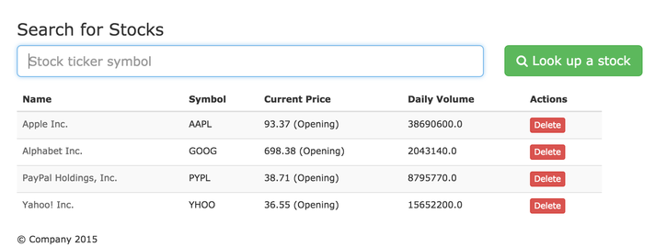
SCREENSHOTS

Slide 8
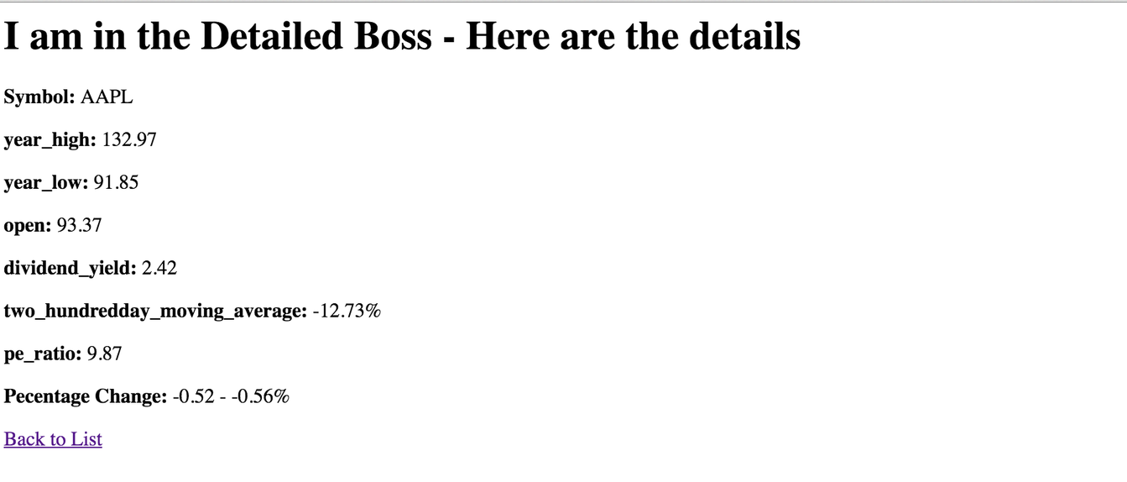
SCREENSHOTS

Slide 9
THIRD ENHANCEMENT
We added Search action controller to find a desired article searchable by title.

Slide 10
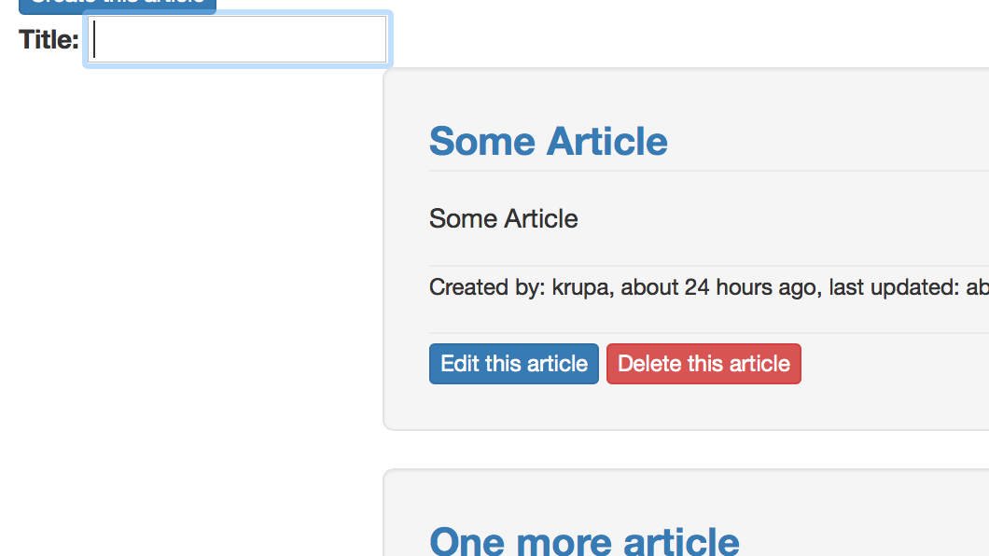
SCREENSHOTS

Slide 11
THANK YOU

