Slide 1
Chapter 1
Ruby Basics
Ruby Programming

Slide 2
Objectives
In this chapter, you:
Get a brief history of computer programming
Get an introduction to Ruby
Get ready to work with Ruby
Use Ruby interactively
Develop Ruby programs
Create the Ruby Joke game
Ruby Programming
1-<number>

Slide 3
Project Preview: The Ruby Joke Game
Ruby Programming
1-<number>

Slide 4
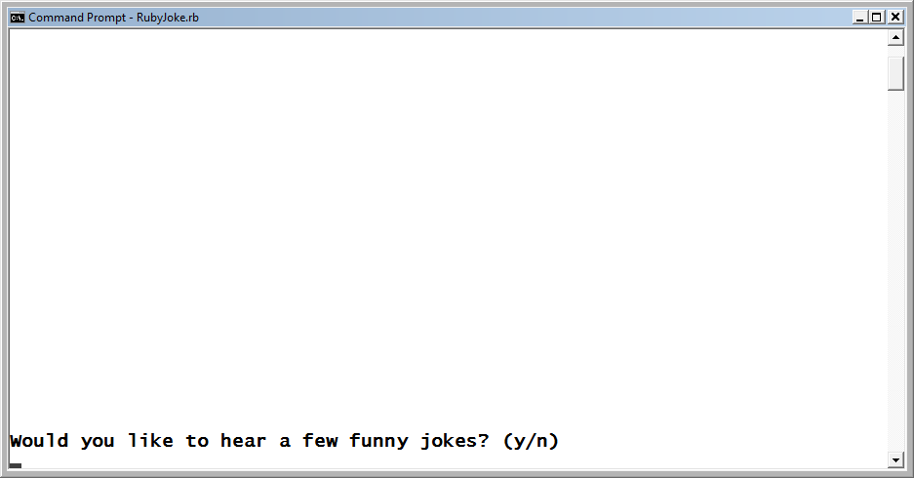
The Ruby Joke Game (continued)
When the game is first started, the player is prompted for permission to begin telling jokes.
Figure 1-1
The player may elect to play the game or quit.
Ruby Programming
1-<number>

Slide 5
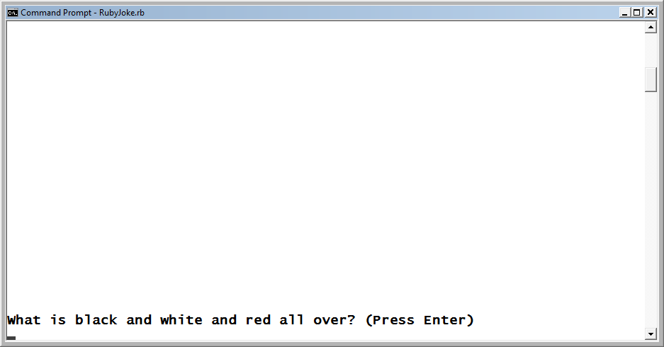
The Ruby Joke Game (continued)
If players enter a value of n, they’re invited to return to play another time. If they enter a value of y, the game begins displaying jokes.
Figure 1-2
The player must press Enter to advance from screen to screen during game play.
Ruby Programming
1-<number>

Slide 6
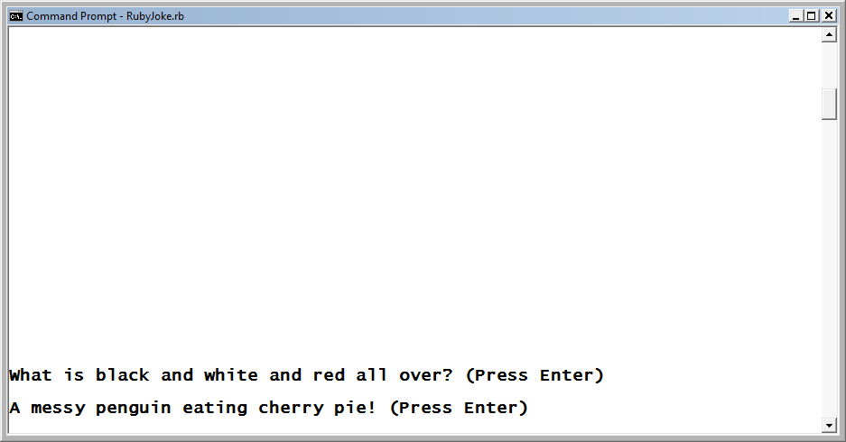
The Ruby Joke Game (continued)
In order to view the first joke’s punch line, the player must press the Enter key, after which the screen shown in Figure 1.3 displays.
Figure 1-3
The punch line for the game’s first joke.
Ruby Programming
1-<number>

Slide 7
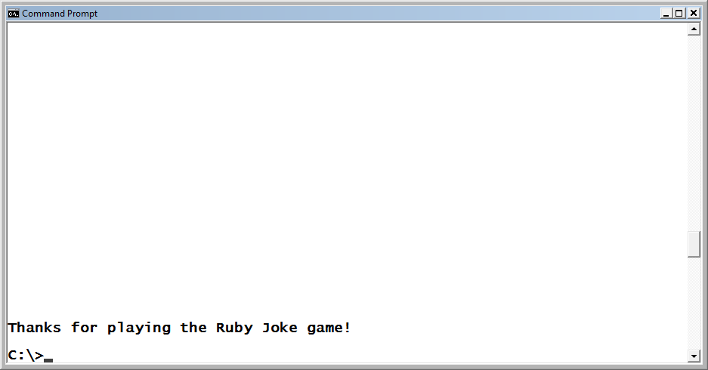
The Ruby Joke Game (continued)
To advance to and view successive jokes, the player must continue to press Enter. Once the final joke is told, the screen shown in Figure 1-4 displays.
Figure 1-4
The game ends by thanking the player.
Ruby Programming
1-<number>

Slide 8
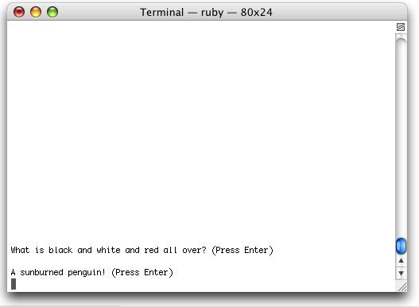
The Ruby Joke Game (continued)
Figure 1-5 shows an example of how the game would look if it were run on Mac OS X.
Figure 1-5
The Ruby Joke game runs exactly the same regardless of which operating system it is run on.
Ruby Programming
1-<number>

Slide 9
A Brief History of Computers and Computer Programming
Ruby Programming
1-<number>

Slide 10
The Mechanized Era
Joseph Marie Jacquard developed the Jacquard loom in 1801. The loom was used to weave cloth. Its operation was managed by instructions provided on punch cards.
In 1822, Charles Babbage began work on the Difference Engine, which was designed to process polynomial functions.
Charles Babbage later used punch cards as the basis for programming a third machine, which he called the Analytical Engine.
Ada Lovelace developed programs for the Analytical Engine and is regarded as the world’s first programmer.
Ruby Programming
1-<number>

Slide 11
The First Generation
1937 to 1953 is regarded as being the first generation of electronic computer systems.
The British created Colossus in 1943 for breaking German military code in WWII.
THE U.S. created Electronic Numerical Integrator and Computer (ENIAC) for computing ballistics in WWII and later used it to perform calculations as part of the development of the hydrogen bomb.
The first computer programs were all written in machine language (machine code).
Machine language is regarded as a first-generation computer programming languages.
Ruby Programming
1-<number>

Slide 12
The Second Generation
1954 to 1962 is regarded as being the second generation of electronic computer systems.
In the early 1950s, assembly languages evolved, replacing 0s and 1s with a set of symbols or mnemonics.
Programmers translated their assembly programs into executable programs using an assembler.
In the mid-to-late 1950s, a new set of higher level programming languages began to supplant assembly language application development.
  Fortran
  Cobol
  ALGOB
Ruby Programming
1-<number>

Slide 13
The Third Generation
1967 to 1972 is regarded as being the third generation of electronic computer systems.
Innovations included an increase in computer processing power and speed and the development of the computer operating system.
Pascal was created as a teaching language. It combined many of the language features found in Fortran, ALGOL, and COBOL.
C is a general-purpose programming language developed in 1972 at Bell Telephone Laboratories.
C has been modified (ported) to work on every major computing platform.
Ruby Programming
1-<number>

Slide 14
The Fourth Generation
1972 to 1983 is regarded as being the fourth generation of electronic computer systems.
Computers were no longer building or room size, and the age of personal computing began.
A new way of programming known as object-oriented programming began to gain notoriety.
Rather than concentrating on the development of procedures, object-oriented programming (OOP) focuses on the definition of objects within programs.
Bell Labs developed a new programming language in 1979 named C with Classes, later changing its name to C++ in 1983.
Ruby Programming
1-<number>

Slide 15
The Fifth Generation
1984 to 1990 is regarded as being the fifth generation of electronic computer systems.
Advances occurred in local area networking (LAN) and wide area networking (WAN). Processor and RAM costs dropped, allowing for the widespread deployment of desktop computers and network servers.
New programming languages were developed during this period. One such language was Perl. Perl is a general-purpose, interpreted scripting language.
Using Perl, programmers develop programs referred to as scripts.
Ruby Programming
1-<number>

Slide 16
1990 and Beyond
Network bandwidth, most notably broadband technologies, have allowed the Internet to evolve into a major media for communication, commerce, education, and entertainment.
A new generation of programming languages designed to enhance and leverage these new technologies has evolved.
A major driving force in recent years has been a movement toward rapid application development (RAD), enabling programmers to develop new applications faster and with higher quality. Programming languages like Visual Basic, C#, and Java emerged to fill this need.
Another major advance that has taken root during this period has been the rise of scripting languages, including Python, Java, Lua, JavaScript, PHP, and Ruby.
Ruby Programming
1-<number>

Slide 17
Introducing Ruby
Ruby Programming
1-<number>

Slide 18
Introducing Ruby (continued)
Ruby is a modern, object-oriented scripting language created by Yukihiro Matsumoto (Matz).
Ruby is the language’s actual name and not an acronym.
Matz was influenced by Smalltalk, Perl, Python, C++, Lisp, and ADA.
Matz began working on Ruby in February of 1993 and released his first version in December of 1995.
Ruby lacked a “Killer App” to demonstrate its capabilities.
Enter Ruby on Rails, a web-based application development framework allowing website applications to be built using Ruby.
Ruby Programming
1-<number>

Slide 19
Ruby is Simple Yet Powerful
Ruby is interpreted
Ruby supports a natural English-like programming style
Ruby has light syntax requirements
Ruby Programming
1-<number>

Slide 20
Ruby Is Object Oriented
Ruby is as close to 100 percent object-oriented as it gets.
Things that describe or characterize an object, such as size or type, are referred to as object properties.
Actions that can be taken against the object or which the object can be directed to perform are stored as part of the object in methods.
Ruby treats numbers (as well as other primitive data types) as objects.
Ruby Programming
1-<number>

Slide 21
Ruby Is Extremely Flexible
Processing text files
Network programming
Application prototyping
System administration
Web development
Ruby Programming
1-<number>

Slide 22
Ruby Exists in Many Different Environments
Ruby can run directly on Microsoft Windows, Mac OS X, and multiple versions of UNIX and Linux.
Using the Ruby on Rails framework, Ruby also facilitates the development and execution of web applications.
Ruby also runs within various other virtual machine environments (JRuby, IronRuby).
Ruby Programming
1-<number>

Slide 23
Getting Ready to Work with Ruby
Ruby Programming
1-<number>

Slide 24
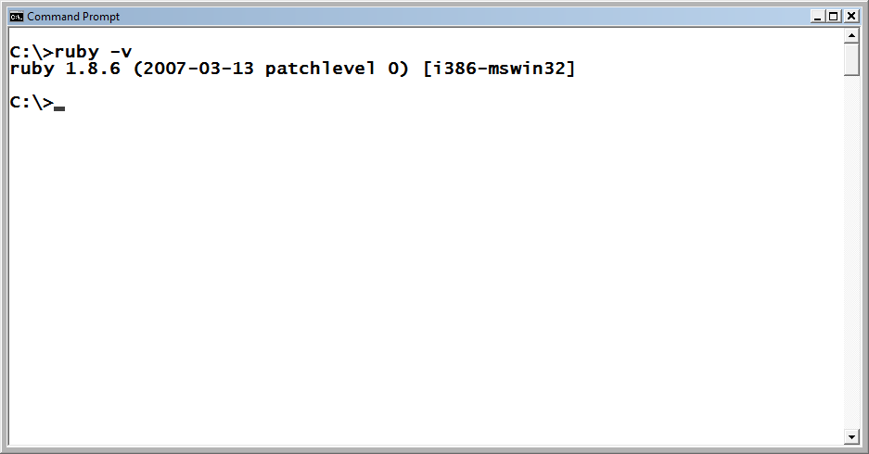
Determining Whether Ruby Is Already Installed
Figure 1-7
Retrieving information about the version of Ruby installed on the computer.
Ruby Programming
1-<number>

Slide 25
Determining Whether Ruby Is Already Installed (continued)
On Mac OS X: Type the following command at the command prompt and press Enter.
ruby –v
Assuming the preceding command worked, type the following command.
irb
You should see the irb command prompt as shown here:
irb(main):001:0>
Ruby Programming
1-<number>

Slide 26
Determining Whether Ruby Is Already Installed (continued)
On UNIX and Linux: Type the following command at the command prompt and press Enter.
irb
You should see the irb command prompt as shown here:
irb(main):001:0>
Ruby Programming
1-<number>

Slide 27
Installing or Upgrading Ruby
Microsoft Windows: Visit www.ruby-lang.org/en/downloads/, download the Windows installer, and double-click on it.
Mac OS X: Ruby is preinstalled on all version of MAC OS X 3 and later.
Ruby Programming
1-<number>

Slide 28
Installing or Upgrading Ruby (continued)
To reinstall, visit one of these sites and follow the instructions provided:
- Locomotive: http://locomotive.raaum.org/
- MacPorts: www.macports.org/
- Fink: www.finkproject.org/
Ruby Programming
1-<number>

Slide 29
Installing or Upgrading Ruby (continued)
UNIX and Linux: Visit www.ruby-lang.org/en/downloads/ and download the tar.gz file for UNIX and Linux and execute the following steps:
  Log in with root access.
  Start a shell session and open the folder where you store the tar.gz file.
  Type tar xzvf ruby-x-x-x.tar.gz and press Enter to uncompress the file.
  Open the folder that is created.
  Type ./configure and press Enter. This generates a makefile file and config.h file.
  Type run and press Enter to compile Ruby.
  Type make install and press Enter.
Ruby Programming
1-<number>

Slide 30
Working with Ruby
Ruby Programming
1-<number>

Slide 31
Working at the Command Prompt
You can interact with Ruby from the command line.
To do so, access the command prompt and type ruby.
Microsoft Windows Mac OS X\Unix\Linux
C:> ruby $ ruby
puts "Hello World!" puts "Hello World!"
^d ^d
Hello World! Hello World!
C:> $
Ruby Programming
1-<number>

Slide 32
IRB - Interactive Ruby
To start the IRB, type irb and press Enter.
irb
irb(main):001:0>
The irb command prompt consists of several parts, separated by colons:
  (main). The word listed inside the parentheses identifies the current class\object (in this case, it’s the main object).
  001. This three-digit number represents a history showing the number of commands that have been entered for the current working session. A value of 001 indicates that that IRB is waiting for the first command to be entered.
  0. The last number that makes up the IRB command prompt represents the current queue depth when working with a class. (You’ll learn what this means in Chapter 2, “Interacting with Ruby.”)
  >. Identifies the end of the command prompt.
Ruby Programming
1-<number>

Slide 33
IRB - Interactive Ruby (continued)
Example:
C:\>irb
irb(main):001:0> "Hello World!"
=> "Hello World!"
irb(main):002:0> puts "Hello World!"
Hello World!
=> nil
irb(main):003:0>
Ruby Programming
1-<number>

Slide 34
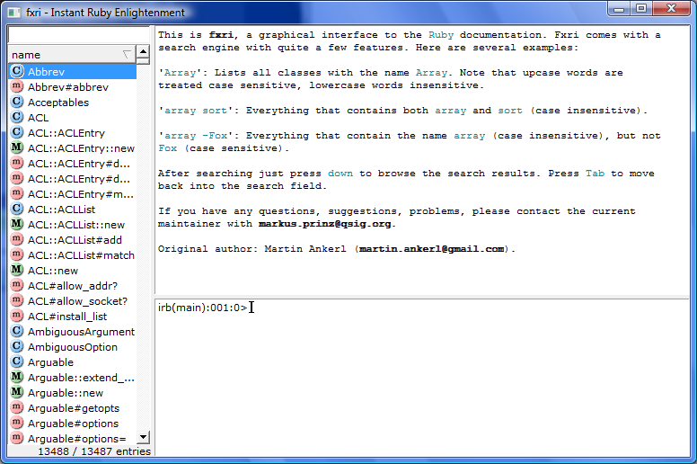
FXRI - Interactive Ruby Help and Console
Figure 1-9
In addition to providing access to help information, fxri also provides access to the IRB.
Ruby Programming
1-<number>

Slide 35
Developing Ruby Scripts
Ruby Programming
1-<number>

Slide 36
Creating Ruby Scripts on Microsoft Windows
To create and save Ruby script files, you need access to a good text or script editor.
  Notepad
  SciTE (Editor installed with Ruby on Windows)
Ruby Programming
1-<number>

Slide 37
Creating Ruby Scripts on Mac OS X
Mac OS X users can use the TextEdit application to create and save Ruby scripts.
Mac users can download and install any of a number of third-party editors like:
  TextMate (www.macromates.com)
  Komodo IDE (www.activestate.com).
Ruby Programming
1-<number>

Slide 38
Creating Ruby Scripts on Linux and UNIX
Linux and UNIX programmers can always use the vi editor to create and save Ruby scripts.
One alternative is KATE (KDE Advanced Text Editor). KATE is a free text editor available at http://kate-editor.org/.
Ruby Programming
1-<number>

Slide 39
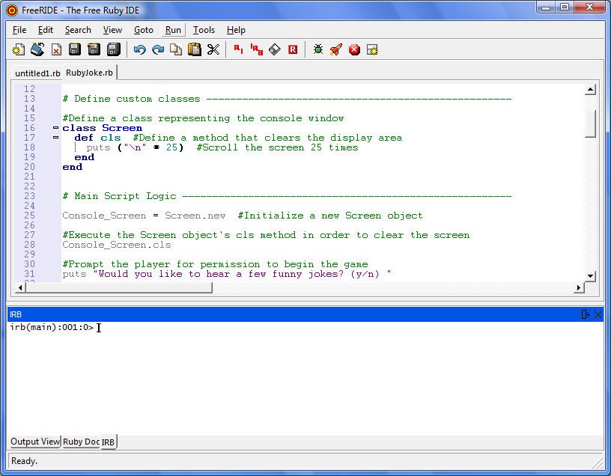
Using a Cross-Platform Ruby Editor
FreeRIDE is a free Ruby-specific code editor that you can download for free (http://rubyforge.org/projects/freeride/).
Figure 1-10
FreeRIDE is a Ruby script editor that works on Windows, Mac OS X, UNIX, and Linux.
Ruby Programming
1-<number>

Slide 40
Creating Your First Ruby Program
Open your code editor and create a new file named HelloWorld.rb.
Add the following statement and save the file.
puts "Hello World! "
Ruby Programming
1-<number>

Slide 41
Running Your Ruby Proram
At the command prompt, navigate to the folder where you stored your new Ruby script file and type:
ruby HelloWorld.rb
Alternatively, specify the path as part of your command:
ruby c:\Ruby_Scripts\HelloWorld.rb (Windows)
ruby /Ruby_Scripts/HelloWorld.rb (Mac OS X, Linux, UNIX)
Ruby Programming
1-<number>

Slide 42
Running Your Ruby Script (continued)
On UNIX or Linux, you can add the following command as the first statement in your Ruby scripts.
  #!/usr/local/bin/ruby –w
On Mac OS X, rewrite this statement as:
  #!/usr/bin/ruby –w
These statements tell the operating system where to find Ruby.
You must also mark your script file an executable, as demonstrated here:
  chmod +x HelloWorld.rb
You can now execute your Ruby script as demonstrated here:
  % ./HelloWorld.rb
Ruby Programming
1-<number>

Slide 43
Back to the Ruby Joke Game
Ruby Programming
1-<number>

Slide 44
Designing the Game
Follow these steps:
Create a new file.
Add comment statements that document the script and its purpose.
Define classes used to instantiate objects.
Instantiate new objects.
Add the code statements that prompt the player for permission to continue.
Add the code statements that outline the script’s high-level conditional logic.
Execute statements that clear the display area.
Add statements that tell the game’s first joke.
Add statements that tell the rest of the game’s jokes.
Add statements that thank the player for playing.
Ruby Programming
1-<number>

Slide 45
Step 1: Creating a New Ruby File
1. Open code editor and create a new file.
2. Save the file with a name of RubyJoke.rb.
  Tip:
  Create a folder to store all of your Ruby scripts, and make sure that you store your new game script there.
Ruby Programming
1-<number>

Slide 46
Step 2: Documenting the Script and Its Purpose
#---------------------------------------------------------
#
# Script Name: RubyJoke.rb
# Version: 1.0
# Author: Jerry Lee Ford, Jr.
# Date: March 2010
#
# Description: This Ruby script tells a series of 5
# humorous jokes
#---------------------------------------------------------
A comment is a line of text that is preceded by the # character.
Comments are ignored by the Ruby interpreter and have no effect on the execution of the script.
Comments help to make scripts easier to understand and maintain.
Ruby Programming
1-<number>

Slide 47
Step 3: Documenting the Script and Its Purpose
class Screen
def cls #Define a method that clears the display area
puts ("\n" * 25) #Scroll the screen 25 times
end
End
These statements define a class named Screen that represents the console window in which the game will execute.
Within the class definition, a method name cls is defined that will write 25 blank lines to the console window (clearing the display area).
Ruby Programming
1-<number>

Slide 48
Step 4: Instantiating New Objects
Console_Screen = Screen.new
Console_Screen.cls
The Screen class defined in step 3 is only a template.
Using it, the first statement shown above creates or instantiates a new object based on that class.
The new object is assigned a name of Console_Screen.
The second statement above executes the Screen class’s cls method to clear out the display area.
Ruby Programming
1-<number>

Slide 49
Step 5: Prompting the Player for Permission to Continue
puts "Would you like to hear a few funny jokes? (y/n)"
answer = STDIN.gets
answer.chop!
The first statement displays a text message asking for permission to tell some jokes, instructing the player to respond by typing either a y or n.
The next two statements collect and format the input provided by the player.
Ruby Programming
1-<number>

Slide 50
Step 6: Outlining the Script’s High-Level Conditional Logic
if answer == "n"
else
end
In the next several steps, you will be asked to return and key in script statements into this block of code.
Ruby Programming
1-<number>

Slide 51
Step 7: Clearing the Screen
Console_Screen.cls
puts "Sorry to hear that. Please return and play again soon."
The first statement calls on the Screen class’s cls method to clear the screen.
The second statement displays a text message, encouraging the player to return and play again another time.
Ruby Programming
1-<number>

Slide 52
Step 8: Telling the First Joke
Console_Screen.cls
puts "What is black and white and red all over? (Press Enter)"
pause = STDIN.gets
puts "A messy penguin eating cherry pie! (Press Enter)"
pause = STDIN.gets
These statements:
Clear the display area.
Display the first joke’s opening line.
Pause the script.
Execute script resumes when the player presses the Enter key.
Display the punch line.
Halt the script again.
Ruby Programming
1-<number>

Slide 53
Step 9: Telling the Remaining Jokes
Console_Screen.cls
puts "What is black and white and red all over? (Press Enter)"
pause = STDIN.gets
puts "A sunburned penguin! (Press Enter)"
pause = STDIN.gets
Console_Screen.cls
puts "What is black and white and red all over? (Press Enter)"
pause = STDIN.gets
puts " An embarrassed Dalmatian puppy!! (Press Enter)"
pause = STDIN.gets
Console_Screen.cls
Ruby Programming
1-<number>

Slide 54
Step 9: Telling the Remaining Jokes (continued)
Console_Screen.cls
puts "What is black and white and red all over? (Press Enter)"
pause = STDIN.gets
puts " A zebra with a scratched knee! (Press Enter)"
pause = STDIN.gets
Console_Screen.cls
puts "What is black and white and red all over? (Press Enter)"
pause = STDIN.gets
puts "A skunk with diaper rash! (Press Enter)"
pause = STDIN.gets
Ruby Programming
1-<number>

Slide 55
Step 10: Thanking the Player
Console_Screen.cls
puts "Thanks for playing the Ruby Joke game!"
The first statement clears the screen.
The second statement thanks the player for playing the game.
Ruby Programming
1-<number>

Slide 56
Running Your New Ruby Script Game
Save your Ruby script.
Access the command prompt and navigate to the folder where you saved the script.
Enter the following command and press the Enter key.
  ruby RubyJoke.rb
Ruby Programming
1-<number>

Slide 57
Summary
The chapter demonstrated how to:
Get a brief history of computer programming
Get an introduction to Ruby
Get ready to work with Ruby
Use Ruby interactively
Develop Ruby programs
Create the Ruby Joke game
Ruby Programming
1-<number>

