Slide 1
Chapter 2
Interacting with Ruby
Ruby Programming

Slide 2
Objectives
In this chapter, you:
Open and work with IRB
Access IRB online
Use IRB to execute Ruby statements and scripts
Use IRB to perform mathematical calculations
Access Ruby documentation
Create the Ruby Tall Tale game
Ruby Programming

Slide 3
Project Preview: The Ruby Tall Tale Game
Ruby Programming

Slide 4
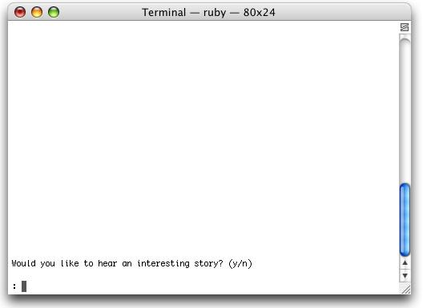
The Ruby Tall Tale Game (continued)
The game begins by prompting the player for permission to begin the game.
Figure 2-1
An invitation to play the Ruby Tall Tale game as it would appear
on a Mac OS X screen.
Ruby Programming

Slide 5
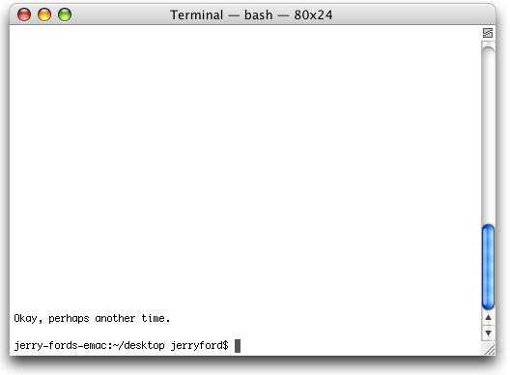
The Ruby Tall Tale Game (continued)
If the player decides not to play, a message is displayed that encourages the player to return to play another time.
Figure 2-2
The game encourages the player to play some other time.
Ruby Programming

Slide 6
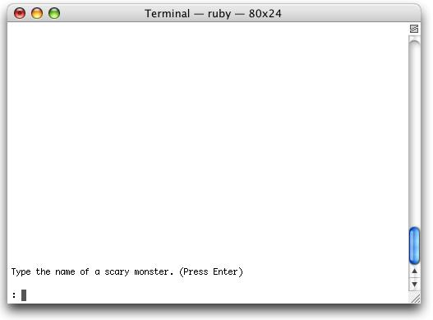
The Ruby Tall Tale Game (continued)
If the player decides to play, he is prompted to answer the first of five questions.
Figure 2-3
The player is asked to provide the first of five pieces
of information.
Ruby Programming

Slide 7
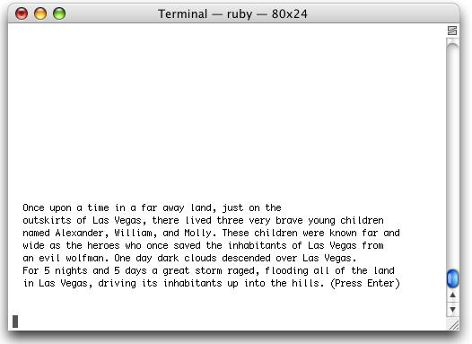
The Ruby Tall Tale Game (continued)
Once all questions have been answered, the game plugs the input provided by the player into the story’s plot and then begins to tell its story, a paragraph at a time.
Figure 2-4
Like many good stories, the Ruby Tall Tale game begins setting the scene and introducing its heroes.
Ruby Programming

Slide 8
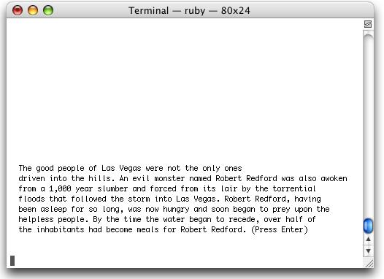
The Ruby Tall Tale Game (continued)
The second paragraph of the story introduces the story’s antagonist.
Figure 2-5
The story introduces the villain and establishes the need
for heroes.
Ruby Programming

Slide 9
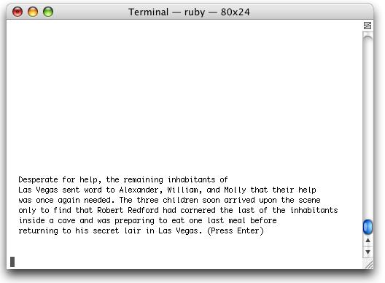
The Ruby Tall Tale Game (continued)
In the third paragraph, the story’s heroes arrive on the scene just in time to save the day.
Figure 2-6
The story paints a picture of desperation and identifies the
challenge its heroes face.
Ruby Programming

Slide 10
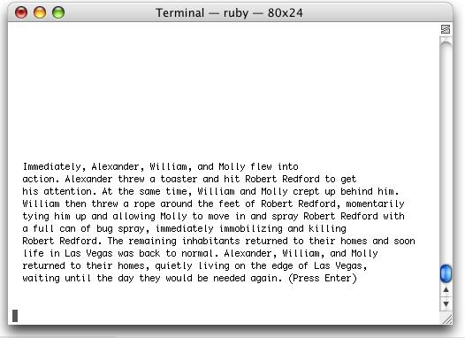
The Ruby Tall Tale Game (continued)
Finally, the fourth paragraph displays, bringing the story to a happy ending.
Figure 2-7
In the end, the people are saved and the heroes return to
their homes.
Ruby Programming

Slide 11
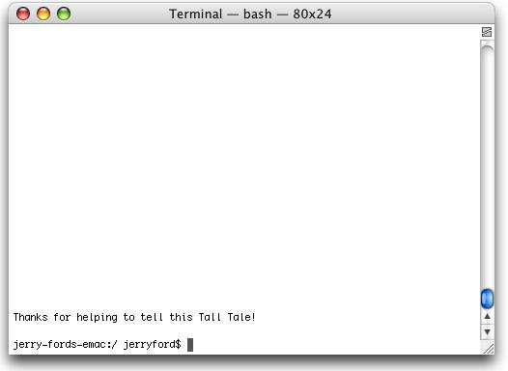
The Ruby Tall Tale Game (continued)
With the story now told, the game pauses to thank the player for taking the time to play before terminating.
Figure 2-8
The game ends after thanking the player.
Ruby Programming

Slide 12
Getting to Know the IRB
Ruby Programming

Slide 13
Starting an IRB Session
The IRB is started from the operating system command prompt:
C:\>irb
irb(main):001:0>
The IRB displays a command prompt and waits for you to enter commands
Ruby Programming

Slide 14
Starting an IRB Session (continued)
The IRB command is actually quite flexible, allowing you to start it by specifying a number of different options.
irb [Options] [Script] [Arguments]
Options is a placeholder representing any number of optional argument supported by the IRB.
Script is the complete name and path of a Ruby script that you want the IRB to run when it starts.
Arguments is a list of one or more arguments that may need to be passed to the script in order for it to execute.
Ruby Programming

Slide 15
Starting an IRB Session (continued)
IRB Command Line Options
-d Sets $DEBUG equal to true
-f Prevents the processing of ~/.irbrc
-I path Sets the $LOAD_PATH directory
-m Enables Math mode
-r module Loads module/s
-v Displays IRB version information
--back-trace-limit x Displays backtrace data using the last x number of entries
-inf-ruby-mode Configures the IRB to run under Emacs
--inspect Formats output using Object#inspect
--irb_debug n Specifies the debug level
--noinspect Disables the default --inspect option
--noprompt Suppresses the display of the IRB command prompt
--noreadline Disables execution of the readline module
--prompt type Configures the IRB command prompt to classic, null, xmp, simple, default, inf-ruby
--readline Loads the readline module
--simple-prompt Sets the IRB command prompt to simple
--tracer Configures the IRB to display trace information
--version Displays IRB version information
Ruby Programming

Slide 16
Working with Multiple IRB Sessions
Each IRB session exists within its own context.
If you open up two separate IRB sessions, each exists completely independently of the other.
Each separate IRB session maintains its own separate memory space.
Classes, methods, or variables defined in one IRB session are not accessible in another session.
Ruby Programming

Slide 17
Accessing IRB Online
Ruby Programming

Slide 18
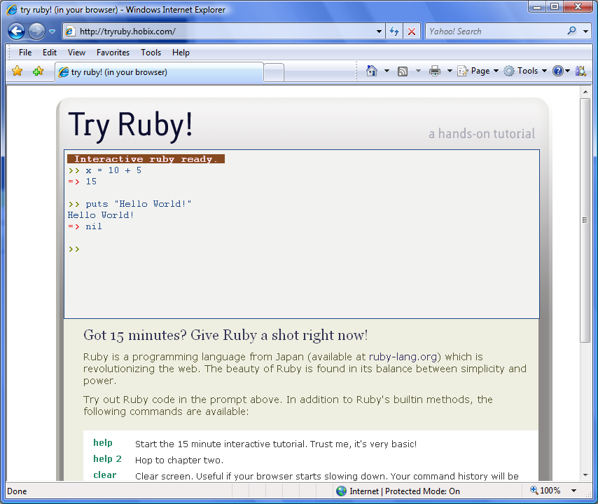
Accessing the IRB Online (continued)
Figure 2-9
The Try Ruby! web page provides online access to IRB.
Ruby Programming

Slide 19
Working with IRB
Ruby Programming

Slide 20
Executing Ruby Statements
The print command, which displays a line of text to the screen:
irb(main):002:0> print "Welcome to Ruby"
Welcome to Ruby=> nil
irb(main):003:0>
The text string to be displayed is passed as an argument wrapped inside quotation marks.
The next line shows the result that is returned.
nil is a value that represents Ruby’s interpretation of nothing.
Ruby Programming

Slide 21
Executing Ruby Statements (continued)
The print command displays a text string but does not advance the cursor to the next line.
You can do this using the puts command.
irb(main):001:0> puts "Welcome to Ruby"
Welcome to Ruby
=> nil
irb(main):002:0>
Ruby Programming

Slide 22
Following Ruby’s Syntax Rules
To work with different Ruby commands, keywords, and operators,
you will have to learn how to follow specific syntactical rules. Failure
to follow these rules when formulating script statements will result in
errors that prevent your scripts from executing.
Consider the following piece of script:
irb(main):005:0> put "Welcome to Ruby"
NoMethodError: undefined method 'put' for main:Object
from (irb):5
irb(main):006:0>
Ruby Programming

Slide 23
Executing Incomplete Statements
The IRB includes a Ruby parser and can tell when the statements you enter are complete.
If you press the Enter key without keying in a complete statement, the IRB displays a modified version of the command prompt that includes an asterisk character.
This serves as a visual indicator that the IRB is waiting on you to finish keying in the current statement.
irb(main):003:0> 5 - 1 +
irb(main):004:0*
Ruby Programming

Slide 24
Using IRB to Test Ruby Scripts
You can use the IRB to run portions of Ruby scripts that you have already written.
Use the load command to load and execute the script.
irb(main):001:0> load 'c:\Ruby_Scripts\RubyJoke.rb'
Alternatively, you could copy and paste individual statements into the IRB one after another.
Ruby Programming

Slide 25
Using the IRB to Perform Mathematical Calculations
Ruby Programming

Slide 26
Ruby Math Operators
Operator Name Description
+ Addition Adds two numbers together
- Subtraction Subtracts one number from another
* Multiplication Multiplies two numbers together
/ Division Divides one number from another
number
** Exponentiation Multiplies a number by itself a specified
number of times
% Modulus Returns the remainder portion of a
division operation
Ruby Programming

Slide 27
Using IRB as a Calculator
Using the math operators, you can formulate mathematical expressions of any level of complexity.
irb(main):001:0> 1 + 1
=> 5
irb(main):002:0>
Ruby Programming

Slide 28
Accessing Methods Stored in the Math Module
Ruby also provides access to advanced mathematical methods stored in its Math module.
A module is a structure used to store collections of classes, methods, and constants.
For example, the sqrt method determines the square root of any number:
irb(main):005:0> Math.sqrt(16)
=> 4.0
Other methods include acos(), which computes the arc cosine for a specified value, and cos(), which computes the cosine for a specified value.
Ruby Programming

Slide 29
Operator Precedence
Ruby processes arithmetic operations in a predetermined order referred to as the order of precedence.
Exponentiation is performed first.
Multiplication, division, and modulus division are performed second.
Addition and subtraction are performed last.
Operators with the same level or precedence are performed from left to right.
10 + 5 * 2 – 8 / 4 + 5**2
10 + 10 – 2 + 25
43
Ruby Programming

Slide 30
Overriding Operator Precedence
Parentheses can be used to override Ruby’s default order of precedence.
When present, Ruby evaluates anything inside parentheses first and then follows the order of precedence.
Before:
irb(main):001:0> 4 + 7 * 3 - 7 / 2 + 5 ** 2
=> 47
After:
irb(main):002:0> (4 + 7) * 3 - 7 / (2 + 5) ** 2
=> 33
Ruby Programming

Slide 31
Integers Versus Floating-Point Numbers
Any time you work with whole numbers, Ruby treats the numbers in the resulting expression as integers.
In Ruby, any operation performed using integers results in an integer value.
irb(main):001:0> 10 / 4
=> 2
irb(main):002:0>
If you require a greater level of mathematical precision, you will need to use floating-point numbers.
irb(main):003:0> 10.0 / 4.0
=> 2.5
irb(main):004:0>
Ruby Programming

Slide 32
Accessing Ruby Documentation
Ruby Programming

Slide 33
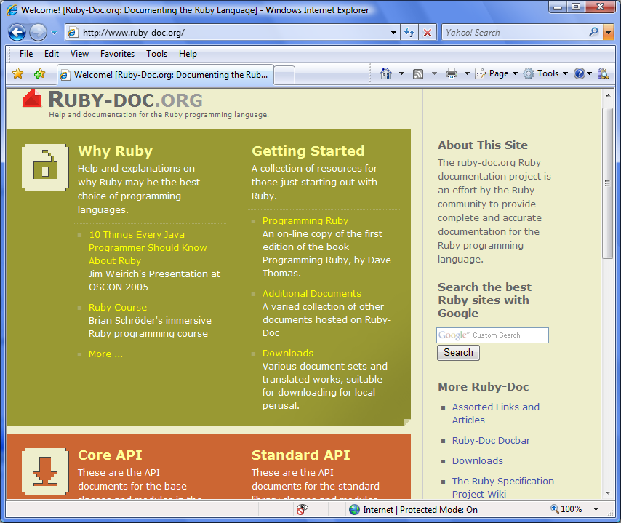
Reviewing Ruby Documentation
Ruby supports thousands of methods.
Access this documentation via RDoc at www.ruby-doc.org/.
Figure 2-10
Accessing Ruby documentation at www.ruby-doc.org.
Ruby Programming

Slide 34
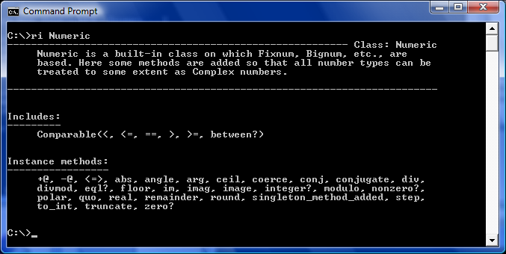
Reviewing Ruby Documentation (continued)
You can also access Ruby documentation on your computer using ri.
ri is a command line Ruby documentation viewer.
Figure 2-11
Using ri to view documentation about Ruby’s Numeric class.
Ruby Programming

Slide 35
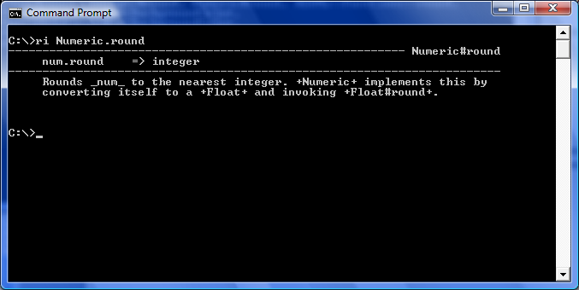
Reviewing Ruby Documentation (continued)
Documentation usually includes a description and a list of related language components.
For Ruby classes, this may include any number of methods. Information on methods can also be retrieved.
Figure 2-12
Using ri to view documentation about the Numeric class’s round method.
Ruby Programming

Slide 36
Back to the Ruby Tall Tale Game
Ruby Programming

Slide 37
Designing the Game
Follow these steps:
Open your text or script editor and create a new file.
Add comment statements to the beginning of the script file to document the script and its purpose.
Define custom classes required by the game.
Prepare the game for play.
Add the code statements that outline the script’s high-level conditional logic.
Terminate the game when the user decides not to play.
Prompt the player to provide story input for key story elements.
Assemble the game’s story using the player’s input.
Tell the game’s story.
Thank the player for playing the game.
Ruby Programming

Slide 38
Step 1: Creating a New Ruby File
1. Open code editor and create a new file.
2. Save the file with a name of RubyJoke.rb.
Ruby Programming

Slide 39
Step 2: Documenting the Script and Its Purpose
#---------------------------------------------------------
#
# Script Name: TallTale.rb
# Version: 1.0
# Author: Jerry Lee Ford, Jr.
# Date: March 2010
#
# Description: This Ruby script demonstrates how to
# collect and process user input through
# the development of an interactive
# storytelling game.
#
#---------------------------------------------------------
Ruby Programming

Slide 40
Step 3: Defining Custom Classes
The first class is named Screen, and it contains a method named cls that when called will clear the terminal window
class Screen
def cls
puts ("\n" * 25)
puts "\a"
end
end
class Tale
attr_accessor :monster, :villain,
:object, :place, :location
attr_accessor :P1, :P2, :P3, :P4
def tell_Story(paragraph)
puts paragraph
end
end
The second class is named Tale, and it defines properties representing key components of the game’s story plot.
Ruby Programming

Slide 41
Step 4: Preparing the Game for Execution
Console_Screen = Screen.new
Console_Screen.cls
print "Would you like to hear an interesting story? (y/n)\n\n: "
answer = STDIN.gets
answer.chomp!
The first statement instantiates the Screen object.
The cls method is then executed to clear the screen.
The player is then prompted for confirmation to play the game.
The player’s response is retrieved using the STDIN class’s gets method and is assigned to a variable named answer.
The chomp! method removes the end of line character from the value stored in answer.
Ruby Programming

Slide 42
Step 5: Outlining the Script’s High-Level Conditional Logic
if answer == "n“
else
end
This set of statements will be used to manage the analysis of the player’s input and the script’s subsequent actions.
Ruby Programming

Slide 43
Step 6: Prematurely Terminating Game Execution
Console_Screen.cls
puts "Okay, perhaps another time.\n\n"
These statements clear the screen and then displays a text string.
Ruby Programming

Slide 44
Step 7: Collecting Player Input
The rest of the statements that you will add to the script file need to be placed between the else and the end statements that are responsible for outlining the script’s overall controlling logic.
Story = Tale.new
Console_Screen.cls
print %Q{Type the name of a scary monster. (Press Enter)\n\n: }
monster = STDIN.gets
monster.chomp!
Console_Screen.cls
print %Q{Who is your favorite movie star? (Press Enter)\n\n: }
villain = STDIN.gets
villain.chomp!
Ruby Programming

Slide 45
Step 7: Collecting Player Input (continued)
Console_Screen.cls
print %Q{Type in the name of a thing. (Press Enter)\n\n: }
object = STDIN.gets
object.chomp!
Console_Screen.cls
print %Q{Enter the name of a good hiding place. (Press Enter)\n\n: }
place = STDIN.gets
place.chomp!
Console_Screen.cls
print %Q{Enter the name of a popular vacation site. (Press Enter)\n\n: }
location = STDIN.gets
location.chomp!
Ruby Programming

Slide 46
Step 8: Building the Game’s Story
The next set of statements is responsible for assigning each of the game’s four paragraphs to different properties belonging to the Story object. Each paragraph is written as a large text string. Variables have been embedded inside the text string and will be replaced by their assigned values.
Story.P1 = %Q{ Once upon a time in a far away land, just on the
outskirts of #{location}, there lived three very brave young children named Alexander, William, and Molly. These children were known far and wide as the heroes who once saved the inhabitants of #{location} from an evil #{monster}. One day dark clouds descended over #{location}. For 5 nights and 5 days a great storm raged, flooding all of the land in #{location}, driving its inhabitants up into the hills. (Press Enter)
}
Ruby Programming

Slide 47
Step 8: Building the Game’s Story (continued)
Story.P2 = %Q{ The good people of #{location} were not the only ones driven into the hills. An evil monster named #{villain} was also awoken from a 1,000 year slumber and forced from its lair by the torrential floods that followed the storm into #{location}. #{villain}, having been asleep for so long, was now hungry and soon began to prey upon the helpless people. By the time the water began to recede, over half of the inhabitants had become meals for #{villain}. (Press Enter)
}
Story.P3 = %Q{ Desperate for help, the remaining inhabitants of #{location} sent word to Alexander, William, and Molly that their help was once again needed. The three children soon arrived on the scene only to find that #{villain} had cornered the last of the inhabitants inside a #{place} and was preparing to eat one last meal before returning to his secret lair in #{location}. (Press Enter)
}
Ruby Programming

Slide 48
Step 8: Building the Game’s Story (continued)
Story.P4 = %Q{ Immediately, Alexander, William, and Molly flew into action. Alexander threw a #{object} and hit #{villain} to get
his attention. At the same time, William and Molly crept up behind him. William then threw a rope around the feet of #{villain}, momentarily tying him up and allowing Molly to move in and spray #{villain} with a full can of bug spray, immediately immobilizing and killing #{villain}. The remaining inhabitants returned to their homes and soon life in #{location} was back to normal. Alexander, William, and Molly returned to their homes, quietly living on the edge of #{location}, waiting until the day they would be needed again. (Press Enter)
}
Ruby Programming

Slide 49
Step 9: Telling the Game’s Story
It is time to begin telling the story.
Console_Screen.cls
Story.tell_Story Story.P1
STDIN.gets
Console_Screen.cls
Story.tell_Story Story.P2
STDIN.gets
Console_Screen.cls
Story.tell_Story Story.P3
STDIN.gets
Console_Screen.cls
Story.tell_Story Story.P4
STDIN.gets
These statements are grouped into sets. Each set begins by calling on the Screen class’s cls method to clear the console window. The Tale class’s tell_Story method is then called and passed a paragraph to display. The STDIN class’s gets method is then run in order to pause the execution of the script until the player presses the Enter key.
Ruby Programming

Slide 50
Step 10: Thanking the Player
Console_Screen.cls
puts "Thanks for helping to tell this Tall Tale!\n\n"
The first statement clears the screen.
The second statement thanks the player for playing the game.
Ruby Programming

Slide 51
Running Your New Ruby Script Game
Save your Ruby script.
Access the command prompt and navigate to the folder where you saved the script.
Enter the following command and press the Enter key.
  ruby TallTale.rb
Ruby Programming

Slide 52
Summary
The chapter demonstrated how to:
Open and work with IRB
Access IRB online
Use IRB to execute Ruby statements and scripts
Use IRB to perform mathematical calculations
Access Ruby documentation
Create the Ruby Tall Tale game
Ruby Programming

