Slide 1
Chapter 3
Working with Objects, Strings, and Variables
Ruby Programming

Slide 2
Objectives
In this chapter, you learn:
How to create and format text strings
Options for manipulating string contents
How to work with String class methods
The principles of object-oriented programming
How to convert from one class to another
How to store and retrieve data
How to store data that does not change
How to create the Ruby Virtual Crazy 8-Ball game
Ruby Programming
3-<number>

Slide 3
Project Preview: The Ruby Virtual Crazy 8 Ball Game
Ruby Programming
3-<number>

Slide 4
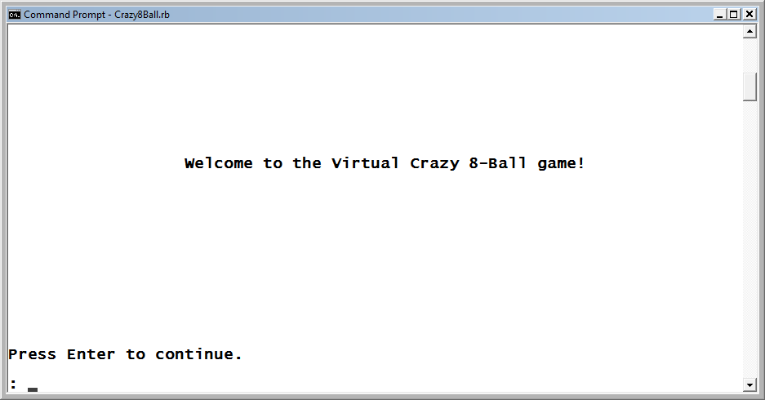
The Ruby Virtual Crazy 8 Ball Game (continued)
The game begins by displaying a welcome screen. To begin the game, the player must press the Enter key.
Figure 3-1
The welcome screen for the Ruby Virtual Crazy 8-Ball game.
Ruby Programming
3-<number>

Slide 5
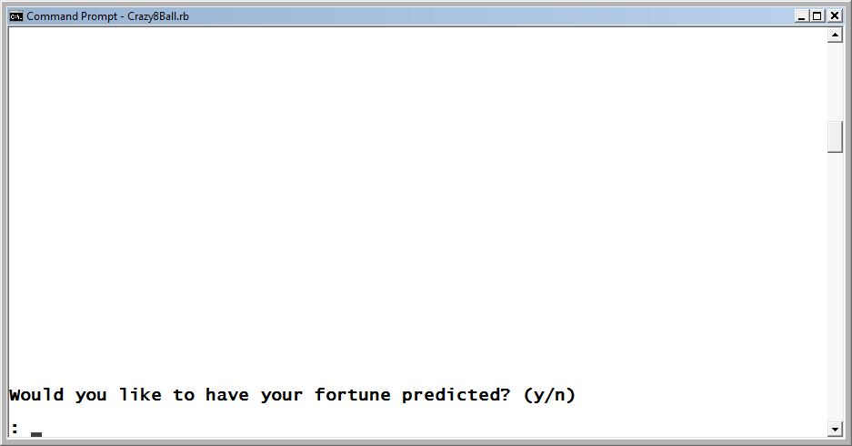
The Ruby Virtual Crazy 8 Ball Game (continued)
Next, the game prompts the player for permission to play the game, instructing the player to respond with a y or an n.
Figure 3-2
The game requires the player to agree to play.
Ruby Programming
3-<number>

Slide 6
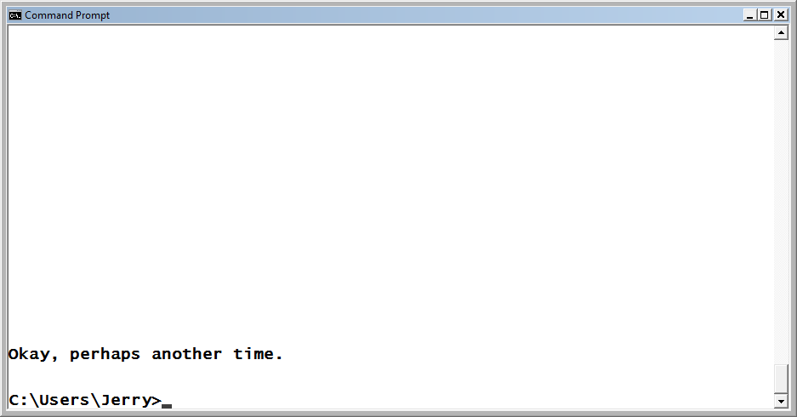
The Ruby Virtual Crazy 8 Ball Game (continued)
If the player responds with anything other than y or n, the game will redisplay the previous screen. If the player responds by typing n, game play ends.
Figure 3-3
The game invites the player to return and play again.
Ruby Programming
3-<number>

Slide 7
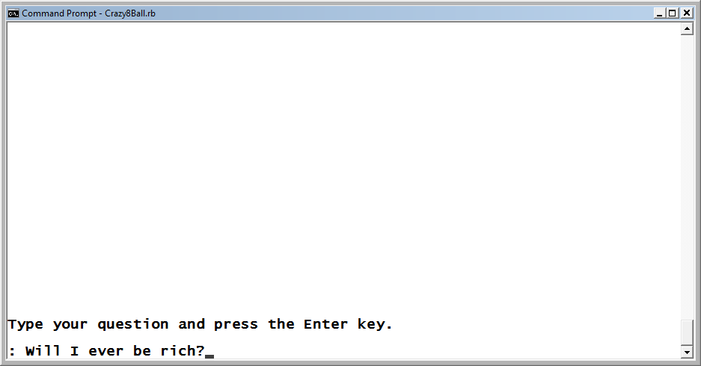
The Ruby Virtual Crazy 8 Ball Game (continued)
If, on the other hand, the player responds with a y, the game prompts the player to ask it a question and then press the Enter key.
Figure 3-4
The game prompts the player to ask it a question.
Ruby Programming
3-<number>

Slide 8
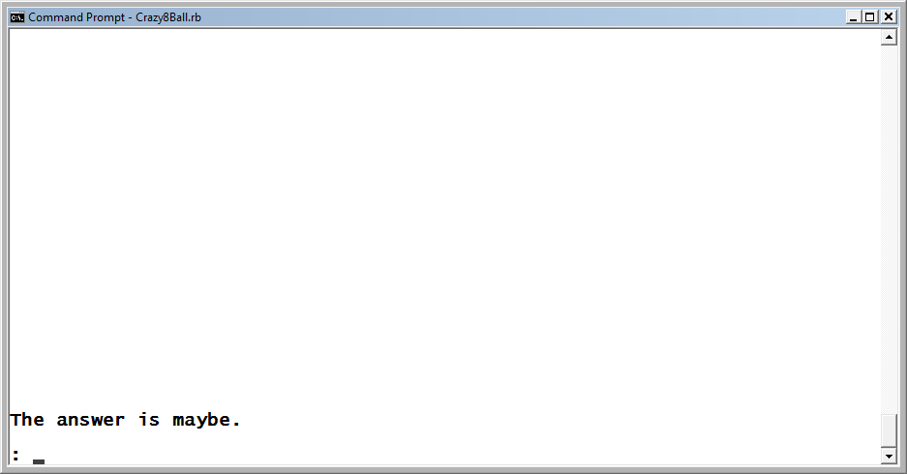
The Ruby Virtual Crazy 8 Ball Game (continued)
The game then answers the player’s questions by displaying one of six randomly selected answers.
Figure 3-5
The game provides a randomly selected answer to the player’s question.
Ruby Programming
3-<number>

Slide 9
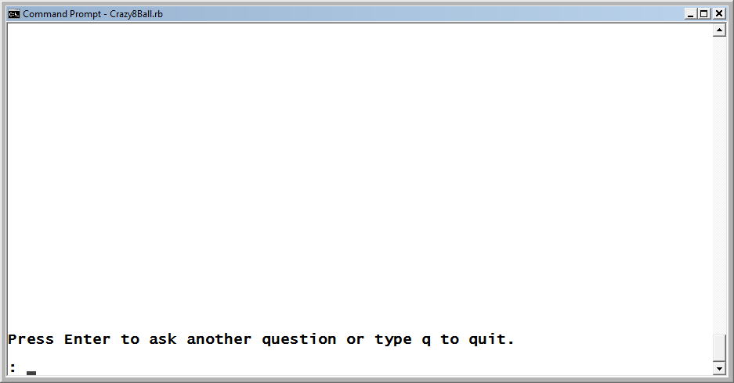
The Ruby Virtual Crazy 8 Ball Game (continued)
Once the player dismisses the game’s answer by pressing the Enter key, the game responds by asking the player if she would like to ask a new question.
Figure 3-6
The player has the option of asking another question or typing
q to quit the game.
Ruby Programming
3-<number>

Slide 10
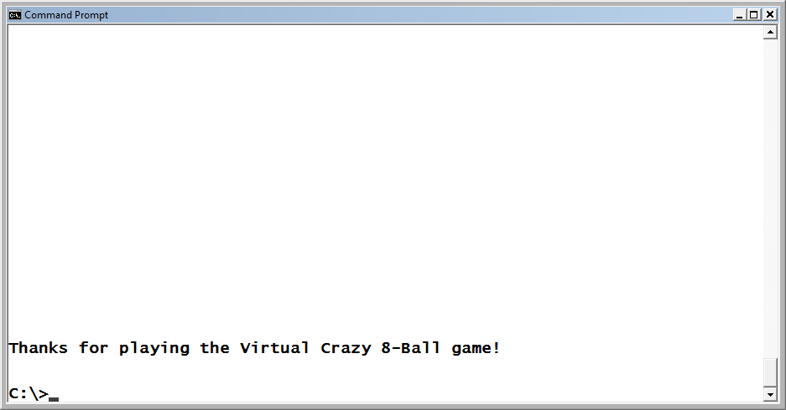
The Ruby Virtual Crazy 8 Ball Game (continued)
The last screen displayed thanks the player for taking time to play the game.
Figure 3-7
The Ruby Virtual Crazy 8-Ball game has ended.
Ruby Programming
3-<number>

Slide 11
Creating and Formatting Text Strings
Ruby Programming
3-<number>

Slide 12
Modifying Text String Format
When working with double-quoted strings, Ruby recognizes a number of escape characters that when found are automatically replaced with the appropriate corresponding operation.
String Escape Substitution Characters
Option Description
\b Backspace
\f Formfeed
\n New line
\r Return
\s Space
\t Tab
Ruby Programming
3-<number>

Slide 13
Modifying Text String Format (continued)
puts "1 2 3 4 5"
1 2 3 4 5
puts "\t1 \t2 \t3 \t4 \t5"
1 2 3 4 5
puts "\n1 \n2 \n3 \n4 \n5"
1
2
3
4
5
Ruby Programming
3-<number>

Slide 14
String Interpolation
String interpolation (or variable substitution) is the process of substituting the value of an expression or variable inside a string.
totalScore = 100
puts "Game over. Your score is #{totalScore}.“
Game over. Your score is 100.
Ruby Programming
3-<number>

Slide 15
Manipulating String Contents
Ruby Programming
3-<number>

Slide 16
Concatenating Text Strings
As an alternative to string interpolation, you could achieve the same results using string concatenation. Concatenation is the process of joining two strings together to form a new string. Concatenation is performed using the + string method.
totalScore = 100
puts "Game over. Your score is " + totalScore.to_s + ".“
Game over. Your score is 100.
Ruby Programming
3-<number>

Slide 17
Multiplying Text Strings
In addition to creating new strings by concatenating existing strings together, you can also create new strings by multiplying existing strings using the String class’s * method.
x = "Happy birthday to you. " * 3
puts x
Happy birthday to you. Happy birthday to you. Happy birthday to you.
Ruby Programming
3-<number>

Slide 18
Comparing Text Strings
Another commonly performed string operation is to compare two strings to see whether they are equal. This is accomplished using the equality operator (==).
puts "Would you like to hear a few funny jokes? (y/n) "
answer = STDIN.gets
answer.chop!
if answer == "n" #See if the player elected not to play
.
.
.
Ruby Programming
3-<number>

Slide 19
Creating Multiline Text Strings
You can also create text strings by embedding text inside the %q{ and } characters or the %Q{ and } characters.
%q{} creates a string that is equivalent to a single-quoted string.
%Q{ and } characters create a string that is equivalent to a double-quoted string.
%q{ and } and %Q{ and } allow you to create strings that span multiple lines.
story = %Q{Once upon a time there were
three children named Alexander, William,
and Molly.}
Ruby Programming
3-<number>

Slide 20
Working with String Class Methods
Ruby Programming
3-<number>

Slide 21
String Class Methods
Listing of Some of the Methods Belonging to the String Class
Method Description
capitalize Capitalizes the first letter of a string
downcase Converts a string to all lowercase letters
chop Removes the last character from a string
length Returns an integer representing the number of characters in a string
next Replaces the next letter in a string with the next letter in the alphabet
reverse Reverses the spelling of a string
swapcase Reverses the case of each letter in a string
upcase Converts a string to all uppercase letters
Ruby Programming
3-<number>

Slide 22
Object-Oriented Programming
Ruby Programming
3-<number>

Slide 23
Defining a New Class
Ruby lets programmers define classes representing real-world concepts like files, folders, people, automobiles, and animals.
Objects are defined as classes using the syntax outlined here:
class ClassName
statements
end
Ruby Programming
3-<number>

Slide 24
Defining Class Properties
Within the class definition, you can define one or more attributes that describe characteristics associated with the class.
Class attributes, also referred to as properties, are defined inside the class using the attr_accessor keyword.
class Automobile
attr_accessor :model, :color
end
Ruby Programming
3-<number>

Slide 25
Instantiating and Interacting with New Objects
Once defined, class can be used as the basis for instantiating scripts objects.
variableName = ClassName.new
Ruby Programming
3-<number>

Slide 26
Defining Class Methods
In order to control objects, you need to define class methods, which can then be used to programmatically interact with any object.
def methodname(arguments)
Statements
end
Ruby Programming
3-<number>

Slide 27
Inheritance
Ruby allows one class definition to be used as the basis for creating another class definition.
For example, you might define a generic automobile class that defines all of the basic properties associated with a car.
class Automobile
attr_accessor :model, :color
def honk
puts "Honk!!!"
end
end
Ruby Programming
3-<number>

Slide 28
Inheritance (continued)
You could use the Automobile class to create another related class of cars.
class Explorer < Automobile
attr_accessor :transmission
def breaks
puts "... screech!"
end
end
Ruby Programming
3-<number>

Slide 29
Converting from One Class to Another
Ruby Programming
3-<number>

Slide 30
Implicit Class Conversion
In Ruby, numbers and strings are different types of objects.
Ruby supports many types of numeric classes, including Fixnum, Integer, Bignum, and float.
Ruby automatically handles numeric class assignments.
You can display an object’s class type as demonstrated here.
irb(main):009:0> x = "Hello"
=> "Hello"
irb(main):010:0> x.class
=> String
Ruby Programming
3-<number>

Slide 31
Explicit Class Conversion
Ruby also provides you with the ability to explicitly coerce objects from one class to another.
Using methods like to_i, to_f, and to_s , you can coerce object type.
Ruby Programming
3-<number>

Slide 32
Storing and Retrieving Data
Ruby Programming
3-<number>

Slide 33
Naming Variables
Variable names must begin with a letter or an underscore character.
Variable names can only contain letters, numbers, and underscore characters.
Variable names cannot include blank spaces.
Ruby Programming
3-<number>

Slide 34
Variable Assignments
Variable value assignments in Ruby are made using the equals assignment operator (=).
x = 10
Incrementing a variable's value is a common task. To help make it easier to perform, you can use the += operator.
x += 1
Ruby Programming
3-<number>

Slide 35
Variable Scope
Variable access depends on scope. Scope is a term that describes the areas within a script where a variable can be seen and accessed.
Variable Scopes
Type Opening Character(s) Description
Local a-z and _ Scope is limited to each iteration loop, module,
class, and method in which it is defined or to
the entire script if the variable is defined outside
of one of the structures.
Instance @ Scope is limited to the scope associated with
the object itself.
Class @@ Scope is limited to objects of class.
Global $ Scope has no limit, allowing the variable to be
accessed throughout the script.
Ruby Programming
3-<number>

Slide 36
Storing Data That Does Not Change
Ruby Programming
3-<number>

Slide 37
Constants
Any time you are creating a Ruby script that will use a value that is known at design time and not subject to change, you should define that value as a constant.
A constant is like a variable, the difference being that constant names begin with a capital letter and will generate warning messages if you change their values during execution.
Pi = 3.14
Ruby Programming
3-<number>

Slide 38
Back to the Ruby Virtual Crazy 8 Ball Game
Ruby Programming
3-<number>

Slide 39
Designing the Game
Follow these steps:
Open your text or script editor and create a new file.
Add comment statements to the beginning of the script file to document the script and its purpose.
Define a class representing the terminal window.
Define a class representing the game’s virtual 8 ball window.
Instantiate custom script objects.
Display a greeting message.
Get confirmation before continuing game play.
Analyze the player’s reply.
Manage early game termination.
Process and respond to player questions.
Ruby Programming
3-<number>

Slide 40
Step 1: Creating a New Ruby File
1. Open code editor and create a new file.
2. Save the file with a name of Crazy8Ball.rb.
Ruby Programming
3-<number>

Slide 41
Step 2: Documenting the Script and Its Purpose
#---------------------------------------------------------
#
# Script Name: Crazy8Ball.rb
# Version: 1.0
# Author: Jerry Lee Ford, Jr.
# Date: April 2010
#
# Description: This Ruby script demonstrates how to work
# with variables. It generates random numbers
# to create a fortune-telling game that
# provides randomly selected answers to the
# player’s questions.
#
#--------------------------------------------------------
Ruby Programming
3-<number>

Slide 42
Step 3: Defining a Screen Class
# Define custom classes ----------------------------------
#Define a class representing the console window
class Screen
def cls #Define a method that clears the display area
puts ("\n" * 25) #Scroll the screen 25 times
puts "\a" #Make a little noise to get the player's
#attention
end
def pause #Define a method that pauses the display area
STDIN.gets #Execute the STDIN class's gets method to
#pause script
#execution until the player presses the
#Enter key
end
end
Ruby Programming
3-<number>

Slide 43
Step 4: Defining a Ball Class
#Define a class representing the 8 ball
class Ball
#Define class properties for the 8 ball
attr_accessor :randomNo, :greeting, :question, :goodbye
Ruby Programming
3-<number>

Slide 44
Step 4: Defining a Ball Class (continued)
def get_fortune #Define a method to be used to generate random answers
randomNo = 1 + rand(6)
#Assign an answer based on the randomly generated number
case randomNo
when 1
$prediction = "yes"
when 2
$prediction = "no"
when 3
$prediction = "maybe"
when 4
$prediction = "hard to tell. Try again"
when 5
$prediction = "unlikely"
when 6
$prediction = "unknown"
end
end
Ruby Programming
3-<number>

Slide 45
Step 4: Defining a Ball Class (continued)
#This method displays the 8 ball greeting message
def say_greeting
greeting = "\t\t Welcome to the Virtual Crazy 8 Ball game!" +
"\n\n\n\n\n\n\n\n\n\n\n\n\nPress Enter to " +
"continue. \n\n: "
print greeting
end
#This method displays the 8 ball's primary query
def get_question
question = "Type your question and press the Enter key. \n\n: "
print question
end
Ruby Programming
3-<number>

Slide 46
Step 4: Defining a Ball Class (continued)
#This method displays the 8 ball answers
def tell_fortune()
print "The answer is " + $prediction + ". \n\n: "
end
#This method displays the 8 ball’s closing message
def say_goodbye
goodbye = "Thanks for playing the Virtual Crazy 8 Ball game!\n\n"
puts goodbye
end
end
Ruby Programming
3-<number>

Slide 47
Step 5: Instantiating New Objects
# Main Script Logic ---------------------------------------------
Console_Screen = Screen.new #Initialize a new Screen object
Eight_Ball = Ball.new #Initialize a new Ball object
Ruby Programming
3-<number>

Slide 48
Step 6: Greeting the Player
Console_Screen.cls #Clear the display area
Eight_Ball.say_greeting #Call method responsible for greeting
#the player
Console_Screen.pause #Pause the game
Ruby Programming
3-<number>

Slide 49
Step 7: Prompting for Confirmation to Continue
answer = "" #Initialize variable that is used to control the
#game's first loop
#Loop until the player enters y or n and do not accept any other
#input.
until answer == "y" || answer == "n"
Console_Screen.cls #Clear the display area
#Prompt the player for permission to begin the game
print "Would you like to have your fortune predicted? (y/n)\n\n: "
answer = STDIN.gets #Collect the player's response
answer.chop! #Remove any extra characters appended to the string
end
Ruby Programming
3-<number>

Slide 50
Step 8: Analyzing the Player’s Response
#Analyze the player's response
if answer == "n" #See if the player elected not to play
else #The player has elected to play the game
end
Ruby Programming
3-<number>

Slide 51
Step 9: Managing Early Termination of the Game
Console_Screen.cls #Clear the display area
#Invite the player to return and play again
puts "Okay, perhaps another time. \n\n"
Ruby Programming
3-<number>

Slide 52
Step 10: Responding to Player Questions
#Initialize variable that is used to control the game's primary loop
gameOver = "No"
#Loop until the player decides to quit
until gameOver == "Yes"
Console_Screen.cls #Clear the display area
#Call upon the method responsible for prompting the player to ask
#a question
Eight_Ball.get_question
#Call upon the method responsible for generating an answer
Eight_Ball.get_fortune
Console_Screen.pause #Pause the game
Ruby Programming
3-<number>

Slide 53
Step 10: Responding to Player Questions (continued)
Console_Screen.cls #Clear the display area
#Call upon the method responsible for telling the player the 8 ball's answer
Eight_Ball.tell_fortune
Console_Screen.pause #Pause the game
Console_Screen.cls #Clear the display area
#Find out if the player wants to ask another question
print "Press Enter to ask another question or type q to quit. \n\n: “
answer = STDIN.gets #Collect the player's response
answer.chop! #Remove any extra characters appended to the string
#Analyze the player's response
if answer == "q" #See if the player elected not to play
gameOver = "Yes" #The player wants to quit
end
end
Ruby Programming
3-<number>

Slide 54
Step 10: Responding to Player Questions (continued)
Console_Screen.cls #Clear the display area
#Call upon the method responsible for saying goodbye to the player
Eight_Ball.say_goodbye
Ruby Programming
3-<number>

Slide 55
Running Your New Ruby Script Game
Save your Ruby script.
Access the command prompt and navigate to the folder where you saved the script.
Enter the following command and press the Enter key.
  ruby Crazy8Ball.rb
Ruby Programming
3-<number>

Slide 56
Summary
The chapter demonstrated:
  How to create and format text strings
  Options for manipulating string contents
  How to work with String class methods
  The principles of object-oriented programming
  How to convert from one class to another
  How to store and retrieve data
  How to store data that does not change
  How to create the Ruby Virtual Crazy 8-Ball game
Ruby Programming
3-<number>

