Slide 1
Chapter 4
Implementing Conditional Logic
Ruby Programming

Slide 2
Objectives
In this chapter, you:
Use conditional logic to create adaptive scripts
Perform alternative types of comparisons
Use conditional logic modifiers
Work with the if and unless expressions
Use case blocks to analyze data
Use the ternary operator
Nest conditional statements
Combine and negate logical comparison operations
Create the Ruby Typing Challenge game
Ruby Programming
4-<number>

Slide 3
Project Preview: The Ruby Typing Challenge Game
Ruby Programming
4-<number>

Slide 4
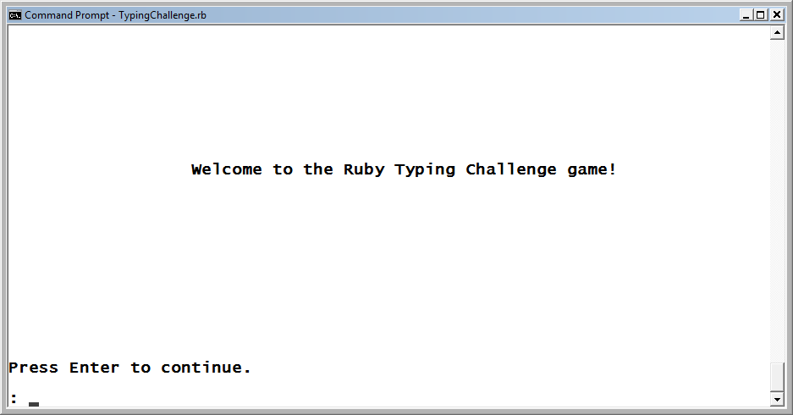
The Ruby Typing Challenge Game (continued)
The Ruby Typing Challenge game begins displaying a welcome screen.
Figure 4-1
The welcome screen for the Ruby Typing Challenge game.
Ruby Programming
4-<number>

Slide 5
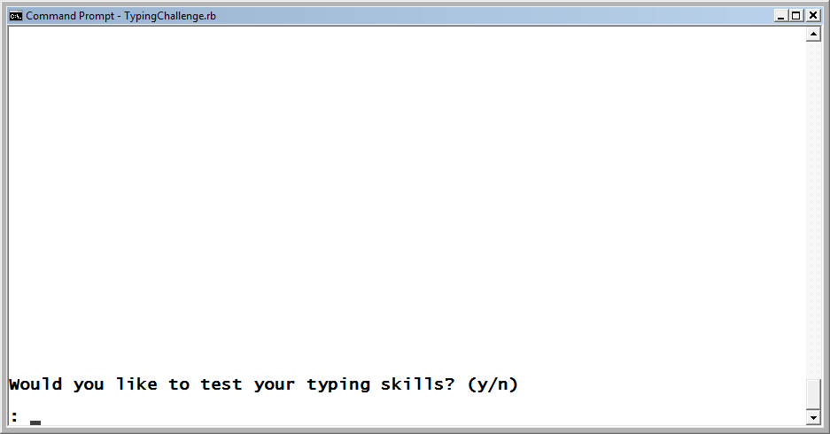
The Ruby Typing Challenge Game (continued)
The game prompts the player for permission to begin the test.
Figure 4-2
The game requires the player to agree to play.
Ruby Programming
4-<number>

Slide 6
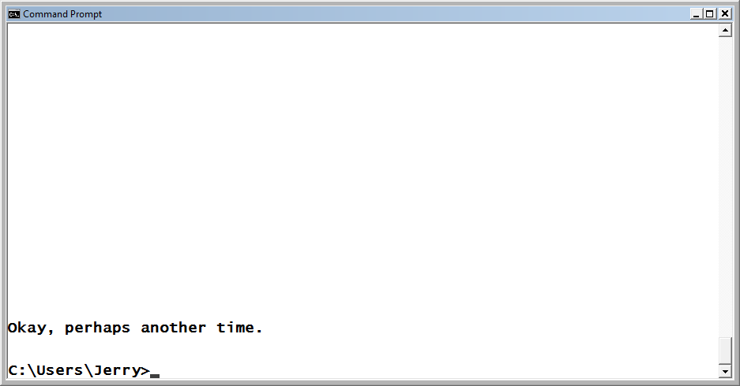
The Ruby Typing Challenge Game (continued)
If the player decides not to take the typing test, the game will end once the player presses the Enter key.
Figure 4-3
The player has elected not to take the test.
Ruby Programming
4-<number>

Slide 7
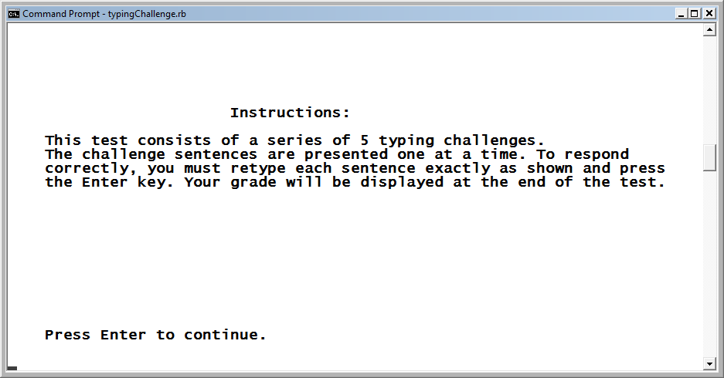
The Ruby Typing Challenge Game (continued)
If the player elects to take the typing test, instructions are provided.
Figure 4-4
Instructions explain how to take the test.
Ruby Programming
4-<number>

Slide 8
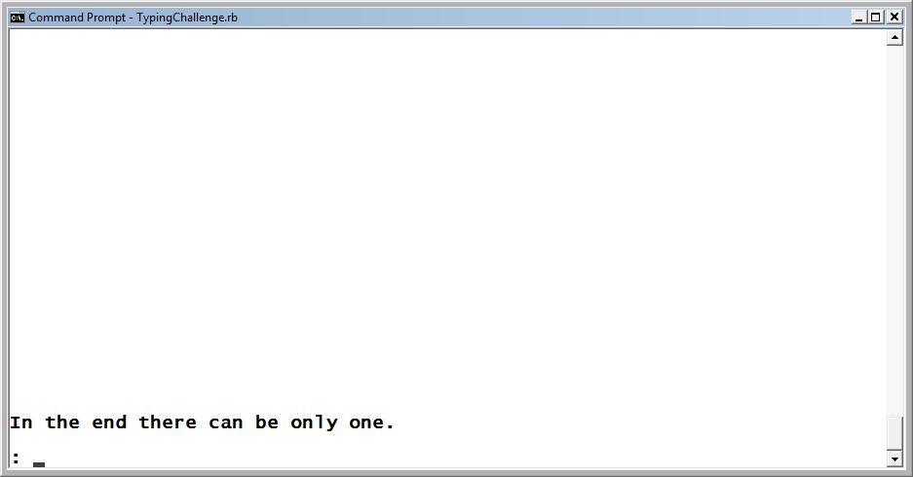
The Ruby Typing Challenge Game (continued)
The first of a series of five sentences is presented. The player must type the sentence exactly as shown.
Figure 4-5
The first typing challenge.
Ruby Programming
4-<number>

Slide 9
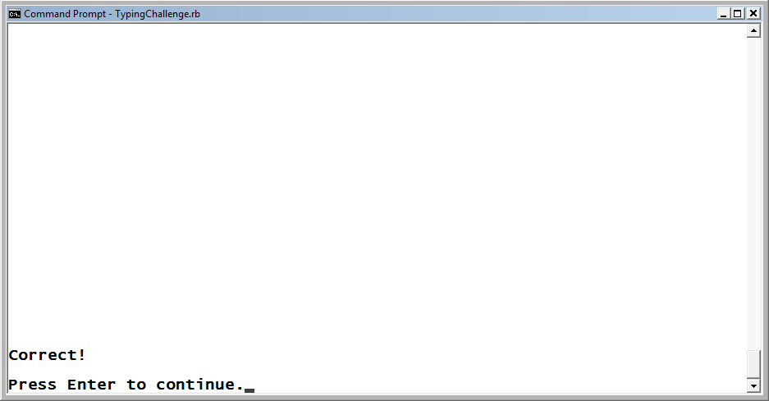
The Ruby Typing Challenge Game (continued)
The game analyzes the player’s input. The player is notified if a match is found. Otherwise, a error message is displayed.
Figure 4-6
The player has correctly typed the challenge sentence.
Ruby Programming
4-<number>

Slide 10
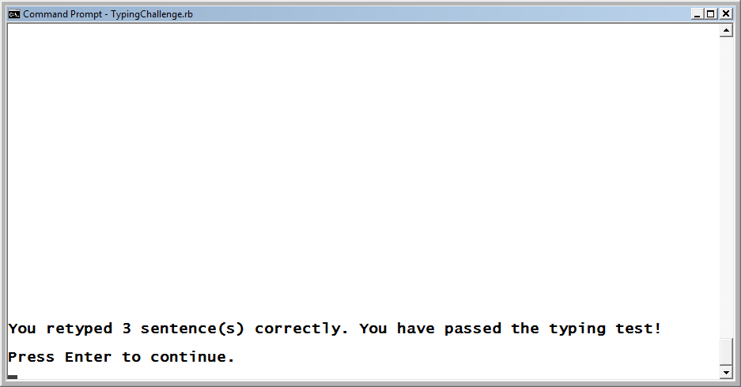
The Ruby Typing Challenge Game (continued)
Sentences grow longer as the test progresses. When completed, the game analyzes the player’s score and lets the player know if he passed.
Figure 4-7
The player has passed the test.
Ruby Programming
4-<number>

Slide 11
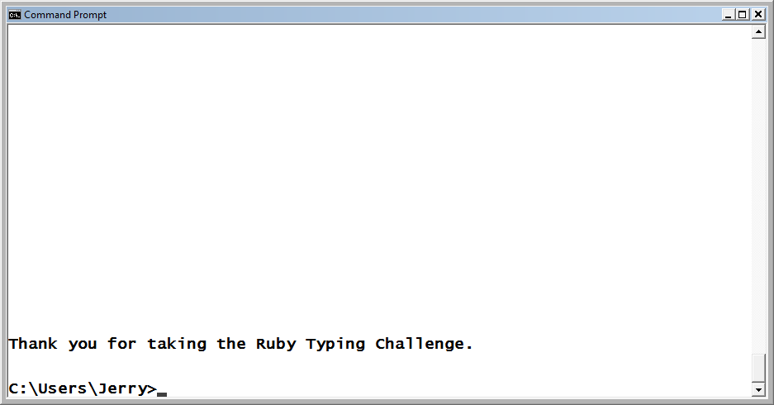
The Ruby Typing Challenge Game (continued)
Once the player presses the Enter key, a message displays thanking the player for taking the typing test.
Figure 4-8
The game ends after thanking the player for taking the test.
Ruby Programming
4-<number>

Slide 12
Using Conditional Logic to Create Adaptive Scripts
Ruby Programming
4-<number>

Slide 13
Creating Adaptive Scripts
You can create scripts that consist of a series of statements that are executed in sequential order.
However, some level of conditional execution is almost always required.
This execution might involve prompting the player for permission to play a game and then either ending or continuing the game based on an analysis of the player’s response.
Ruby Programming
4-<number>

Slide 14
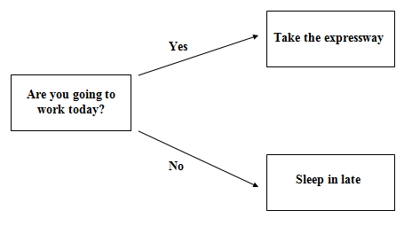
Creating Adaptive Scripts (continued)
A visual depiction of the application of conditional logic as required to select between two alternatives.
Figure 4-9
Choosing between different courses of action.
Ruby Programming
4-<number>

Slide 15
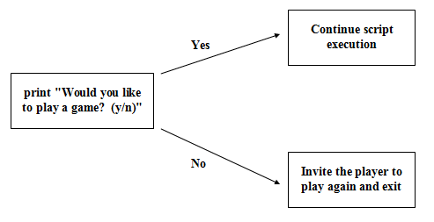
Creating Adaptive Scripts (continued)
This same basic logic can easily be applied to the development of a computer program or script.
Figure 4-10
A graphical representation of the conditional logic used to determine whether or not to start game play.
Ruby Programming
4-<number>

Slide 16
Creating Adaptive Scripts (continued)
A flowchart is a tool used to graphically represent some or all of a script’s logical flow.
Flowcharts outline the overall design of the logic involved in designing a computer program or script.
Flowcharts can be used to identify different parts of a program or project, making the division of work easier when multiple programmers are involved.
Ruby Programming
4-<number>

Slide 17
Creating Adaptive Scripts (continued)
Ruby provides numerous ways of applying conditional logic:
The if modifier
The unless modifier
The if expression
The unless expression
Case
The ternary operator
Ruby Programming
4-<number>

Slide 18
Performing Alternative Types of Comparisons
Ruby Programming
4-<number>

Slide 19
Comparison Operators
Ruby provides programmers with access to a range of comparison operators.
Operator Description
== Equal
!= Not equal
< Less than
<= Less than or equal to
> Greater than
>= Greater than or equal to
Ruby Programming
4-<number>

Slide 20
Conditional Logic Modifiers
Ruby Programming
4-<number>

Slide 21
The if Modifier
Using the if modifier, you can attach a conditional test to the end of a Ruby statement to control the execution of that statement.
print "Enter your age and press Enter: "
answer = STDIN.gets
answer.chop!
puts "You must be 18 or older to play this game!" if answer.to_i < 18
Ruby Programming
4-<number>

Slide 22
The Unless Modifier
As an alternative to the if modifier, you can use the unless modifier.
The unless modifier is the logical opposite of the if modifier.
print "Enter your age and press Enter: "
answer = STDIN.gets
answer.chop!
puts "You must be 18 or older to play this game!" unless answer.to_i > 17
Ruby Programming
4-<number>

Slide 23
Working with if and unless Expressions
Ruby Programming
4-<number>

Slide 24
Creating if Expressions
if expressions can control the execution of more than one statement.
The if expression supports a very flexible syntax that provides the ability to use the expression in a number of different ways.
if condition then
statements
elsif condition then
statements
.
.
.
else
statements
end if
Ruby Programming
4-<number>

Slide 25
Replacing if Modifiers with if Expressions
print "Enter your age and press Enter: "
answer = STDIN.gets
answer.chop!
puts "You must be 18 or older to play this game!" if answer.to_i < 18
print "Enter your age and press Enter: "
answer = STDIN.gets
answer.chop!
if answer.to_i < 18 then
puts "You must be 18 or older to play this game!"
end
Ruby Programming
4-<number>

Slide 26
Creating Single Line if Expressions
The syntax support of the if expression is very flexible, allowing for many formats. For example, the following example demonstrates how to format an if expression that fits on a single line.
x = 10
if x == 10 then puts "x is equal to 10" end
Ruby Programming
4-<number>

Slide 27
Using the else Keyword to Specify Alternative Actions
You can modify an if expression to execute one or more statements in the event the test condition evaluates as being false.
x = 10
if x == 10 then
puts " x is equal to 10"
else
puts " x does not equal 10"
end
Ruby Programming
4-<number>

Slide 28
Checking Alternative Conditions
You could use the if expression’s optional elsif keyword to rewrite this example as shown here.
if x == 10 then
puts "x is 10"
elsif x == 15 then
puts "x is 15"
elsif x == 20 then
puts "x is 20"
elsif x == 25 then
puts "x is 25"
end
Ruby Programming
4-<number>

Slide 29
Creating Unless Expressions
The unless expression is the polar opposite of the if expression.
print "Enter your age and press Enter: "
answer = STDIN.gets
answer.chop!
unless answer.to_i > 17
puts "You must be 18 or older to play this game!"
end
Ruby Programming
4-<number>

Slide 30
Using case Blocks to Analyze Data
Ruby Programming
4-<number>

Slide 31
case Block Syntax
Ruby also provides the case block as a means of comparing a series of expressions against a single expression to see whether any of the expressions being evaluated result in equivalent value.
case expression
when value
statements
.
.
.
when value
statements
else
statements
end
Ruby Programming
4-<number>

Slide 32
A case Block Example
puts "\nWelcome to the vacation calculator!\n\n“
print "How many years have you worked for the company? \n\n: "
answer = STDIN.gets
answer.chop!
answer = answer.to_i
case
when (answer.between?(1, 5))
puts "You are entitled to 1 week of vacation per year."
when (answer.between?(6, 10))
puts "You are entitled to 2 weeks of vacation per year."
when (answer.between?(11, 30))
puts "You are entitled to 3 weeks of vacation per year."
else
puts "You are entitled to 5 weeks of vacation per year."
end
Ruby Programming
4-<number>

Slide 33
Using the Ternary Operator
Ruby Programming
4-<number>

Slide 34
A Ternary Operator Example
The ternary operator (?:) evaluates the values of two different expressions and makes a variable assignment as a result of that comparison.
variable = expression ? true_result : false_result
print "\n\nEnter your age and press Enter: "
answer = STDIN.gets
answer.chop!
answer = answer.to_i
result = answer < 18 ? "denied!" : "approved!"
puts "\n\nYour access has been " + result + "\n\n"
Ruby Programming
4-<number>

Slide 35
Nesting Conditional Statements
Ruby Programming
4-<number>

Slide 36
Nesting Example
Some situations require more complicated analysis than can be accomplished using an individual conditional modifier expression.
One way of addressing this type of challenge is to embed one conditional statement inside another through a process called nesting.
redStatus = "Go"
blueStatus = "Go"
greenStatus = "Go“
if redStatus == "Go" then
if blueStatus == "Go" then
if greenStatus == "Go" then
puts "All systems are go. Prepare for launch!"
end
end
end
Ruby Programming
4-<number>

Slide 37
Combining and Negating Logical Comparison Operations
Ruby Programming
4-<number>

Slide 38
Ruby Boolean Operators
Operator Type Example
and Evaluates as true if both x > 1 and x < 10
comparisons evaluate as True
&& Evaluates as true if both x > 1 && x < 10
comparisons evaluate as True
or Evaluates as true if either x = 1 or x = 10
comparison evaluates as True
|| Evaluates as true if either x = 1 || x = 10
comparison evaluates as True
not Reverses the value of a not (x > 5)
comparison
! Reverses the value of a ! (x > 5)
comparison
Ruby Programming
4-<number>

Slide 39
Ruby Boolean Operators (continued)
The and and && operators are essentially identical.
The and operator has a higher level of precedence than the && operator.
The or has a higher level of precedence than the || operator.
The and and && operators evaluate the second operand only if the first operand is true.
The or and || operators evaluate the second operand only if the first operand is false.
print "Enter your age and press Enter: "
reply = STDIN.gets
reply.chop!
reply = reply.to_i
puts "You are old enough!" if reply >= 18 && reply <= 65
Ruby Programming
4-<number>

Slide 40
Back to the Ruby Typing Challenge Game
Ruby Programming
4-<number>

Slide 41
Designing the Game
Follow these steps:
1. Open your text or script editor and create a new file.
2. Add comment statements that document the script and its purpose.
3. Define a Screen class representing the console window.
4. Define a Test class representing the typing test.
5. Develop a method in the Test class that displays a greeting message.
6. Develop a method in the Test class that displays test instructions.
7. Develop a method in the Test class that presents typing challenge sentences.
8. Develop a method in the Test class that displays test results.
9. Initialize script objects.
10. Prompt the player for permission to start the typing test.
11. Develop the overall programming logic responsible for analyzing the player response.
12. Manage early game termination.
13. Execute methods required to deliver the typing test.
Ruby Programming
4-<number>

Slide 42
Step 1: Creating a New Ruby File
1. Open code editor and create a new file.
2. Save the file with a name of TypingChallenge.rb.
Ruby Programming
4-<number>

Slide 43
Step 2: Documenting the Script and Its Purpose
#---------------------------------------------------------
#
# Script Name: TypingChallenge.rb
# Version: 1.0
# Author: Jerry Lee Ford, Jr.
# Date: March 2010
#
# Description: This Ruby script demonstrates how to apply
# conditional logic in order to analyze user
# input and control script execution through
# the development of a computer typing test
# that evaluates the player's typing skills.
#
#--------------------------------------------------------
Ruby Programming
4-<number>

Slide 44
Step 3: Define a Class Representing the Console Window
# Define custom classes -----------------------------------------
#Define a class representing the console window
class Screen
def cls #Define a method that clears the display area
puts ("\n" * 25) #Scroll the screen 25 times
puts "\a" #Make a little noise to get the player's attention
end
def pause #Define a method that pauses the display area
STDIN.gets #Execute the STDIN class's gets method to pause
#script execution until the player presses the
#Enter key
end
end
Ruby Programming
4-<number>

Slide 45
Step 4: Define a Class Representing the Typing Test
Begin the definition of a new class that will represent the game’s typing test by adding the following statements to the end of the script file. This class will be named Test and will eventually be populated with four methods.
#Define a class representing the typing test
class Test
end
Ruby Programming
4-<number>

Slide 46
Step 5: Define the display_greeting Method
#This method displays the 8-ball greeting message
def display_greeting
Console_Screen.cls #Clear the display area
#Display a welcome screen
print "\t\t Welcome to the Ruby Typing Challenge game!" +
"\n\n\n\n\n\n\n\n\n\n\n\n\nPress Enter to " +
"continue. \n\n: "
Console_Screen.pause #Pause the game
end
Ruby Programming
4-<number>

Slide 47
Step 6: Define the display_instructions Method
#Define a method to be used to present test instructions
def display_instructions
Console_Screen.cls #Clear the display area
puts "\t\t\tInstructions:\n\n" #Display a heading
#Display the game's instructions
puts %Q{ This test consists of a series of 5 typing challenges.
The challenge sentences are presented one at a time. To respond
correctly, you must retype each sentence exactly as shown and
press the Enter key. Your grade will be displayed at the end of
the test.
\n\n\n\n\n\n\n\n\n
Press Enter to continue.\n\n}
Console_Screen.pause #Pause the game
end
Ruby Programming
4-<number>

Slide 48
Step 7: Define the present_test Method
#Define a method to be used to present typing challenges
def present_test(challenge)
Console_Screen.cls #Clear the display area
print challenge + "\n\n: " #Display the challenge sentence
result = STDIN.gets #Collect the player's input
result.chop! #Remove the end of line marker
Ruby Programming
4-<number>

Slide 49
Step 7: Defining the present_test Method (continued)
#Analyze the player input and see if it is correct
if challenge == result then
#Keep track of the number of correctly retyped challenge sentences
$noRight += 1
Console_Screen.cls #Clear the display area
#Keep the player informed
print "Correct!\n\nPress Enter to continue."
Console_Screen.pause #Pause the game
else
Console_Screen.cls #Clear the display area
#Keep the player informed
print "Incorrect!\n\nPress Enter to continue."
Console_Screen.pause #Clear the game
end
end
Ruby Programming
4-<number>

Slide 50
Step 8: Defining the determine_grade Method
#Define a method to be used to display test results
def determine_grade
Console_Screen.cls #Clear the display area
#To pass the test the player must correctly retype 3 sentences
if $noRight >= 3 then
#Inform the player of the good news
print "You retyped " + $noRight.to_s + " sentence(s) correctly. "
puts "You have passed the typing test!\n\nPress Enter to continue."
else #The player has failed the test
#Inform the player of the bad news
print "You retyped " + $noRight.to_s + " sentence(s) correctly. "
puts "You have failed the typing test!\n\nPress Enter to continue."
end
end
Ruby Programming
4-<number>

Slide 51
Step 9: Initializing Script Objects
# Main Script Logic -----------------------------------------------
#Initialize global variable that will be used to keep track of the
#number of correctly retyped sentences
$noRight = 0
Console_Screen = Screen.new #Instantiate a new Screen object
Typing_Test = Test.new #Instantiate a new Test object
#Execute the Test object's display_greeting method
Typing_Test.display_greeting
Ruby Programming
4-<number>

Slide 52
Step 10: Getting Permission to Begin the Test
#Execute the Screen object's cls method in order to clear the screen
Console_Screen.cls
#Prompt the player for permission to begin the test
print "Would you like to test your typing skills? (y/n)\n\n: "
answer = STDIN.gets #Collect the player's response
answer.chop! #Remove any extra characters appended to the string
#Loop until the player enters y or n and do not accept any other input.
until answer == "y" || answer == "n“
Console_Screen.cls #Clear the display area
#Prompt the player for permission to begin the test
print "Would you like to test your typing skills? (y/n)\n\n: "
answer = STDIN.gets #Collect the player's response
answer.chop! #Remove any extra characters appended to the string
end
Ruby Programming
4-<number>

Slide 53
Step 11: Developing the Controlling Logic Required to Administer the Test
#Analyze the player's response
if answer == "n" #See if the player elected not to play
else #The player wants to take the test
end
Ruby Programming
4-<number>

Slide 54
Step 12: Managing Early Game Termination
Console_Screen.cls #Clear the display area
#Invite the player to return and play again
puts "Okay, perhaps another time.\n\n
Ruby Programming
4-<number>

Slide 55
Step 13: Executing the Typing Test
#Execute the Test object's display_instructions method
Typing_Test.display_instructions
#Display typing challenges and grade each answer by calling on the
#Test object's present_test method
Typing_Test.present_test "In the end there can be only one."
Typing_Test.present_test "Once a great plague swept across the land."
Typing_Test.present_test "Welcome to Ruby Programming for the Absolute" +
" Beginner."
Typing_Test.present_test "There are very few problems in the world " +
"that enough M&Ms cannot fix."
Typing_Test.present_test "Perhaps today is a good day to die. Fight " +
"beside me and let us die together."
Ruby Programming
4-<number>

Slide 56
Step 13: Executing the Typing Test (continued)
#Notify the player of the results by executing the Test object's
#determine_grade method
Typing_Test.determine_grade
Console_Screen.pause #Pause the game
Console_Screen.cls #Clear the display area
#Thank the player for taking the typing test
puts "Thank you for taking the Ruby Typing Challenge.\n\n"
Ruby Programming
4-<number>

Slide 57
Running Your New Ruby Script Game
Save your Ruby script.
Access the command prompt and navigate to the folder where you saved the script.
Enter the following command and press the Enter key.
  ruby TypingChallenge.rb
Ruby Programming
4-<number>

Slide 58
Summary
The chapter demonstrated how to:
      Use conditional logic to create adaptive scripts
  Perform alternative types of comparisons
  Use conditional logic modifiers
  Work with the if and unless expressions
  Use case blocks to analyze data
  Use the ternary operator
  Nest conditional statements
  Combine and negate logical comparison operations
  Create the Ruby Typing Challenge game
Ruby Programming
4-<number>

