Slide 1
Chapter 5
Working with Loops
Ruby Programming

Slide 2
Objectives
In this chapter, you:
Use language constructs to create loops
Use loop modifiers
Execute looping methods
Alter loop execution
Create the Superman Movie Trivia Quiz
Ruby Programming

Slide 3
Project Preview: The Superman Movie Trivia Quiz
Ruby Programming

Slide 4
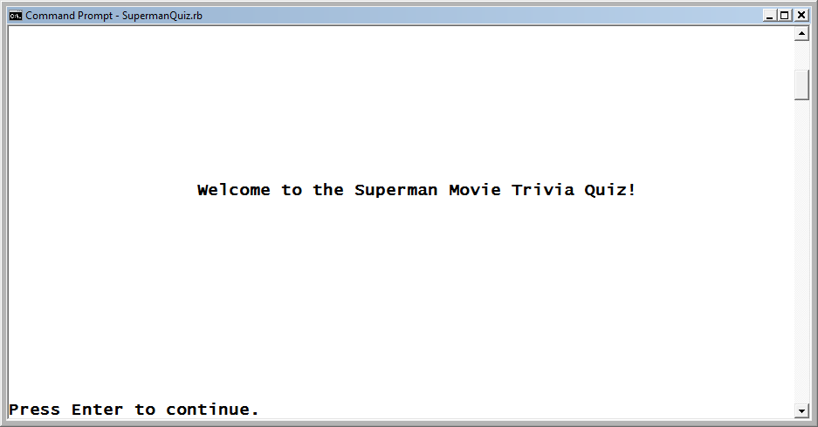
The Superman Movie Trivia Quiz (continued)
This Ruby script demonstrates how to collect player input through the creation of an interactive quiz. The game begins by displaying a welcome screen.
Figure 5-1
The welcome screen for the Superman Movie Trivia Quiz.
Ruby Programming

Slide 5
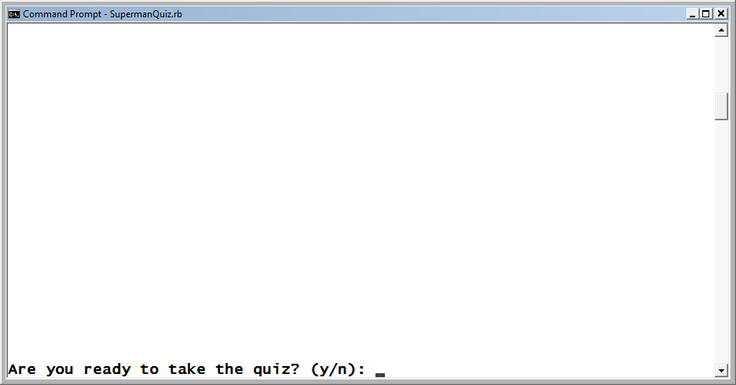
The Superman Movie Trivia Quiz (continued)
The player is prompted for permission to begin the quiz.
Figure 5-2
The player must decide to play before the quiz can begin.
Ruby Programming

Slide 6
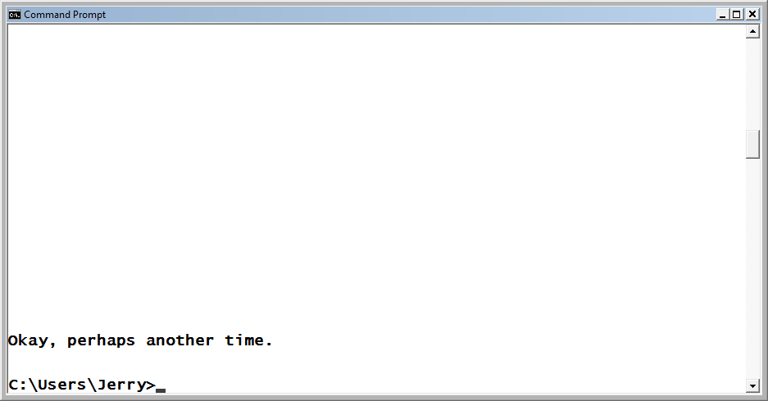
The Superman Movie Trivia Quiz (continued)
If the player decides not to play, a message is displayed, encouraging the player to take the quiz another day.
Figure 5-3
The player is encouraged to take the quiz some other time.
Ruby Programming

Slide 7
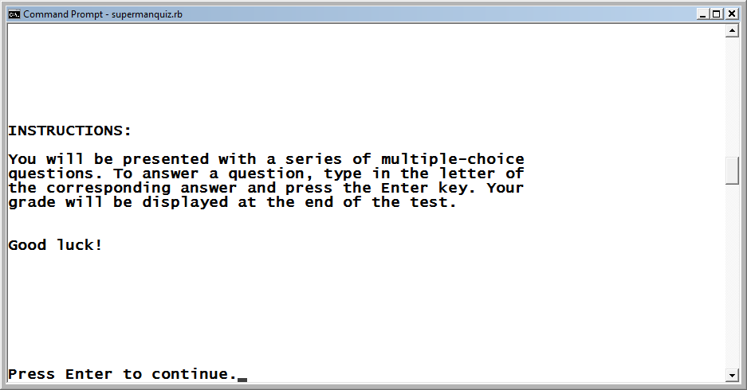
The Superman Movie Trivia Quiz (continued)
If the player elects to take the quiz, instructions are displayed.
Figure 5-4
Instructions for how to play are provided.
Ruby Programming

Slide 8
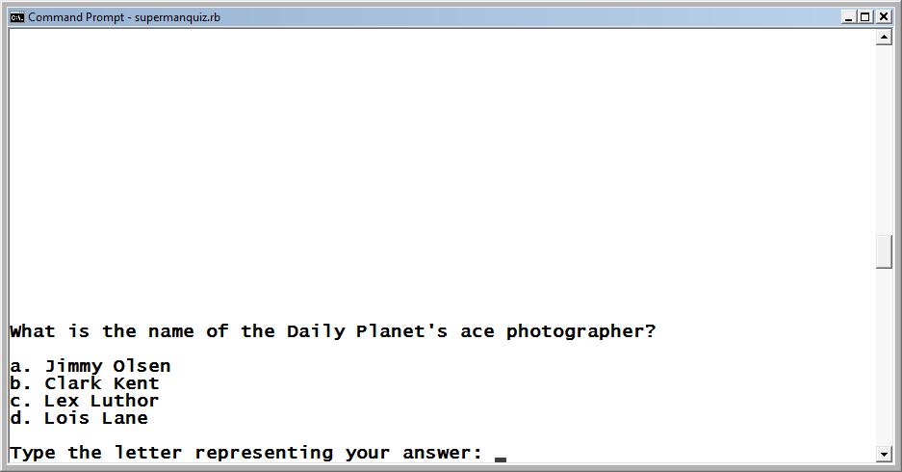
The Superman Movie Trivia Quiz (continued)
The first of five questions is displayed, and the player is prompted to specify an answer.
Figure 5-5
All the quiz questions are multiple choice.
Ruby Programming

Slide 9
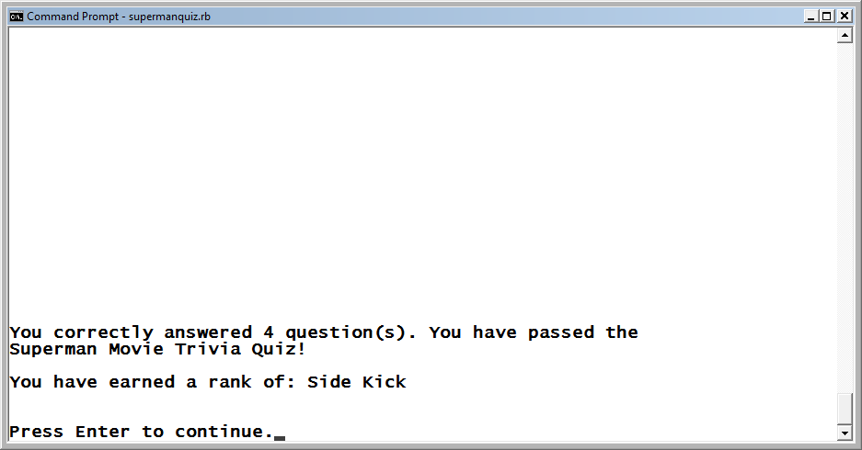
The Superman Movie Trivia Quiz (continued)
Once a valid answer is provided, the game evaluates the answer and displays another question. At the end of the quiz, a message is displayed that indicates the result. If the player passes, a rank is assigned.
Figure 5-6
The player has passed the quiz by correctly answering four questions.
Ruby Programming

Slide 10
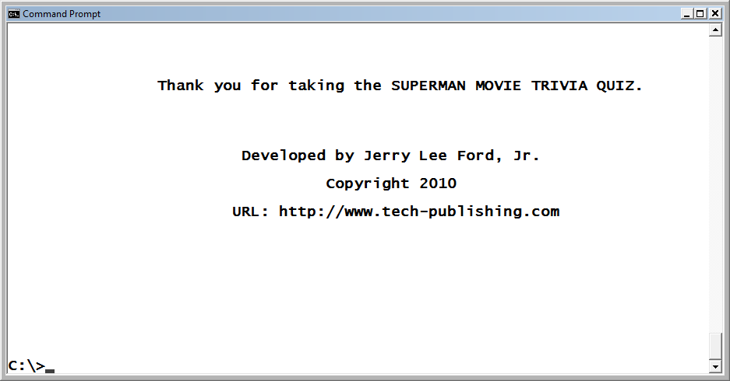
The Superman Movie Trivia Quiz (continued)
Once the player presses the Enter key, the game ends by displaying a thank you message.
Figure 5-7
The Superman Movie Trivia Quiz’s closing screen thanks the player for
taking the quiz.
Ruby Programming

Slide 11
Understanding Loops
Ruby Programming

Slide 12
Understanding Loops (continued)
A loop is a collection of statements that execute repeatedly as a unit.
Loops facilitate the processing of large text files or the collection of unlimited amounts of user input.
Loops also provide the ability to develop scripts that can repeat the execution of any number of commands.
Ruby supports several types of loops, including:
- Language constructs: Commands that are part of the core Ruby
scripting language.
- Modifiers: A modifier appended to the end of a Ruby statement to
repeat the statement until a specified condition is met.
- Methods: Loops provided as methods associated with specific
objects.
Ruby Programming

Slide 13
Using Language Constructs to Create Loops
Ruby Programming

Slide 14
Using Language Constructs to Create Loops (continued)
Ruby supports three types of loops provided as part of the core programming language.
while
until
for
Ruby Programming

Slide 15
Working with while Loops
The while loop is a loop that executes as long as a tested condition is true. The syntax for this loop is outlined here:
while Expression [ do | : ]
Statements
end
Ruby Programming

Slide 16
Working with while Loops (continued)
Example
x = 1
while x <= 5 do
puts x
x += 1
end
Output
1
2
3
4
5
Ruby Programming

Slide 17
Working with until Loops
The until loop is pretty much the opposite of the while loop. The until loop executes until the tested condition becomes true.
until Expression [ do | : ]
Statements
end
Ruby Programming

Slide 18
Working with until Loops (continued)
Example
x = 1
until x >= 5 do
puts x
x += 1
end
Result
1
2
3
4
5
Ruby Programming

Slide 19
Working with for…in Loops
The for…in loop is designed to process collections of data.
for Variable in Expression [ do | : ]
Statements
End
Principles of

Slide 20
Working with for…in Loops (continued)
Example
MyList = ["Molly", "William", "Alexander", "Jerry", "Mary"]
for x in MyList
print "Hi ", x, "!\n"
end
Output
Hi Molly!
Hi William!
Hi Alexander!
Hi Jerry!
Hi Mary!
Ruby Programming

Slide 21
Using Loop Modifiers
Ruby Programming

Slide 22
Using Loop Modifiers (continued)
A loop modifier is an expression added to the end of another Ruby statement.
Loop modifiers execute the statements to which they are attached as loops.
Ruby supports both while and until loop modifiers.
Loop modifiers are perfect for repeating the execution of a single statement.
Ruby Programming

Slide 23
The while Modifier
The while modifier evaluates a Boolean expression and then conditionally executes the statement to which is has been appended as long as that condition remains true.
Expression while Condition
Example
counter = 1
counter += 1 while counter < 10
puts counter
Ruby Programming

Slide 24
The until Modifier
The until modifier executes the statement to which it has been appended repeatedly until a specified condition is evaluated as being true.
Expression until Condition
Example
counter = 1
counter += 1 until counter < 10
puts counter
Ruby Programming

Slide 25
Executing Looping Methods
Ruby Programming

Slide 26
Executing Looping Methods (continued)
Ruby supports a number of looping methods belonging to various classes.
These methods simplify loop construction and help to eliminate the chance of errors that sometimes occur when working with built-in language looping constructions
Looping methods include:
- each
- times
- upto
- downto
- step
- loop
Ruby Programming

Slide 27
Working with the each Method
The each method is supported by a number of different Ruby classes, including the Array, Dir, Hash, and Range classes.
Object.each { |i| Statement }
Example
MyList = ["Molly", "William", "Alexander", "Jerry", "Mary"]
MyList.each do |x|
print "Hi ", x, "!\n"
end
Ruby Programming

Slide 28
Working with the times Method
The times method is used to execute a code block a specific number of times. The times method is provided by the Integer class.
Integer.times { |i| Statement }
Example
puts "Watch me count!"
3.times {|x| puts x}
Output
1
2
3
Ruby Programming

Slide 29
Working with the upto Method
The upto method is provided by the Integer class. It generates a loop that iterates a predetermined number of times.
Integer.upto(EndValue) { |i| Statement }
Example
1.upto(5) do |x|
print x, ") Hello!\n"
end
Output
1) Hello!
2) Hello!
3) Hello!
4) Hello!
5) Hello!
Ruby Programming

Slide 30
Working with the downto Method
The downto method is provided by the Integer class. It allows you to set up a loop that iterates a predetermined number of times, starting at a specified integer value and counting down to whatever integer value is passed to it.
Integer.downto(EndValue) { |i| Statement }
Example
3.downto(1) do |x|
print x, ") Hello!\n"
end
puts "That's all folks!“
Output
3) Hello!
2) Hello!
1) Hello!
That's all folks!
Ruby Programming

Slide 31
Working with the step Method
The step method is used to set up loops that execute a predefined number of times. The step method works with the Float and Integer classes.
Number.step(EndNumber, Increment) { |i| Statement }
Example
1.step(10,2) do |x|
print x, ". Counting by 2\n"
end
Output
1. Counting by 2
3. Counting by 2
5. Counting by 2
7. Counting by 2
9. Counting by 2
Ruby Programming

Slide 32
Working with the loop Method
The loop method belongs to the Kernel module. The loop method supports two forms of syntax.
loop { Statement }
and
loop do
Statements
end
Example
counter = 1
loop do
print counter.to_s + " "
counter += 1
break if counter == 10
end
Output
1 2 3 4 5 6 7 8 9
Ruby Programming

Slide 33
Altering Loop Execution
Ruby Programming

Slide 34
Prematurely Terminating Loop Execution
The break command provides the ability to terminate the execution of a loop at any time.
loop do
print "Type q to quit this script. "
answer = STDIN.gets
answer.chop!
break if answer == "q"
end
Principles of

Slide 35
Repeating the Current Execution of a Loop
The redo command forces a loop to repeat without evaluating its condition and without iterating.
i = 1
loop do
puts i
redo if i == 3
i += 1
end
Output
1
2
3
3
3
.
.
.
Ruby Programming

Slide 36
Skipping to the Next Iteration of a Loop
The next command stops the current iteration of the loop and immediately begins a new iteration. Before the new iteration occurs, the loop condition is evaluated. The loop only executes again if the analysis of the loop condition permits it.
for i in 1..5
next if i == 3
puts i
end
Output
1
2
4
5
Ruby Programming

Slide 37
Restarting a Loop from the Beginning
The retry command restarts a loop from the beginning. The value of the loop’s iterator is also reset.
for i in 1..5
puts i
retry if i == 3
end
Output
1
2
3
1
2
3
.
.
.
Ruby Programming

Slide 38
Back to the Superman Movie Trivia Quiz
Ruby Programming

Slide 39
Designing the Game
Follow these steps:
1. Open your text or script editor and create a new file.
2. Add comment statements to the beginning of the script file to document the script and its purpose.
3. Define a class representing the terminal window.
4. Define a class representing the game’s quiz.
5. Add a display_greeting method to the Quiz class.
6. Add a display_instructions method to the Quiz class.
7. Add a disp_q method to the Quiz class.
8. Add a determine_grade method to the Quiz class.
9. Add a display_credits method to the Quiz class.
10. Instantiate script objects.
11. Prompt the player for permission to begin the quiz.
12. Administer the quiz.
Ruby Programming

Slide 40
Step 1: Creating a New Ruby File
1. Open code editor and create a new file.
2. Save the file with a name of SupermanQuiz.rb.
Ruby Programming

Slide 41
Step 2: Documenting the Script and Its Purpose
#--------------------------------------------------------
#
# Script Name: SupermanQuiz.rb
# Version: 1.0
# Author: Jerry Lee Ford, Jr.
# Date: March 2010
#
# Description: This Ruby script demonstrates how to
# work with loops when collecting user
# input through the creation of an
# interactive quiz that evaluates the
# player’s knowledge of the Superman movie
# series.
#
#--------------------------------------------------------
Ruby Programming

Slide 42
Step 3: Define a Class Representing the Console Window
# Define custom classes -----------------------------------------
#Define a class representing the console window
class Screen
def cls #Define a method that clears the display area
puts ("\n" * 25) #Scroll the screen 25 times
puts "\a" #Make a little noise to get the player's attention
end
def pause #Define a method that pauses the display area
STDIN.gets #Execute the STDIN class's gets method to pause
#script execution until the player presses the
#Enter key
end
end
Ruby Programming

Slide 43
Step 4: Define a Class Representing the Quiz
The second class definition that you need to add to your new Ruby script is the Quiz class. This class will be used to represent the game’s quiz and will contain methods used to administer and control the delivery of the quiz.
#Define a class representing the Superman Movie Trivia Quiz
class Quiz
end
Ruby Programming

Slide 44
Step 5: Define the display_greeting Method
#This method displays the quiz's opening screen
def display_greeting
Console_Screen.cls #Clear the display area
#Display a welcome message
print "\t\t Welcome to the Superman Movie Trivia Quiz!" +
"\n\n\n\n\n\n\n\n\n\n\n\n\n\nPress Enter to " +
"continue."
Console_Screen.pause #Pause the game
end
Ruby Programming

Slide 45
Step 6: Define the display_instructions Method
#Define a method to be used to present quiz instructions
def display_instructions
Console_Screen.cls #Clear the display area
puts "INSTRUCTIONS:\n\n" #Display a heading
#Display the game's instructions
puts "You will be presented with a series of multiple choice"
puts "questions. To answer a question, type in the letter of"
puts "the corresponding answer and press the Enter key. Your"
puts "grade will be displayed at the end of the test.\n\n\n"
puts "Good luck!\n\n\n\n\n\n\n\n\n"
print "Press Enter to continue.“
Console_Screen.pause #Pause the game
end
Ruby Programming

Slide 46
Step 7: Define the disp_q Method
#Define a method to be used to present and process quiz questions
def disp_q(question, q_A, q_B, q_C, q_D, answer)
#Loop until the player inputs a valid answer
loop do
Console_Screen.cls #Clear the display area
#Format the display of the quiz question
puts question + "\n\n"
puts q_A
puts q_B
puts q_C
puts q_D
print "\nType the letter representing your answer: "
reply = STDIN.gets #Collect the player's answer
reply.chop! #Remove the end of line marker
Ruby Programming

Slide 47
Step 7: Define the disp_q Method (continued)
#Analyze the player's input to determine if it is correct
if answer == reply then
#Keep track of the number of correctly answered questions
$noRight += 1
end
#Analyze the answer to determine if it was valid
if reply == "a" or reply == "b" or reply == "c" or reply == "d" then
break #Terminate the execution of the loop
end
end
end
Ruby Programming

Slide 48
Step 8: Define the determine_grade Method
#Define a method to be used to grade and display quiz results
def determine_grade
Console_Screen.cls #Clear the display area
#To pass the test, the player must correctly answer 3 questions
if $noRight >= 3 then
#Inform the player of the good news and assign a ranking
print "You correctly answered " + $noRight.to_s + " question(s). "
puts "You have passed the Superman Movie Trivia Quiz!\n\n"
puts "You have earned a rank of: Good Citizen" if $noRight == 3
puts "You have earned a rank of: Side Kick" if $noRight == 4
puts "You have earned a rank of: Superhero" if $noRight == 5
print "\n\nPress Enter to continue."
Ruby Programming

Slide 49
Step 8: Define the determine_grade Method (continued)
else #The player has failed the quiz
#Inform the player of the bad news
print "You missed " + (5 - $noRight).to_s + " questions. "
puts "You have failed the Superman Movie Trivia Quiz."
puts "Perhaps you should watch the movies again before returning to"
puts "retake the quiz"
print "\n\nPress Enter to continue."
end
Console_Screen.pause #Pause the game
end
Ruby Programming

Slide 50
Step 9: Define the display_credits Method
#This method displays the information about the Superman Movie
#Trivia Quiz
def display_credits
Console_Screen.cls #Clear the display area
#Thank the player and display game information
puts "\t\tThank you for taking the SUPERMAN MOVIE TRIVIA QUIZ." +
"\n\n\n\n"
puts "\n\t\t\t Developed by Jerry Lee Ford, Jr.\n\n"
puts "\t\t\t\t Copyright 2010\n\n"
puts "\t\t\tURL: http://www.tech-publishing.com\n\n\n\n\n\n\n\n\n\n"
end
Ruby Programming

Slide 51
Step 10: Initializing Script Objects
# Main Script Logic --------------------------------------------------
#Initialize global variable that will be used to keep track of the
#number of correctly answered quiz questions
$noRight = 0
Console_Screen = Screen.new #Instantiate a new Screen object
SQ = Quiz.new #Instantiate a new Quiz object
#Execute the Quiz class's display_greeting method
SQ.display_greeting
Ruby Programming

Slide 52
Step 11: Getting Permission to Start the Quiz
answer = ""
#Loop until the player enters y or n and do not accept any other
#input.
loop do
Console_Screen.cls #Clear the display area
#Prompt the player for permission to start the quiz
print "Are you ready to take the quiz? (y/n): “
answer = STDIN.gets #Collect the player's response
answer.chop! #Remove any extra characters appended to the string
break if answer == "y" || answer == "n"
end
Ruby Programming

Slide 53
Step 12: Administering the Quiz
#Analyze the player's input
if answer == "n" #See if the player elected not to take the quiz
Console_Screen.cls #Clear the display area
#Invite the player to return and take the quiz some other time
puts "Okay, perhaps another time.\n\n"
else #The player wants to take the quiz
#Execute the Quiz class's display_instructions method
SQ.display_instructions
#Execute the Quiz class's disp_q method and pass it
#arguments representing a question, possible answers and the letter
#of the correct answer
SQ.disp_q("What is the name of the Daily Planet's ace photographer?",
"a. Jimmy Olsen", "b. Clark Kent", "c. Lex Luthor", "d. Louis Lane",
"a")
Ruby Programming

Slide 54
Step 12: Administering the Quiz (continued)
#Call upon the disp_q method and pass it the second question
SQ.disp_q("What is the name of Clark Kent's home town?",
"a. Metropolis", "b. Gotham City", "c. Smallville", "d. New York",
"c")
#Call upon the disp_q method and pass it the third question
SQ.disp_q("In which movie did Superman battle General Zod?",
"a. Superman", "b. Superman II", "c. Superman III", "d. Superman IV",
"b")
#Call upon the disp_q method and pass it the fourth question
SQ.disp_q("What is the name of Superman's father?",
"a. Nimo", "b. Jarrell", "c. Lex Luthor", "d. Krypton",
"b")
Ruby Programming

Slide 55
Step 12: Administering the Quiz (continued)
#Call upon the disp_q method and pass it the fifth question
SQ.disp_q("Where had Superman been at the start of 'Superman Returns'?",
"a. Moon", "b. Fortress of Solitude", "c. Earth's Core", "d. Krypton",
"d")
#Call upon the Quiz class's determine grade method to display
#the player's grade and assigned rank
SQ.determine_grade
#Call upon the Quiz class's determine grade method to thank
#the player for taking the quiz and to display game information
SQ.display_credits
end
Ruby Programming

Slide 56
Running Your New Ruby Script Game
Save your Ruby script.
Access the command prompt and navigate to the folder where you saved the script.
Enter the following command and press the Enter key.
  ruby SupermanQuiz.rb
Ruby Programming

Slide 57
Summary
The chapter demonstrated how to:
Use language constructs to create loops
Use loop modifiers
Execute looping methods
Alter loop execution
Create the Superman Movie Trivia Quiz
Ruby Programming

