Slide 1
Chapter 6
Working with Collections of Data
Ruby Programming

Slide 2
Objectives
In this chapter, you:
Store and manipulate lists using arrays
Replace and add array items
Retrieve items from arrays
Store and manipulate lists using hashes
Add hash key-value pairs
Delete hash key-value pairs
Retrieve data stored in hashes
Create the Ruby Number Guessing game
Ruby Programming

Slide 3
Project Preview: The Ruby Number Guessing Game
Ruby Programming

Slide 4
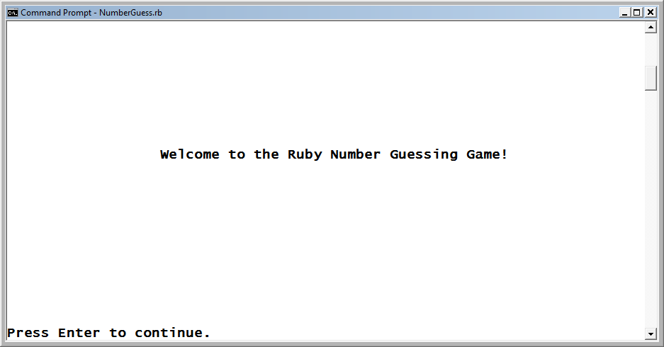
The Ruby Number Guessing Game (continued)
This game challenges the player to guess a randomly generated number from 1 to 100 in as few guesses as possible. The game begins by displaying a welcome screen.
Figure 6-1
The welcome screen for the Ruby Number Guessing game.
Ruby Programming

Slide 5
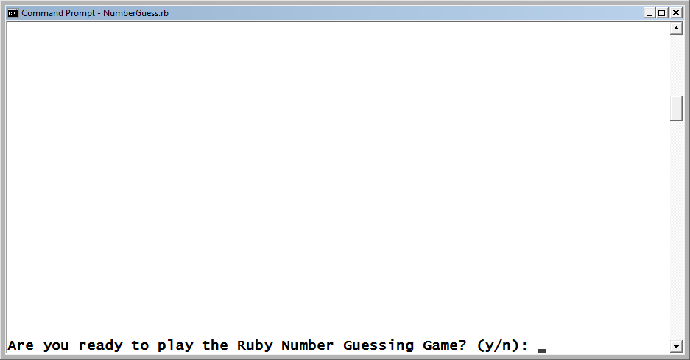
The Ruby Number Guessing Game (continued)
Before starting a new round of play, the game requires that the player provide it with permission to begin.
Figure 6-2
The game prompts the player for permission to begin.
Ruby Programming

Slide 6
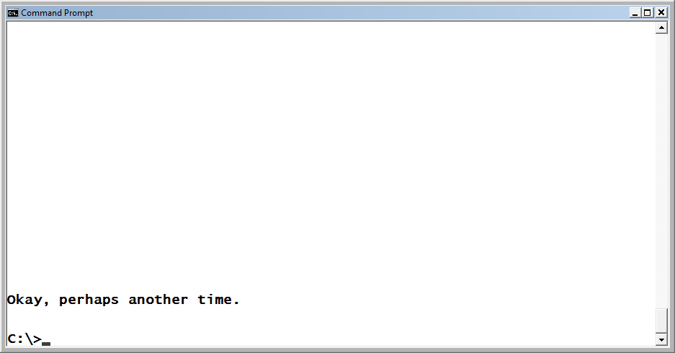
The Ruby Number Guessing Game (continued)
To begin playing, the player must respond by typing a y and pressing the Enter key. Alternatively, the player can enter a value of n to instruct the game to terminate.
Figure 6-3
The player is encouraged to play another time.
Ruby Programming

Slide 7
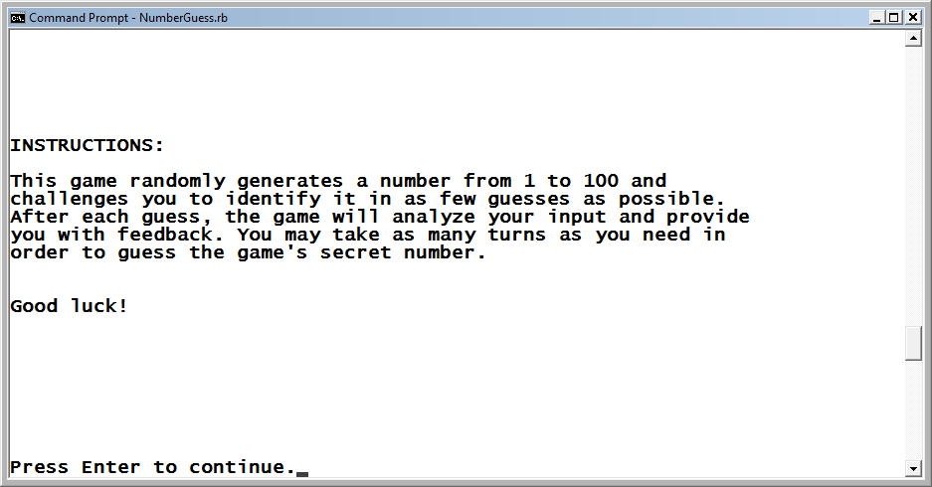
The Ruby Number Guessing Game (continued)
Instructions are displayed when the player has elected to play the game.
Figure 6-4
The game provides the player with instructions on how to play.
Ruby Programming

Slide 8
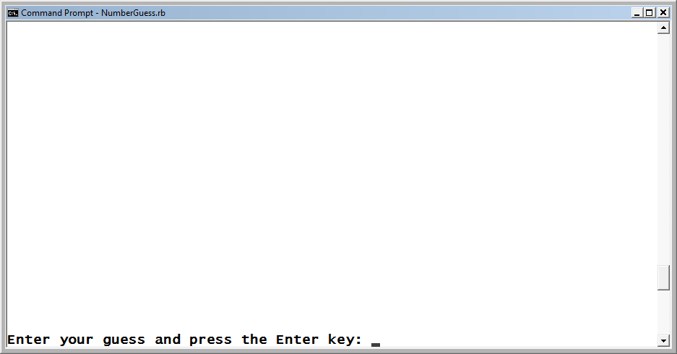
The Ruby Number Guessing Game (continued)
Once the player has read and dismissed the instructions by pressing the Enter key, game play begins and the player is prompted to make an initial guess.
Figure 6-5
The player is prompted to enter a guess.
Ruby Programming

Slide 9
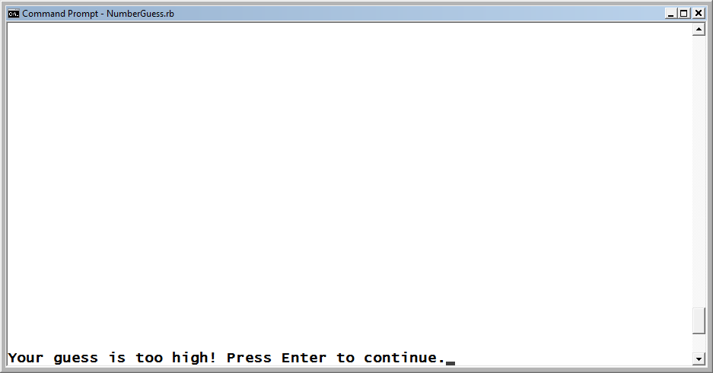
The Ruby Number Guessing Game (continued)
After each guess, the game provides the player with a hint that will help him hone in on the game’s secret number. In this case, the player’s guess is too high.
Figure 6-6
The game notifies the player that the guess is too high.
Ruby Programming

Slide 10
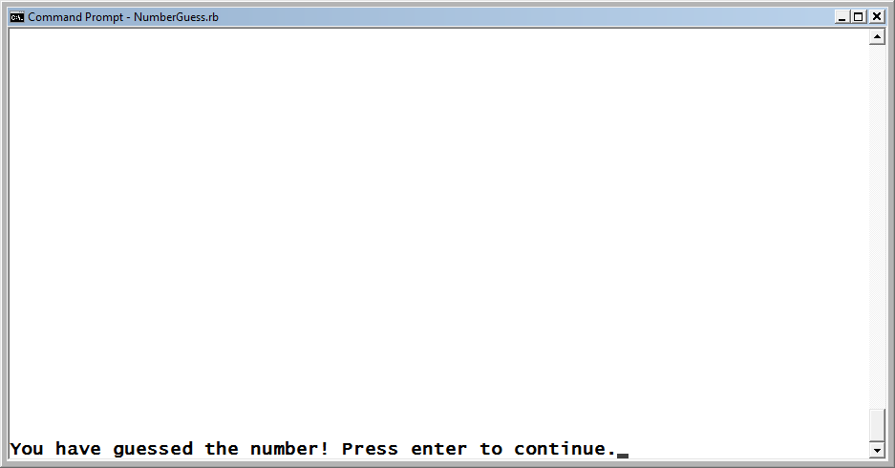
The Ruby Number Guessing Game (continued)
The player may make as many guesses as are necessary to finally guess the game’s secret number. Once the player guesses the secret number, game play ends.
Figure 6-7
The player has won the game by guessing the number.
Ruby Programming

Slide 11
Storing and Manipulating Lists Using Arrays
Ruby Programming

Slide 12
Options For Managing Data Collections
As scripts grow more complex, the amount of data that is managed becomes too large to be effectively managed using variables.
Since this data is usually related, it can often be managed using lists.
In Ruby, lists can be managed and stored using one of the following structures:
  Arrays
  Hashes
Ruby Programming

Slide 13
Working with Lists and Arrays
A list is a collection of data.
Lists are created as comma-separated items.
Lists can be used as the basis for populating arrays.
An array is an indexed list of items.
Array indexes begin at 0 and are incremented by 1 each time a new item is added.
Index numbers can only be whole numbers (integers).
Arrays are simply viewed as another type of object.
Ruby Programming

Slide 14
Working with Lists and Arrays (continued)
Ruby arrays have an initial element, a final element, and any number of elements in between.
Once added to an array, an array element can be referred to by specifying its index position within the array.
VariableName = [Elements]
Example:
x = [2, 4, 6, 8, 10]
You can use the inspect method to view an array’s contents.
irb(main):001:0> puts x.inspect
[2, 4, 6, 8, 10]
Ruby Programming

Slide 15
Managing Data Using Arrays
One way to create an array is to assign a list to it.
children = ["Alexander", "William", "Molly"]
Another option for creating arrays is to use the %w( and ) characters.
children = %w(Alexander William Molly)
Arrays can also be created using the new method.
x = Array.new
Ruby Programming

Slide 16
Managing Data Using Arrays (continued)
New arrays can also be created by assigning the contents of one array to another array.
x = [1, 2, 3]
y = x
New arrays can be created by adding two existing arrays together.
x = [1, 2, 3]
y = [4, 5, 6]
z = x + y
Ruby Programming

Slide 17
Replacing and Adding Array Items
Ruby permits the retrieval or modification of array contents by specifying the index number of the item to be replaced or added.
arrayname[indexNo]
Retrieval:
children = ["Alexander", "William", "Molly"]
children[2] = "Mighty One"
puts children.inspect
Assignment:
children = ["Alexander", "William", "Molly"]
children[3] = "Dolly"
puts children.inspect
Ruby Programming

Slide 18
Replacing and Adding Array Items (continued)
Using the << method, you can add elements to an array by pushing them onto the end of the array.
Names = []
Names << "Alexander"
Names << "William"
Names << "Molly"
New items can also be added to the end of an array using the push method.
Names = []
Names.push("Alexander")
Names.push("William")
Names.push("Molly")
Ruby Programming

Slide 19
Determining if an Array Is Empty
Before working with an array, it’s a good idea to check to see if anything is in it. This can be accomplished using the Array class’s length or size methods to see if the value that they return is equal to zero.
The empty? method can also be used to determine if an array is empty. This method returns a value of true if an array is empty and false if it contains at least one element.
if children.empty? == false then
children.each {|child| puts child}
else
puts "The children array is empty"
end
Ruby Programming

Slide 20
Retrieving Items from an Array
Ruby provides you with a host of different ways to access data stored in an array.
You can retrieve any item located in an array by specifying the name of the array followed by the index number where the item is stored.
children = ["Alexander", "William", "Molly"]
middleChild = children[1]
You can also use the Array class’s at method to retrieve an array item based on its index position.
children = %w(Alexander William Molly)
puts children.at(1)
Ruby Programming

Slide 21
Retrieving Items from an Array (continued)
You can use the Array class’s slice method to retrieve a series of elements, referred to as a slice, from an array by enclosing a list or range of index numbers within a pair of parentheses.
children = %w(Alexander William Molly)
boys = children.slice(0..1)
The first method retrieves the first element from the specified array.
children = %w(Alexander William Molly)
puts children.first
Ruby Programming

Slide 22
Using a Loop to Iterate Through the Contents of an Array
The last method retrieves the last element from the specified array.
children = %w(Alexander William Molly)
puts children.last
While you can certainly use the while and until loop for processing the contents of a loop, the Array class’s each method is tailor-made for processing loops.
children = %w(Alexander William Molly)
children.each do |child|
puts child
end
Ruby Programming

Slide 23
Deleting Items from an Array
Ruby provides you with a number of different methods that you can use to delete items stored in arrays.
Use the Array class’s clear method to delete all items stored in an array.
children = %w(Alexander William Molly)
children.clear
Use the Array class’s shift method to delete the first element stored in an array, shifting the index number of all remaining items’ elements down by one index position.
children = %w(Alexander William Molly)
x = children.shift
puts children.inspect
Ruby Programming

Slide 24
Deleting Items from an Array (continued)
You can delete an item from the end of an array using the Array class’s pop method.
family = %w(Alexander William Molly Daddy Mommy)
family.pop
family.pop
puts family.inspect
You may also to delete items based on their value using the Array class’s delete method.
fruit = %w(Apples Oranges Bananas Oranges Grapes)
fruit.delete("Oranges")
Ruby Programming

Slide 25
Deleting Items from an Array (continued)
The delete_at method is used to delete an item from an array based on its index position.
fruit = %w(Apples Oranges Bananas Oranges Grapes)
fruit.delete_at(3)
Ruby Programming

Slide 26
Sorting the Contents of an Array Alphabetically
By default, items are in an array based on the order in which they are added.
You may end up with a list of items that are not in a desired order.
Use the Array class’s sort method to sort the contents of the array.
fruit = %w(Apples Oranges Bananas Grapes)
puts fruit.sort.inspect
Ruby Programming

Slide 27
Sorting the Contents in Reverse Alphabetical Order
The Array class’s reverse method reverses the order of array items after they have been sorted.
fruit = %w(Apples Oranges Bananas Grapes)
puts fruit.sort.reverse.inspect
Result:
["Oranges", "Grapes", "Bananas", "Apples"]
Ruby Programming

Slide 28
Searching an Array
One way to find something stored in an array is to set up a loop to iterate through the array looking for it.
Another option is to use the Array class’s include? method to check and see if the array contains any instances of the item you are looking for.
children = %w(Alexander William Molly)
puts "I found him!" if children.include?("William")
Ruby Programming

Slide 29
Storing and Manipulating Lists Using Hashes
Ruby Programming

Slide 30
Storing Data Using Unique Keys
As arrays grow in size, it becomes difficult trying to keep up with the index positions where individual items are stored.
As an alternative to arrays, Ruby also supports the storage and retrieval of data using hashes.
A hash, sometimes referred to as an associative array or dictionary in other programming languages, is a list of data stored in key-value pairs.
Each piece of data stored in a hash is stored as a value and assigned a key, which uniquely identifies the data.
Instead of referencing data stored using an index position, as with arrays, you reference values by specifying their assigned keys.
Ruby Programming

Slide 31
Creating a Hash
The syntax that you need to follow when creating a hash and populating it with an initial set of key-value pairs is outlined here:
variableName = {key => value, key => value, ... key => value}
Example:
kids = {"first" => "Alex", "second" => "Will", "third" => "Molly"}
Ruby Programming

Slide 32
Creating a Hash (continued)
The previous example can be rewritten and spread across multiple lines to make is easier to expand.
kids = {"first" => "Alexander",
"second" => "William",
"third" => "Molly"
}
A hash can also be created using the Hash class’s new method.
kids = Hash.new
Ruby Programming

Slide 33
Adding a Hash’s Key-Value Pairs
You can add as many key-value pairs as you want to a hash using the following syntax.
hashVariable[key] = value
Example:
kids = {"first" => "Alex", "second" => "Will", "third" => "Molly"}
kids["fourth"] = "Dolly"
kids["fifth"] = "Regis"
Ruby Programming

Slide 34
Adding a Hash’s Key-Value Pairs (continued)
Another way to create a hash is to copy the contents of one hash into a new hash, as demonstrated here:
kids = {"first" => "Alex", "second" => "Will", "third" => "Molly"}
family = kids
You also can use the Hash class’s merge method to create a new hash based on the contents of two existing hashes.
kids = {"first" => "Alex", "second" => "Will", "third" => "Molly"}
parents = {"daddy" => "Jerry", "mommy" => "Mary"}
family = kids.merge(parents)
Ruby Programming

Slide 35
Deleting a Hash’s Key-Value Pairs
The Hash class’s clear method removes all key-value pairs from a hash.
kids = {"first" => "Alex", "second" => "Will", "third" => "Molly"}
kids.clear
Ruby Programming

Slide 36
Deleting a Hash’s Key-Value Pairs (continued)
The Hash class’s delete method removes a key-value pair from a hash.
kids = {"first" => "Alex", "second" => "Will", "third" => "Molly"}
kids.delete("second")
The Hash class’s delete_if method is used to delete key-value pairs from a hash.
kids = {"first" => "Alex", "second" => "Will", "third" => "Molly"}
kids.delete_if {|key, value| key >= "third"}
Ruby Programming

Slide 37
Determining the Number of Key-Value Pairs in a Hash
Use the Hash class’s empty? method to determine if a hash contains any key-value pairs. The method returns a value of true if the specified hash contains no key-value pairs.
kids = {"first" => "Alex", "second" => "Will", "third" => "Molly"}
if kids.empty? == false then
puts kids.inspect
else
puts "The kids hash is empty"
end
Ruby Programming

Slide 38
Retrieving Data Stored in Hashes
Data is extracted from a hash in very much the same way that it is extracted from an array, only you specify a key instead of an index number.
kids = {"first" => "Alex", "second" => "Will", "third" => "Molly"}
x = kids["third"]
Ruby Programming

Slide 39
Retrieving Data Stored in Hashes (continued)
Hashes are not indexed and cannot be processed with a loop like an array.
Ruby provides you a way around this hash limitation by providing you with access to the keys method.
The keys method creates a list of all the keys stored within a specified hash. Using this list, you can set up a loop to iterate through and process the hash’s keys.
kids = {"first" => "Alex", "second" => "Will", "third" => "Molly"}
puts "\n\nKeys belonging to the kids hash:\n\n"
kids.keys.each do |child|
puts child
end
Ruby Programming

Slide 40
Sorting Hash Keys
Hashes are unordered, storing their key-value pairs in no particular order.
However, you can use the keys method’s output to the sort method prior to looking through a hash’s keys.
kids = {"first" => "Alex", "second" => "Will", "third" => "Molly"}
kids.keys.sort.each do |child|
puts child
end
Ruby Programming

Slide 41
Back to the Number Guessing Game
Ruby Programming

Slide 42
Designing the Game
Follow these steps:
1. Open your text or script editor and create a new file.
2. Add comment statements to the beginning of the script file to document the script and its purpose.
3. Define a class representing the terminal window.
4. Define a class representing the Ruby Number Guessing game.
5. Add a display_greeting method to the Game class.
6. Add a display_instructions method to the Game class.
7. Add a generate_number method to the Game class.
8. Add a play_game method to the Game class.
9. Add a display_credits method to the Game class.
10. Instantiate script objects.
11. Prompt the player for permission to begin the game.
12. Set up the game’s controlling logic.
Ruby Programming

Slide 43
Step 1: Create a New Ruby File
1. Open code editor and create a new file.
2. Save the file with a name of NumberGuessing.rb.
Ruby Programming

Slide 44
Step 2: Document the Script and Its Purpose
#--------------------------------------------------------
#
# Script Name: NumberGuess.rb
# Version: 1.0
# Author: Jerry Lee Ford, Jr.
# Date: March 2010
#
# Description: This Ruby script is a number guessing game
# that challenges the player to guess a
# randomly generated number in as few
# guesses as possible.
#
#--------------------------------------------------------
Ruby Programming

Slide 45
Step 3: Define the Screen Class
# Define custom classes -----------------------------------------
#Define a class representing the console window
class Screen
def cls #Define a method that clears the display area
puts ("\n" * 25) #Scroll the screen 25 times
puts "\a" #Make a little noise to get the player's attention
end
def pause #Define a method that pauses the display area
STDIN.gets #Execute the STDIN class's gets method to pause
#script execution until the player presses the
#Enter key
end
end
Ruby Programming

Slide 46
Step 4: Define the Game Class
The second class definition that you need to add to your new Ruby script is the Game class. It provides access to five methods that are needed to control the overall execution of the game.
#Define a class representing the Ruby Number #Guessing Game
class Game
end
Ruby Programming

Slide 47
Step 5: Define the display_greeting Method
#This method displays the game's opening screen
def display_greeting
Console_Screen.cls #Clear the display area
#Display welcome message
print "\t\t Welcome to the Ruby Number Guessing Game!" +
"\n\n\n\n\n\n\n\n\n\n\n\n\n\nPress Enter to " +
"continue.“
Console_Screen.pause #Pause the game
end
Ruby Programming

Slide 48
Step 6: Define the display_instructions Method
#Define a method to be used to present game instructions
def display_instructions
Console_Screen.cls #Clear the display area
puts "INSTRUCTIONS:\n\n" #Display a heading
#Display the game's instructions
puts "This game randomly generates a number from 1 to 100 and"
puts "challenges you to identify it in as few guesses as possible."
puts "After each guess, the game will analyze your input and provide"
puts "you with feedback. You may take as many turns as you need in"
puts "order to guess the game's secret number.\n\n\n"
puts "Good luck!\n\n\n\n\n\n\n\n\n“
print "Press Enter to continue.“
Console_Screen.pause #Pause the game
end
Ruby Programming

Slide 49
Step 7: Define the generate_number Method
#Define a method that generates the game's secret number
def generate_number
#Generate and return a random number from 1 to 100
return randomNo = 1 + rand(100)
end
Ruby Programming

Slide 50
Step 8: Define the play_game Method
#Define a method to be used to control game play
def play_game
#Call on the generate_number method to get a random number
number = generate_number
#Loop until the player inputs a valid answer
loop do
Console_Screen.cls #Clear the display area
#Prompt the player to make a guess
print "\nEnter your guess and press the Enter key: “
reply = STDIN.gets #Collect the player's answer
reply.chop! #Remove the end of line marker
reply = reply.to_i #Convert the player's guess to an integer
#Validate the player's input only allowing guesses from 1 to 100
if reply < 1 or reply > 100 then
redo #Redo the current iteration of the loop
end
Ruby Programming

Slide 51
Step 8: Define the play_game Method (continued)
#Analyze the player's guess to determine if it is correct
if reply == number then #The player's guess was correct
Console_Screen.cls #Clear the display area
print "You have guessed the number! Press Enter to continue."
Console_Screen.pause #Pause the game
break
elsif reply < number then #The player's guess was too low
Console_Screen.cls #Clear the display area
print "Your guess is too low! Press Enter to continue."
Console_Screen.pause #Pause the game
elsif reply > number then #The player's guess was too high
Console_Screen.cls #Clear the display area
print "Your guess is too high! Press Enter to continue."
Console_Screen.pause #Pause the game
end
end
end
Ruby Programming

Slide 52
Step 9: Define the display_credits Method
#This method displays the information about the Ruby Number Guessing
#game
def display_credits
Console_Screen.cls #Clear the display area
#Thank the player and display game information
puts "\t\tThank you for playing the Ruby Number Guessing Game.\n\n\n\n"
puts "\n\t\t\t Developed by Jerry Lee Ford, Jr.\n\n"
puts "\t\t\t\t Copyright 2010\n\n"
puts "\t\t\tURL: http://www.tech-publishing.com\n\n\n\n\n\n\n\n\n\n"
end
Ruby Programming

Slide 53
Step 10: Initialize Script Objects
# Main Script Logic ------------------------------------------------
#Initialize a global variable that will be used to keep track of the
#number of correctly answered quiz questions
$noRight = 0
Console_Screen = Screen.new #Instantiate a new Screen object
SQ = Game.new #Instantiate a new Quiz object
#Execute the Quiz class's display_greeting method
SQ.display_greeting
answer = ""
Ruby Programming

Slide 54
Step 11: Get Permission to Start the Game
#Loop until the player enters y or n and do not accept any other
#input
loop do
Console_Screen.cls #Clear the display area
#Prompt the player for permission to start the quiz
print "Are you ready to play the Ruby Number Guessing Game? (y/n): "
answer = STDIN.gets #Collect the player's response
answer.chop! #Remove any extra characters appended to the string
#Terminate the loop if valid input was provided
break if answer == "y" || answer == "n"
end
Ruby Programming

Slide 55
Step 12: Administering Game Play
#Analyze the player's input
if answer == "n" #See if the player elected not to take the quiz
Console_Screen.cls #Clear the display area
#Invite the player to return and take the quiz some other time
puts "Okay, perhaps another time.\n\n“
else #The player wants to take the quiz
#Execute the Quiz class's display_instructions method
SQ.display_instructions
loop do
#Execute the Quiz class's disp_q method and pass it
#arguments representing a question, four possible answers, and the
#letter representing the correct answer
SQ.play_game
Ruby Programming

Slide 56
Step 12: Administering Game Play (continued)
Console_Screen.cls #Clear the display area
#Prompt the player for permission to start the quiz
print "Would you like to play again? (y/n): “
playAgain = STDIN.gets #Collect the player's response
playAgain.chop! #Remove any extra characters appended to the string
break if playAgain == "n"
end
#Call upon the Quiz class's determine_credits method to thank
#the player for taking the quiz and to display game information
SQ.display_credits
end
Ruby Programming

Slide 57
Running Your New Ruby Script Game
Save your Ruby script.
Access the command prompt and navigate to the folder where you saved the script.
Enter the following command and press the Enter key.
  ruby NumberGuessing.rb
Ruby Programming

Slide 58
Summary
The chapter demonstrated how to:
  Store and manipulate lists using arrays
  Replace and add array items
  Retrieve items from arrays
  Store and manipulate lists using hashes
  Add hash key-value pairs
  Delete hash key-value pairs
  Retrieve data stored in hashes
  Create the Ruby Number Guessing game
Ruby Programming

