Slide 1
Chapter 7
Working with Regular Expressions
Ruby Programming

Slide 2
Objectives
In this chapter, you:
Learn the basics of working with regular expressions
Learn how to match basic patterns
Learn how to work with metacharacters
Examine other uses of regular expressions
Ruby Programming

Slide 3
Project Preview: The Word Guessing Game
Ruby Programming

Slide 4
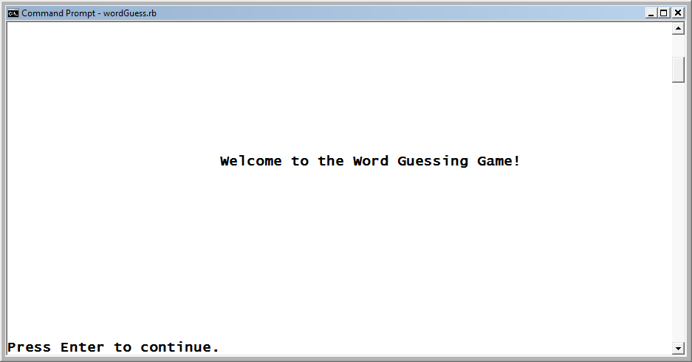
The Word Guessing Game (continued)
This chapter’s project is called the Word Guessing game. This game challenges the player to guess a secret word in three or less guesses.
Figure 7-1
The welcome screen for the Ruby Word Guessing game.
Ruby Programming

Slide 5
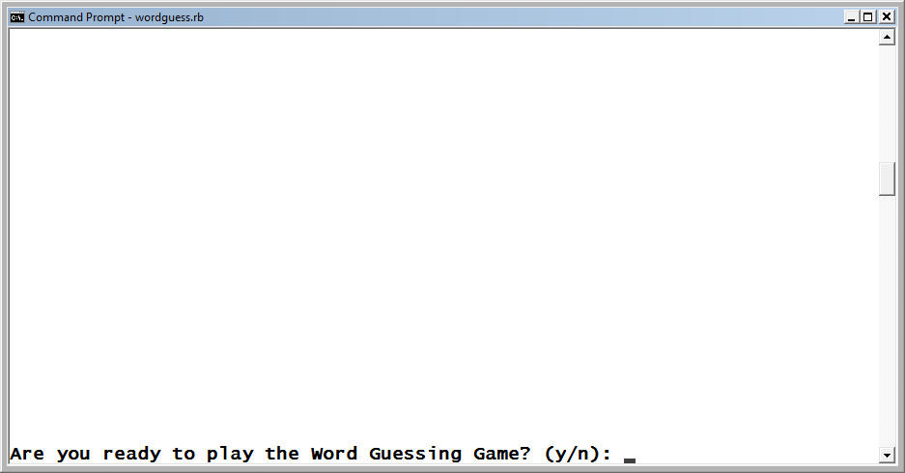
The Word Guessing Game (continued)
The player is allowed to specify five consonants and one vowel, which, if present in the word, are revealed, providing the player with a clue as to the word.
Figure 7-2
The player is prompted for permission to begin the game.
Ruby Programming

Slide 6
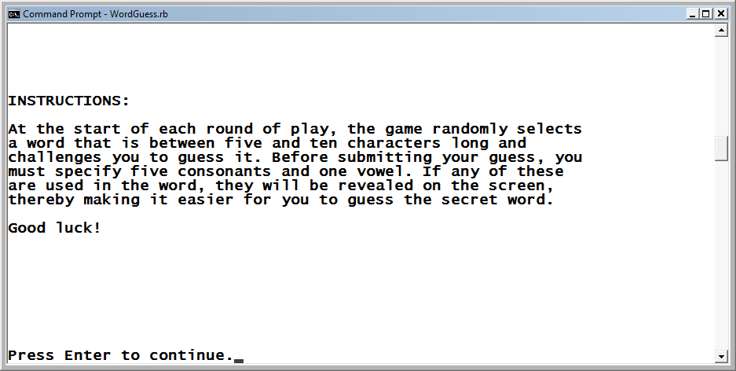
The Word Guessing Game (continued)
Before the first round of play begins, instructions for playing the game are presented.
Figure 7-3
The player is told how to play the game.
Ruby Programming

Slide 7
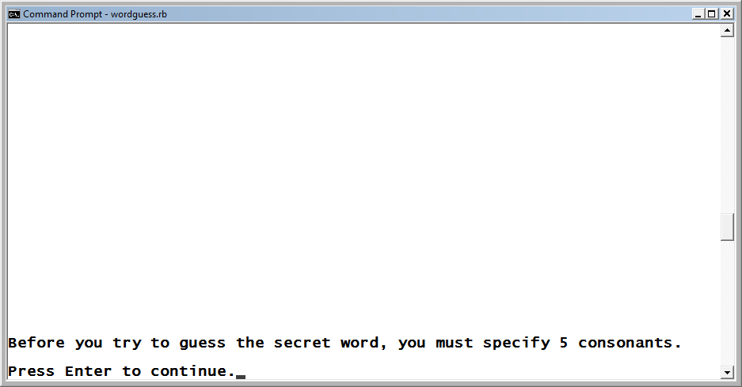
The Word Guessing Game (continued)
The player is asked to specify five consonants.
Figure 7-4
The player is told to specify five consonants before trying to guess the
secret word.
Ruby Programming

Slide 8
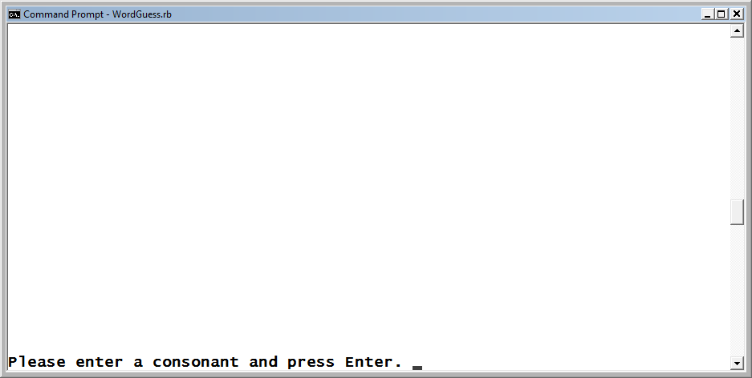
The Word Guessing Game (continued)
Consonants are collected one at a time. If the player attempts to enter a vowel, number, special character, or more than one character at a time, the input is rejected.
Figure 7-5
The player is told to enter a consonant.
Ruby Programming

Slide 9
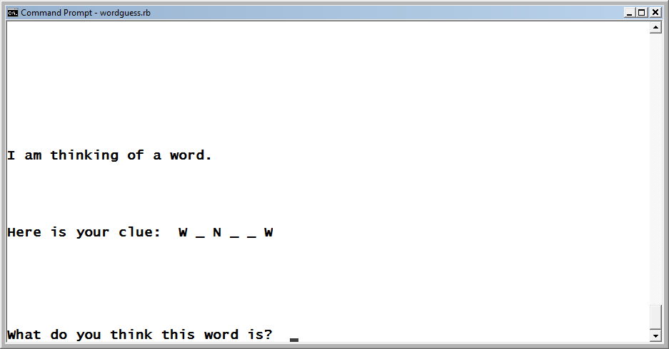
The Word Guessing Game (continued)
Once five consonants have been collected, the player is prompted to specify a vowel, after which the game then displays a clue to its secret word and challenges the player to guess it.
Figure 7-6
The player is given a clue and asked to guess the secret word.
Ruby Programming

Slide 10
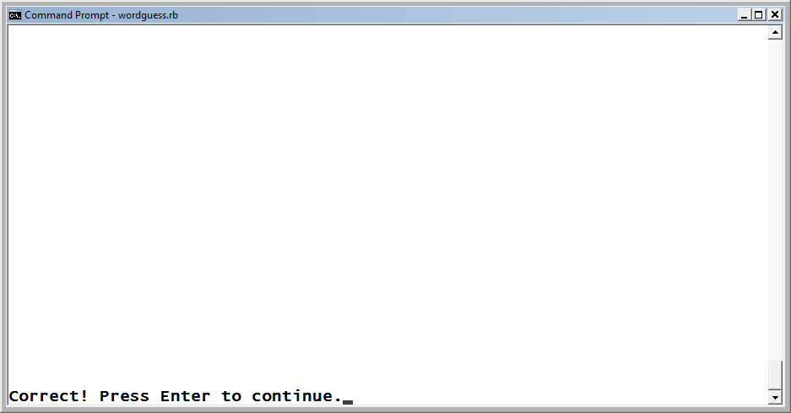
The Word Guessing Game (continued)
The following message is displayed if the player guesses the secret word.
Figure 7-7
The player has won the game by correctly guessing the secret word
Ruby Programming

Slide 11
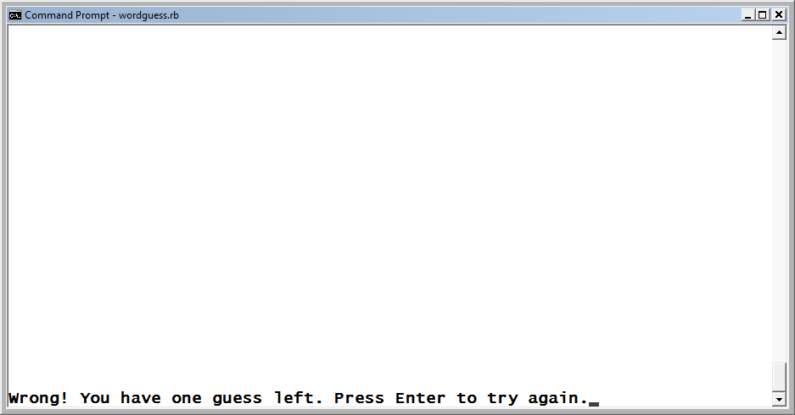
The Word Guessing Game (continued)
If the player’s first guess is incorrect, two more chances are given to guess the secret word.
Figure 7-8
The game gives the player one last guess.
Ruby Programming

Slide 12
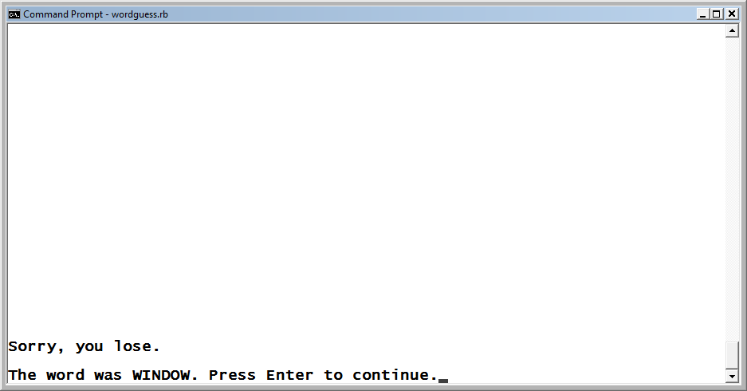
The Word Guessing Game (continued)
If the player is unable to guess the game’s secret word, a message is displayed informing the player the current round of play is over and revealing the secret word to the player.
Figure 7-9
The player has failed to guess the secret word.
Ruby Programming

Slide 13
Using Regular Expressions for Data Validation
Ruby Programming

Slide 14
The Basics of Working with Regular Expressions (continued)
Data processed in computer scripts can come from many different sources, including: databases, files, users, and as argument passed to your programs.
A certain amount of data validation uses conditional logic and methods belonging to Ruby classes.
To create really granular data validation routines, you will need to work with regular expressions.
A regular expression is a pattern used to identify matching character data.
Ruby Programming

Slide 15
The Basics of Working with Regular Expressions (continued)
Regular expressions are not just limited to data validation.
Regular expressions can search for data within strings and to perform string substitutions.
For example, using regular expressions, you can define patterns that:
  Perform search and replace operations on strings
  Keep counts of instances of patterns
  Extract a substring from a larger string
Ruby Programming

Slide 16
Matching Basic Patterns
Ruby Programming

Slide 17
Matching Specific Patterns
The most basic type of regular expression is one that matches up against a specific pattern or a set of characters. This type of pattern has the following syntax: /pattern/
Example:
if "Welcome to New York Harbor, USA." =~ /USA/ then
puts "Welcome to America!"
end
The =~ operator is the equivalent of the equals operation in a regular expression.
The !~ operator is the equivalent of the not equals operation in a regular expression.
Ruby Programming

Slide 18
Matching Multiple Patterns
Regular expression patterns can be set up to look for any of a possible set of matches using the | character to separate each possible match.
if "Welcome the USA!." =~ /USA|America/ then
puts "We have a match!"
End
Things can be simplified using parentheses to separate unique parts of the search pattern from common parts.
if "Remember to call your mother." =~ /(t|c|w)all/ then
puts "We have a match!"
end
Ruby Programming

Slide 19
Working with Metacharacters
Ruby Programming

Slide 20
Understanding How to Work with Metacharacters (continued)
Normally, any character in a regular expression pattern matches the same character if found in the source string.
Metacharacters are an exception to this rule.
A metacharacter is a character that alters the way a pattern match occurs.
Ruby Programming

Slide 21
Understanding How to Work with Metacharacters (continued)
Character Description
. Matches any character
^ Looks for a match at the beginning of a line
$ Looks for a match at the end of a line
\A Looks for a match at the beginning of a string
\Z Looks for a match at the end of a string
\d Matches any numeric character
\w Matches any alphabetic, numeric, or underscore character
\D Matches any non-numeric character
\W Matches any non-alphabetic, non-numeric, or non- underscore character
\s Matches white space
\S Matches non-white space
Ruby Programming

Slide 22
Escaping Metacharacters
You can escape (disable) a metacharacter’s special function by preceding it with the \ character. For example, if you precede the . metacharacter with the \ character, it gets treated like a period.
Example:
  if "Type your name (and press Enter):" = ~ /press Enter\) / then
  print "We have a match!"
  end
The source string is searched using the regular-expression pattern press Enter). When Ruby sees the ) metacharacter in the first statement’s search pattern, an error is generated because, syntactically, Ruby expects there to have been a preceding ( character. To force the ) to be interpreted literally, the ) metacharacter must be escaped, which is accomplished using the \ character. The result is a match.
Ruby Programming

Slide 23
Matching Individual Characters
The . metacharacter can be used as part of a pattern to match any individual character (except for the new line character).
By using multiple instances of the . metacharacter, you can create patterns that match more than one character.
if "I am Jerry. My father’s is Mr. Ford." =~ /f…er/ then
print "We have a match!"
end
Ruby Programming

Slide 24
Matching a Pattern at the Beginning of a String
By default, a regular expression looks anywhere within a string for a match.
Using the ^ metacharacter, you can create regular expression patterns that only look at the beginning of a line for a match.
if "I am Jerry. My father is Mr. Ford." =~ /^My name/ then
print "We have a match!"
end
Ruby Programming

Slide 25
Matching a Pattern at the End of a String
The $ metacharacter is the opposite of the ^ character.
The $ metacharacter performs a match only if the pattern is found at the end of the line.
if "I am Jerry. My father is Mr. Ford." =~ /Ford\.$/ then
print "We have a match!"
end
Ruby Programming

Slide 26
Matching Once or Not At All
In some situations, it may be necessary to search for a character or a group of characters that occur either once or not at all, with either possibility resulting in a match.
The ? metacharacter modifier matches zero or none of the preceding characters.
if "I am Jerry. My father is Mr. Ford." =~ /Mrs?/ then
print "We have a match!"
end
Ruby Programming

Slide 27
Matching Zero or More Times
The * character is similar to the . metacharacter except that the * metacharacter matches zero or more instances of the preceding character.
Example: A pattern of /f*r/ would match any of the following set of characters:
Father
Friendlier
For
r
Ruby Programming

Slide 28
Matching Any of a Collection of Characters
Another useful type of pattern is one that searches for a range of characters. This can be set up using character classes.
Character classes are enclosed inside a matching pair of square brackets ([]).
Any characters placed inside the [] characters are regarded as a single character
Ruby Programming

Slide 29
Matching Any of a Collection of Characters (continued)
Character Class Patterns
Pattern Description
/[abc]/ Matches any specified lowercase
letter (a, b, c)
/[abcdefghijklmnopqrstuvwxyz]/ Matches any lowercase letter
/[0123456789]/ Matches any number between 0 and 9
/[0 – 9]/ Shorthand option for matching any number between 0 and 9
/[a – z]/ Shorthand option for matching any of the lowercase letters
/[A – Z]/ Shorthand option for matching any of the uppercase letters
Ruby Programming

Slide 30
Matching Any of a Collection of Characters (continued)
Example of how to work with character class patterns:
print "Please enter a vowel and press Enter: "
input = STDIN.gets
input.chop!
if input =~ /[aeiou]/ then
puts "A vowel has been submitted."
end
Ruby Programming

Slide 31
Other Uses for Regular Expressions
Ruby Programming

Slide 32
Overcoming Differences in Case
By default, all regular expression in Ruby are case sensitive. However, you can disable case sensitivity using the optional i modifier.
if "Welcome to New York Harbor, USA." =~ /usa/i then
puts "Welcome to America!"
end
Ruby Programming

Slide 33
String Substitution
In addition to finding and validating string contents, you can modify strings using character substitution using the String class’s sub method. This method has the following syntax.
string.sub(search, replace)
Example:
x = "Once upon a time there was a small boy who climbed a
small tree."
puts x.sub("small", "big")
Ruby Programming

Slide 34
String Substitution (continued)
Using the String class’s gsub method, you can replace all instances of the search pattern within a text string.
Like the sub method, the gsub method accepts as an argument a search pattern, which can be any regular expression pattern or string, and a replacement pattern.
Example:
x = "Once upon a time, there was a small boy who climbed a small tree."
puts x.gsub("small", "big")
Ruby Programming

Slide 35
Back to the Word Guessing Game
Ruby Programming

Slide 36
Designing the Game
Follow these steps:
Open your text or script editor and create a new file.
Add comment statements to the script file to document the script and its purpose.
Define a class representing the terminal window.
Define a class representing the Number Guessing game.
Add a display_greeting method to the Game class.
Add a display_instructions method to the Game class.
Add a select_word method to the Game class.
Add a get_consonants method to the Game class.
Add a get_vowel method to the Game class.
Add a prompt_for_guess method to the Game class.
Add a play_game method to the Game class.
Add a display_credits method to the Game class.
Instantiate script objects.
Prompt the player for permission to begin the game.
Set up the game’s controlling logic.
Ruby Programming

Slide 37
Step 1: Creating a New Ruby File
1. Open code editor and create a new file.
2. Save the file with a name of WordGuess.rb.
Ruby Programming

Slide 38
Step 2: Documenting the Script and Its Purpose
#---------------------------------------------------------------
#
# Script Name: WordGuess.rb
# Version: 1.0
# Author: Jerry Lee Ford, Jr.
# Date: April 2010
#
# Description: This Ruby script demonstrates how to work with
# regular expressions through the development of a
# computer game that challenges the player to guess
# a mystery word after being first allowed to guess
# 5 consonants and 1 vowel.
#
#---------------------------------------------------------------
Ruby Programming

Slide 39
Step 3: Creating the Screen Class
# Define custom classes -----------------------------------------
#Define a class representing the console window
class Screen
def cls #Define a method that clears the display area
puts ("\n" * 25) #Scroll the screen 25 times
puts "\a" #Make a little noise to get the player's attention
end
def pause #Define a method that pauses the display area
STDIN.gets #Execute the STDIN class's gets method to pause
#script execution until the player presses the
#Enter key
end
end
Ruby Programming

Slide 40
Step 4: Creating the Game Class
The second class definition that you need to add to your new Ruby script is the Game class. It provides access to five methods that are needed to control the overall execution of the game.
#Define a class representing the Word Guessing Game
class Game
end
Ruby Programming

Slide 41
Step 5: Defining the display_greeting Method
#This method displays the game's opening screen
def display_greeting
Console_Screen.cls #Clear the display area
#Display welcome message
print "\t\t\tWelcome to the Word Guessing Game!" +
"\n\n\n\n\n\n\n\n\n\n\n\n\n\nPress Enter to " +
"continue.“
Console_Screen.pause #Pause the game
end
Ruby Programming

Slide 42
Step 6: Defining the display_instructions Method
#Define a method to be used to present game instructions
def display_instructions
Console_Screen.cls #Clear the display area
puts "INSTRUCTIONS:\n\n" #Display a heading
#Display the game's instructions
puts "At the start of each new round of play, the game will randomly"
puts "select a word that is between 5 and 10 characters long"
puts "and challenge you to guess it. Before submitting your guess, you"
puts "are allowed to provide the game with 5 consonants and 1 vowel to"
puts "determine if they are used in the secret word.\n\n\n"
puts "Good luck!\n\n\n\n\n\n\n\n\n"
print "Press Enter to continue.“
Console_Screen.pause #Pause the game
end
Ruby Programming

Slide 43
Step 7: Defining the select_word Method
#Define a method that generates the secret word
def select_word
#Define an array of 20 words from which the game will randomly select
words = ["W I N D O W", "S T A T I O N", "H A M B U R G E R",
"E X P R E S S I O N", "W A L L E T", "C A M E R A",
"A I R P L A N E", "C A N D L E", "C O M P U T E R",
"P I C T U R E", "F R A M E", "S H E L F", "B O W L I N G",
"P O L I T E", "S T A T E M E N T", "N E G A T I V E",
"M E T H O D", "F I S H I N G", "C O M P E N S A T E",
"H A P P Y"]
#Generate and return a random number between 0 and 19
randomNo = rand(19)
#Return a randomly selected word to the calling statement
return words[randomNo]
end
Ruby Programming

Slide 44
Step 8: Defining the get_consonants Method
#Define a method that collects the player's consonant guesses
def get_consonants
list = Array.new #define an array in which to store the consonants
#Give the player an idea of what is coming
puts "Before you try to guess the secret word, you must specify " +
"5 consonants.\n\n"
print "Press Enter to continue."
Console_Screen.pause #Pause the game
Ruby Programming

Slide 45
Step 8: Defining the get_consonants Method (continued)
5.times do #Iterate 5 times
Console_Screen.cls #Clear the display area
#Prompt the player to enter a consonant
print "\nPlease enter a consonant and press Enter: "
input = STDIN.gets #Collect the player's input
input.chop! #Remove the end of line marker
#Only accept consonant characters
if input !~ /[bcdfghjklmnpqrstvwxyz]/i then
Console_Screen.cls #Clear the display area
print "Error: " + input + " is not a consonant. Press Enter to " +
"continue."
Console_Screen.pause #Pause the game
redo #Repeat the current execution of the loop
end
Ruby Programming

Slide 46
Step 8: Defining the get_consonants Method (continued)
#Only accept one character of input per guess
if input.length > 1 then # !~ /./ then
Console_Screen.cls #Clear the display area
print "Error: You may only enter one character at a time. Press " +
"Enter to continue."
Console_Screen.pause #Pause the game
redo #Repeat the current execution of the loop
end
Ruby Programming

Slide 47
Step 8: Defining the get_consonants Method (continued)
#Do not allow the player to submit the same guess twice
if list.include?(input.upcase) == true then
Console_Screen.cls #Clear the display area
print "Error: You have already guessed " + input + ". Press " +
"Enter to continue."
Console_Screen.pause #Pause the game
redo #Repeat the current execution of the loop
else
list.push(input.upcase) #Convert the consonant to uppercase and
end #add it to the list of consonants
end
return list #Return the list of consonants to the calling statement
end
Ruby Programming

Slide 48
Step 9: Defining the get_vowel Method
#Define a method that collects the player's vowel guess
def get_vowel
#Give the player an idea of what is coming
puts "Before you try to guess the secret word, you must specify " +
"1 vowel.\n\n"
print "Press Enter to continue."
Console_Screen.pause #Pause the game
Ruby Programming

Slide 49
Step 9: Defining the get_vowel Method (continued)
1.times do #Iterate 1 time
Console_Screen.cls #Clear the display area
#Prompt the player to enter a vowel
print "\nPlease enter a vowel and press Enter: "
input = STDIN.gets #Collect the player's input
input.chop! #Remove the end of line marker
#Only accept vowel characters
if input !~ /[aeiou]/i then
Console_Screen.cls #Clear the display area
print "Error: " + input + " is not a vowel. Press Enter to " +
"continue."
Console_Screen.pause #Pause the game
redo #Repeat the current execution of the loop
end
Ruby Programming

Slide 50
Step 9: Defining the get_vowel Method (continued)
#Only accept one character of input per guess
if input.length > 1 then # !~ /./ then
Console_Screen.cls #Clear the display area
print "Error: You may only enter one character at a time. Press " +
"Enter to continue."
Console_Screen.pause #Pause the game
redo
end
input = input.upcase #Convert the vowel to uppercase
return input #Return the vowel to the calling statement
end
end
Ruby Programming

Slide 51
Step 10: Defining the prompt_for_guess Method
#Define a method that collects player guesses
def prompt_for_guess(shortWord, word, consonants, vowel)
Console_Screen.cls #Clear the display area
consonants.push(vowel) #To make things easy, add the vowel to the
#list of consonants
wordArray = word.split(" ") #Split the secret word into an array
i = 0 #Initial the variable with a starting value of zero
Ruby Programming

Slide 52
Step 10: Defining the prompt_for_guess Method (continued)
#Loop once for each letter in the word (stored in an array)
wordArray.each do |letter|
match = false #Initial the variable with a starting value of false
#Loop once for each consonant stored in the consonants array
consonants.each do |character|
#Compare the current character from the consonants array to the
#current letters in the wordArray array
if character == letter then
match = true #Set variable value to indicate a match
break #Terminate loop execution when a match occurs
end
end
Ruby Programming

Slide 53
Step 10: Defining the prompt_for_guess Method (continued)
#If there is no matching character in the consonants array for the
#current letter in the wordArray array, replace that letter in the
#wordArray with an underscore character
if match == false then
wordArray[i] = "_" #Replace the current character with an
end #underscore
match = false #Reset the value of the match variable
i = i + 1 #Increment the variable's value by 1
end
#Once the contents of the array have been formatted with
#underscores convert the contents of the array back into a word
word = wordArray.join(" ")
Ruby Programming

Slide 54
Step 10: Defining the prompt_for_guess Method (continued)
#Allow the player up to three guesses
3.times do |i| #i equals 0 on the first iteration of the loop
Console_Screen.cls #Clear the display area
#Prompt the player to try to guess the secret word
puts "I am thinking of a word.\n\n\n\n\n\n"
print "Here is your clue: " + word + "\n\n\n\n\n\n\n\n"
print "What do you think this word is? "
reply = STDIN.gets #Collect the player's reply
reply.chop! #Remove the end of line marker
reply = reply.upcase #Convert the reply to all uppercase
Ruby Programming

Slide 55
Step 10: Defining the prompt_for_guess Method (continued)
#Analyze the player’s guess
if reply == shortWord then #The player guessed the secret word
Console_Screen.cls #Clear the display area
print "Correct! Press Enter to continue."
Console_Screen.pause #Pause the game
break #Terminate the execution of the loop
Ruby Programming

Slide 56
Step 10: Defining the prompt_for_guess Method (continued)
else #The player did not guess the secret word
Console_Screen.cls #Clear the display area
#Display a message based on how many turns remain
if i == 1 then
print "Wrong! You have one guess left. Press Enter to " +
"try again."
elsif i == 2
print "Sorry, you lose.\n\n"
print "The word was " + shortWord + ". Press Enter to continue."
else
print "Wrong! Press Enter to try again."
end
Console_Screen.pause #Pause the game
end
end
end
Ruby Programming

Slide 57
Step 11: Defining the play_game Method
#Define a method to control game play
def play_game
word = select_word #Call on the method that retrieves a random word
Console_Screen.cls #Clear the display area
consonants = get_consonants #Call on the method that prompts the player
#to enter a list of consonants
Console_Screen.cls #Clear the display area
#Call on the method that prompts the player to enter a vowel
vowel = get_vowel
#Remove blank spaces from the word to create a short version of the word
shortWord = word.gsub(" ", "")
#Call the method that processes player guesses
prompt_for_guess(shortWord, word, consonants, vowel)
Console_Screen.cls #Clear the display area
end
Ruby Programming

Slide 58
Step 12: Defining the display_credits Method
#This method displays the information about the Word Guessing game
def display_credits
Console_Screen.cls #Clear the display area
#Thank the player and display game information
puts "\t\t Thank you for playing the Word Guessing Game.\n\n\n\n"
puts "\n\t\t\t Developed by Jerry Lee Ford, Jr.\n\n"
puts "\t\t\t\t Copyright 2010\n\n"
puts "\t\t\tURL: http://www.tech-publishing.com\n\n\n\n\n\n\n\n\n\n"
end
Ruby Programming

Slide 59
Step 13: Initializing Script Objects
# Main Script Logic ---------------------------------------------------
Console_Screen = Screen.new #Instantiate a new Screen object
WordGuess = Game.new #Instantiate a new Game object
#Execute the Game class's display_greeting method
WordGuess.display_greeting
answer = "" #Initialize variable and assign it an empty string
Ruby Programming

Slide 60
Step 14: Getting Permission to Start the Game
#Loop until the player enters y or n and do not accept any other
#input
loop do
Console_Screen.cls #Clear the display area
#Prompt the player for permission to start the quiz
print "Are you ready to play the Word Guessing Game? (y/n): "
answer = STDIN.gets #Collect the player's answer
answer.chop! #Remove any extra characters appended to the string
#Terminate the loop if valid input was provided
break if answer =~ /y|n/i
end
Ruby Programming

Slide 61
Step 15: Controlling Game Play
#Analyze the player's input
if answer == "n" #See if the player elected not to take the quiz
Console_Screen.cls #Clear the display area
#Invite the player to return and take the quiz some other time
puts "Okay, perhaps another time.\n\n"
else #The player wants to play the game
#Execute the game class's display_instructions method
WordGuess.display_instructions
Ruby Programming

Slide 62
Step 15: Controlling Game Play (continued)
loop do #Loop forever
#Execute the Game class's play_game method
WordGuess.play_game
#Find out if the player wants to play another round
print "Enter Q to quite or press any key to play again: "
playAgain = STDIN.gets #Collect the player's response
playAgain.chop! #Remove any extra characters appended to the string
#Terminate the loop if valid input was provided
break if playAgain =~ /Q/i
end
#Call upon the Game class's determine_credits method
WordGuess.display_credits
end
Ruby Programming

Slide 63
Running Your New Ruby Script Game
Save your Ruby script.
Access the command prompt and navigate to the folder where you saved the script.
Enter the following command and press the Enter key.
  ruby WordGuess.rb
Ruby Programming

Slide 64
Summary
The chapter demonstrated:
The basics of working with regular expressions
How to match basic patterns
How to work with metacharacters
About other uses of regular expressions
Ruby Programming

