Slide 1
Chapter 8
Object-Oriented Programming
Ruby Programming

Slide 2
Objectives
In this chapter, you:
Work with key features of object-oriented programming
Initialize objects upon instantiation
Develop variable scope
Take advantage of Ruby’s built-in classes
Modify Ruby classes
Ruby Programming

Slide 3
Project Preview: The Rock, Paper, Scissors Game
Ruby Programming

Slide 4
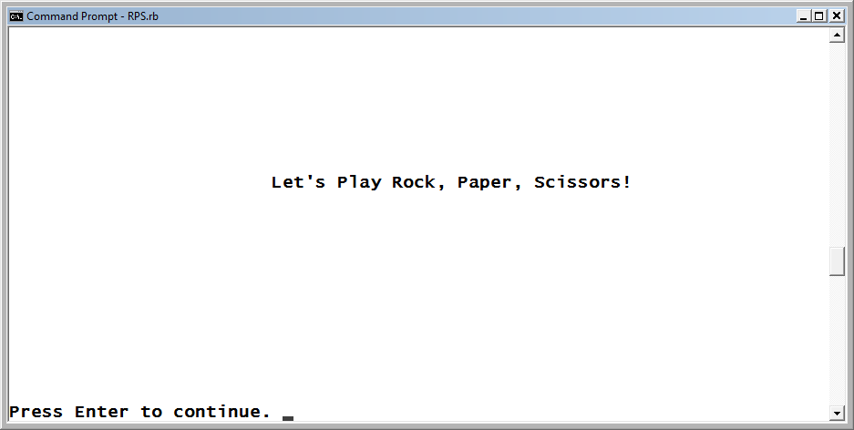
The Rock, Paper, Scissors Game (continued)
In this chapter, students will learn how to create a computer game called the Rock, Paper, Scissors game. It is a computerized version of the classic Rock, Paper, Scissors game, and it pits the player against the computer.
Figure 8-1
The welcome screen for the Rock, Paper, Scissors game.
Ruby Programming

Slide 5
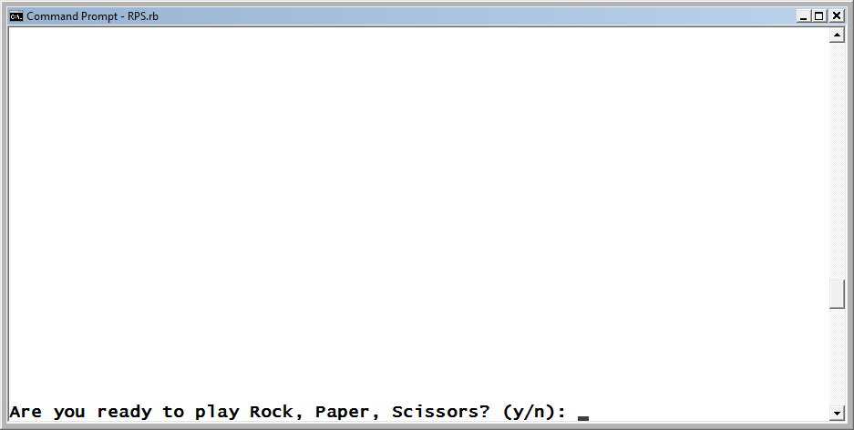
The Rock, Paper, Scissors Game (continued)
After pressing Enter, the player is prompted for permission to begin the game.
Figure 8-2
The player must decide to play before the game can begin.
Ruby Programming

Slide 6
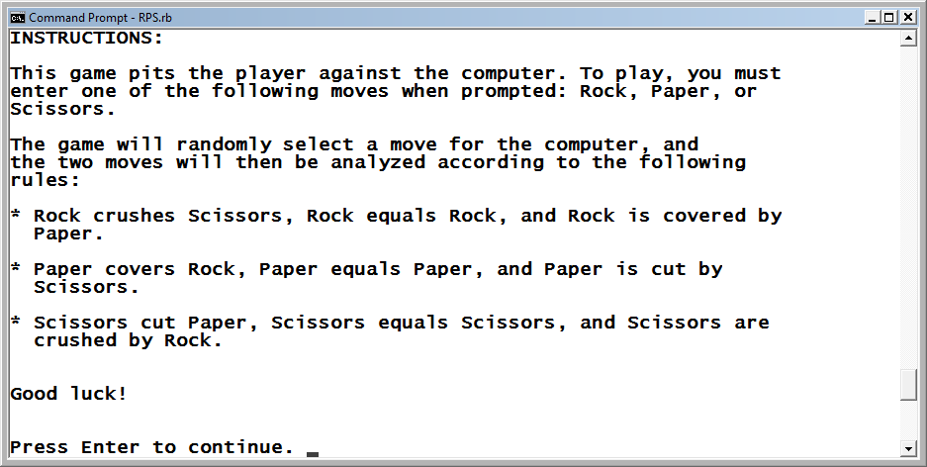
The Rock, Paper, Scissors Game (continued)
If the player decides to play, instructions are displayed, providing a brief description of how the game is played.
Figure 8-3
Instructions for how to play are provided.
Ruby Programming

Slide 7
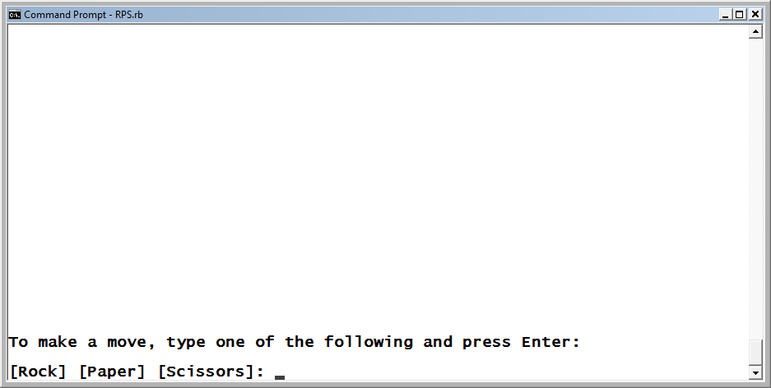
The Rock, Paper, Scissors Game (continued)
Next, the player is prompted to submit a move of Rock, Paper, or Scissors.
Figure 8-4
To make a move, the player must type Rock, Paper, or Scissors and
press Enter.
Ruby Programming

Slide 8
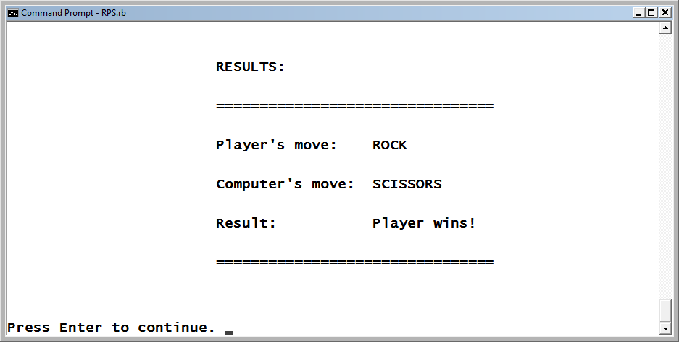
The Rock, Paper, Scissors Game (continued)
As soon as the player selects a move, the game randomly selects a move on behalf of the computer and the player’s move is then compared to the computer’s move in order to determine the result.
Figure 8-5
The player’s move beats the computer’s move.
Ruby Programming

Slide 9
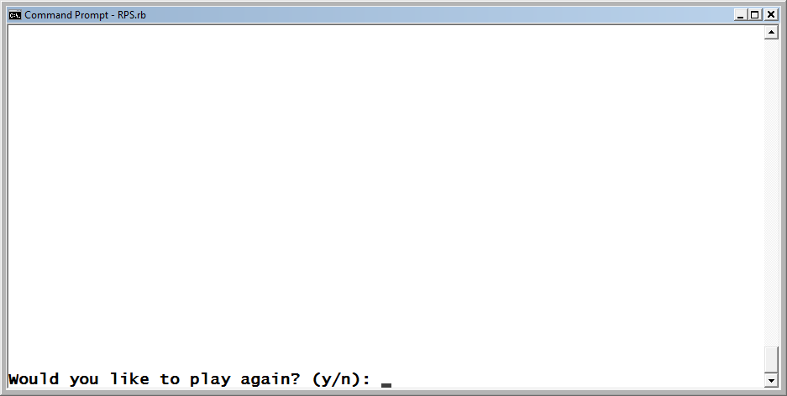
The Rock, Paper, Scissors Game (continued)
At the end of each round of play, the game prompts the player for permission to play again.
Figure 8-6
The player is prompted to play again.
Ruby Programming

Slide 10
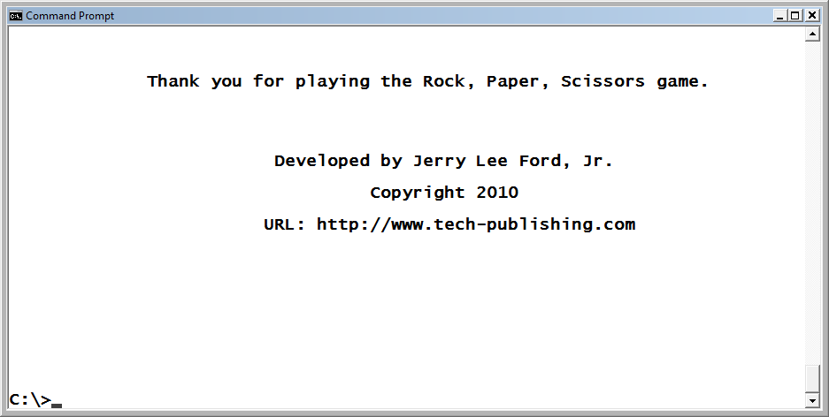
The Rock, Paper, Scissors Game (continued)
When the player has decided to quit playing, a message is displayed thanking the player and the game ends.
Figure 8-7
The closing message displays the developer’s name and website.
Ruby Programming

Slide 11
Key Features of Object-Oriented Programming
Ruby Programming

Slide 12
Abstraction
Abstraction is the ability to make important object features available
while hiding nonessential details, thereby focusing on the outside
view of an object. It is implemented through classes and includes
the specification of both properties and methods. Using the class
as a template, you can create instances of objects.
Example:
class Automobile
attr_accessor :color
def drive
puts "Vroom!!!"
end
end
Ruby Programming

Slide 13
Abstraction (continued)
Once the class is defined, you can create a new object from it:
myCar = Automobile.new
Once the object is created, you can assign a value to its color property:
myCar.color = "Blue"
Once the property is set, you can access it whenever you need to. You
can also execute the object’s drive method:
puts "I love to drive my little " + myCar.color + " car."
myCar.drive
When executed, these two statements display the following results:
I love to drive my little Blue car.
Vroom!!
Ruby Programming

Slide 14
Encapsulation
Encapsulation involves the restriction of access to one or more of the properties and methods defined within a class, thereby allowing the internal representation of objects to be hidden from view outside the object definition. It makes program code more reliable by limiting access to just the areas within the program where access is required, which helps prevent accidental modification or execution.
Ruby Programming

Slide 15
Encapsulation (continued)
By default, any properties and methods that you define in a class are public, which means they can be accessed from outside the class. To control access to the properties and methods within a class, insert any of the following keywords into the class:
public—Makes any specified properties or methods available throughout the program
private—Restricts the access of any specified properties or methods defined within the object itself
protected—Restricts the access of any specified properties or methods to objects of the same class or objects of subclasses of the class
To use these keywords, place them on a line by themselves immediately before the property or method definitions for which you wish to specify access. Access to any properties or methods that are defined after the occurrence of one of these keywords is governed by that keyword, which remains in effect until either the end of the class is reached or a different level of encapsulation is specified.
Ruby Programming

Slide 16
Encapsulation (continued)
This example demonstrates how to restrict access to a method. The statements that follow the class definition prompt the user for the name of a superhero, which is then displayed.
class Superhero
def initialize(name)
secret_identity(name)
end
def display_identity
puts "\n\nThis superhero's secret " +
"identity is " + @identity + "\n\n"
print "Press Enter to continue."
end
private
def secret_identity(name)
if name =˜ /Superman/i then
@identity = "Clark Kent"
elsif name =˜ /Batman/i then
@identity = "Bruce Wayne"
elsif name =˜ /Spiderman/i then
@identity = "Peter Parker"
else
@identity = "Unknown"
end
end
end
loop do
puts ("\n" * 25)
puts "\n\nWelcome to the " +
"Superhero Identity Tracker!\n\n"
print "Enter a superhero's name " +
"or type Q to quit: "
input = STDIN.gets
input.chop!
break if input =˜ /q/i
puts ("\n" * 25)
myHero = Superhero.new(input)
myHero.display_identity
STDIN.gets
end
Ruby Programming

Slide 17
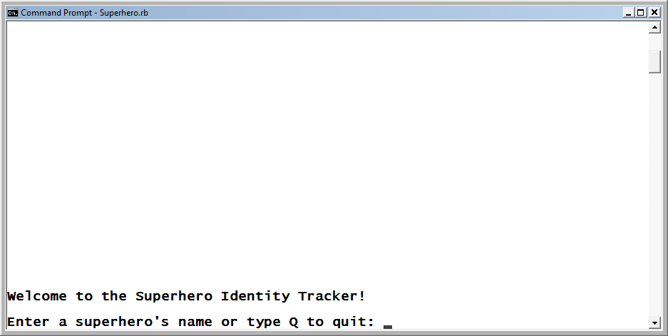
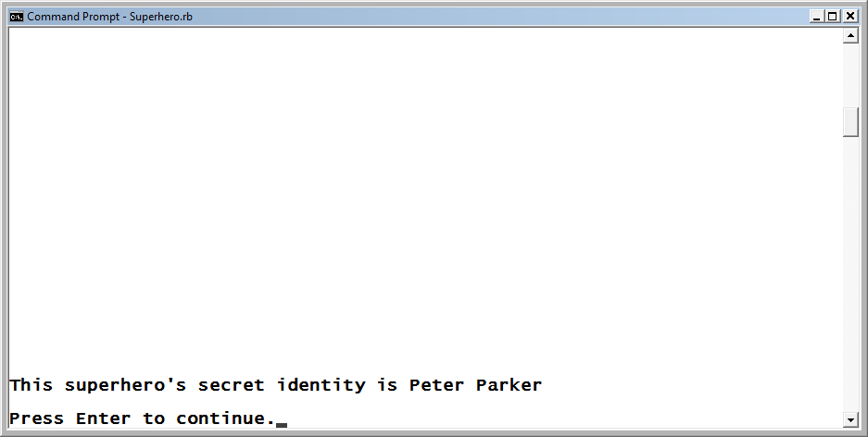
Encapsulation (continued)
Ruby Programming

Slide 18
Inheritance
Inheritance is the process by which one class is derived from another class. The derived class (child class) inherits all of the properties and methods of the parent class.
You can modify the inherited properties and methods or add new ones to customize the child class. With inheritance, it is possible to build an entire family of classes consisting of parents, children, grandchildren, siblings, and so on.
Ruby Programming

Slide 19
Inheritance (continued)
To see how inheritance works, look at the following program, which defines a class named Hero and then uses that class as the basis for defining three child classes:
class Hero
attr_accessor :power, :weakness
def catch_phrase
print "Halt in the name of the law! "
end
end
class UnderDog < Hero
def bark
puts "Woof!"
end
end
class Superman < Hero
attr_accessor :cape
end
class Batman < Hero
attr_accessor :mask
end
UD = UnderDog.new
SM = Superman.new
BM = Batman.new
SM.power = "Flight"
SM.weakness = "Kryptonite"
SM.cape = "red"
SM.catch_phrase
puts "Or I will fly over there " +
"in my " + SM.cape + " cape
" and capture you!"
Ruby Programming

Slide 20
Polymorphism
Polymorphism is the ability to define objects and methods in different forms. One way to implement polymorphism within Ruby is to assign the same name to different methods, allowing Ruby to execute the appropriate method based on the context in which the method is executed.
A good example of polymorphism is provided by Ruby’s + method:
puts "Once upon " + "a time in a faraway land... "
After being executed, this statement displays the following output:
Once upon a time in a faraway land...
When used on two numbers, the + method adds them together:
puts 5 + 4
After being executed, this statement displays a value of 9. When used with two arrays, the + method merges them:
x = [1, 2, 3] + [4, 5, 6]
puts x.inspect
After being executed, these statements display the following output:
[1, 2, 3, 4, 5, 6]
Ruby Programming

Slide 21
Polymorphism
You can easily use polymorphic programming with your own custom
methods, as shown here:
class Hero
attr_accessor :power, :weakness
def catch_phrase
puts "Here I come to save the day!"
end
end
class UnderDog < Hero
end
class Superman < Hero
def catch_phrase
puts "Up, up and away!"
end
end
class Batman < Hero
def catch_phrase
puts "Quick, to the batcave!"
end
end
Ruby Programming

Slide 22
Initializing Objects Upon Instantiation
Ruby Programming

Slide 23
Initializing Objects Upon Instantiation (continued)
You may want to instantiate an object and initialize it with one or more properties in a single step.
To allow you to do so, Ruby provides a method named initialize.
When included in a class definition, the initialize method is automatically executed anytime an object is instantiated.
Ruby Programming

Slide 24
Initializing Objects Upon Instantiation (continued)
In a class definition, arguments can be passed to the class when instantiated. These arguments will be passed to the initialize method and mapped to variables.
  class Noise
  def initialize(number_beeps)
  @occurrences = number_beeps
  end
  def make_sound
  @occurrences.times {print "\a"}
  end
  end
The following statements instantiate two objects based on the Noise class while initializing the @occurrences variable:
  shortSound = Noise.new(1)
  longSound = Noise.new(10)
Once instantiated, you can call the class’s make_sound method for each of the objects using the method’s initialized value for the @occurrences variable:
  shortSound.make_sound
  STDIN.gets
  longSound.make_sound
Ruby Programming

Slide 25
Understanding Variable Scope
Ruby Programming

Slide 26
Working with Local Variables
A variable with a local scope can be accessed only within the scope
that it was created in.
class Greeting
def display_msg
puts "Hello " + myName
end
end
As a local variable, myName can only be accessed from within the
method it was created in.
Ruby Programming

Slide 27
Working with Global Variables
Global variables are accessible throughout a Ruby program and have an unlimited scope. Every class in the program is allowed to access them. To create a global variable, precede its name with the $ character.
class Greeting
def display_msg
puts "Hello " + $myName
end
end
Msg = Greeting.new
$myName = "Jerry Ford“
Msg.display_msg
A problem with using global variables is that they expose data located in other parts of a program file, opening up the possibility that the data might be accidentally changed.
Ruby Programming

Slide 28
Working with Instance Variables
When working with variables that are defined within different methods belonging to the same class definition, it is sometimes helpful to increase the scope of the variables to allow them to be referenced by all the methods in that class definition. Instance variables begin with the @ character.
class Noise
def initialize(occurrences)
@occurrences = occurrences
end
def make_sound
@occurrences.times {print "\a"}
end
end
Ruby Programming

Slide 29
Working with Class Variables
Class variables are similar to instance variables except they are accessible to all the instances of the same class, which makes it easier to make repeated references to variables. They begin with the @@ characters.
class Superman
def initialize
if defined?(@@myHero) then
puts "Error: Only one instance of Superman is " +
"permitted at a time."
else
@@myHero = "Is alive"
puts "Up, up and away!"
end
end
end
Ruby Programming

Slide 30
Taking Advantage of Ruby’s Built-in Classes
Ruby Programming

Slide 31
Taking Advantage of Ruby’s Built-in Classes (continued)
Ruby provides access to many built-in classes. By creating objects based on these classes, you instantly get access to all the predefined methods that Ruby defines for those objects. In addition, your objects have access to the properties belonging to these classes. As a result, programming is significantly simpler.
As an example, consider the Array class. Since every array automatically has access to all the methods defined by the Array class:
myArray = [2, 8, 3, 5, 1]
puts myArray.sort.reverse.inspect
Here, methods have been chained together, passing one method’s output to another method as input.
Ruby Programming

Slide 32
Modifying Ruby Classes
Ruby Programming

Slide 33
Modifying Ruby Classes (continued)
Ruby allows you to customize the language. For example, you can add new methods to the Numeric class which can be used in place of Ruby’s +, –, *, \ methods:
class Numeric
def add(x)
self.+(x)
end
def subtract(x)
self.-(x)
end
def multiply(x)
self.*(x)
end
def divide(x)
self./(x)
end
end
Ruby Programming

Slide 34
Back to the Rock, Paper, Scissors Game
Ruby Programming

Slide 35
Designing the Game
Follow these steps:
Open your text or program editor, and create a new file.
Add comment statements to the script to document its purpose.
Define a Screen class representing the terminal window.
Define a Game class representing the Rock, Paper, Scissors game.
Add a display_greeting method to the Game class.
Add a display_instructions method to the Game class.
Add a play_game method to the Game class.
Add a get_player_move method to the Game class.
Add a get_computer_move method to the Game class.
Add an analyze_results method to the Game class.
Add a display_results method to the Game class.
Add a display_credits method to the Game class.
Instantiate script objects.
Prompt the player for permission to begin the game.
Set up the game’s controlling logic.
Ruby Programming

Slide 36
Step 1: Create a New Ruby File
Open your text or script editor, and create a new Ruby script file.
Save the file with the name RPS.rb, and store it in the folder with your other Ruby scripts.
Ruby Programming

Slide 37
Step 2: Document the Script and Its Purpose
Add the following comment statements to the new script file.
#-------------------------------------------------
#
# Script Name: RPS.rb
# Version: 1.0
# Author: Jerry Lee Ford, Jr.
# Date: April 2010
#
# Description: This Ruby game is a computerized
# version of the classic Rock, Paper, Scissors
# game, in which the player goes head-to-head
# against the computer.
#
#-------------------------------------------------
Ruby Programming

Slide 38
Step 3: Define the Screen Class
This program will have two custom classes, Screen and Game, each of which contains numerous methods for controlling the interaction with the user and executing the game. Below ate the program statements for the Screen class:
#Define custom classes -----------------------------------
#Define a class representing the console window
class Screen
def cls #Define a method that clears the display area
puts ("\n" * 25) #Scroll the screen 25 times
puts "\a" #Make a little noise to get the player's attention
end
def pause #Define a method that pauses the display area
STDIN.gets #Execute the STDIN class's gets method to
#pause script execution until the player
#presses the Enter key
end
end
Ruby Programming

Slide 39
Step 4: Define the Game Class
The Game class contains eight methods that control the execution of the game. To begin developing the Game class, add the following statements to the end of the script file:
#Define a class representing the Rock, Paper, Scissors game
class Game
end
Ruby Programming

Slide 40
Step 5: Define the display_greeting Method
This method displays the game’s welcome message.
#This method displays the game's opening message
def display_greeting
Console_Screen.cls #Clear the display area
#Display welcome message
print "\t\t\tLet's Play Rock, Paper, Scissors!" +
"\n\n\n\n\n\n\n\n\n\n\n\n\n\nPress Enter to " +
"continue. "
Console_Screen.pause #Pause the game
end
Ruby Programming

Slide 41
Step 6: Define the display_instructions Method
This method displays the instructions for playing the game.
#Define a method to be used to present game instructions
def display_instructions
Console_Screen.cls #Clear the display area
puts "INSTRUCTIONS:\n\n" #Display a heading
#Display the game's instructions
puts "This game pits the player against the computer. " +
"To play, you must"
puts "enter one of the following moves when prompted: " +
"Rock, Paper, or"
puts "Scissors.\n\n"
puts "The game will randomly select a move for the " +
"computer, and "
puts "the two moves will then be analyzed according to " +
"the following"
Ruby Programming

Slide 42
Step 6: Define the display_instructions Method (continued)
puts "rules: \n\n"
puts "* Rock crushes Scissors, Rock equals Rock, and " +
"Rock is covered by"
puts " Paper.\n\n"
puts "* Paper covers Rock, Paper equals Paper, and " +
"Paper is cut by"
puts " Scissors.\n\n"
puts "* Scissors cut Paper, Scissors equals Scissors, " +
"and Scissors are"
puts " crushed by Rock.\n\n\n"
puts "Good luck!\n\n\n"
print "Press Enter to continue. "
Console_Screen.pause #Pause the game
end
Ruby Programming

Slide 43
Step 7: Define the play_game Method
This method manages the execution of a round of play through the execution of other methods.
#Define a method to control game play
def play_game
Console_Screen.cls #Clear the display area
#Call on the method responsible for collecting the
#player's move
playerMove = get_player_move
#Call on the method responsible for generating the
#computer's move
computerMove = get_computer_move
#Call on the method responsible for determining the
#results of the game
result = analyze_results(playerMove, computerMove)
#Call on the method responsible for displaying the
#results of the game
display_results(playerMove, computerMove, result)
end
Ruby Programming

Slide 44
Step 8: Define the get_player_move Method
This method collects the player’s move using a loop that runs forever. Each time the loop repeats, it displays a prompt that instructs the player to respond by entering a move (Rock, Paper, or Scissors).
#Define the method responsible for collecting the player's move
def get_player_move
Console_Screen.cls #Clear the display area
loop do #Loop forever
Console_Screen.cls #Clear the display area
#Prompt the player to select a move
puts "To make a move, type one of the following:\n\n"
print "[Rock] [Paper] [Scissors]: "
@choice = STDIN.gets #Collect the player's answer
@choice.chop! #Remove any extra characters appended to
#the string
#Terminate the loop if valid input was provided
break if @choice =˜ /Rock|Paper|Scissors/i
end
#Convert the player move to uppercase and return it to the calling
#statement
return @choice.upcase
end
Ruby Programming

Slide 45
Step 9: Define the get_computer_move Method
This method is responsible for making the computer’s move.
#Define the method responsible for making the #computer's move
def get_computer_move
#Define an array containing a list of three possible moves
moves = ["ROCK", "PAPER", "SCISSORS"]
#Generate and return a random number between 0 and 2
randomNo = rand(3)
#Return a randomly selected move to the calling statement
return moves[randomNo]
end
Ruby Programming

Slide 46
Step 10: Define the analyze_results method
This method compares the player’s and the computer’s moves, which are passed to it as arguments, to determine the result of the current round of play.
#Define the method responsible for analyzing and returning the
#result of #the game (arguments are passed as upper case characters)
def analyze_results(player, computer)
#Analyze the results of the game when the player selects ROCK
if player == "ROCK" then
return "Player wins!" if computer == "SCISSORS"
return "Tie!" if computer == "ROCK"
return "Computer wins!" if computer == "PAPER"
end
#Analyze the results of the game when the player selects PAPER
if player == "PAPER" then
return "Player wins!" if computer == "ROCK"
return "Tie!" if computer == "PAPER"
return "Computer wins!" if computer == "SCISSORS"
end
#Analyze the results of the game when the player selects SCISSORS
if player == "SCISSORS" then
return "Player wins!" if computer == "PAPER"
return "Tie!" if computer == "SCISSORS"
return "Computer wins!" if computer == "ROCK"
end
end
Ruby Programming

Slide 47
Step 11: Define the display_results Method
This method displays the result of the game, which is passed to it as an argument, along with the player’s and the computer’s moves.
#Define the method responsible for displaying the
#result of the game
def display_results(player, computer, result)
#Display arguments passed to the method using the
#following template
Console_Screen.cls #Clear the display area
puts "\n\n\t\t\tRESULTS:"
puts "\n\n\t\t\t================================"
puts "\n\n\t\t\tPlayer's move: " + player
puts "\n\n\t\t\tComputer's move: " + computer
puts "\n\n\t\t\tResult: " + result
puts "\n\n\t\t\t================================"
puts "\n\n\n\n"
print "Press Enter to continue. "
Console_Screen.pause #Pause the game
end
Ruby Programming

Slide 48
Step 12: Define the display_credits Method
This method displays information about the game, including the developer’s URL.
#This method displays information about the
#Rock, Paper, Scissors game
def display_credits
Console_Screen.cls #Clear the display area
#Thank the player and display game information
puts "\t Thank you for playing the Rock, Paper, " +
"Scissors game."
puts "\n\n\n\n"
puts "\n\t\t\t Developed by Jerry Lee Ford, Jr.\n\n"
puts "\t\t\t\t Copyright 2010\n\n"
puts "\t\t\tURL: http://www.tech-publishing.com\n\n\n\n\" +
"n\n\n\n\n\n"
end
Ruby Programming

Slide 49
Step 13: Instantiate Script Objects
Instantiate two objects named Console_Screen and RPS, based on the
Console_Screen and Game classes, by adding the following statements
to the end of the script file:
# Main Script Logic --------------------------------------
Console_Screen = Screen.new #Instantiate a new Screen object
RPS = Game.new #Instantiate a new Game object
#Execute the Game class's display_greeting method
RPS.display_greeting
answer = "" #Initialize variable and assign it an empty string
Ruby Programming

Slide 50
Step 14: Get Permission to Start the Game
Set up the prompt for getting the player’s permission to play the game
by adding the following statements to the end of the script file:
#Loop until the player enters y or n and do not
#accept any other input
loop do
Console_Screen.cls #Clear the display area
#Prompt the player for permission to start the game
print "Are you ready to play Rock, Paper, Scissors? (y/n): "
answer = STDIN.gets #Collect the player's answer
answer.chop! #Remove any extra characters appended to the string
#Terminate the loop if valid input was provided
break if answer =˜ /y|n/i
end
Ruby Programming

Slide 51
Step 15: Control Game Play
Supply the programming logic that manages the overall execution of the game by adding the following statements to the end of the script file:
#Analyze the player's answer
if answer =˜ /n/i #See if the player wants to quit
Console_Screen.cls #Clear the display area
#Invite the player to return and play the game some other time
puts "Okay, perhaps another time.\n\n"
else #The player wants to play the game
#Execute the Game class's display_instructions method
RPS.display_instructions
playAgain = ""
loop do #Loop forever
#Execute the Game class's play_game method
RPS.play_game
Ruby Programming

Slide 52
Step 15: Control Game Play (continued)
loop do #Loop forever
Console_Screen.cls #Clear the display area
#Find out if the player wants to play another round
print "Would you like to play again? (y/n): "
playAgain = STDIN.gets #Collect the player's response
playAgain.chop! #Remove any extra characters
appended to the string
#Terminate the loop if valid input was provided
break if playAgain =˜ /n|y/i
end
#Terminate the loop if valid input was provided
break if playAgain =˜ /n/i
end
#Call upon the Game class's determine_credits method
RPS.display_credits
end
Ruby Programming

Slide 53
Running Your New Ruby Program Game
Save your Ruby script.
If you run into any errors, read the error messages carefully to ascertain what went wrong.
If necessary, review the script, and look for mistyped or missing statements.
Ruby Programming

Slide 54
Summary
This chapter demonstrated:
How to work with key features of object-oriented programming
How to initialize objects upon instantiation
How to develop variable scope
How to take advantage of Ruby’s built-in classes
How to modify Ruby classes
Ruby Programming

