Slide 1
Chapter 9
File and Folder Administration
Ruby Programming

Slide 2
Objectives
In this chapter, you:
Redirect file input and output
Administer text files and folders
Work with files and folders on different operating systems
Read from and write to text files
Create the Ruby Blackjack game
Ruby Programming

Slide 3
Project Preview: The Ruby Blackjack Game
Ruby Programming

Slide 4
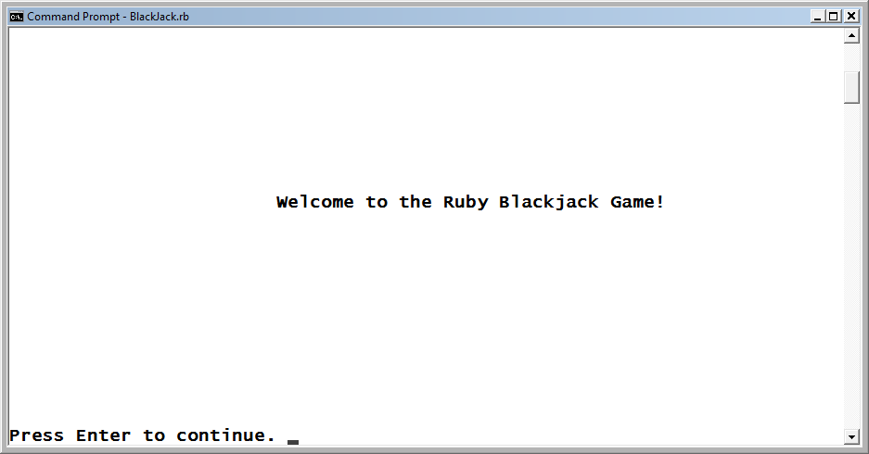
The Ruby Blackjack Game (continued)
In this chapter, you create a computer game called the Ruby Blackjack game. In this game, a virtual blackjack dealer is pitted against the player, each of them trying to build a card hand that comes as close as possible to 21 without going over.
Figure 9-1
The welcome screen for the Ruby Blackjack game.
Ruby Programming

Slide 5
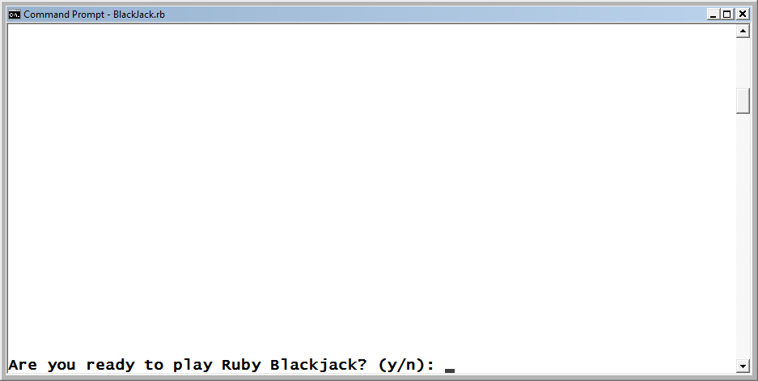
The Ruby Blackjack Game (continued)
After pressing Enter, the player is prompted for permission to begin the game.
Figure 9-2
The player must respond with a y to begin the game.
Ruby Programming

Slide 6
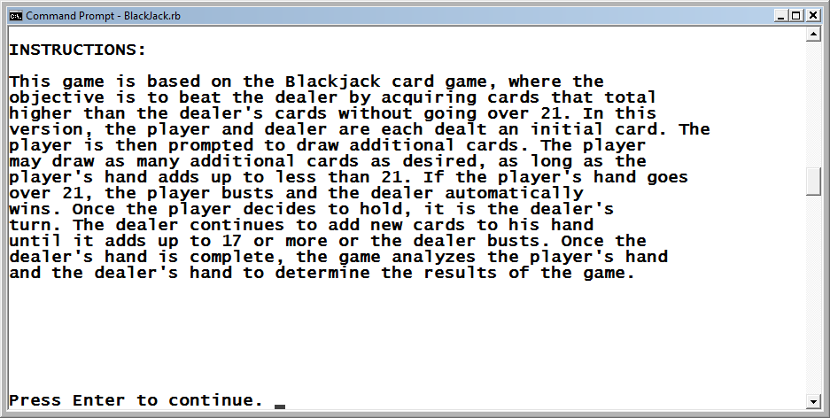
The Ruby Blackjack Game (continued)
Once permission has been given, the instructions for playing the
game are displayed.
Figure 9-3
Instructions for how to play are provided.
Ruby Programming

Slide 7
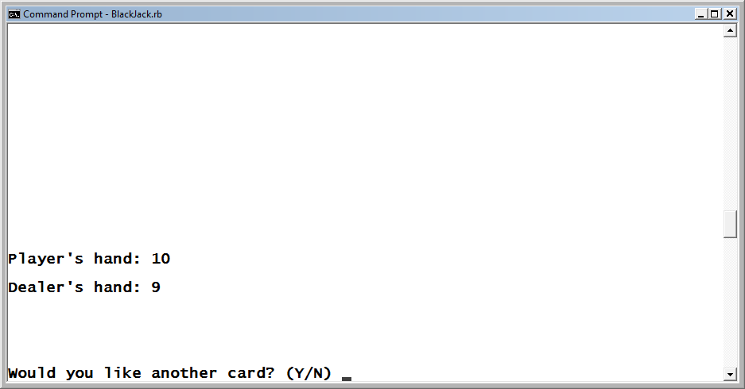
The Ruby Blackjack Game (continued)
Both the player and the dealer are dealt an initial card, after which the player is prompted to play out the rest of her hand.
Figure 9-4
Once initial cards are dealt, the player goes first.
Ruby Programming

Slide 8
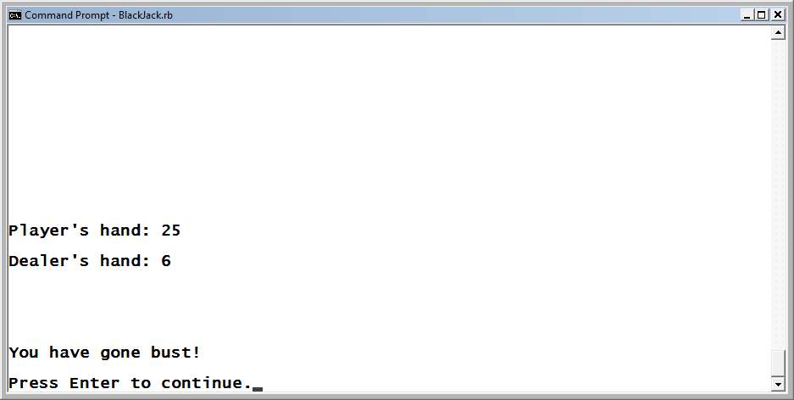
The Ruby Blackjack Game (continued)
The player may ask for as many additional cards as he wants, as long as the total value of his cards does not exceed 21. If this happens, the player busts and loses the hand.
Figure 9-5
The player’s hand has exceeded a total of 21, resulting in a loss.
Ruby Programming

Slide 9
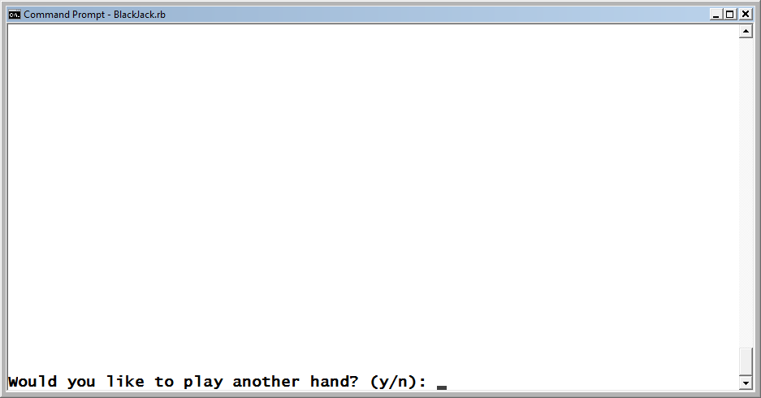
The Ruby Blackjack Game (continued)
After each round of play, the player is prompted for permission to start a new hand.
Figure 9-6
The player is invited to play again.
Ruby Programming

Slide 10
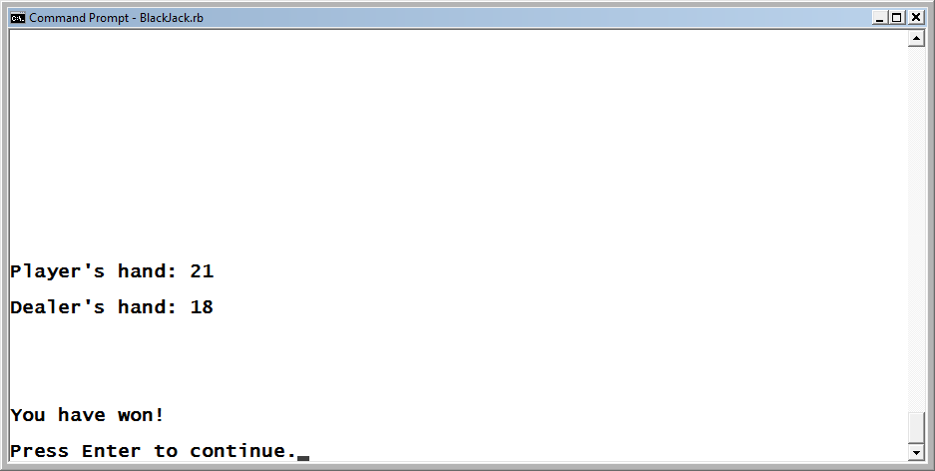
The Ruby Blackjack Game (continued)
Here is an example of a game that the player has won. Here, the player’s hand adds up to 21.
Figure 9-7
The player has won this hand.
Ruby Programming

Slide 11
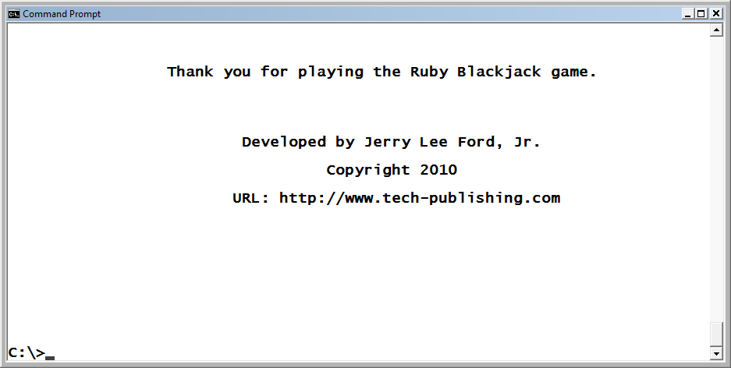
The Ruby Blackjack Game (continued)
Once the player has decided to stop playing, the game ends after
displaying a message that thanks the player and provides information about the game and its author.
Figure 9-8
The game’s closing screen.
Ruby Programming

Slide 12
Redirecting File Input and Output
Ruby Programming

Slide 13
Redirecting File Input and Output (continued)
The movement of data from one place to another is referred to as data input and data output. By default, a computer receives standard input (STDIN) from the keyboard and sends standard output (STDOUT) to the computer’s monitor.
You can redirect STDIN and STDOUT.
Redirection is accomplished using the > redirection output operator and the < redirection input operator.
Using the > redirection output operator, you can redirect the script’s output to a text file, as shown here:
  ruby Hello.rb > Hello.txt
Using the < redirection output operator, you can redirect STDIN from a file, as shown here:
  ruby Dispmsg.rb < Hello.txt
Ruby Programming

Slide 14
Administering Test Files and Folders
Ruby Programming

Slide 15
Verifying Whether a File or Folder Exists
Before you administer a file or folder, you should check to see whether it already exists.
To determine if a file or folder exists, use the File class’s exist? method, which uses the following syntax:
  File.exist?(Name)
In the following example, a check is made to determine whether a folder exists:
  if File.exist?("TestDirectory") then
  puts "TestDirectory folder found."
  else
  puts "TestDirectory folder created."
  Dir.mkdir("TestDirectory")
  end
Ruby Programming

Slide 16
Retrieving Information About a File or Folder
The File and Dir classes provide you with access to a number of methods that you can use to get information about files and folders.
Using the File class’s directory? method, you can determine if a resource is a folder or something else (socket, pipe, etc.). It is a method that uses the following syntax:
  File.directory?(Name)
Example:
  if File.directory?("TestDir") then
  puts "It's a folder."
  else
  puts "It is something else."
  end
Ruby Programming

Slide 17
Retrieving Information About a File or Folder (continued)
  The File class also contains a method named file?, which can be used to determine whether a resource is a file or something else. It has the following syntax:
    File.file?(Name)
  Example:
  if File.file?("Hello.txt") then
  puts "It's a file."
  else
  puts "It is something else."
  end
Ruby Programming

Slide 18
Retrieving Information About a File or Folder (continued)
  Before reading from a file or overwriting an existing file with a new file, you may want to check to see if the file has anything in it.
  To determine if a file has any data in it, use the File class’s size method, which returns a count of the specified file’s size in bytes. The method has the following syntax:
    File.size(Name)
  Example:
    puts "File Hello.txt is " + File.size("Hello.txt").to_s +
    " bytes in size."
Ruby Programming

Slide 19
Retrieving Information About a File or Folder (continued)
  Ruby lists the contents of a folder using the Dir class’s entries method, which returns the contents of the folder as an array. You can then iterate through the array and work with each individual file or folder as necessary. The method has the following syntax:
    Dir.entries(Name)
  Example:
    puts Dir.entries(".")
Ruby Programming

Slide 20
Creating New Folders
Ruby allows you to create new folders using the Dir class’s mkdir method, which has the following syntax:
  Dir.mkdir(Name)
Example:
  if File.exist?("TestDir") then
  Dir.mkdir("TestDir")
  end
Ruby Programming

Slide 21
Deleting Files and Folders
Ruby allows you to delete both files and folders using the File and Dir classes’ delete methods. The File class’s delete method has the following syntax:
  File.delete(Name,... Name)
Except for the class name, the syntax for the Dir class’s delete method is the same, as shown here:
  Dir.delete(Name,... Name)
Example:
  Dir.delete("TestDir")
Ruby Programming

Slide 22
Renaming Files
Ruby allows you to rename a file using the File class’s rename method, which has the following syntax:
  File.rename(OldName, NewName)
Example:
  File.rename("Hello.txt", "Greeting.txt")
Ruby Programming

Slide 23
Working with Files and Folders on Different Operating Systems
Ruby Programming

Slide 24
Working with Files and Folders on Different Operating Systems (continued)
You need to be able to specify the path to the files and directories you want to work with. To do so in Microsoft Windows, include the path in your script statements, as shown here:
  puts File.exists?('C:\Test_Files\Hello.txt')
If, instead of Microsoft Windows, you were working on a computer running UNIX or Linux, you could type the following:
  puts File.exists?('/Test_Files/Hello.txt')
Ruby Programming

Slide 25
Working with Files and Folders on Different Operating Systems (continued)
If you develop a script that will run on different operating systems, you will need a way to determine which type of operating system your script is currently executing on. One way to do this is by taking advantage of Ruby’s RUBY_PLATFORM special variable, as shown here:
  if RUBY_PLATFORM =˜ /win32/ then
  puts File.exists?('C:\Test_Files\Hello.txt')
  else
  puts File.exists?('/Test_Files/Hello.txt')
  End
RUBY_PLATFORM is a special variable. A special variable is a variable that is automatically created and maintained by Ruby and can be referenced by any Ruby scripts.
Ruby Programming

Slide 26
Reading From and Writing to Text Files
Ruby Programming

Slide 27
Reading From and Writing to Text Files (continued)
Ruby offers a number of different ways to write data to and read it from files by using methods belonging to the File class.
One way is to use the File class’s new method to set up a reference to the file. Once the reference is established, you can refer to the file when you need to perform read and write operations. You can set up a file reference using the following syntax:
  Reference = File.new("Name", "Mode")
Name represents the file that you want to interact with, and Mode represents one of the options listed in Table 9-1, which specify the mode you want the file opened in.
Ruby Programming

Slide 28
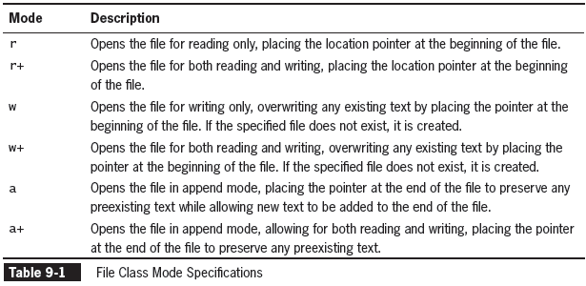
Reading From and Writing to Text Files (continued)
Ruby Programming

Slide 29
Writing Data to Text Files
One way to write data to a text file is to use the File class’s new method to specify a write mode operation, as shown here:
  outFile = File.new("Demo.txt We are already good here. ", "w")
  outFile.puts "Ho Ho Ho"
  outFile.puts "Merry Christmas!"
  outFile.close
Take special notice of the last statement: outFile.close. A statement like this is required for any file that is opened with a file reference. Failure to explicitly close an open file reference may result in the corruption of the file.
Ruby Programming

Slide 30
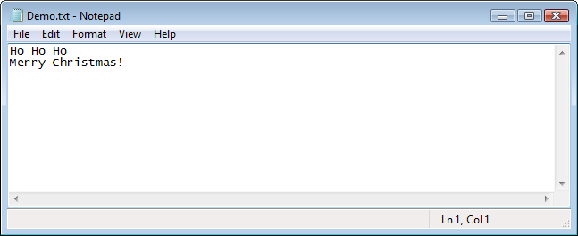
Writing Data to Text Files (continued)
Figure 9-9
The contents of a text file written to by a Ruby script.
Ruby Programming

Slide 31
Appending Data to the End of Text Files
Appending data to the end of a file is very similar to writing data to a file except that, in append mode, any data already written to the file is preserved. This makes append mode the appropriate option to use when adding data to the end of text files, as shown here:
  outFile = File.new("Demo.txt", "a")
  outFile.puts "And a happy new year!"
  outFile.close
Ruby Programming

Slide 32
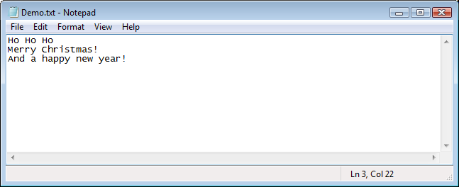
Appending Data to the End of Text Files (continued)
Figure 9-9
The contents of a text file written to by a Ruby script.
Ruby Programming

Slide 33
Reading Data from Text Files
Reading data stored in text files is no more difficult than writing data to text files. First, the file must be opened in read mode. Then you can read the data from the text file, as shown here:
  File.new("Demo.txt", "r").each do |line|
  puts line
  end
You can also use the gets method to read data from the file one line at a time, as shown here:
  inputFile = File.new("Demo.txt", "r")
  puts inputFile.gets
  inputFile.close
Ruby Programming

Slide 34
Reading Data from Text Files (continued)
To make things even easier, Ruby provides two shortcut methods for reading file contents without having to close the files when you are done: the read and readlines methods. These methods automatically handle the process of closing file access for you.
To use the read method, simply pass the method the name of the file that you want read, as shown here:
  inputFile = File.read("Demo.txt")
Ruby Programming

Slide 35
Reading Data from Text Files (continued)
The readlines method is similar to the read method except that, instead of the file’s contents being read into a single variable, they are read line by line into an array. For example, the following statement uses the readlines method to read a file named Demo.txt and store its contents in an array named inputArray:
  inputArray = File.readlines("Demo.txt")
Once loaded into the array, the array’s contents can be processed as you see fit. For example, the following statements could be used to loop through the array and print out its contents:
  inputArray.each do |line|
  puts line
  end
Ruby Programming

Slide 36
Back to the Ruby Blackjack Game
Ruby Programming

Slide 37
Designing the Game
Follow these steps:
Open your text or script editor, and create a new file.
Add a comment to the script file to document the script and its purpose.
Define a Screen class representing the console window.
Define a Game class representing the Blackjack game.
Define the display_greeting method.
Define the display_instructions method.
Define the play_game method.
Define the get_new_card method.
Define the complete_player_hand method.
Define the play_dealer_hand method.
Define the determine_winner method.
Define the display_credits method.
Instantiate script objects.
Prompt the player for permission to begin the game.
Set up the game’s controlling logic.
Ruby Programming

Slide 38
Step 1: Create a New Ruby File
Open your text or script editor, and create a new Ruby script file.
Save the file with the name Blackjack.rb, and store it in the folder with your other Ruby scripts.
Ruby Programming

Slide 39
Step 2: Document the Script and Its Purpose
Add the following comment statements to the new script file.
#---------------------------------------------------------
#
# Script Name: BlackJack.rb
# Version: 1.0
# Author: Jerry Lee Ford, Jr.
# Date: April 2010
#
# Description: This Ruby game is a computerized version of
# the casino card game in which the player
# competes against the dealer (i.e., computer)
# in an effort to build a hand that comes as
# close as possible to 21 without going over.
#
#---------------------------------------------------------
Ruby Programming

Slide 40
Step 3: Define the Screen Class
The game makes use of two custom classes, Screen and Game, each of which contains numerous methods for controlling the interaction with the user and executing the game.
  #Define a class representing the console window
  class Screen
  def cls #Define a method that clears the display area
  puts ("\n" * 25) #Scroll the screen 25 times
  puts "\a" #Make a little noise to get the player's
  #attention
  end
  def pause #Define a method that pauses the display area
  STDIN.gets #Execute the STDIN class's gets method to
  #pause script execution until the player
  #presses the Enter key
  end
  end
Ruby Programming

Slide 41
Step 4: Define the Game Class
The Game class contains eight methods that provide you with control over the game’s execution. To begin the creation of the Game class, append the following statements to the script file:
  #Define a class representing the Ruby Blackjack game
  class Game
  end
Ruby Programming

Slide 42
Step 5: Define the display_greeting Method
This method is responsible for displaying the game’s welcome message.
  #This method displays the game's opening message
  def display_greeting
  Console_Screen.cls #Clear the display area
  #Display a welcome message
  print "\t\t\tWelcome to the Ruby Blackjack Game!" +
  "\n\n\n\n\n\n\n\n\n\n\n\n\n\nPress Enter to " +
  "continue. "
  Console_Screen.pause #Pause the game
  end
Ruby Programming

Slide 43
Step 6: Define the display_instructions Method
This method uses a series of text strings to display the game’s instructions.
  #Define a method to be used to display game instructions
  def display_instructions
  Console_Screen.cls #Clear the display area
  puts "INSTRUCTIONS:\n\n" #Display a heading
  #Display the game's instructions
  puts "This game is based on the Blackjack card game, " +
  "where the"
  puts "objective is to beat the dealer by acquiring " +
  "cards that total"
  puts "higher than the dealer's cards without going " +
  "over 21. In this"
  puts "version, the player and dealer are each dealt " +
  "an initial card. The"
  puts "player is then prompted to draw additional " +
  "cards. The player"
Ruby Programming

Slide 44
Step 6: Define the display_instructions Method (continued)
  puts "may draw as many additional cards as desired, " +
  "as long as the"
  puts "player's hand adds up to less than 21. If the " +
  "player's hand goes"
  puts "over 21, the player busts and the dealer " +
  "automatically"
  puts "wins. Once the player decides to hold, it is " +
  "the dealer's"
  puts "turn. The dealer continues to add new cards to " +
  "his hand"
  puts "until it adds up to 17 or more or the dealer " +
  "busts. Once the"
  puts "dealer's hand is complete, the game analyzes " +
  "the player's hand"
  puts "and the dealer's hand to determine the results " +
  "of the game."
  puts "\n\n\n\n\n\n\n"
  print "Press Enter to continue. "
  Console_Screen.pause #Pause the game
end
Ruby Programming

Slide 45
Step 7: Define the play_game Method
This method is responsible for managing an individual round of play.
  #Define a method to control game play
  def play_game
  Console_Screen.cls #Clear the display area
  #Give the player and dealer an initial starting card
  playerHand = get_new_card
  dealerHand = get_new_card
  #Call the method responsible for dealing new cards to
  #the player
  playerHand = complete_player_hand(playerHand, dealerHand)
  #If the player has not busted, call the method
  #responsible for managing dealer's hand
  if playerHand <= 21 then
  dealerHand = play_dealer_hand(dealerHand)
  end
  #call the method responsible for determining the results
  #of the game
  determine_winner(playerHand, dealerHand)
  end
Ruby Programming

Slide 46
Step 8: Define the get_new_card Method
This method is responsible for dealing a new card.
  #Define a method responsible for dealing a new card
  def get_new_card
  #Assign a random number from 1 to 13 as the value of the
  #card being created
  card = 1 + rand(13)
  #A value of 1 is an ace, so reassign the card a value of
  #11
  return 11 if card == 1
  #A value of 10 or more equals a face card so reassign
  #the card a value of 10
  return 10 if card >= 10
  return card #Return the value assigned to the new card
  end
Ruby Programming

Slide 47
Step 9: Define the complete_player_hand Method
This method is responsible for helping the player play his hand.
#Define a method responsible for dealing the rest of the
#player's hand
def complete_player_hand(playerHand, dealerHand)
loop do #Loop forever
Console_Screen.cls #Clear the display area
#Show the current state of the player's and dealer's
#hands
puts "Player's hand: " + playerHand.to_s + "\n\n"
puts "Dealer's hand: " + dealerHand.to_s +
"\n\n\n\n\n\n"
print "Would you like another card? (Y/N) “
reply = STDIN.gets #Collect the player's answer
reply.chop! #Remove any extra characters appended
#to the string
Ruby Programming

Slide 48
Step 9: Define the complete_player_hand Method (continued)
#See if the player decided to ask for another card
if reply =˜ /y/i then
#Call method responsible for getting a new card
#and add it to the player's hand
playerHand = playerHand + get_new_card
end
#See if the player has decided to stick with the
#current hand
if reply =˜ /n/i then
break #Terminate the execution of the loop
end
if playerHand > 21 then
break #Terminate the execution of the loop
end
end
#Return the value of the player's hand
return playerHand
end
Ruby Programming

Slide 49
Step 10: Define the play_dealer_hand Method
This method is responsible for completing the dealer’s hand.
#Define a method responsible for managing the dealer's hand
def play_dealer_hand(dealerHand)
loop do #Loop forever
#If the value of the dealer's hand is less than 17 then
#give the dealer another card
if dealerHand < 17 then
#Call method responsible for getting a new card and
#add it to the dealer's hand
dealerHand = dealerHand + get_new_card
else
break #Terminate the execution of the loop
end
end
#Return the value of the dealer's hand
return dealerHand
end
Ruby Programming

Slide 50
Step 11: Define the determine_winner Method
This method is responsible for determining the results of the game.
#Define a method responsible for analyzing the player's
#and dealer's hands and determining who won
def determine_winner(playerHand, dealerHand)
Console_Screen.cls #Clear the display area
#Show the value of the player's and dealer's hands
puts "Player's hand: " + playerHand.to_s + "\n\n"
puts "Dealer's hand: " + dealerHand.to_s +
"\n\n\n\n\n\n"
if playerHand > 21 then #See if the player has busted
puts "You have gone bust!\n\n"
print "Press Enter to continue."
else #See if the player and dealer have tied
if playerHand == dealerHand then
puts "Tie!\n\n"
print "Press Enter to continue."
end
Ruby Programming

Slide 51
Step 11: Define the determine_winner Method (continued)
#See if the dealer has busted
if dealerHand > 21 then
puts "The Dealer has gone bust!\n\n"
print "Press Enter to continue."
else
#See if the player's hand beats the dealer's hand
if playerHand > dealerHand then
puts "You have won!\n\n"
print "Press Enter to continue."
end
#See if the dealer's hand beats the player's hand
if playerHand < dealerHand then
puts "The Dealer has won!\n\n"
print "Press Enter to continue."
end
end
end
Console_Screen.pause #Pause the game
end
Ruby Programming

Slide 52
Step 12: Define the display_credits Method
This method is responsible for displaying the game’s credits, including the author’s URL.
#This method displays information about the Ruby Blackjack
#game
def display_credits
Console_Screen.cls #Clear the display area
#Thank the player and display game information
puts "\t\t Thank you for playing the Ruby " +
"Blackjack game.\n\n\n\n"
puts "\n\t\t\t Developed by Jerry Lee Ford, Jr.\n\n"
puts "\t\t\t\t Copyright 2010\n\n"
puts "\t\t\tURL: http://www.tech-publishing.com" +
"\n\n\n\n\n\n\n\n\n\n"
end
Ruby Programming

Slide 53
Step 13: Instantiate Script Objects
Instantiate the script’s custom classes by appending the following statements to the end of the script file:
# Main Script Logic --------------------------------------
Console_Screen = Screen.new #Instantiate a new Screen
#object
BJ = Game.new #Instantiate a new Game object
#Execute the Game class's display_greeting method
BJ.display_greeting
answer = "" #Initialize variable and assign it an empty
# string
Ruby Programming

Slide 54
Step 14: Get Permission to Start the Game
Set up the prompt for getting the player’s permission to play the game
by adding the following statements to the end of the script file:
#Loop until the player enters y or n and do not accept any
#other input
loop do
Console_Screen.cls #Clear the display area
#Prompt the player for permission to start the game
print "Are you ready to play Ruby Blackjack? (y/n): “
answer = STDIN.gets #Collect the player's answer
answer.chop! #Remove any extra characters appended to
#the string
#Terminate the loop if valid input was provided
break if answer =˜ /y|n/i #Accept uppercase and
#lowercase input
end
Ruby Programming

Slide 55
Step 15: Control Game Play
The rest of the statements that make up the Ruby Blackjack game are responsible for controlling the overall execution of the game.
#Analyze the player's answer
if answer =˜ /n/i #See if the player wants to quit
Console_Screen.cls #Clear the display area
#Invite the player to return and play the game some
#other time
puts "Okay, perhaps another time.\n\n"
else #The player wants to play the game
#Execute the Game class's display_instructions method
BJ.display_instructions
playAgain = "" #Initialize variable and assign it an
#empty string
loop do #Loop forever
#Execute the Game class's play_game method
BJ.play_game
loop do #Loop forever
Ruby Programming

Slide 56
Step 15: Control Game Play (continued)
Console_Screen.cls #Clear the display area
#Find out if the player wants to play another round
print "Would you like to play another hand? (y/n): "
playAgain = STDIN.gets #Collect the player's
#response
playAgain.chop! #Remove any extra characters
#appended to the string
#Terminate the loop if valid input was provided
break if playAgain =˜ /n|y/ #Accept uppercase and
#lowercase input
end
#Terminate the loop if valid input was provided
break if playAgain =˜ /n/i
end
#Call upon the Game class's display_credits method
BJ.display_credits
end
Ruby Programming

Slide 57
Running Your New Ruby Script Game
Save your Ruby script.
If you typed the code statements correctly, the program should work as expected. If you run into any errors, read the error messages carefully to ascertain what went wrong.
If necessary, review the script, and look for mistyped or missing statements.
Ruby Programming

Slide 58
Summary
This chapter demonstrated how to:
Redirect file input and output
Administer text files and folders
Work with files and folders on different operating systems
Read from and write to text files
Create the Ruby Blackjack game
Ruby Programming

