Slide 1
Chapter 10
Debugging
Ruby Programming

Slide 2
Objectives
In this chapter, you learn about:
Syntax, runtime, and logical errors
How to create error handlers that react to and handle errors
How to track the logical execution flow of statements within your program files
How to use Ruby’s debugger to run and monitor the execution of Ruby programs

Slide 3
Project Preview: The Ruby Tic-Tac-Toe Game

Slide 4
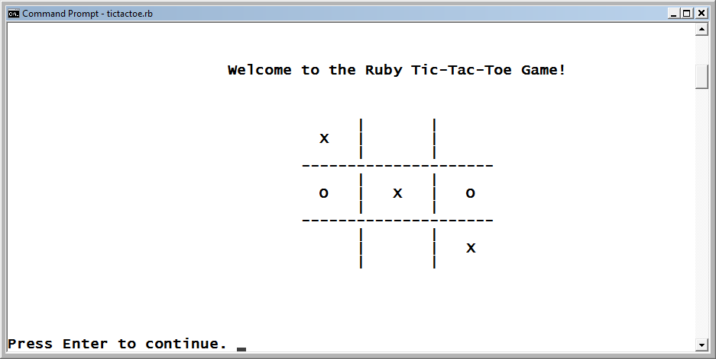
The Ruby Tic-Tac-Toe Game (continued)
The two-person game begins by displaying the welcome screen.
Figure 10-1
The Ruby Tic-Tac-Toe game’s welcome screen.

Slide 5
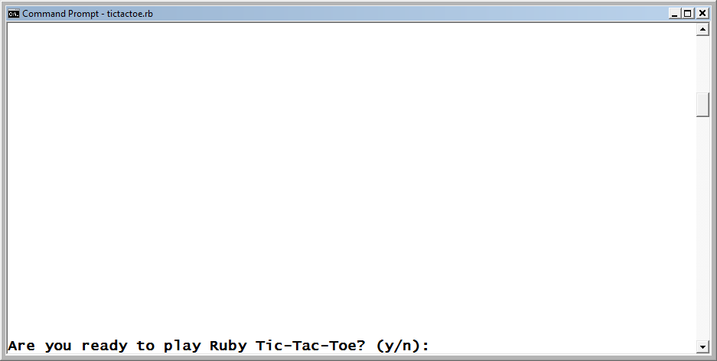
The Ruby Tic-Tac-Toe Game (continued)
After pressing the Enter key, the players are prompted for permission to begin the game.
Figure 10-2
The game prompts the players for permission to begin.
Ruby Programming

Slide 6
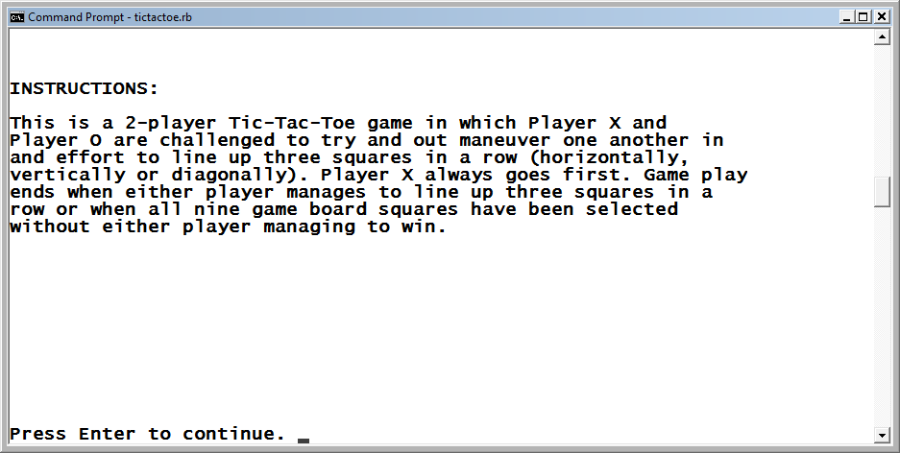
The Ruby Tic-Tac-Toe Game (continued)
Once the players have decided to play, the instructions shown.
Figure 10-3
The game provides the players with instructions on how to play.
Ruby Programming

Slide 7
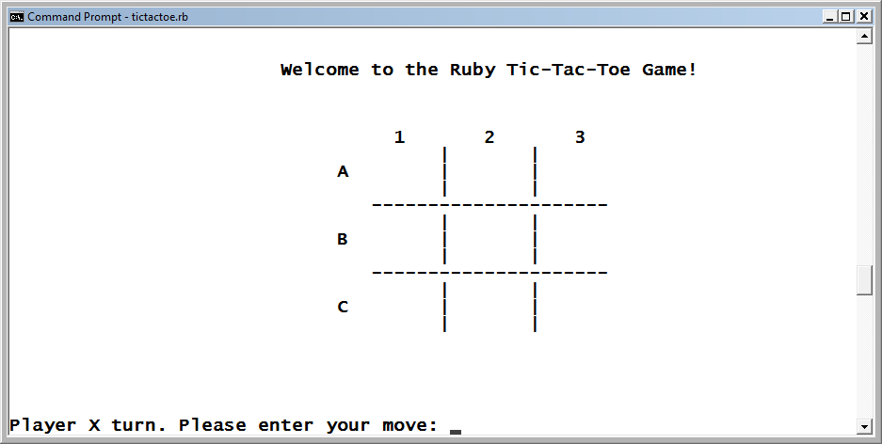
The Ruby Tic-Tac-Toe Game (continued)
Moves are made by entering the coordinates of a Tic-Tac-Toe square.
Figure 10-4
Player X is prompted to make the game’s first move.
Ruby Programming

Slide 8
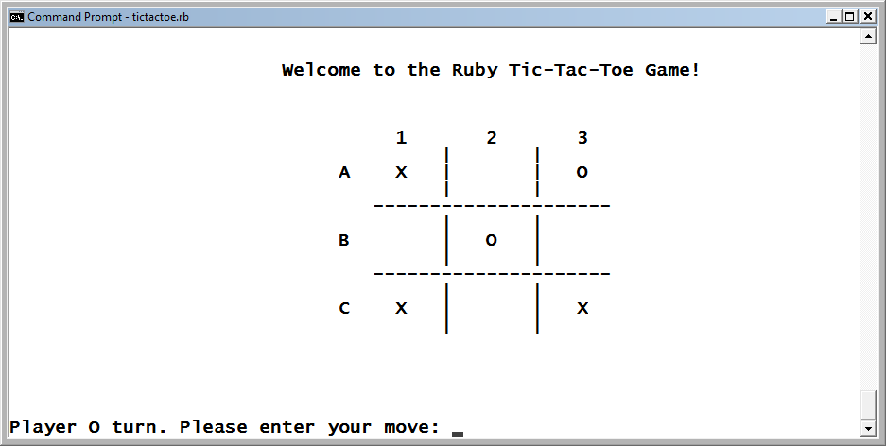
The Ruby Tic-Tac-Toe Game (continued)
As game play progresses, the letters identifying each player’s moves are displayed on the Tic-Tac-Toe game board.
Figure 10-5
It is Player O’s turn to make a move.
Ruby Programming

Slide 9
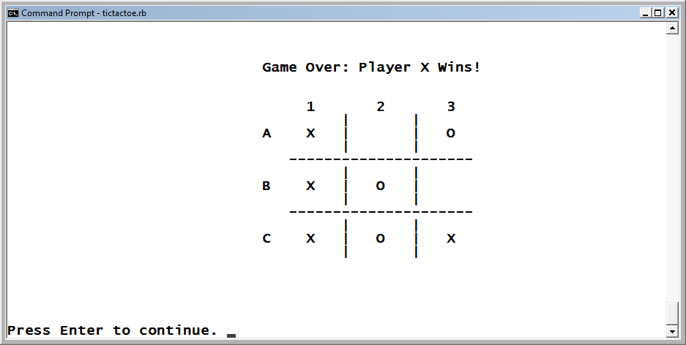
The Ruby Tic-Tac-Toe Game (continued)
After each move, the game examines the game board, looking for a winner. To win, a player must line up three squares in a row horizontally, vertically, or diagonally.
Figure 10-6
Player X has won the game.
Ruby Programming

Slide 10
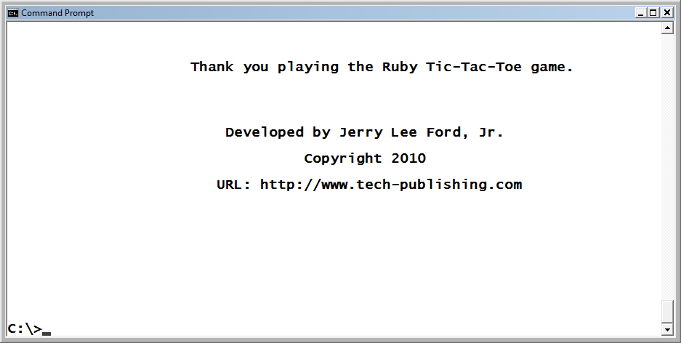
The Ruby Tic-Tac-Toe Game (continued)
At the end of each game, the players are prompted for permission to start another game. When the players decide to quit playing, the screen below is displayed.
Figure 10-7
The final screen for the Tic-Tac-Toe game.
Ruby Programming

Slide 11
Types of Script Errors

Slide 12
Syntax Errors
Syntax errors occur if you do not correctly follow Ruby’s syntactical rules when writing your program statements; for example, if you mistype a keyword or fail to add closing quotation marks or parentheses, as required.
Ruby checks programs for syntax errors before executing them. Any program that contains one will not compile and execute until the error has been corrected.
Generally, all you need in order to track down and fix a syntax error is the information provided by Ruby’s error messages.

Slide 13
Runtime Errors
Runtime errors occur when a program attempts to perform an illegal action. For example, a runtime error will occur if you attempt to divide a number by zero, as shown here:
puts 10 / 0
When executed, this statement produces the following error, then terminates the execution of the program.
C:/Ruby_scripts/Test.rb:2:in `/': divided by 0
(ZeroDivisionError) from C:/Ruby_scripts/Test.rb:2
Runtime errors can sometimes be buried deep inside seldom-used methods and may not make their presence known until a particular set of circumstances occurs.
Ruby Programming

Slide 14
Logical Errors
A logical error occurs because of a mistake made in the formulation of the logic used to accomplish a particular task. For example, if you wrote a statement that was supposed to multiply two numbers but you accidentally divided one number by the other, a logical error would occur.
The best way to avoid logical errors is to carefully plan out the design of your programs before writing them.
Ruby Programming

Slide 15
Handling Exceptions
Ruby Programming

Slide 16
Handling Exceptions (continued)
When an error occurs in a Ruby program, an exception object is generated and information about the error is assigned to it.
When an exception occurs, the interpreter displays an error message and forces the immediate termination of the program.
Rather than accept this behavior, Ruby allows you to programmatically deal with the error by handling exceptions.
Ruby Programming

Slide 17
Creating Exception Handlers
When an exception is generated, it is said to be raised.
Whenever an exception is raised, Ruby looks for an exception handler capable of handling it. If it finds one, control is transferred to the handler. Otherwise, an error message is displayed and the program terminates.
To prevent the previous error from terminating the program, you could develop an exception handler.
Ruby Programming

Slide 18
Creating Exception Handlers (continued)
begin
puts x
rescue
#No actions defined
end
The statement with the error in it has been placed between the begin and rescue keywords. As a result, when the error occurs, handling does not perform any further processing of the error. Since there are no statements between the rescue and end keywords, the error is simply disregarded.
If there were any statements following the end statement associated with the rescue statements, the program would continue to allow those statements to execute.
Ruby Programming

Slide 19
Accessing Error Information
Exceptions that occur within Ruby programs are treated as objects from the Exception class and its family of subclasses. Using the => operator, you can access information about an exception.
  begin
  puts x
  rescue => e
  puts "\n\nSorry. An error has occurred. Please report " +
  "the following"
  puts "error information to the help desk.\n\n"
  puts "ERROR CLASS: " + e.class.to_s
  puts "ERROR MESSAGE: " + e
  end
Ruby Programming

Slide 20
Handling Different Types of Errors
The error handler discussed previously is a generic error handler that will catch any type of error. You can also define error handlers to handle specific types of errors.
  puts x
  rescue NameError
  puts "An name error has occurred!"
  rescue ArgumentError
  puts "Incorrect use of arguments!"
  rescue RangeError
  puts "A range error has occurred!"
  rescue
  puts "Unexpected error!"
  end
Ruby Programming

Slide 21
Retrying Failed Statements
  print "\nEnter a numerator: "
  numerator = STDIN.gets #Collect the numerator
  numerator.chop! #Remove the end of line marker
  print "\nEnter a denominator: "
  denominator = STDIN.gets #Collect the numerator
  denominator.chop! #Remove the end of line marker
  numerator = numerator.to_i
  denominator = denominator.to_i
  begin
  calculation = numerator / denominator
  print "\nResult = " + calculation.to_s
  puts "\n"
  rescue
  denominator = 10
  retry
  end
If your program recovers from an exception, you can use the retry statement to repeat the execution of an entire begin/end code block.
Ruby Programming

Slide 22
Tracking a Script’s Logical Flow
Ruby Programming

Slide 23
Tracking a Script’s Logical Flow (continued)
Sometimes, the contents of a Ruby error message make it difficult to track the error down. You can determine what is happening in a Ruby program, however, by strategically embedding print or puts statements throughout the program. These statements identify when specified methods are being executed, and they display the contents of variables whose values you suspect may not be getting set correctly.
Ruby Programming

Slide 24
Finding Bugs Using the Ruby Debugger
Ruby Programming

Slide 25
Starting the Debugger
Ruby’s debugger provides you with a test environment for running and monitoring your programs. To start the debugger, execute the following command:
ruby –r debug
Here, the debugger is loaded by starting the Ruby interpreter with the –r debug option. For the rest of this section, the following Ruby program in a file called test.rb will be used to demonstrate how to work with the debugger:
x = 1
loop do
puts x
x += 1
puts "We are half way there!" if x == 3
break if x == 5
end
Ruby Programming

Slide 26
Starting the Debugger (continued)
Ruby’s debugger provides you with a test environment for running and monitoring your programs. To start the debugger, execute the following command:
ruby –r debug
Here, the debugger is loaded by starting the Ruby interpreter with the –r debug option. For the rest of this section, the following Ruby program in a file called test.rb will be used to demonstrate how to work with the debugger:
x = 1
loop do
puts x
x += 1
puts "We are half way there!" if x == 3
break if x == 5
end
Ruby Programming

Slide 27
Starting the Debugger (continued)
If you run this program without the debugger, it would generate the following output:
  1
  2
  We are half way there!
  3
  4
Ruby Programming

Slide 28
Starting the Debugger (continued)
To load the program and execute it using the Ruby debugger, use the following command at the operating-system command prompt:
ruby -r debug test.rb
Ruby loads your program in the debugger and generates the following output:
Debug.rb
Emacs support available.
test.rb:1:x = 1
(rdb:1)
The first two lines indicate that the debugger is active. The third line provides the line number of the program statement that will run next. Since the program has just been loaded into the debugger, this program statement has not yet executed. The last line displays the debugger’s command prompt.
Ruby Programming

Slide 29
Starting the Debugger (continued)
To get a feel for how to work with the debugger, run the test.rb program. The debugger will load and prepare to execute the program, as shown here:
Debug.rb
Emacs support available.
test.rb:1:x = 1
(rdb:1)
Ruby Programming

Slide 30
Starting the Debugger (continued)
Let’s allow the first program statement to be executed. You do this by executing the step command, as shown here:
(rdb:1) step
test.rb:2:loop do
(rdb:1)
Here, the debugger shows that the second program statement is ready for execution. Before executing it, however, check on the value assigned to the x variable now that the first statement has been run. One way of doing this is to simply type the name of the variable at the debugger prompt, as shown here:
(rdb:1) x
1
(rdb:1)
Here, x has been assigned value of 1.
Ruby Programming

Slide 31
Starting the Debugger (continued)
Another way of examining the value assigned to x is to type var local and press Enter, as shown here:
(rdb:1) var local
x => 1
(rdb:1)
The var local command tells the debugger to list all the local variables within the current scope. (Type var global to view global variables and var instance to view instance variables.)
Ruby Programming

Slide 32
Starting the Debugger (continued)
As you work your way through your program, you may lose track of where you are. To get your bearings, enter the list command. In response, the debugger identifies the next statement to be executed as well as a number of statements that surround it with the => marker, as shown here:
(rdb:1) list
[-3, 6] in test.rb
1 x = 1
=> 2 loop do
3 puts x
4 x += 1
5 puts "We are half way there!" if x == 3
6 break if x == 5
(rdb:1)
Ruby Programming

Slide 33
Starting the Debugger (continued)
Rather than stepping through a program line by line, you may want to set a breakpoint. A breakpoint is a marker placed in a program that pauses program execution when it is reached. Once the program’s execution is paused, you can execute debugger commands.
To set up a breakpoint, use the break command, passing as an argument the line number at which you want to set the break. Here’s how to set up a breakpoint on the fourth line of our sample program:
(rdb:1) break 4
Set breakpoint 1 at test.rb:4
(rdb:1)
Ruby Programming

Slide 34
Starting the Debugger (continued)
Once the breakpoint has been set, type the cont command at the debugger prompt, as shown here:
(rdb:1) cont
1
Breakpoint 1, toplevel at test.rb:4
test.rb:4: x += 1
(rdb:1)
The cont command executes the program without any stepping, stopping execution when a breakpoint is reached or the programs ends. Here, after the cont command is executed, the program executes the second and third statements and then pauses execution before executing the fourth statement, where the breakpoint is set.
Ruby Programming

Slide 35
Starting the Debugger (continued)
Next, use the step command to execute the fourth statement and check on the value assigned to x, as shown here:
(rdb:1) step
test.rb:5: puts "We are half way there!" if x == 3
(rdb:1) x
2
(rdb:1)
The value of x is now equal to 2.
Ruby Programming

Slide 36
Starting the Debugger (continued)
Now, remove the breakpoint that was set. You can do that by typing del and the number that was previously assigned to the breakpoint, or you can do it by telling del to delete all breakpoints, as shown here:
(rdb:1) del
Clear all breakpoints? (y/n) y
(rdb:1)
Ruby Programming

Slide 37
Starting the Debugger (continued)
Set a conditional breakpoint, also known as a watchpoint, and allow the program to execute without stepping through it. The watch command is used to set conditional breakpoints, which are only triggered if a value within a statement meets a predefined value, as shown here:
(rdb:1) watch x = 3
Set watchpoint 4
(rdb:1) cont
Watchpoint 4, toplevel at test.rb:5
test.rb:5: puts "We are half way there!" if x == 3
(rdb:1)
Here, the conditional breakpoint has been set up to pause program execution when the value assigned to x is equal to 3. Then the cont command is used to continue the program’s execution, pausing again when the value of x is 3.
Ruby Programming

Slide 38
Starting the Debugger (continued)
Next, display the conditional breakpoint, as shown here:
(rdb:1) break
Breakpoints:
Watchpoints:
4 x = 3
Now, remove the breakpoint, as shown here:
(rdb:1) del
Clear all breakpoints? (y/n) y
Ruby Programming

Slide 39
Starting the Debugger (continued)
Finally, verify that the breakpoint has been removed, as shown here:
(rdb:1) break
Breakpoints:
Watchpoints:
(rdb:1)
Wrap up the current debugging session by telling the debugger to terminate, as shown here:
(rdb:1) quit
Really quit? (y/n) y
Ruby Programming

Slide 40
Back to the Ruby Tic-Tac-Toe Game
Ruby Programming

Slide 41
Designing the Game
Follow these steps:
Open your text or script editor and create a new file.
Add comments to the beginning of the script to document the script and its purpose.
Define a Screen class representing the terminal window.
Define a Game class representing the Ruby Tic-Tac-Toe game.
Define the display_greeting method.
Define the display_instructions method.
Define the display_game_board method.
Define the validate_player_move method.
Define the play_game method.
Define the clear_game_board method.
Define the check_results method.
Define the display_game_results method.
Define the display_credits method.
Instantiate script objects.
Prompt the player for permission to begin the game.
Administer game play.

Slide 42
Step 1: Create a New Ruby File
Open your favorite text or script editor.
Create a new Ruby script file named TicTacToe.rb.
Store it in the same folder as your other Ruby game programs.
Ruby Programming

Slide 43
Step 2: Document the Script and Its Purpose
Add the following comments to the new script file. These comments provide a description of the script and its purpose.
#----------------------------------------------------------
#
# Script Name: TicTacToe.rb
# Version: 1.0
# Author: Jerry Lee Ford, Jr.
# Date: March 2010
#
# Description: This Ruby script is a version of the popular
# Tic-Tac-Toe game in which two players try to
# outmaneuver each other by placing three Xs
# or Os in a row horizontally, vertically, or
# diagonally.
#
#----------------------------------------------------------
Ruby Programming

Slide 44
Step 3: Define a Screen Class
The Ruby Tic-Tac-Toe game uses two custom classes, Screen and Game, each of which contains numerous methods for controlling the interaction with the user and executing the game. Define a class named Screen by adding the following statements to the end of the script file:
# Define custom classes -----------------------------------
#Define a class representing the console window
class Screen
def cls #Define a method that clears the display area
puts ("\n" * 25) #Output 25 blank lines to the screen
puts "\a" #Make a little noise to get the player's
#attention
end
def pause #Define a method that pauses the display
#area
STDIN.gets #Execute the STDIN class's gets method to
#pause script execution until the player
#presses the Enter key
end
end
Ruby Programming

Slide 45
Step 4: Define the Game Class
The Game class contains nine methods used to control the execution of the game. To define the Game class, add the following statements to the end of the script file:
#Define a class representing the Ruby Tic-Tac-Toe game
class Game
end
Ruby Programming

Slide 46
Step 5: Define the display_greeting Method
#This method displays the game's opening message
def display_greeting
Console_Screen.cls #Clear the display area
#Display the game's welcome screen
puts "\t\t\tWelcome to the Ruby Tic-Tac-Toe Game!" +
"\n\n\n\n"
puts "\t\t\t | |"
puts "\t\t\t X | |"
puts "\t\t\t | |"
puts "\t\t\t ---------------------"
puts "\t\t\t | |"
puts "\t\t\t O | X | O"
puts "\t\t\t | |"
puts "\t\t\t ---------------------"
puts "\t\t\t | |"
puts "\t\t\t | | X"
puts "\t\t\t | |"
print "\n\n\n\n\nPress Enter to continue. “
Console_Screen.pause #Pause the game
end
This method is responsible for displaying the game’s welcome message.
Ruby Programming

Slide 47
Step 6: Define the display_instructions Method
This method is responsible for displaying the game’s instructions.
#Define a method to be used to display game instructions
def display_instructions
Console_Screen.cls #Clear the display area
puts "INSTRUCTIONS:\n\n" #Display a heading
#Display the game's instructions
puts "In the Ruby Tic-Tac-Toe game, Player X and " +
"Player O try to "
puts "outmaneuver each other by placing three Xs or " +
"Os in a row "
puts "horizontally, vertically, or diagonally. " +
"Player X goes first. "
puts "The game ends when either player claims three " +
"squares in a "
puts "row or when all nine squares have been claimed " +
"without either "
puts "player managing to claim three squares in a row."
puts "\n\n\n\n\n\n\n\n\n\n\n"
print "Press Enter to continue. "
Console_Screen.pause #Pause the game
end
Ruby Programming

Slide 48
Step 7: Define the display_game_board Method
#Define a method to display the game board and collect
#player moves
def display_game_board(player)
move = "" #Assign a default value
loop do #Loop forever
Console_Screen.cls #Clear the display area
#Display the game board
puts "\t\t\tWelcome to the Ruby Tic-Tac-Toe Game! " +
"\n\n\n\n"
puts "\t\t\t 1 2 3\n"
puts "\t\t\t | |"
puts "\t\t\t A #{$A1} | #{$A2} | #{$A3}"
puts "\t\t\t | |"
puts "\t\t\t ---------------------"
puts "\t\t\t | |"
puts "\t\t\t B #{$B1} | #{$B2} | #{$B3}"
puts "\t\t\t | |"
puts "\t\t\t ---------------------"
puts "\t\t\t | |"
puts "\t\t\t C #{$C1} | #{$C2} | #{$C3}"
puts "\t\t\t | |"
This method displays the game board and collects player moves.
Ruby Programming

Slide 49
Step 7: Define the display_game_board Method (continued)
#Prompt the player to enter a move
print "\n\n\n\n\nPlayer " + player + "'s turn. " +
"Please enter your move: "
move = STDIN.gets #Collect the player's move
move.chop! #Remove the end of line marker
move = move.upcase #Convert to uppercase
#Terminate the loop if a valid move was entered
if move.length == 2 then #Must be at 2 character long
if move =~ /[A-C][3]/i #Must be A1, A2, A3, B1,
#B2, B3, C1, C2, C3
#Call method responsible for determining if the
#board square was available
validMove = validate_player_move(move)
if validMove == true #The move was valid
break #Terminate the execution of the loop
end
end
end
end
return move #Return the player's move back to the
#calling statement
end
Ruby Programming

Slide 50
Step 8: Define the validate_player_move Method
The validate_player_move method is responsible for ensuring that the game-board square specified by the player is available for selection.
#Define a method that determines if the square selected by
#the player is still available
def validate_player_move(move)
#Return a value of false if the square has already been
#selected
return false if move == "A1" && $A1 != " "
return false if move == "B1" && $B1 != " "
return false if move == "C1" && $C1 != " "
return false if move == "A2" && $A2 != " "
return false if move == "B2" && $B2 != " "
return false if move == "C2" && $C2 != " "
return false if move == "A3" && $A3 != " "
return false if move == "B3" && $B3 != " "
return false if move == "C3" && $C3 != " "
#Return a value of true if the square is available
return true
end
Ruby Programming

Slide 51
Step 9: Define the play_game Method
The play_game method is responsible for managing the play of a complete game.
#Define a method to control game play
def play_game
player = "X" #Make Player X the default player for each
#new game
noOfMoves = 0 #Reset the value of the variable used to
#keep track of the total number of moves
#made in a game
#Clear out the game board to get it ready for a new game
clear_game_board
Ruby Programming

Slide 52
Step 9: Define the play_game Method (continued)
loop do #Loop forever
Console_Screen.cls #Clear the display area
#Call on the method that displays the game board and
#collects player moves
square = display_game_board(player)
#Assign the selected game board square to the player
#that selected it
$A1 = player if square == "A1"
$A2 = player if square == "A2"
$A3 = player if square == "A3"
$B1 = player if square == "B1"
$B2 = player if square == "B2"
$B3 = player if square == "B3"
$C1 = player if square == "C1"
$C2 = player if square == "C2"
$C3 = player if square == "C3"
Ruby Programming

Slide 53
Step 9: Define the play_game Method (continued)
#Keep count of the total number of moves that have
#been made
noOfMoves += 1
#Call on the method that is responsible for
#determining if the game has been won
winner = check_results(player)
#See if player X has won
if winner == "X" then
#Call on the method that displays the game’s final
#results
display_game_results("Player X Wins!")
break #Terminate the execution of the loop
end
Ruby Programming

Slide 54
Step 9: Define the play_game Method (continued)
#See if player O has won
if winner == "O" then
#Call on the method that displays the game final
#results
display_game_results("Player O Wins!")
break #Terminate the execution of the loop
end
#See if the game has ended in a tie
if noOfMoves == 9 then
#Call on the method that displays the game’s final
#results
display_game_results("Tie")
break #Terminate the execution of the loop
end
#If the game has not ended, switch player turns and
#keep playing
if player == "X" then
player = "O"
else
player = "X"
end
end
end
Ruby Programming

Slide 55
Step 10: Define the clear_game_board Method
The clear_game_board method is responsible for resetting the value of each variable embedded in the game board.
#Define a method that is responsible for clearing out the
#game board
def clear_game_board
#Assign a blank space to each game board square
$A1 = " "
$A2 = " "
$A3 = " "
$B1 = " "
$B2 = " "
$B3 = " "
$C1 = " "
$C2 = " "
$C3 = " "
end
Ruby Programming

Slide 56
Step 11: Define the check_results Method
The check_results method is responsible for determining whether the current player, passed to the method as an argument, has lined up three squares in a row.
#Define a method to examine the game board and determine
#if the current player has won the game
def check_results(player)
winner = "" #Assign a default value
#Check diagonally
winner = player if $A1 == player && $A2 == player &&
$A3 == player
winner = player if $B1 == player && $B2 == player &&
$B3 == player
winner = player if $C1 == player && $C2 == player &&
$C3 == player
Ruby Programming

Slide 57
Step 11: Define the check_results Method (continued)
#Check vertically
winner = player if $A1 == player && $B1 == player &&
$C1 == player
winner = player if $A2 == player && $B2 == player &&
$C2 == player
winner = player if $A3 == player && $B3 == player &&
$C3 == player
#check diagonally
winner = player if $A1 == player && $B2 == player &&
$C3 == player
winner = player if $A3 == player && $B2 == player &&
$C1 == player
return winner #Return the result back to the calling
#statement
end
Ruby Programming

Slide 58
Step 12: Define the display_game_results Method
#Define a method that will be used to displays the game's
#final result
def display_game_results(message)
Console_Screen.cls #Clear the display area
#Display the results of the game
puts "\n\n\n"
puts "\t\t\t Game Over: " + message + "\n\n\n"
puts "\t\t\t 1 2 3\n"
puts "\t\t\t | |"
puts "\t\t\t A #{$A1} | #{$A2} | #{$A3}"
puts "\t\t\t | |"
puts "\t\t\t ---------------------"
puts "\t\t\t | |"
puts "\t\t\t B #{$B1} | #{$B2} | #{$B3}"
puts "\t\t\t | |"
puts "\t\t\t ---------------------"
puts "\t\t\t | |"
puts "\t\t\t C #{$C1} | #{$C2} | #{$C3}"
puts "\t\t\t | |"
print "\n\n\n\n\nPress Enter to continue. "
Console_Screen.pause #Pause the game
end
This method is responsible for displaying the results of the current round of play.
Ruby Programming

Slide 59
Step 13: Define the display_credits Method
The display_credits method displays information about the game and its developer, including the developer’s URL.
#This method displays information about the Ruby
#Tic-Tac-Toe game
def display_credits
Console_Screen.cls #Clear the display area
#Thank the player and display game information
puts "\t\t Thank you for playing the Ruby " +
"Tic-Tac-Toe game.\n\n\n\n"
puts "\n\t\t\t Developed by Jerry Lee Ford, Jr.\n\n"
puts "\t\t\t\t Copyright 2010\n\n"
puts "\t\t\tURL: http://www.tech-publishing.com\n\n" +
"\n\n\n\n\n\n\n\n"
end
Ruby Programming

Slide 60
Step 14: Initialize Script Objects
Initialize an instance of the Screen and Game classes by adding the following statements to the end of the script file:
# Main Script Logic ---------------------------------------
Console_Screen = Screen.new #Instantiate a new Screen
#object
TTT = Game.new #Instantiate a new Game object
#Execute the Game class's display_greeting method
TTT.display_greeting
#Execute the Game class's clear_game_board method
TTT.clear_game_board
answer = "" #Initialize variable and assign it an empty
#string
Ruby Programming

Slide 61
Step 15: Get Permission to Start the Game
Set up the prompt for getting the player’s permission to play the game by adding the following statements to the end of the script file:
#Loop until the player enters y or n and do not accept any
#other input
loop do
Console_Screen.cls #Clear the display area
#Prompt the player for permission to start the game
print "Are you ready to play Ruby Tic-Tac-Toe? (y/n): “
answer = STDIN.gets #Collect the player's answer
answer.chop! #Remove the end of line marker
#Terminate the loop if valid input was provided
break if answer =~ /y|n/i
end
Ruby Programming

Slide 62
Step 16: Control Game Play
The remainder of the script file consists of statements responsible for controlling the overall execution of the game. The program’s remaining statements are shown next. These statements are responsible for controlling the overall execution of the game.
#Analyze the player's answer
if answer =~ /n/i #See if the player wants to quit
Console_Screen.cls #Clear the display area
#Invite the player to return and play the game some other
#time
puts "Okay, perhaps another time.\n\n“
else #The player wants to play the game
#Execute the Game class's display_instructions method
TTT.display_instructions
playAgain = "" #Initialize variable and assign it an
#empty string
Ruby Programming

Slide 63
Step 16: Control Game Play (continued)
loop do #Loop forever
#Execute the Game class's play_game method
TTT.play_game
loop do #Loop forever
Console_Screen.cls #Clear the display area
#Find out if the player wants to play another round
print "Would you like to play another round? (y/n): "
playAgain = STDIN.gets #Collect the player's
#response
playAgain.chop! #Remove the end of line marker
#Terminate the loop if valid input was provided
break if playAgain =~ /n|y/i
end
#Terminate the loop if the player wants to quit
break if playAgain =~ /n/i
end
#Call upon the Game class's display_credits method
TTT.display_credits
end
Ruby Programming

Slide 64
Running Your New Ruby Script Game
Save your Ruby script.
If you type the code statements correctly, the program should work as expected.
If you run into any errors, read the error messages carefully to ascertain what went wrong. Review the script, looking for mistyped or missing statements.
If necessary, crank up Ruby’s debugger and use it to debug your program.

Slide 65
Summary
This chapter demonstrated:
Syntax, runtime, and logical errors
How to create error handlers that react to and handle errors
How to track the logical execution flow of statements within your program files
How to use Ruby’s debugger to run and monitor the execution of Ruby programs

