Slide 1
Chapter 11
Ruby on Rails Web Development
Ruby Programming

Slide 2
Objectives
In this chapter, you:
Get an overview of Ruby on Rails
Learn how to get Ruby on Rails up and running
Learn how to verify that Ruby on Rails is set up correctly
Create a Ruby on Rails blog application

Slide 3
Project Preview: The Blog Application

Slide 4
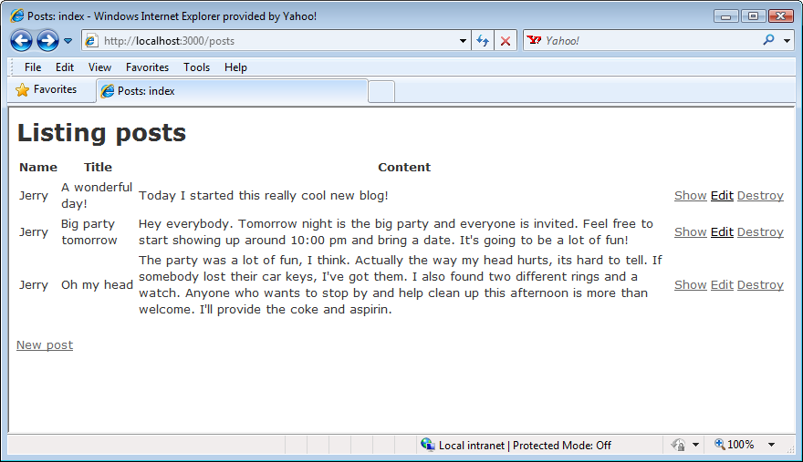
The Blog Application (continued)
This chapter’s project is called the Blog application. This application will allow you to create, view, and modify blog entries. Blog entries consist of name, title, and content data. The application can be used to store any number of blog entries.
Figure 1
Sample entries in the blog application.

Slide 5
Overview of Ruby on Rails

Slide 6
Overview of Ruby on Rails (continued)
Ruby on Rails, sometimes referred to as RoR or Rails, includes a collection of scripts used to automate the creation of web-based applications.
Web developers chose Ruby on Rails in large part because it handles most of the work involved in developing new applications -tasks like database access, output display, and data validation.
There are many ways to customize your Ruby on Rails applications, including:
  Editing an application’s HTML code
  Modifying the CSS style sheets to alter the application’s appearance
  Changing an application’s database management system
  Modifying an application’s URL associations by changing the application’s routing information
New application features and functionality can be added by executing additional Ruby on Rails helper scripts and by making use of a feature known as scaffolding.

Slide 7
Skills Needed to Work with Ruby on Rails
To work with Ruby on Rails, you need a basic understanding of HTML, web-page construction, and how the Internet works.
You also need to understand Cascading Style Sheets (CSS), which Ruby on Rails uses to configure the presentation of the content viewed by web browsers.
Finally, you need to understand web-server and database management systems.

Slide 8
Required Software
To create applications using Ruby on Rails, you must have Ruby installed on your computer.
Ruby on Rails applications usually require a database management system to facilitate the management of a database in which the application’s data is stored.
Ruby on Rails can work with many different types, but all you will usually need, in order to create and test the execution of your web applications, is the SQLite web server, which you can download for free.
You must have access to a web server that can host your Ruby on Rails web applications. When Ruby on Rails is installed, so is a small web server called WEBrick.
Ruby Programming

Slide 9
Development Philosophy
Ruby on Rails follows a number of guiding principles, which allow it to deliver full-featured web applications quickly.
Convention Over Configuration: Using a set of assumptions, Ruby on Rails configures a new application based on best practices and common standards, resulting in general-purpose applications that can be further customized as necessary.
Don’t Repeat Yourself, or DRY: The idea behind this principle is that you should avoid writing the same program code more than once within a web application.
Ruby Programming

Slide 10
Architecture
Ruby on Rails is built on a Model-View-Controller (MVC) architecture, which organizes your applications into three primary components:
Models are Ruby on Rails programs that manage the relationship between controllers and the application’s database.
Views help maintain a separation between an application’s programming logic and the presentation of its data.
Controllers tie together different models and views, processing application input and output.
Ruby Programming

Slide 11
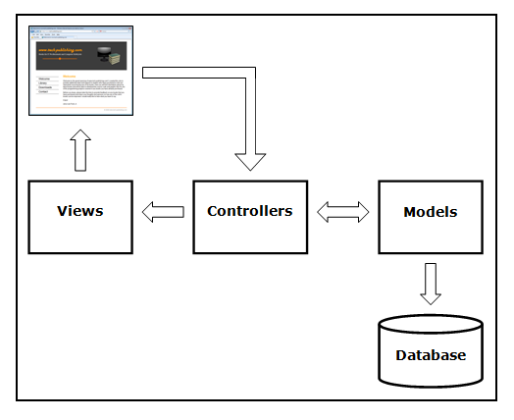
Architecture (continued)
The following figure depicts the relationship between the primary components in the Model-View-Controller (MVC) architecture.
Figure 3
The three main components of MVC architecture.
Ruby Programming

Slide 12
Working with Database Management Systems
Ruby on Rails applications involve the management of information using a database. Every new Ruby on Rails project is automatically configured to use the SQLite database management system.
Ruby on Rails can be configured to use any database management system, such as MySQL, SQL Server, DB2, and Oracle.
Ruby on Rails applications support three different environments: development, test, and production environments.
Development: This is where you work on your Ruby on Rails applications when you are building them.
Test: This is where you will work with an applications once it is complete to make sure it works as expected.
Production: This is where your Ruby on Rails applications go once they are ready to be made ready to the rest of the world.
Ruby Programming

Slide 13
Getting Ruby on Rails Up and Running
Ruby Programming

Slide 14
Installing Ruby On Rails on Windows
The easiest way to install Ruby on Rails is through RubyGems. RubyGems is a package installer program that comes as part of Ruby.
RubyGems should already be installed on any computer running Windows that has Ruby installed on it. From the Windows command prompt, issue the following command to install Ruby on Rails:
gem install rails --include-dependencies
This command installs Ruby on Rails on your computer and then downloads and installs various Ruby on Rails libraries, along with their documentation, on your computer.
Ruby Programming

Slide 15
Installing Ruby On Rails on Mac OS X
Begin by making sure RubyGems is installed. To do so, type the following command at the command prompt:
$gem –v
If RubyGems is already installed, its version number will be displayed. Otherwise, download and install it using these steps:
  Go to http://rubygems.org/pages/download.
  Download and then unpack RubyGems into a folder.
  Use the cd command to navigate to that folder.
  Type sudo ruby setup.rb and press Enter. When prompted, type your password and press Enter.
  Once complete, execute the following command and press Enter:
sudo gem install rails -–include-dependencies
Ruby Programming

Slide 16
Selecting a Web Server
Ruby on Rails applications require a web server. Ruby on Rails can work with any web server.
The WEBrick web server is automatically installed as part of Ruby. To start the WEBrick server, execute the following command from the command prompt and press Enter while you’re within the folder where your Ruby on Rails application has been stored:
script/server
In response, the WEBrick server starts up and waits for incoming requests from a web browser on your computer.
Ruby Programming

Slide 17
Installing the SQLite Database Management System
SQLite is a small, compact database management system well suited to small- and moderate-sized applications.
For Mac OS X 10.5 users, it should already be installed on your computer.
On other operating systems, it can be installed using RubyGems. To do so, establish an Internet connection and then execute the following command from the command prompt and press Enter:
gem install sqlite3-ruby
Ruby Programming

Slide 18
Verifying Ruby on Rails Setup
Ruby Programming

Slide 19
Creating a Demo Application
To create the Demo application, access the command prompt and navigate to a folder in which you will store the application.
Type the following command and press Enter:
rails demo
This command will create a new folder named demo containing all of the files and folders that make up the application.
rails is a Ruby script installed as part of Ruby on Rails. When executed, it creates a Ruby on Rails project, including its directory structure and its core application files. The rails script requires a single argument, the name of the application to be created, which in this case is demo.
Ruby Programming

Slide 20
Verifying the Execution of Your Web Server
To verify that you have a working copy of the WEBrick web server, navigate to the newly created demo folder using the following command:
cd demo
Once inside the folder, type:
ruby script/server
This command will generate output similar to that shown here:
  => Booting WEBrick
  => Rails 2.3.8 application starting on http://0.0.0.0:3000
  => Call with -d to detach
  => Ctrl-C to shutdown server
  [2010-06-27 14:30:42] INFO WEBrick 1.3.1
  [2010-06-27 14:30:42] INFO ruby 1.8.6 (2007-03-13) [i386-mswin32]
  [2010-06-27 14:30:42] INFO WEBrick::HTTPServer#start: pid=1328 port=3000
Ruby Programming

Slide 21
Verifying the Execution of Your Web Server (continued)
At this point, WEBrick pauses and begins monitoring port 3000, waiting for incoming requests from a web browser.
As requests are received, they are processed, and text will be displayed on the terminal window reflecting the actions that WEBrick takes when processing those requests.
Now that you have created your new Ruby on Rails project and started up the WEBrick web server, you can review the results of your efforts by opening your web browser and loading the following URL:
http://localhost:3000
Ruby Programming

Slide 22
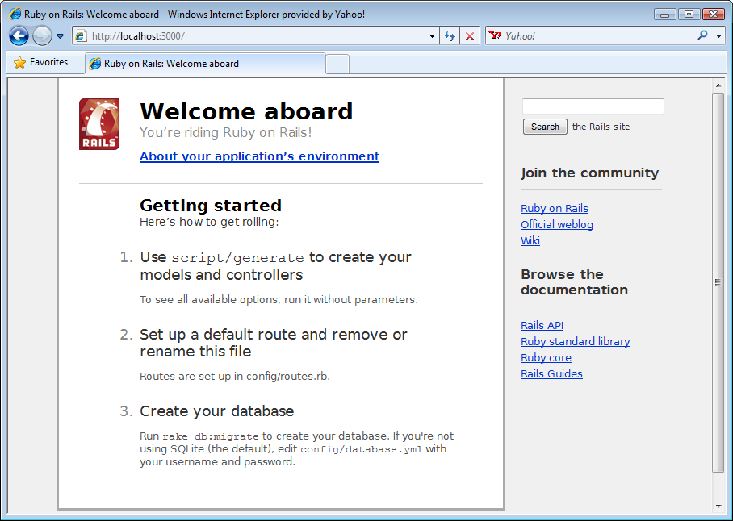
Verifying the Execution of Your Web Server (continued)
If everything works, you should see the Ruby on Rails web page displayed in your web browser.
Figure 5
The “Welcome aboard” message verifies that your Ruby on Rails development environment is functional.
Ruby Programming

Slide 23
Ruby on Rails Applications Files
Ruby on Rails applications are created using helper programs, like the rails program. These programs create the program files required for a basic web application.
The files are stored using a specific directory structure. Ruby on Rails creates the same directory structure for each new web application. As a result, Ruby on Rails applications have a clearly defined structure, making them easier to maintain.
Ruby Programming

Slide 24
RoR Applications Files (continued)
The following list shows the directory structure for the demo application:
demo/
      ..../app
      ......../controller
      ......../helpers
      ......../modules
      ......../views
      ............/layouts
      ..../config
      ..../db
      ..../doc
      ..../lib
      ..../log
      ..../public
      ..../script
      ..../test
      ..../tmp
      ..../vendor
      README
      Rakefile
Ruby Programming

Slide 25
Back to the Blog Application
Ruby Programming

Slide 26
Designing the Game
Follow these steps:
Create an application folder.
Create a new Ruby on Rails application.
Create a database for your application.
Create a controller and a view for the blog application.
Edit the application’s index page.

Slide 27
Step 1: Create an Application Folder
Create a folder on your computer where you would like to store the application’s files. You can do so from the command prompt by executing the following command:
mkdir RoR_Apps
Here, a new folder named RoR_Apps is created. Now, execute the following command to navigate into the new folder.
cd RoR_Apps
Ruby Programming

Slide 28
Step 2: Create a New Ruby on Rails Application
Create the blog application’s base file and folder structure. Do this by using the rails command, as shown here:
  rails blog
When executed, this command creates a Ruby on Rails application and configures it to work with a SQLite database, which will be used to store the application’s data.
Ruby Programming

Slide 29
Step 3: Create a Database for Your Application
Create the application’s database. Do this from within the blog folder that was created in the previous step. To navigate to this folder, execute the following command:
cd blog
Use the rake command to create the application’s database, as shown here:
rake db:create
Rake is a Ruby on Rails program that is used to perform different administrative tasks. One of its most common uses is the creation of databases. In the previous statement, rake is used to create a new SQLite database within the current folder.
Ruby Programming

Slide 30
Step 4: Create a Controller and a View for the Blog Application
Every Ruby on Rails application needs at least one controller and a view. To set this up, you need to execute the generate program (script/generate), passing it the arguments shown here in bold:
ruby script/generate controller home index
Output similar to the following is generated.
exists app/controllers/
exists app/helpers/
create app/views/home
exists test/functional/
create test/unit/helpers/
create app/controllers/home_controller.rb
create test/functional/home_controller_test.rb
create app/helpers/home_helper.rb
create test/unit/helpers/home_helper_test.rb
create app/views/home/index.html.erb
Ruby Programming

Slide 31
Step 5: Edit Your Application’s Index Page
At this point, the home page created for the application does not have any content to display. To customize it, use your favorite program or text editor to open the index.html.erb file.
This file resides in the app/views/home folder. By default, the index.html.erb file contains the following statements:
<h1>Home#index</h1>
<p>Find me in app/views/home/index.html.erb</p>
Modify this file so that it contains a single statement, as shown here:
<h1>Jerry Ford’s Blog</h1>
This modification displays a Level 1 HTML heading, Jerry Ford’s Blog, on the application’s home page.
Ruby Programming

Slide 32
Running Your New Ruby on Rails Project
To test the blog application, start the WEBrick web server by accessing the command prompt, navigating to the application blog folder, and executing the ruby script/server command, as shown here:
ruby script/server
To review the results of your efforts so far, open your web browser and load the following URL: http://localhost:3000
In response, a copy of the Ruby on Rails “Welcome aboard” page is displayed.

Slide 33
Running Your New Ruby on Rails Project (continued)
Modify the URL to load the application’s home page into the browser window by loading the following URL:
http://localhost:3000/home/index
Figure 6
The blog application’s index page.
Ruby Programming

Slide 34
Completing the Ruby on Rails Project
Thus far, the overall file and folder structure for the blog application has been created. In addition, a home page has been developed for it. However, the programming logic needed to support the posting of blog entries still needs to be added. The steps for doing this and for adding other enhancements to the application are provided in the chapter’s reinforcement exercises.
Ruby Programming

Slide 35
Learning More About Ruby on Rails
Ruby Programming

Slide 36
Learning More About Ruby on Rails (continued)
Ruby on Rails is not easily mastered. Entire books have been dedicated to it. This chapter has provided you with a basic overview of its features and capabilities. To learn more about Ruby on Rails, visit its official website at:
http://rubyonrails.org/
Another valuable online resource is the Ruby on Rails documentation site at:
http://api.rubyonrails.org//
Here, you will find documentation of the classes that make up the Ruby on Rails framework.
Ruby Programming

Slide 37
Summary
This chapter demonstrated:
How to get an overview of Ruby on Rails
How to get Ruby on Rails up and running
How to verify that Ruby on Rails is set up correctly
How to create a Ruby on Rails blog application

