Slide 1

Note: The data and information in this document is reflective of a hypothetical situation and client. This document is to be used for KPMG Virtual Internship purposes only.
Sprocket Central Pty Ltd
Data analytics approach
Krupaul Mallepudi

Slide 2
Note: The data and information in this document is reflective of a hypothetical situation and client. This document is to be used for KPMG Virtual Internship purposes only.
Agenda
Introduction
Data Exploration
Model Development
Interpretation

Slide 3
Note: The data and information in this document is reflective of a hypothetical situation and client. This document is to be used for KPMG Virtual Internship purposes only.
Introduction
Recommend Top 1000 new customers to Target from Datasets.
Problem Outline:
Sprocket Central Pty Ltd is a long-standing KPMG client whom specialises in high-quality bikes and accessible cycling accessories.
Their marketing team is looking to boost business by analysing their existing customer dataset to determine customer trends and behaviour.
Using the existing 3 datasets (Customer demographic, customer address and transactions) as a labelled dataset, please recommend which of these 1000 new customers should be targeted to drive the most value for the organisation.
Data Analysis:
Customer age of Wealth Segment
Bike related purchase in last 3 years by Industry
Profit by State
Number of Cars owned and not by State
RFM profile classification

Slide 4
Note: The data and information in this document is reflective of a hypothetical situation and client. This document is to be used for KPMG Virtual Internship purposes only.
Data Exploration
Data Quality Assessment and Clean up.
Keys Issues:
Accuracy- Outlier in DOB & Invalid values in Gender are corrected.
Completeness- Filtered out Missing values
Consistency- Changed to correct datatypes
Currency- Checked for all values up to date
Relevancy- Removed Meta data and Deceased customers
Validity- Checked all columns for valid values
Uniqueness- Deleted Duplicate values.

Slide 5
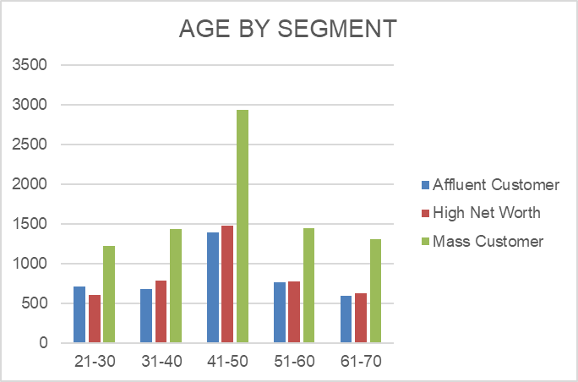
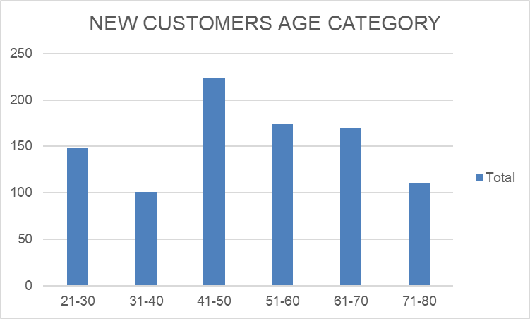
Note: The data and information in this document is reflective of a hypothetical situation and client. This document is to be used for KPMG Virtual Internship purposes only.
Data Exploration
Customer Age by Wealth Distribution.

Slide 6
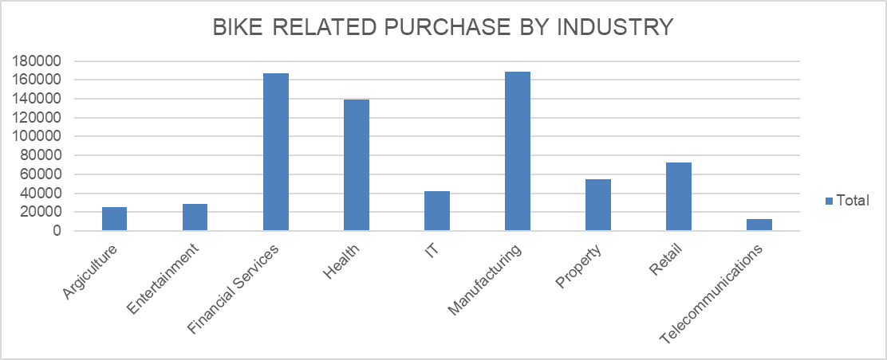
Note: The data and information in this document is reflective of a hypothetical situation and client. This document is to be used for KPMG Virtual Internship purposes only.
Data Exploration
Bike related purchase in last 3 years by Industry.

Slide 7
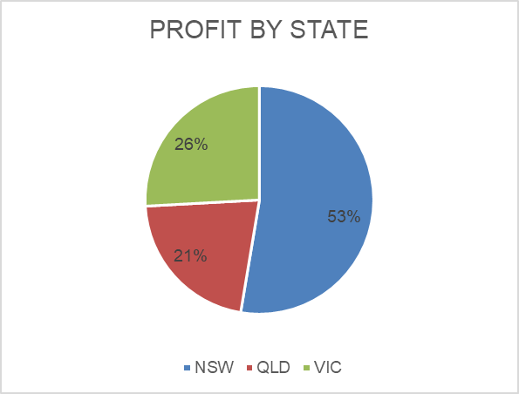
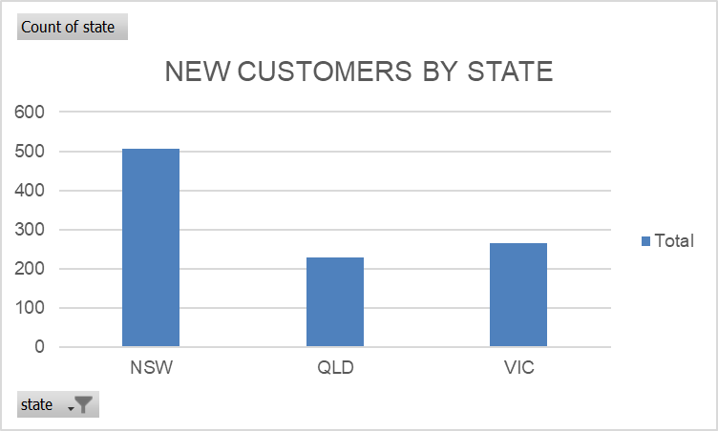
Note: The data and information in this document is reflective of a hypothetical situation and client. This document is to be used for KPMG Virtual Internship purposes only.
Data Exploration
Profit by State.

Slide 8
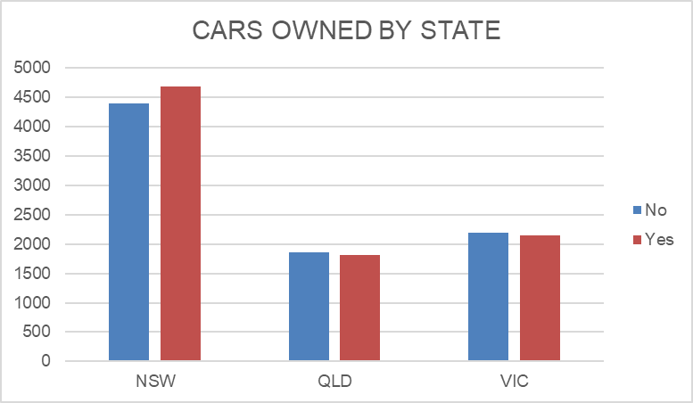
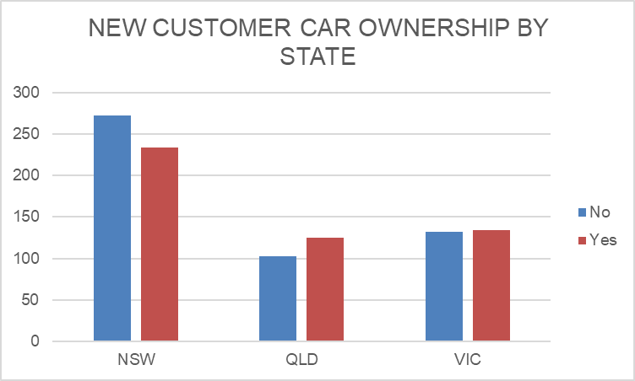
Note: The data and information in this document is reflective of a hypothetical situation and client. This document is to be used for KPMG Virtual Internship purposes only.
Data Exploration
Cars owned and not By Sate.
Keys

Slide 9
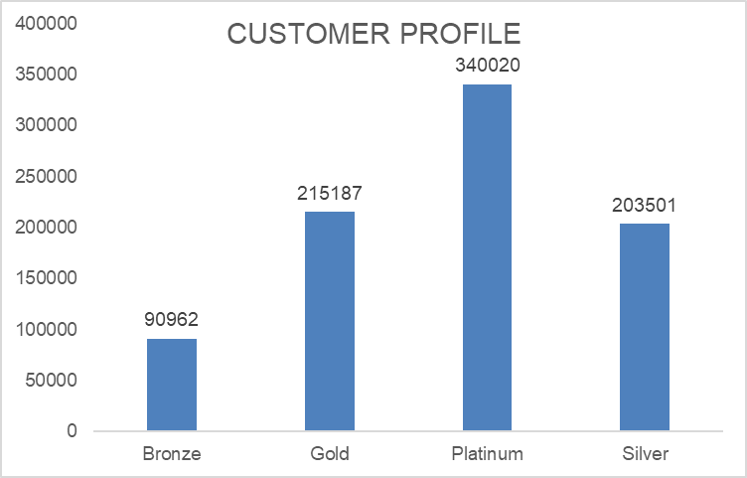
Note: The data and information in this document is reflective of a hypothetical situation and client. This document is to be used for KPMG Virtual Internship purposes only.
Model Development
CUSTOMER CLASSIFICATION BY RFM ANALYSIS
RFM analysis is used to determine which customers a business should target to increase its revenue and value.
RFM (Recency, Frequency, Monetary) model shows different levels customer engagement with Business.

Slide 10
Note: The data and information in this document is reflective of a hypothetical situation and client. This document is to be used for KPMG Virtual Internship purposes only.
Interpretation
Customers to Target.
Platinum Customers from RFM analysis.
Customers in age group of 41-50.
Customers in Mass wealth segment.
Customer from Financial, Health and Manufacturing Industries
Customer from State NSW as Profit is highest generated. Population and Customers who does not own car is highest.

Slide 11
Note: The data and information in this document is reflective of a hypothetical situation and client. This document is to be used for KPMG Virtual Internship purposes only.
Appendix

