Slide 1




Hardware-Assisted Dynamic Heat Redistribution Using PCM and Logic Control for Efficient Thermal Management in Advanced VLSI
Paper ID: 1144 Track No:01
Author Name and Affiliation
Dr.S.Dhivya(Assosicate Professor), R.Priya (Assistant Professor), K.Jambulingam(Assistant Professor),
K.Rupawaani(Student), S.Theema(Student)
Presented By
K.Rupawaani,S.Theema
Student
IEEE International Conference on Emerging Technologies in Engineering Applications
14-15 May 2026, Puducherry, India
ICETEA 2026

Slide 2

INTRODUCTION
Advanced VLSI systems operate at high transistor density, leading to increased power density and thermal hotspots
Hotspots negatively impact performance, reliability, and device lifespan
Existing thermal techniques (DVFS, cooling systems) suffer from latency, power overhead, and limited adaptability
A real-time, hardware-based thermal management approach using PCM and logic control is required
ICETEA 2026

Slide 3
PROBLEM STATEMENT
Localized hotspots cause performance degradation, leakage increase, and accelerated aging.
Passive methods (PCM alone) lack control over heat redistribution.
Software-based thermal management introduces delay and inefficient response.
Absence of a low-latency, adaptive on-chip thermal control mechanism.
ICETEA 2026

Slide 4
EXISTING SOLUTION
DVFS and software-based thermal control introduce latency and reduce overall system performance during operation.
Heat sinks and conventional cooling techniques operate mainly at the package level and do not provide effective on-chip thermal management.
Passive PCM cooling can absorb heat temporarily but suffers from saturation and lacks control over heat redistribution.
Existing approaches do not provide real-time, localized, and adaptive thermal redistribution within the chip.
ICETEA 2026

Slide 5
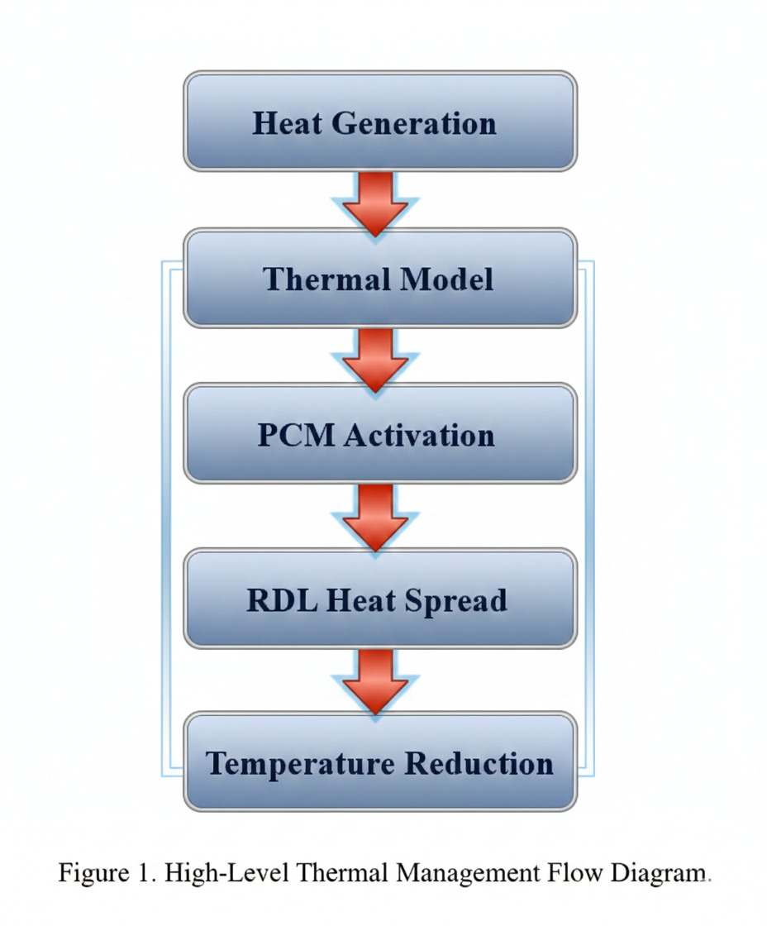
PROPOSED FRAMEWORK
The proposed framework introduces a PCM-assisted, logic-controlled thermal management system for efficient heat regulation in VLSI circuits.
It integrates thermal sensing, hardware-based control, and heat redistribution mechanisms to manage localized hotspots.
The framework enables real-time, low-latency thermal response without relying on software-based control.
Figure 1.1. High-level operational flow of the PCM-assisted thermal management system
ICETEA 2026

Slide 6
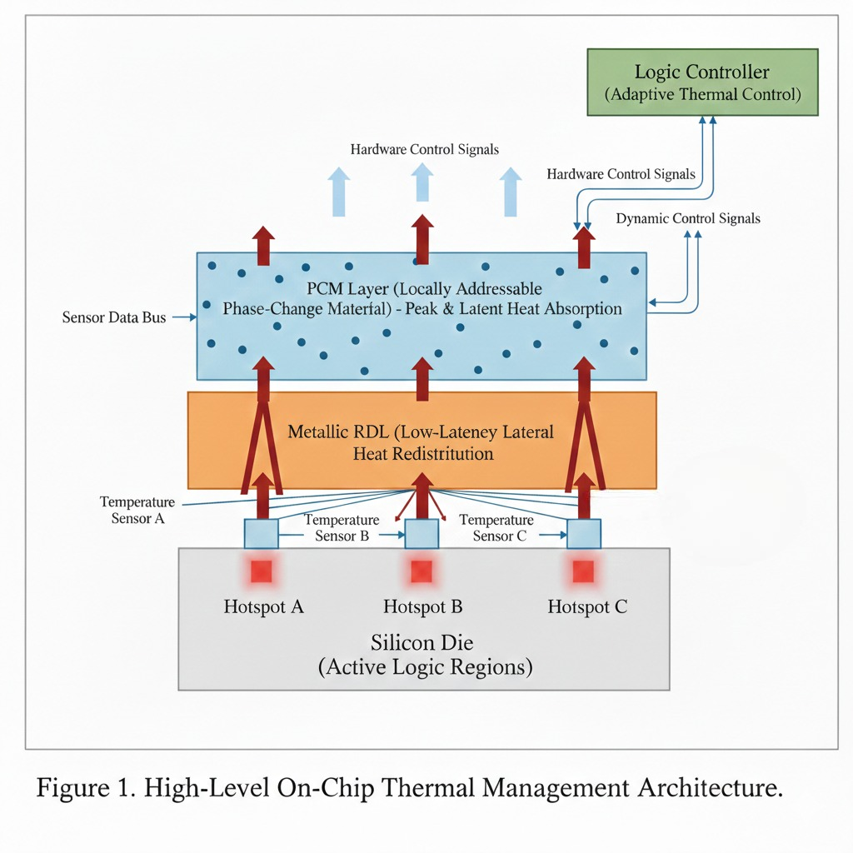
SYSTEM OVERVIEW
The system consists of thermal sensors, a logic control unit, PCM regions, and a redistribution layer forming a closed-loop architecture.
Temperature data from sensors is continuously monitored and processed by the control unit to detect hotspot conditions.
When a threshold is exceeded, PCM absorbs heat and the redistribution layer spreads it, ensuring dynamic thermal stabilization.
Figure 1.2. On-chip PCM-assisted architecture with logic-controlled heat redistribution
ICETEA 2026

Slide 7
SIMULATION & VALIDATION
The proposed system is validated using multiphysics thermal simulation (ElmerSolver) along with control logic verification.
Simulation models include heat conduction, PCM phase transition, and dynamic heat redistribution across the chip.
Results confirm effective hotspot detection and real-time activation of control signals for thermal regulation.
ICETEA 2026

Slide 8
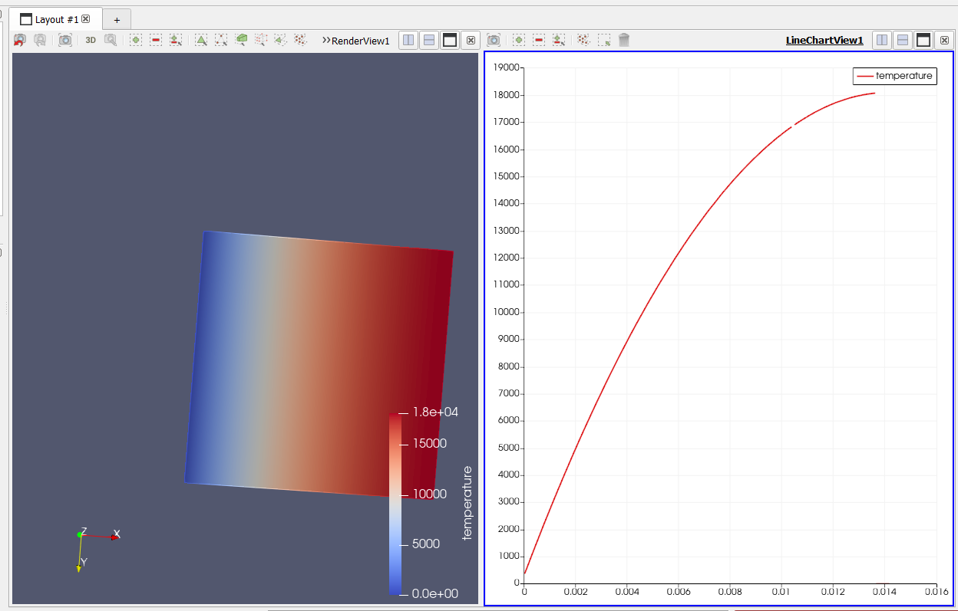
Figure 1.3. Thermal distribution and simulation response of the proposed system
ICETEA 2026

Slide 9
RESULT & DISCUSSION
The proposed approach achieves significant reduction in peak hotspot temperature and improved thermal uniformity.
Dynamic response analysis shows fast stabilization of temperature under varying thermal conditions.
Overall system demonstrates efficient, low-latency thermal management compared to conventional methods.
ICETEA 2026

Slide 10
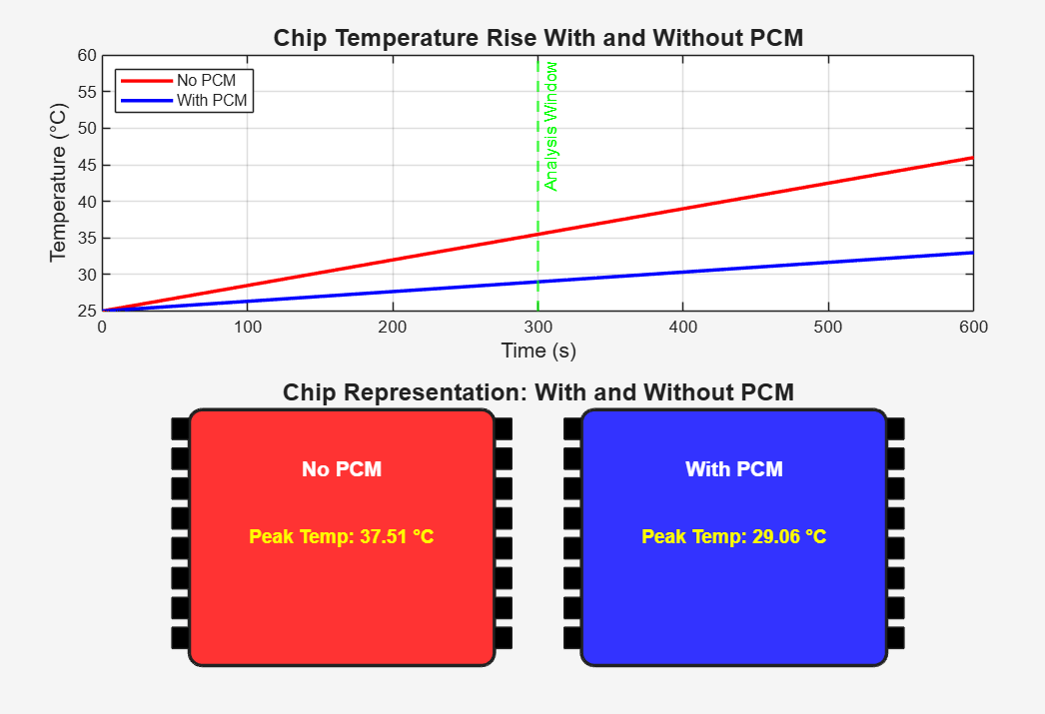
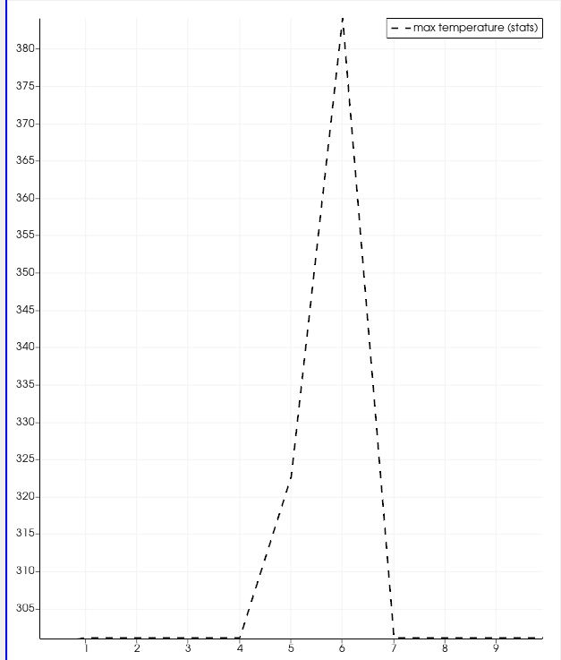
Figure 1.4. Temperature comparison with and without PCM showing reduced peak temperature
Figure 1.5. Dynamic hotspot temperature response over time
ICETEA 2026

Slide 11
COMPARISON WITH EXISTING THERMAL MANAGEMENT TECHNIQUES
Technique | Response Time | Control Type | Efficiency | Limitation
DVFS | High latency | Software-based | Moderate | Performance loss
Heat Sink / Cooling | Slow | Passive | Moderate | No on-chip control
PCM (Passive) | Medium | Passive | Good | Saturation issue
Software Thermal Control | High latency | Software | Moderate | Delayed response
Proposed System | Near-zero latency | Hardware-based | High | Needs hardware validation
ICETEA 2026

Slide 12
CONCLUSION & FUTURE WORK
The proposed framework achieves real-time hotspot mitigation using PCM-assisted logic control with near-zero latency.
It improves thermal stability, reduces peak temperature, and enhances overall system reliability.
The system is scalable, energy-efficient, and compatible with CMOS fabrication processes.
Future work includes hardware implementation, FPGA prototyping, and advanced PCM material optimization.
ICETEA 2026

Slide 13
THANK YOU!
ICETEA 2025
ICETEA 2026

