Slide 1
The Logic of Hypothesis Testing
Population Hypothesis:
A description of the probabilities of the values in the unobservable population.
Sampling Distribution:
The predicted probabilities of the various values of the sample statistic.
Simulated Repeated Random Sampling:
For each sample, compute the value of the statistic of interest.
Logic of rejection: Probabilistic Modus Tollens.
Hypothesis implies prediction. Disconfirm prediction. Therefore disconfirm hypothesis.

Slide 2
A Population Model:
Probabilities of nominal values.
For example, a tetrahedral die, with faces labeled a, b, c & d.
If the die is fair, then each face has probability of 0.25.
0.25
P(outcome)
a
b
c
d
outcome

Slide 3
Expected Frequencies in a Sample
For a sample of size N, the expected frequency of outcome i is
Exp(i) = P(i)*N .
The actually observed frequency is denoted Obs(i).
0.25
P(outcome)
a
b
c
d
outcome

Slide 4
Deviation of Actual from Expected: Pearson χ²
Pearson χ² =
Σ_{i} (Obs(i)-Exp(i))²/Exp(i)
0.25
P(outcome)
a
b
c
d
outcome

Slide 5
Example of computing Pearson χ²
Outcome | Observed Frequency | Expected Frequency | (Obs-Exp)² /Exp
A | 10 | 25 | (10-25)²/25 = 9.0
B | 20 | 25 | (20-25)²/25 = 1.0
C | 30 | 25 | (30-25)²/25 = 1.0
D | 40 | 25 | (40-25)²/25 = 9.0
Pearson χ² = Σ (obs-exp)²/exp = 20.0 .

Slide 6
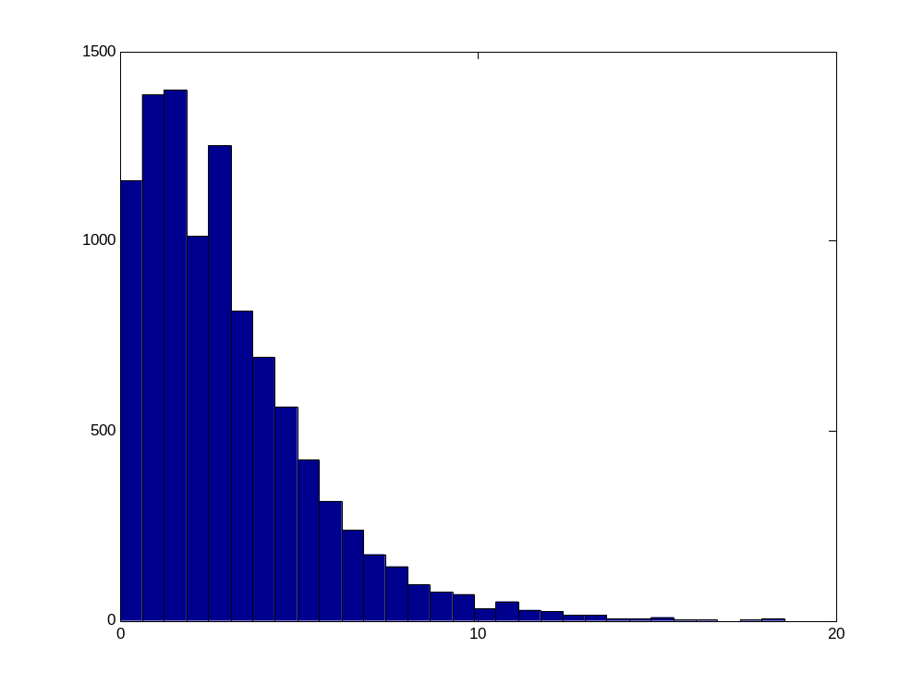
Sampling distribution of Pearson χ²
10,000 randomly generated samples from p(a)=…=p(d)=0.25, N=100.
95th %ile = 7.76
99th %ile = 11.28
χ²
0
10
20

Slide 7
Population and Sampling Distributions side by side
Hypothesized Population
Implied Sampling Distribution
0.25
95th %ile = 7.76
99th %ile = 11.28
P(outcome)
a
b
c
d
χ²
outcome
0
10
20

Slide 8
Highlighting:
Exp. 2 of Kruschke (2001)
Early Training: | I.PEE .
Late Training: | I.PEE I.PLL
Testing Results: | PE.PLL
general – irrational – perplexing

Slide 9
Design: Exp. 2 of Kruschke (2001)
Phase | CuesOutcome
Initial Training: | I1.PE1E1 I2.PE2E2
3:1 base-rate Training: | (3x) I1.PE1E1 (3x) I2.PE2E2 (1x) I1.PL1L1 (1x) I2.PL2L2
1:3 base-rate Training: | (1x) I1.PE1E1 (1x) I2.PE2E2 (3x) I1.PL1L1 (3x) I2.PL2L2
Testing: | PE.PL?, etc.

Slide 10
Design: Exp. 2 of Kruschke (2001)
Phase | CuesOutcome
Initial Training: | I1.PE1E1 I2.PE2E2
3:1 base-rate Training: | (3x) I1.PE1E1 (3x) I2.PE2E2 (1x) I1.PL1L1 (1x) I2.PL2L2
1:3 base-rate Training: | (1x) I1.PE1E1 (1x) I2.PE2E2 (3x) I1.PL1L1 (3x) I2.PL2L2
Testing: | PE.PL?, etc.

Slide 11
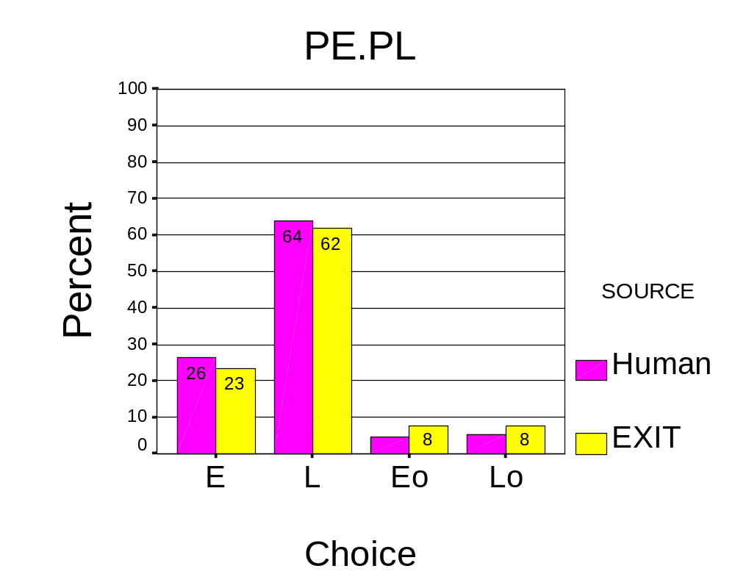
Results and EXIT fit: PE.PL

Slide 12
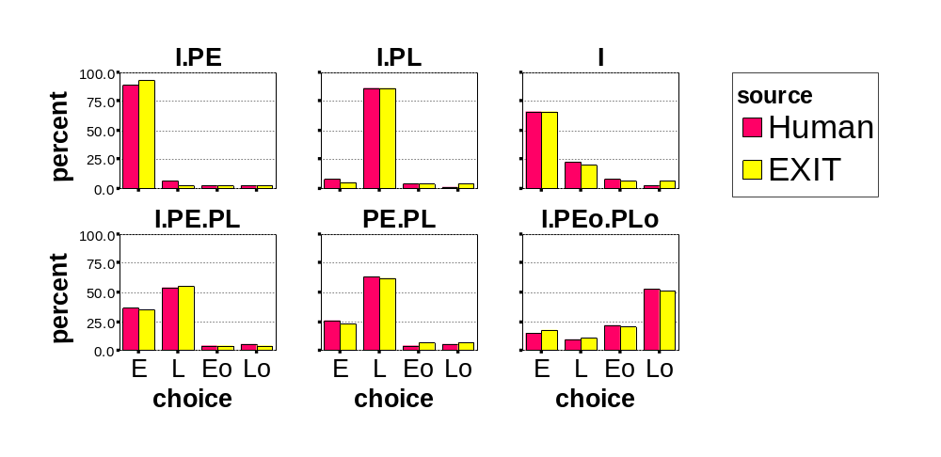
Results and EXIT fit:
All test items

Slide 13
Highlighting in EXIT
Output
E
L
Attention
Exemplars
PE.I
I.PL
Input
PE
I
PL

Slide 14
Logic of Sampling from a Population Model
Same logic as standard inferential statistics:
Hypothesize a population, i.e., p(Data|Hyp).
Repeatedly sample from the population.
For each sample, compute the statistic of interest (e.g. χ², t, F, etc.).
Determine the sampling distribution and critical values of the sample statistic.

Slide 15
Hypothesize a Population: EXIT
EXIT’s Predictions for Exp. 2, Table 9:
Outcome Choice
Cues E L Eo Lo
I.PE 92.3 3.0 2.3 2.3
I.PL 5.7 86.6 3.8 3.8
I 65.7 20.3 6.9 6.9
I.PE.PL 35.5 54.9 4.7 4.7
PE.PL 23.4 61.7 7.4 7.4
I.PEo.PLo 17.4 10.7 20.4 51.3
Parameter values:
spec attCap choiceD attShift outWtLR gainWtLR biasSal
0.0100 2.3865 3.9149 0.3632 0.0503 0.0177 0.0100
RMSE = 1.9550

Slide 16
Repeatedly Sample from the Population: Matlab code
% specify number of samples
number_of_samples = 1000;
% From Experiment 2 of Kruschke 2001, specify sample size
sample_size = 56;
% Seed the random number generator
rand('state',47);
% Enter the table of predicted percentages.
% EXIT
fprintf(1,'\n Using EXIT predictions as population...\n')
pred_percent = [ ...
92.3272 3.0482 2.3123 2.3124;...
5.7280 86.6391 3.8164 3.8164;...
65.7072 20.2938 6.9999 6.9991;...
35.5105 54.9081 4.7905 4.7909;...
23.3931 61.6699 7.4684 7.4685;...
17.4380 10.7550 20.4813 51.3258];

Slide 17
Choosing a discrete outcome according to p(i)
Predicted percentages
for I.PEo.PLo:
p(E) p(L) p(Eo) p(Lo)
17.4 10.8 20.5 51.3
50
40
30
20
Converted to cumulative probabilites
10
E L Eo Lo
0.0 0.174 0.282 0.487 1.000
Use Matlab rand to obtain uniform value in interval (0,1).

Slide 18
Repeatedly Sample from the Population: Matlab (cont.)
% for convenience in comparing with RAND,
% change percentages to proportions and
% then convert to cumulative proportions
pred = pred_percent / 100.0;
pred(:,2) = pred(:,2) + pred(:,1);
pred(:,3) = pred(:,3) + pred(:,2);
pred(:,4) = pred(:,4) + pred(:,3);
>>
pred =
0.9233 0.9538 0.9769 1.0000
0.0573 0.9237 0.9618 1.0000
0.6571 0.8600 0.9300 1.0000
0.3551 0.9042 0.9521 1.0000
0.2339 0.8506 0.9253 1.0000
0.1744 0.2819 0.4867 1.0000

Slide 19
Repeatedly Sample from the Population: Matlab (cont.)
rmse = []; % Clear out vector that stores sample RMSEs.
for sample_idx = 1 : number_of_samples,
% Initialize sample table
sample_table = zeros(size(pred,1),size(pred,2));
% Begin loop for sample N
for subject_idx = 1 : sample_size,
% For each row of the table...
for row_idx = 1 : size(pred,1),
% ...choose a column according to the predicted probabilities
x = rand;
if x > pred(row_idx,3)
sample_table(row_idx,4) = sample_table(row_idx,4) + 1;
else if x > pred(row_idx,2)
sample_table(row_idx,3) = sample_table(row_idx,3) + 1;
else if x > pred(row_idx,1)
sample_table(row_idx,2) = sample_table(row_idx,2) + 1;
else
sample_table(row_idx,1) = sample_table(row_idx,1) + 1;
end
end
end
end % for row_idx = ...
end % End loop for sample N
% Convert sample table to percentages
sample_table = 100.0 * sample_table / sample_size ;
% Compute RMSE of randomly sampled table and store the RMSE
sample_rmse = sqrt( sum(sum(( sample_table - pred_percent ).^2 )) ...
/ (size(pred_percent,1)*size(pred_percent,2)) ) ;
rmse = [ rmse sample_rmse ];
end % End loop for generating a sample and computing RMSE.

Slide 20
Repeatedly Sample from the Population: Matlab (cont.)
rmse = []; % Clear out vector that stores sample RMSEs.
% Begin repeatedly sampling
for sample_idx = 1 : number_of_samples,
% For each sample, initialize the sample table
sample_table = zeros(size(pred,1),size(pred,2));

Slide 21
Repeatedly Sample from the Population: Matlab (cont.)
% Begin loop for sampling N subjects
for subject_idx = 1 : sample_size,
% For each row of the table...
for row_idx = 1 : size(pred,1),
% ...choose a column according to the predicted probabilities
x = rand; % a random number from uniform (0,1)
if x > pred(row_idx,3)
sample_table(row_idx,4) = sample_table(row_idx,4) + 1;
else if x > pred(row_idx,2)
sample_table(row_idx,3) = sample_table(row_idx,3) + 1;
else if x > pred(row_idx,1)
sample_table(row_idx,2) = sample_table(row_idx,2) + 1;
else
sample_table(row_idx,1) = sample_table(row_idx,1) + 1;
end
end
end
end % for row_idx = ...
end % End loop for sample N

Slide 22
Repeatedly Sample from the Population: Matlab (cont.)
Example of a randomly generated sample’s percentages:
sample_table =
94.6429 0 5.3571 0
5.3571 87.5000 1.7857 5.3571
55.3571 21.4286 8.9286 14.2857
23.2143 66.0714 8.9286 1.7857
25.0000 62.5000 5.3571 7.1429
17.8571 12.5000 14.2857 55.3571

Slide 23
For each sample, compute the statistic of interest: RMSE
% Convert sample table to percentages
sample_table = 100.0 * sample_table / sample_size ;
% Compute RMSE of randomly sampled table and store the RMSE
sample_rmse = sqrt( sum(sum(( sample_table - pred_percent ).^2 )) ...
/ (size(pred_percent,1)*size(pred_percent,2)) ) ;
rmse = [ rmse sample_rmse ];
end % End loop for generating a sample and computing RMSE.

Slide 24
For each sample, compute the RMSE (cont.)
Example of a randomly generated sample’s percentages and RMSE:
sample_table =
94.6429 0 5.3571 0
5.3571 87.5000 1.7857 5.3571
55.3571 21.4286 8.9286 14.2857
23.2143 66.0714 8.9286 1.7857
25.0000 62.5000 5.3571 7.1429
17.8571 12.5000 14.2857 55.3571
sample_rmse =
4.8714

Slide 25
Sampling distribution and critical values
% Display histogram of sample RMSEs
hist(rmse,20)
% Display values of 95, 97.5, 99 percentiles
crit_rmse = prctile(rmse,[ 95 97.5 99 ]);
fprintf(1,'95, 97.5 and 99 RMSE percentiles:')
fprintf(1,'%7.4f',crit_rmse);
fprintf(1,'\n')
% Display actual RMSE of best fit
fprintf(1,'EXIT actual best fit RMSE = 1.9550 \n');

Slide 26
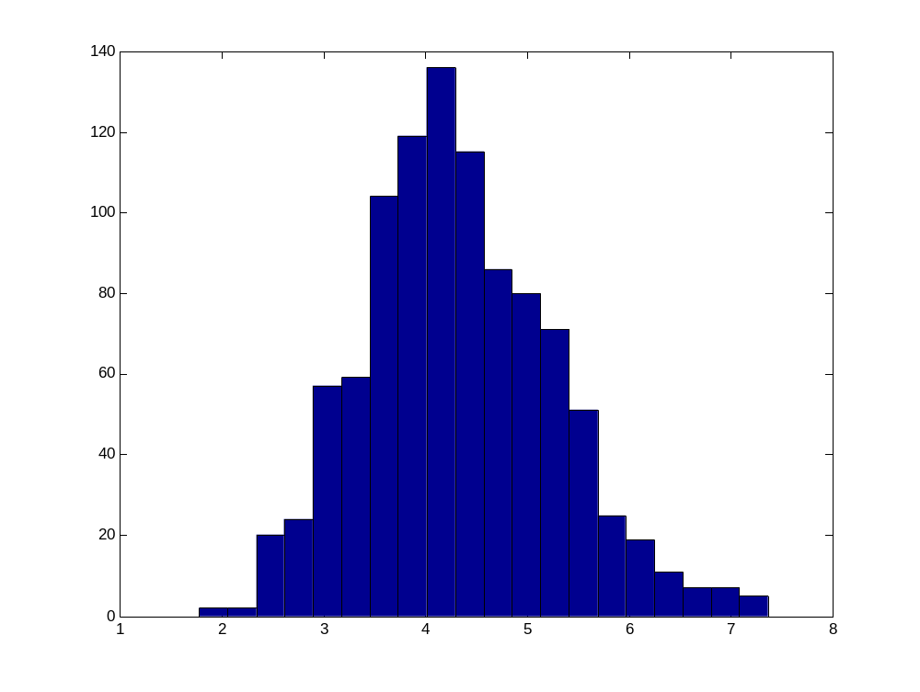
Sampling distribution of RMSE from EXIT population
95th %ile = 5.94
Actual data RMSE = 1.96
Freq.
2
4
6
RMSE

Slide 27
Hypothesize a Population: ELMO
ELMO’s Predictions for Exp. 2, Table 9:
88.8 6.7 1.7 2.7
6.7 86.1 2.7 4.3
55.0 43.9 0.4 0.6
55.0 43.9 0.4 0.6
40.5 48.9 4.0 6.4
15.0 13.3 39.1 32.4
Parameter values:
si sp pc pr
0.4975 0.2808 0.7935 0.6822
RMSE = 9.7585

Slide 28
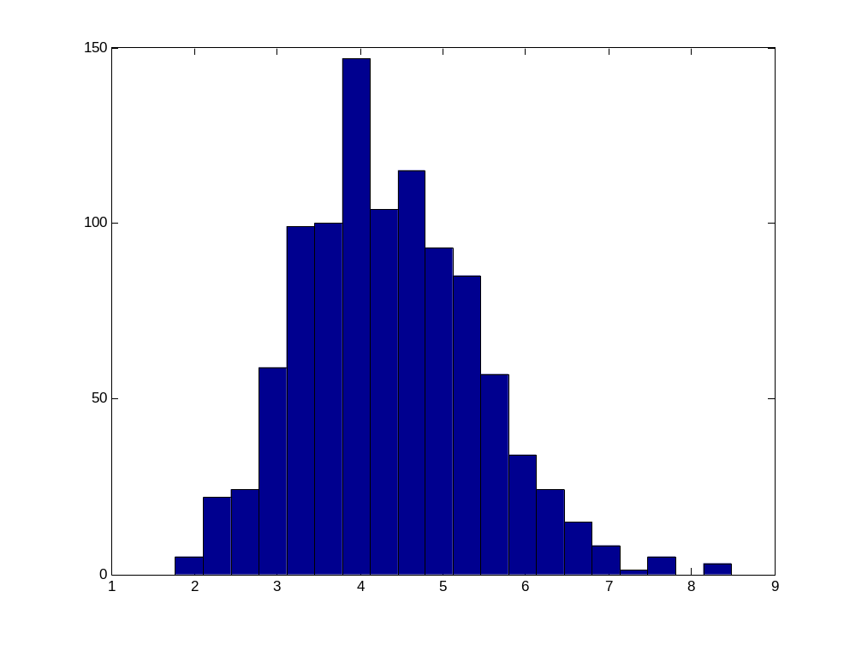
Sampling distribution of RMSE from ELMO population
95th %ile = 6.22
99th %ile = 7.07
Actual data RMSE = 9.76
Freq.
2
4
6
RMSE

