Slide 1

Shrinathji College Of Computer Applications
Homy Bazaar
SUBMITTED BY:
Riddhi Pawar (7341)
Krushi Patel (7340)
GUIDED BY:
Prof. Milind Pawar

Slide 2
Introduction
Homybazaar is an online grocery store designed to provide
customers with a convenient and seamless shopping experience
from the comfort of their home. The platform allows users to
browse, search, and purchase a wide range of grocery items, and fresh products. With an easy-to-navigate interface, secure authentication, and smooth checkout process, Homy Bazaar aims to simplify grocery shopping and bring it closer to the digital age.

Slide 3
INDEX
Introduction
Objectives
Features of website
Workflow of website
ER Diagram
Screenshots
Conclusion
References

Slide 4
Software Used:
Language | HTML, JavaScript, CSS
Operating System | Windows 11
Server | MongoDB
Web Browser | Chrome, Microsoft Edge
Designing Tool | Visual Studio Code
Server-Side Scripting | MongoDB compass

Slide 5
Future Scope
Future versions of Homybazaar may include advanced features like:
AI-based Smart Recommendations: Suggesting items based on previous shopping behavior and preferences.
Subscription & Auto-Reorder Options: Allowing users to automatically reorder frequently bought items.
Live Customer Chat Support: Real-time help and assistance for a better shopping experience.
Reward Points & Loyalty System: Offering exclusive benefits and discounts for regular Customers.
Voice Search & Multilingual Support: Making the platform accessible and easy to use for everyone.
Social Sharing: Allowing users to share grocery lists or favourite products with family and friends.

Slide 6
Objectives
Convenience: Enable users to shop for groceries online without visiting physical stores.
Efficiency: Reduce shopping time by providing quick product search, categorization, and filtering options.
Accessibility: Make grocery shopping accessible 24/7 for all users through web access.
User Engagement: Allow users to track orders, manage wish lists, and monitor shopping history.
Business Growth: Facilitate sales management and inventory tracking for the admin to streamline store operations

Slide 7
Features of website
User Side
Admin Side
User authentication (signup/login)
Browse and search products with categories and filters
Add products to cart, Wishlist, and manage orders
Checkout with simulated payment options
Order tracking and Cancellation
Responsive design for mobile and desktop users
Admin login and authentication
Add, update, and delete products
Manage user orders and track inventory
View sales reports and analytics
Handle product categories and stock availability

Slide 8
Workflow of website
User Workflow:
User signs up or logs in.
Browses products using categories, search, or filters.
Adds selected items to the cart or wishlist.
Proceeds to checkout and simulates payment.
Tracks order status and can cancel orders if needed
Admin Workflow:
Admin logs in to the dashboard.
Manages products: add, edit, or delete items.
Views and processes user orders.
Monitors inventory and stock levels.
Generates sales reports to analyze business performance.

Slide 9
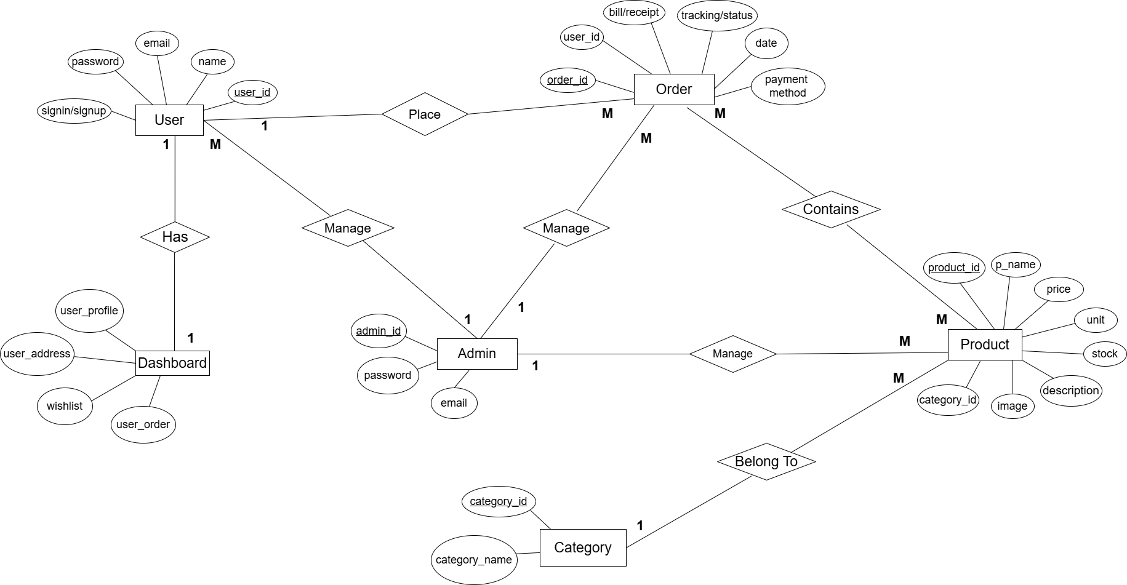
ER Diagram

Slide 10
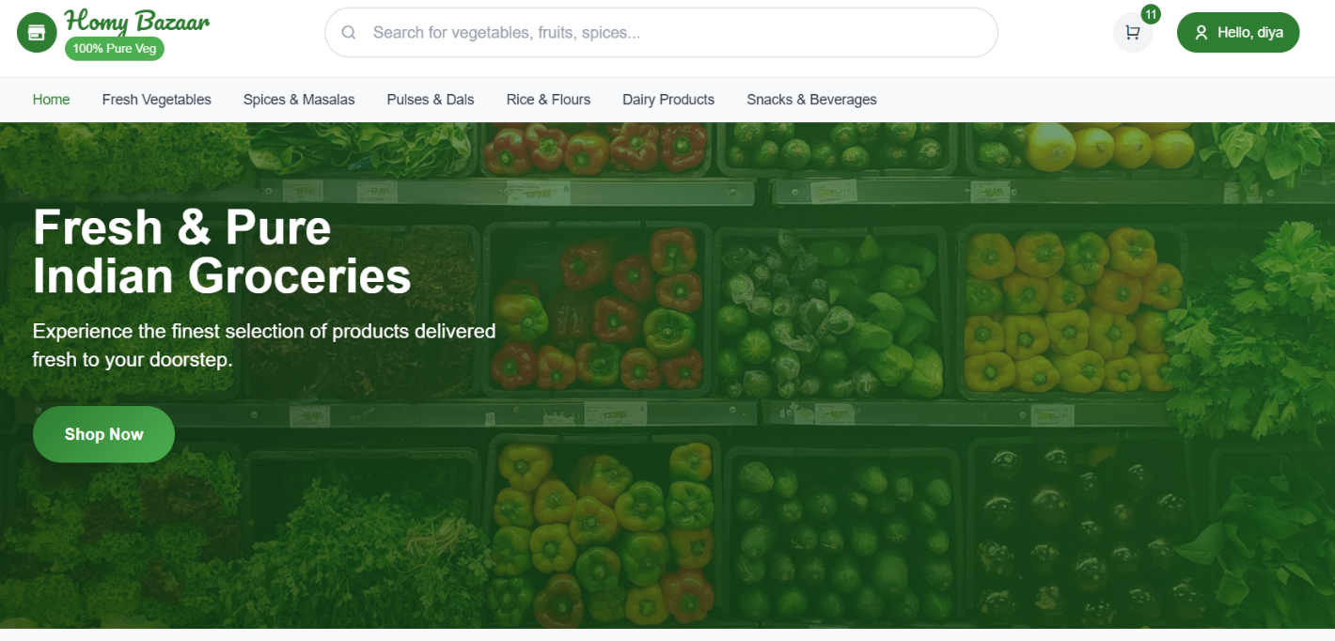
Home Page

Slide 11
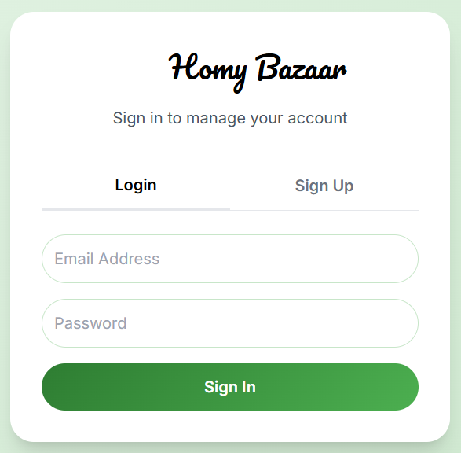
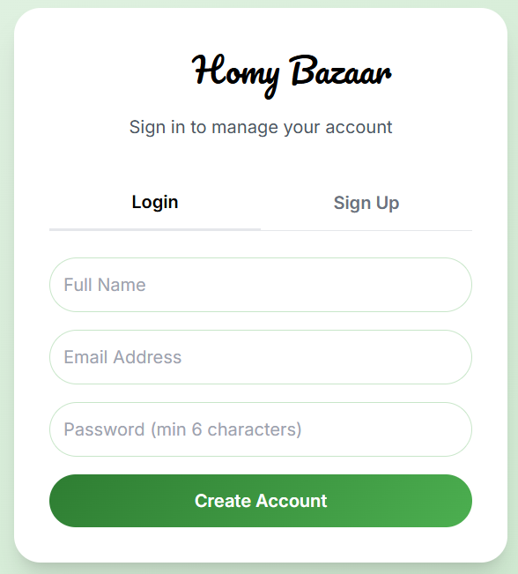
User Sign up and Login

Slide 12
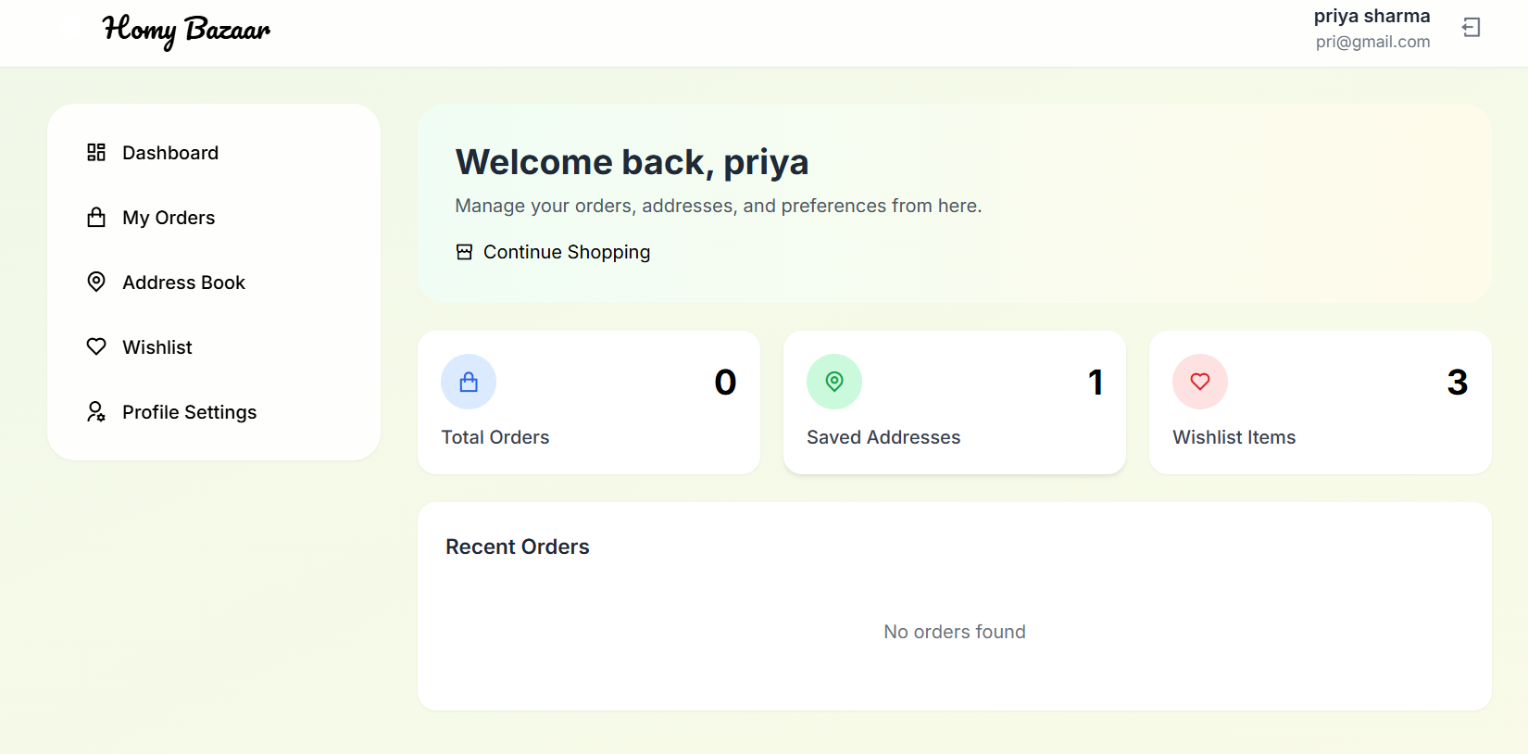
User Dashboard

Slide 13
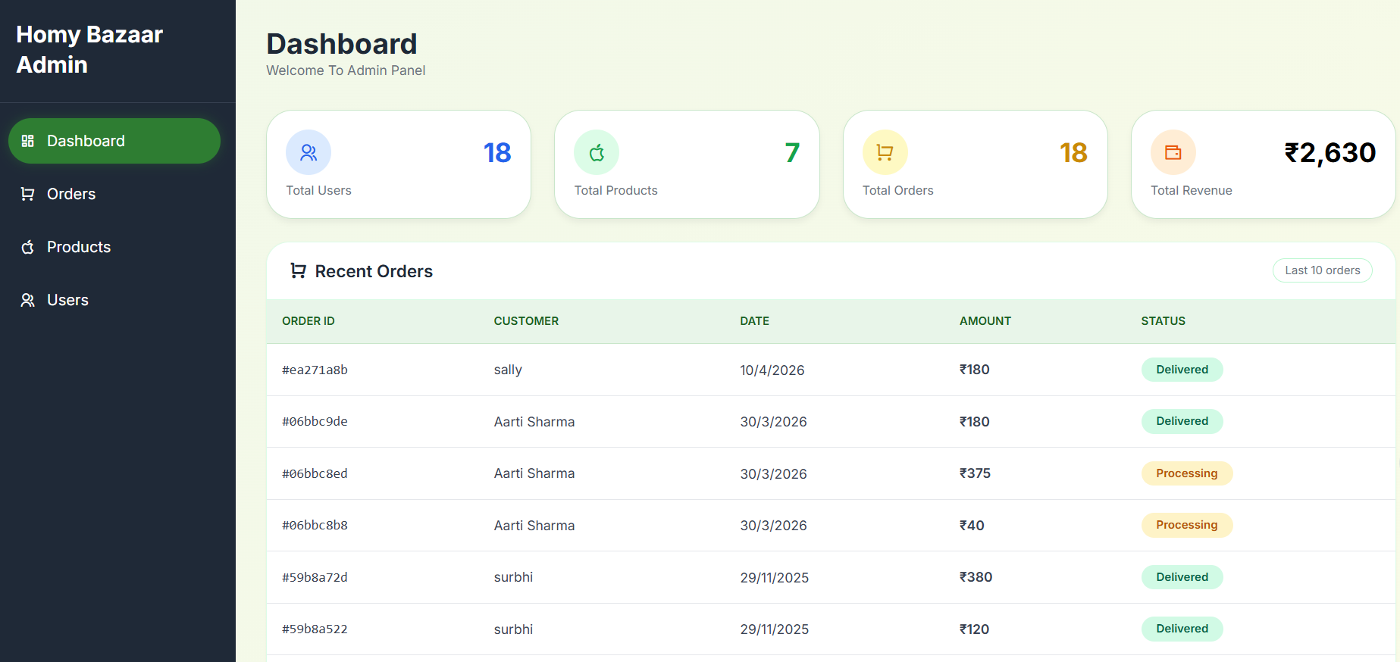
Admin Dashboard

Slide 14
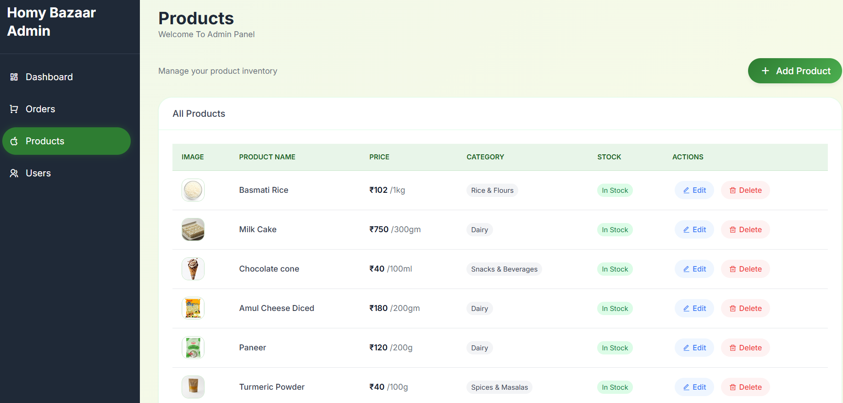
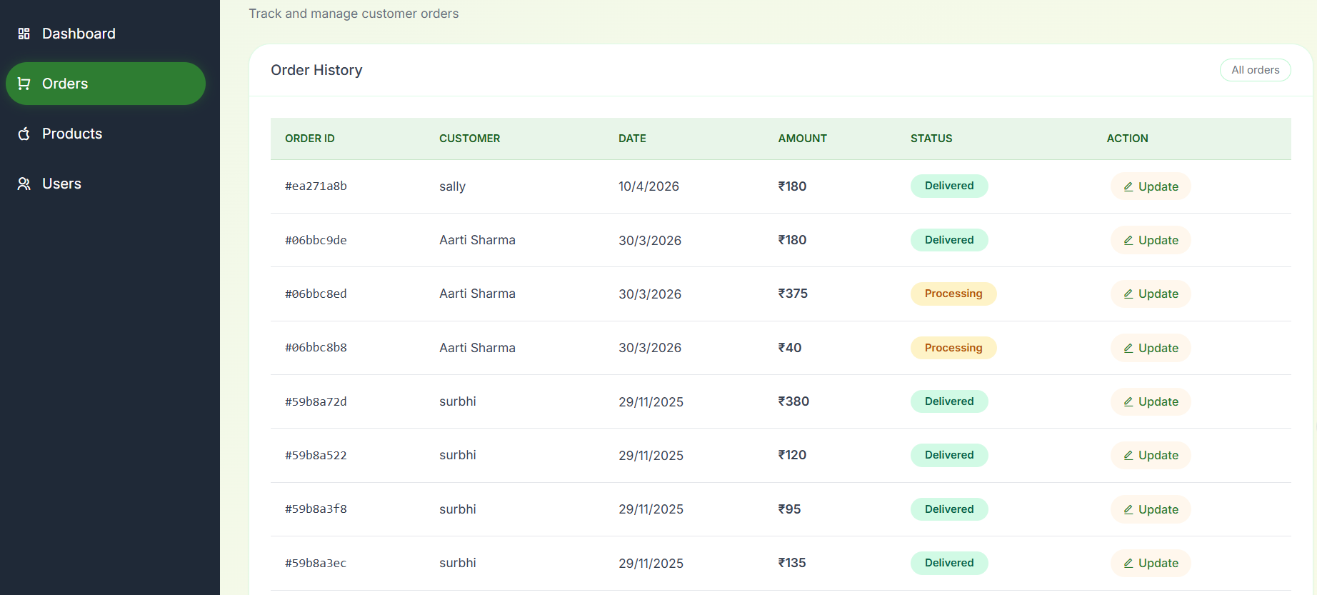
Product & Order management

Slide 15
Conclusion
The project demonstrates a well-structured design through detailed Data Flow Diagrams (Level 0 to Level 1) and a complete Entity-Relationship (ER) diagram, highlighting the relationships between users, products, orders, payments, reviews, and Wishlist functionalities. Additionally, the data dictionaries for all key tables provide a clear understanding of the database structure, attributes, and constraints.
HomyBazaar is a comprehensive and user-friendly e-commerce platform designed to facilitate seamless online shopping. The system efficiently manages all aspects of the shopping experience, including product browsing, cart management, order placement, payment processing, and order tracking. The admin side provides robust control over products, users, and orders, ensuring smooth operations and inventory management. Overall, serves as a strong example of an organized, scalable, and maintainable e-commerce system that balances user convenience with admin efficiency, and it can be further enhanced with features like real-time inventory updates, analytics, and personalized recommendations.

Slide 16
Reference
https://www.jiomart.com/ - online grocery shopping store
https://chatgpt.com/- AI for coding and designing
https://gemini.google.com/- AI for coding and designing
https://www.mongodb.com/- database connections
https://www.drawio.com/- for DFD & ER Diagrams

