Slide 1

SHRINATHJI COLLEGE OF COMPUTER APPLICATION
ServeKind
Submitted By:
Riddhi Pawar(7961)
Krushi Patel(7960)
Under the Guidance of:
Prof. Milind Pawar

Slide 2

INDEX
Introduction
Software Used
Features
Scope
Future Enhancement
Workflow
Screenshots
DFD Diagram
ER Diagram
Conclusion

Slide 3
Introduction
“ServeKind” is a compassionate and technology-driven donation platform dedicated to connecting those who have with those in need. Designed to make the act of giving simple, transparent, and impactful, ServeKind enables individuals, organizations, and communities to contribute food easily through an organized and secure system. Whether it’s surplus food from events, restaurants, or homes, ServeKind ensures that every contribution reaches the right hands at the right time. With a clean interface, smart donation modes, and seamless communication between donors and volunteers, the platform empowers people to fight hunger one meal at a time.

Slide 4
Software Used:
Language | HTML, JavaScript, CSS
Operating System | Windows 11
Server | Xampp
Web Browser | Chrome, Microsoft Edge
Designing Tool | Visual Studio Code
Server-Side Scripting | PHP and MySql

Slide 5
Main Advantages of ServeKind
User-Friendly Interface: Clean and intuitive design allowing donors, recipients, and volunteers to navigate and participate effortlessly.
Secure Access: Authentication-based login ensures verified donations and safe participation for all users.
Multiple Donation Options: Support through monetary donations, food contributions, or volunteer services, making it easy for anyone to help in their own way.
Real-Time Updates: Track donations, view status updates, and receive notifications about ongoing drives or new campaigns.
Interactive & Inspiring Design: Engaging visuals and dynamic layout that reflect kindness, community, and hope.
Volunteer Engagement: Dedicated volunteer registration and task allocation system to ensure organized food distribution.
Responsive & Accessible Platform: Works smoothly across devices, enabling people to donate or volunteer anytime, anywhere.

Slide 6
Features of Websites
User Side
Login/Signup
View/read blogs & stories
Search & filters programs
Can donate food And money
Become a part by volunteering
Admin Side
Admin login
Manage users
Manage Donations
Decide volunteer & team
Manage payments & reports
Website content management

Slide 7
Scope of Project
The ServeKind Project aims to create a digital platform that bridges the gap between donors, NGOs, and individuals in need. It provides an efficient and transparent way to manage food donations and reduce wastage. Through ServeKind, users can donate surplus food, register as volunteers, or contribute funds to support hunger-relief efforts.
The system simplifies coordination between donors and recipients while ensuring safety, authenticity, and accountability. It also helps NGOs manage donations, track inventory, and communicate with volunteers. The overall goal is to build a sustainable ecosystem where technology enhances compassion — making giving back simple, quick, and meaningful.

Slide 8
Future Enhancements
AI-Powered Matching System: Automatically connecting nearby donors with NGOs or recipients in real time.
Translation & Multilingual Support: Making the platform accessible to users across different languages and regions.
Location Tracking: Mapping donations and volunteer activities for faster delivery and better coordination.
Reward & Recognition System: Appreciating top donors and volunteers with digital certificates or points.
Community Stories & Impact Section: Showcasing real-life stories of change to inspire more participation.
Integration with Government & NGOs: Strengthening partnerships to maximize food reach and minimize wastage..

Slide 9
Objectives
To Provide Help Fast & Effectively : ServerKind aims to make help reach people quickly by connecting donors, volunteers, and individuals in need through a simple and organized online platform.
.
To Encourage Community Participation : ServerKind encourages people to contribute through food donations, monetary help, or volunteering. It boosts community-driven social work.
To Maintain Transparency & Trust : Every donation, application, and program record is stored digitally.
This ensures transparency between admin, volunteers, and users.
To Organize and Manage Programs Smoothly: ServerKind helps the admin publish, update, and manage charity programs, events, and awareness drives.
To Manage Volunteers Efficiently: Volunteer applications are collected, reviewed, and approved or rejected by the admin.This ensures only genuine volunteers join activities.
To Share Inspiring Stories & Blogs: ServerKind promotes positivity by publishing stories, community updates,
and blog posts that motivate others to participate in social good.
To Digitize an NGO’s Daily Operations: ServerKind acts as a digital management system.
To Build a Scalable Social Platform: ServerKind is designed to grow — more features.

Slide 10
Workflow of website
1. User Visits the Website
User lands on: Home AboutUs Programs Donate Volunteer ContactUs User can explore programs, read blogs/stories, and learn about the NGO.
4. Admin Logs Into Admin Panel
After login, Admin reaches the dashboard
Admin sees:
Overview :Total users, Donations ,Volunteers,
Published Posts , Contact Messages
2. User Performs an Action
A visitor can:
Submit a Donation Form
Enters name, email, contact, amount, or food donation type
Data goes to database
Admin sees the entry in admin panel
Submit a Volunteer Request
Fills form with skills, availability
Application goes to database
Admin decides approve/reject
Contact the Organization
Sends a message or inquiry
Admin reads and replies
5. Admin Managements Includes
User Management
View list of registered users & user's activity
Volunteer Management
View all volunteer applications
Approve / reject requests
Post & Content Management
Admin can Add / Edit / Delete:
Blogs, Stories, Programs
Form Data Management
Donation ent ries, Contact messages, Feedback submissions
Website Updates
Update program details
Upload images
3. Database Stores All Form Data
All user-submitted data is stored in tables such as:
Users volunteers, donations, contact messages, posts
This data is used by the admin panel.

Slide 11
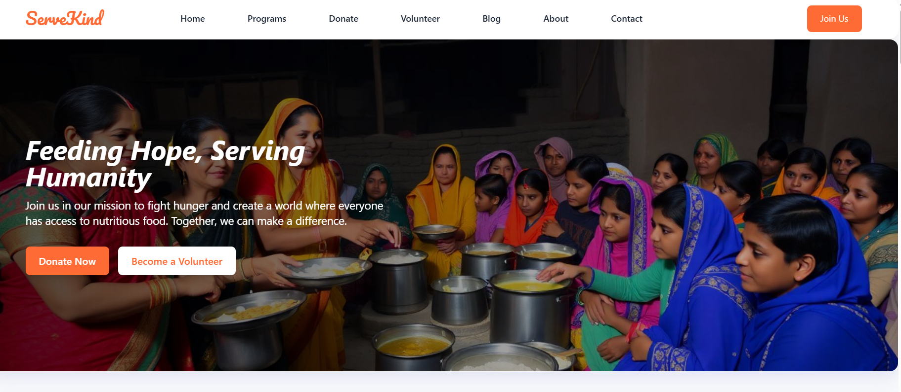
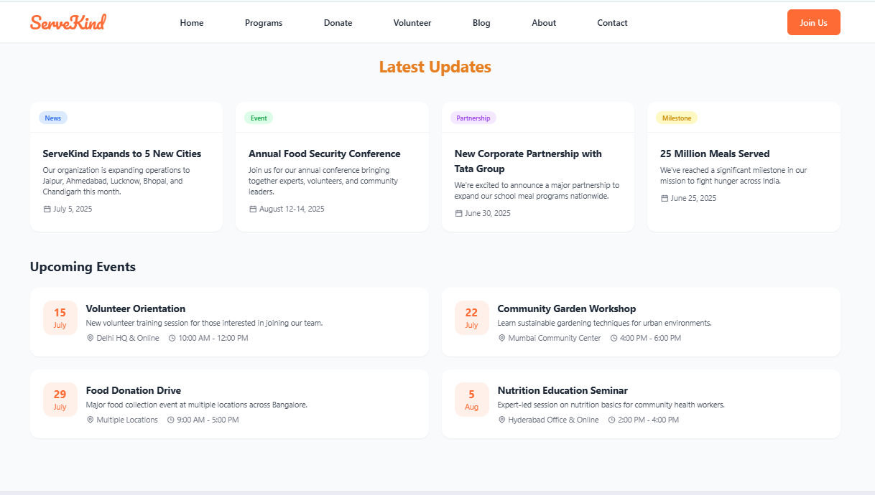
Home Page

Slide 12
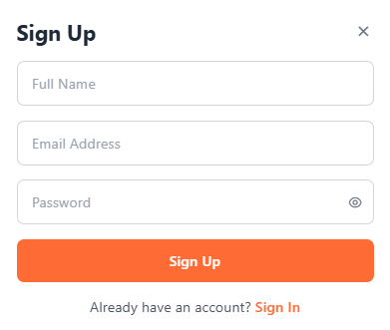
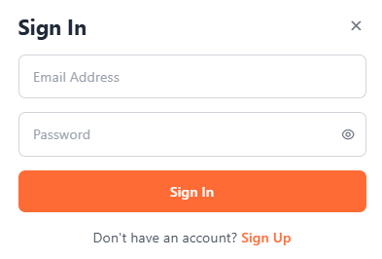
User login & Sign Up

Slide 13
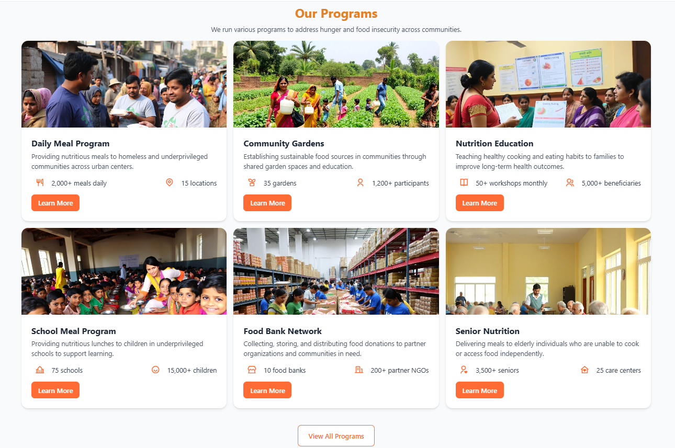
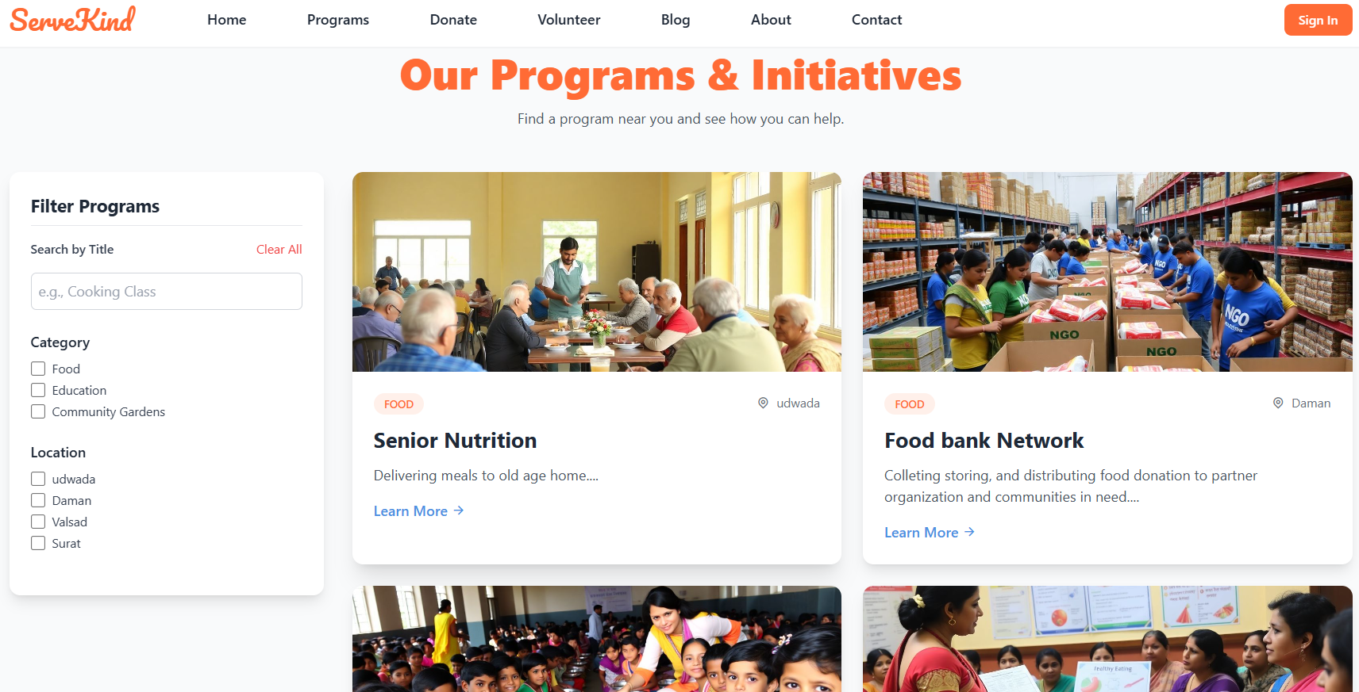
Programs

Slide 14
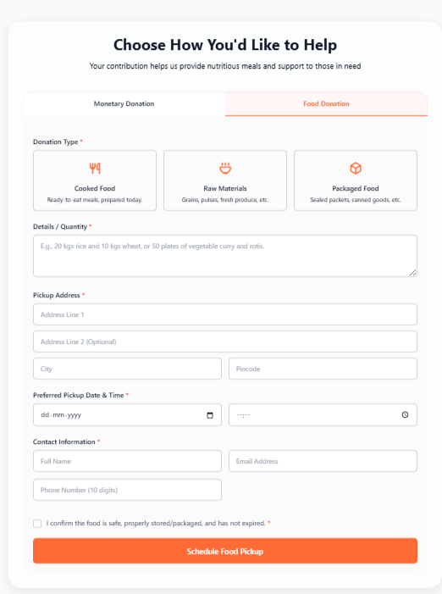
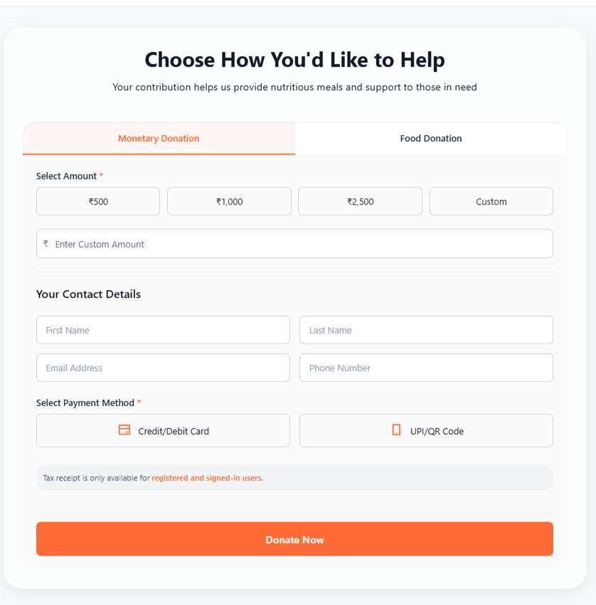
Donations

Slide 15
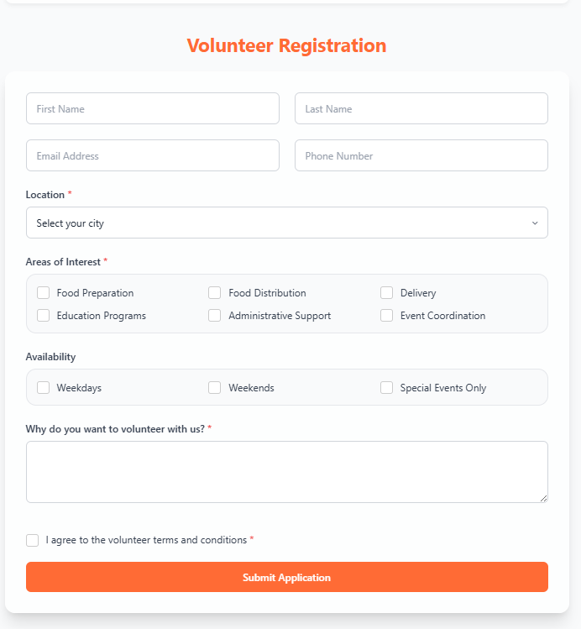
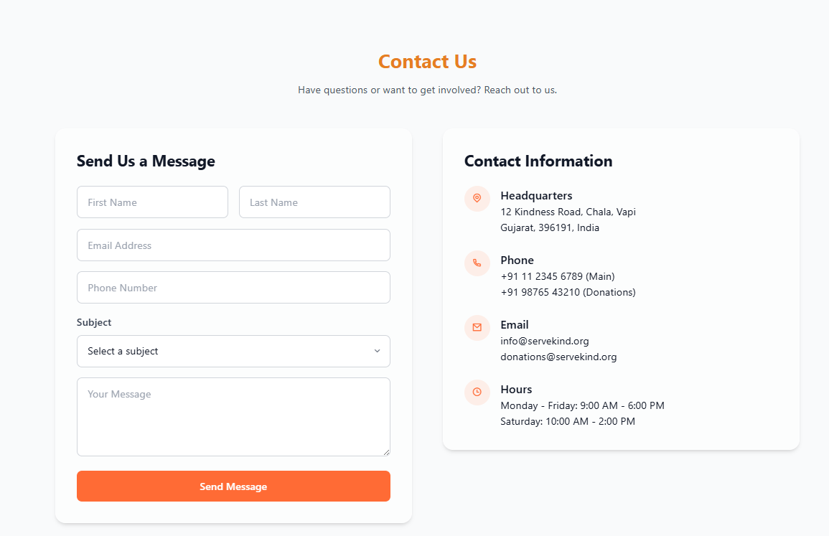
Volunteers & Contact us

Slide 16
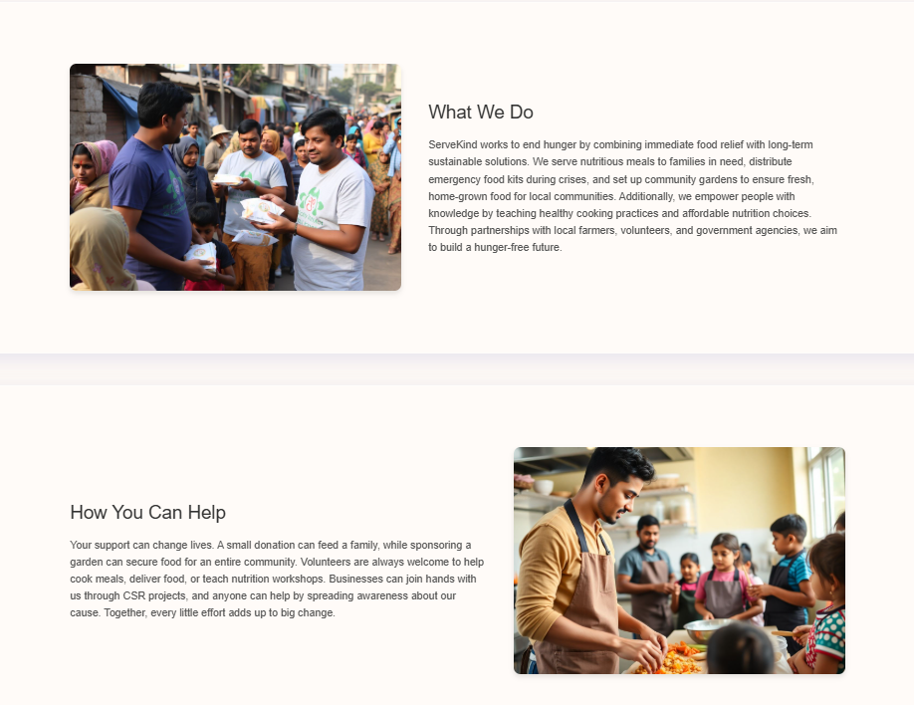
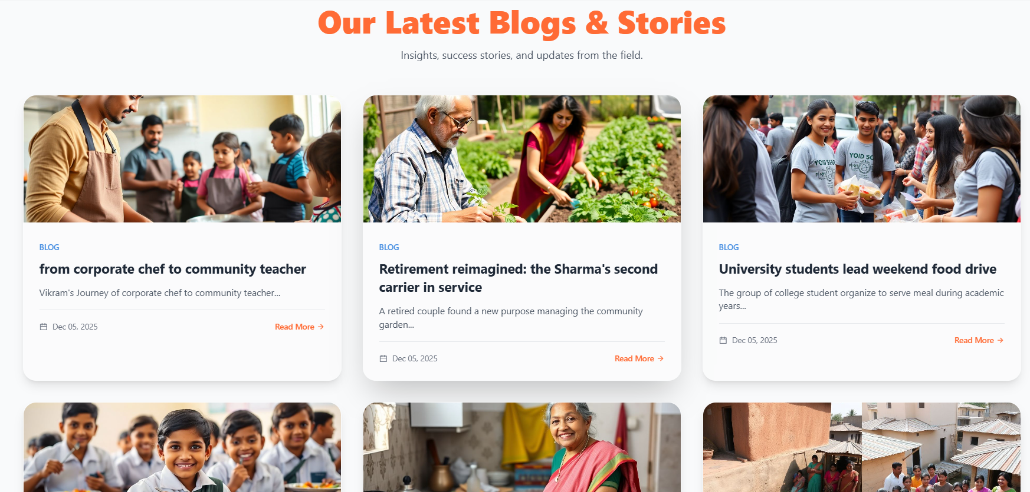
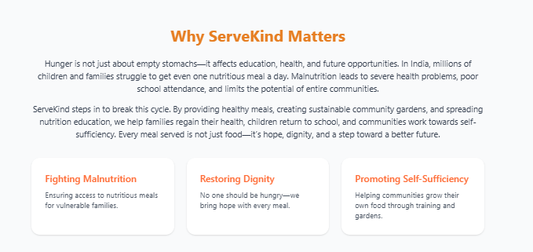
Blogs, Stories & About Us

Slide 17
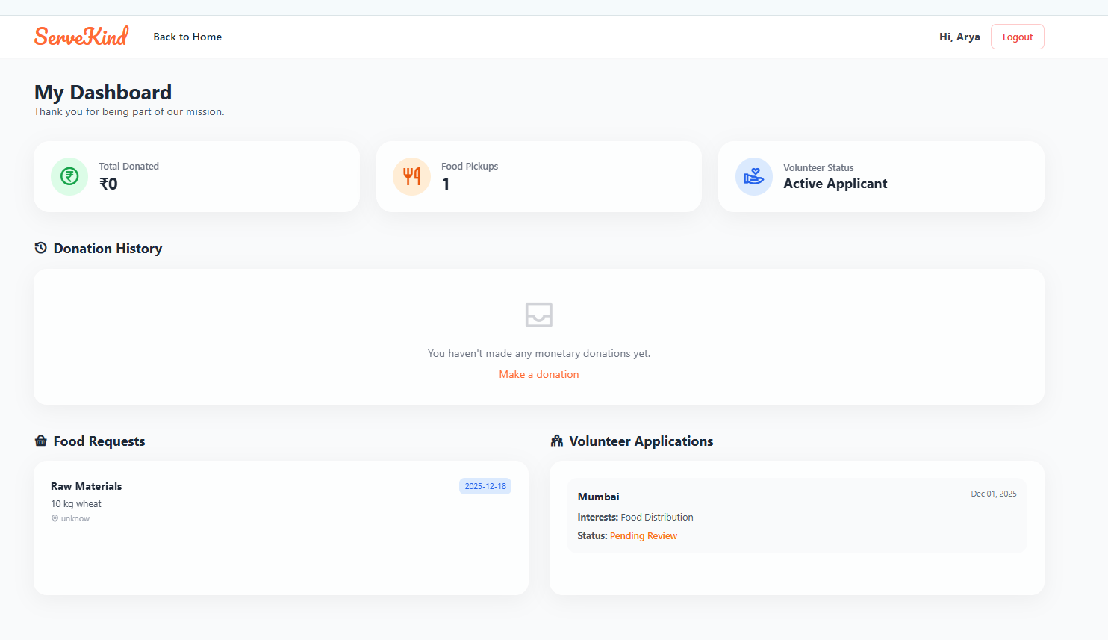
User’s Dashboard

Slide 18
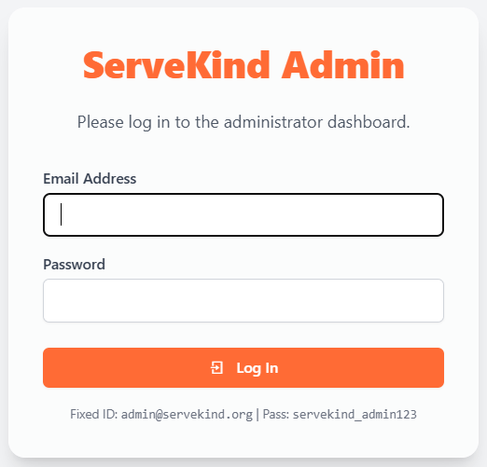
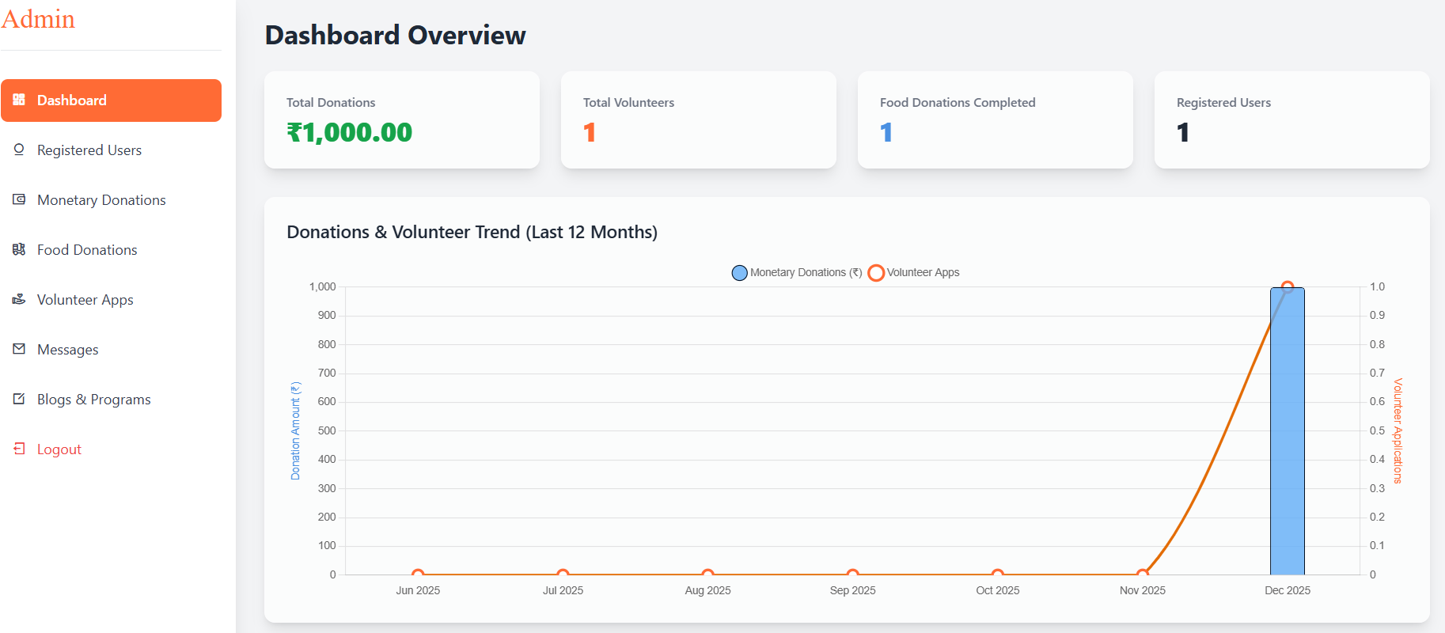
Admin Login/Dashboard

Slide 19
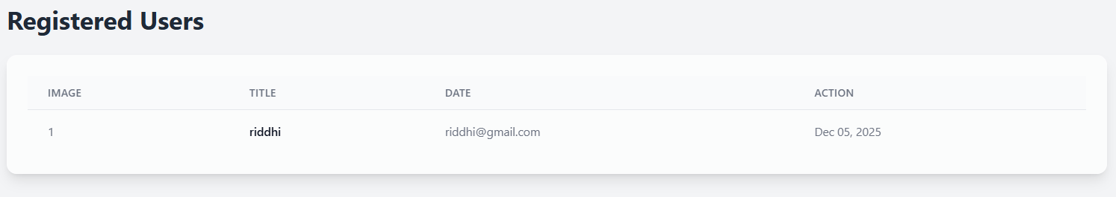
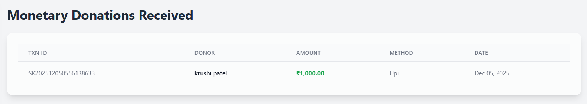
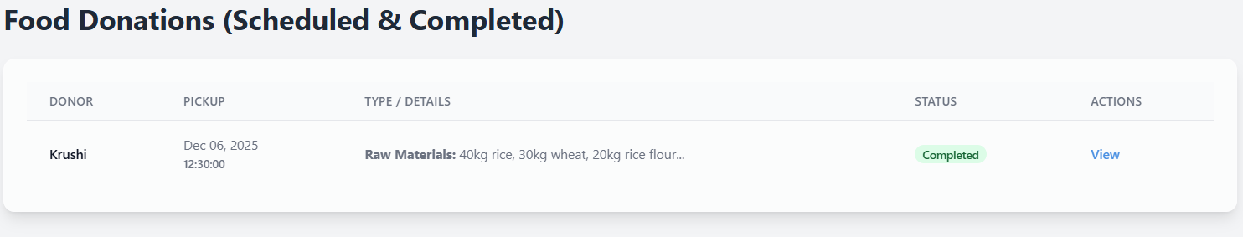
Users and Donors

Slide 20
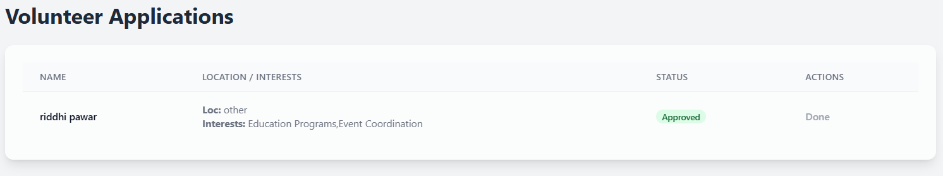
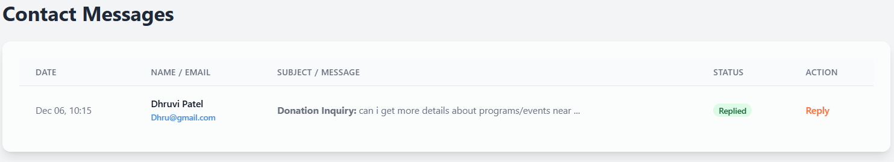
Volunteer Application & ContactMessage

Slide 21
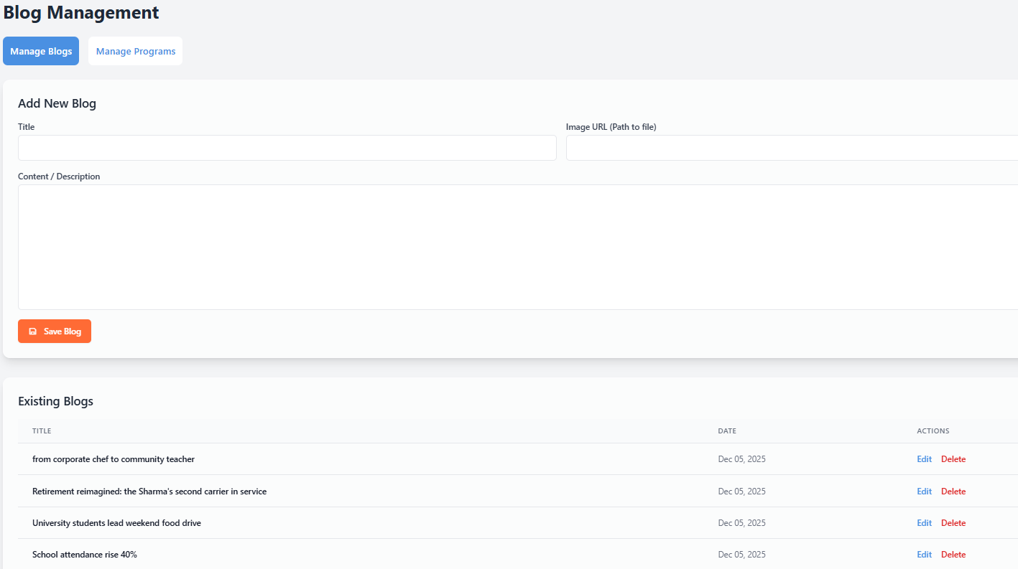
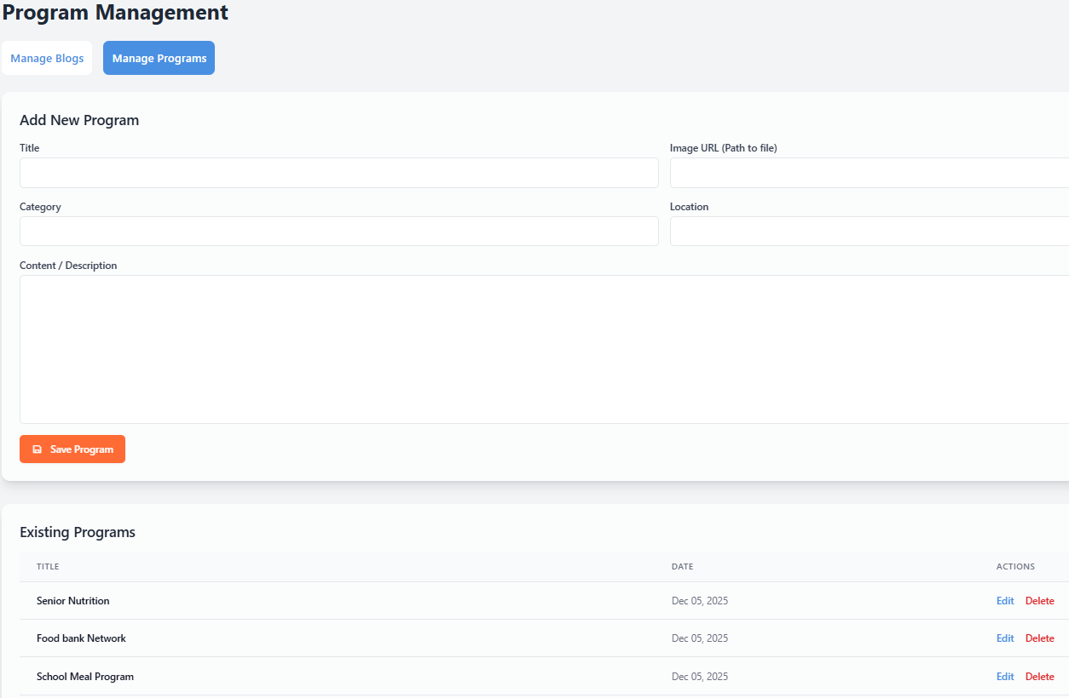
Program And Blog Management

Slide 22
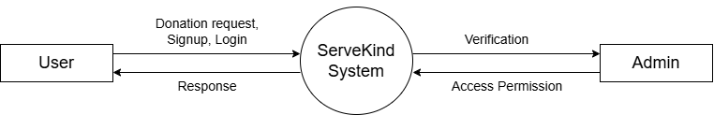
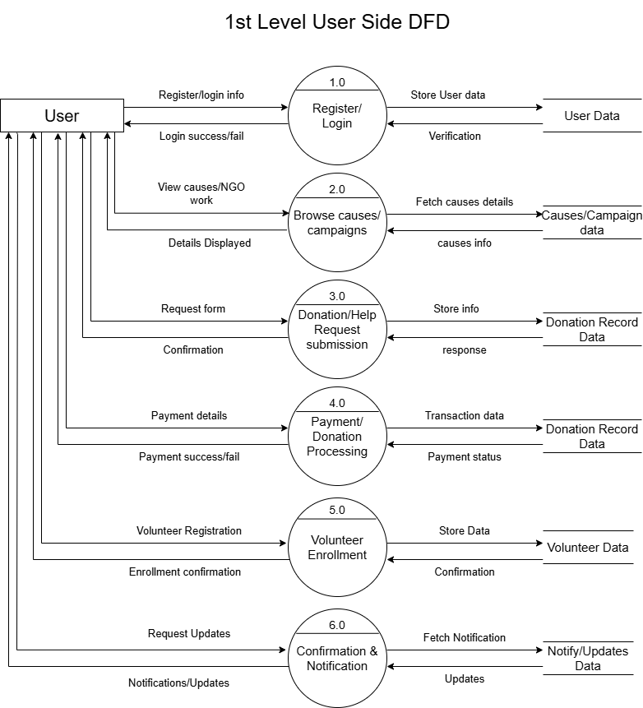
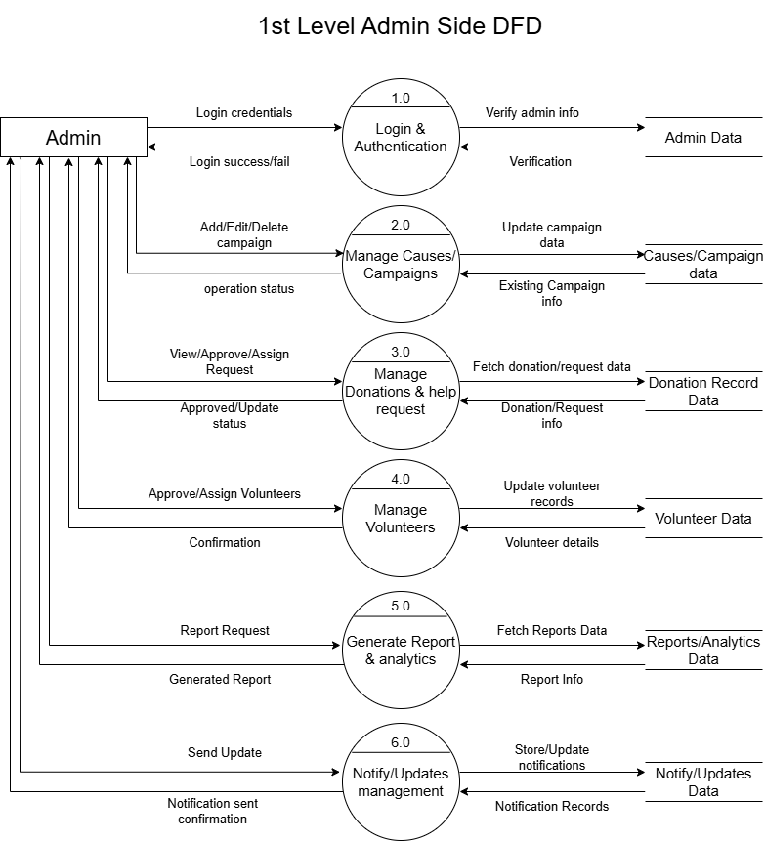
DFD Diagram
Zero level DFD

Slide 23
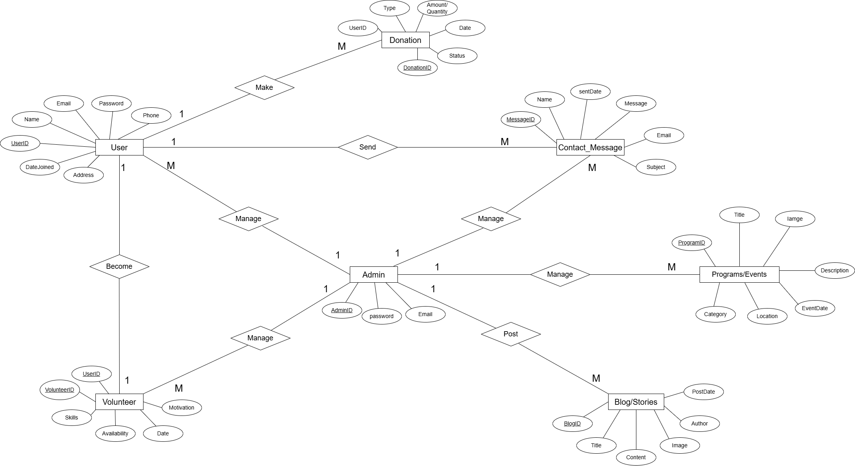
Entity Relationship Diagram

Slide 24
Conclusion
ServerKind successfully establishes a digital platform that simplifies and organizes community support activities such as donations, volunteering, and program management.
By providing an easy-to-use interface for users and a powerful admin panel for the organization, ServerKind ensures transparency, efficiency, and real-time communication.
The system enables the NGO to reach more people, manage resources better, and handle form submissions in a structured manner. Features like volunteer approvals, donation tracking, blog updates, and program management help build trust and engagement within the community.
Overall, ServerKind contributes to a more connected, informed, and socially responsible society by bridging the gap between people willing to help and those who need support.

Slide 25
References
https://www.apachefriends.org/ - for php And Mysql database
https://www.mca.gov.in/content/mca/global/ - Ministry of corporate Affairs
https://www.akshayapatra.org/ - NGO for references
https://gemini.google.com/ - For website designing
https://chatgpt.com/ - for coding
https://www.youtube.com/ - For NGO working & functions guidelines

