Slide 1

Nimap Infotech Pvt Ltd

Slide 2
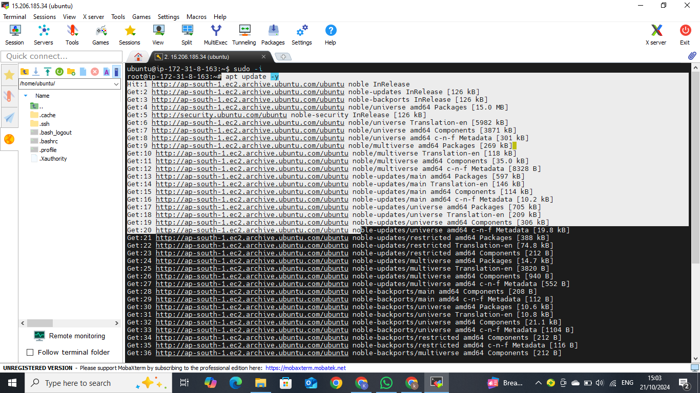
First updated the packages

Slide 3
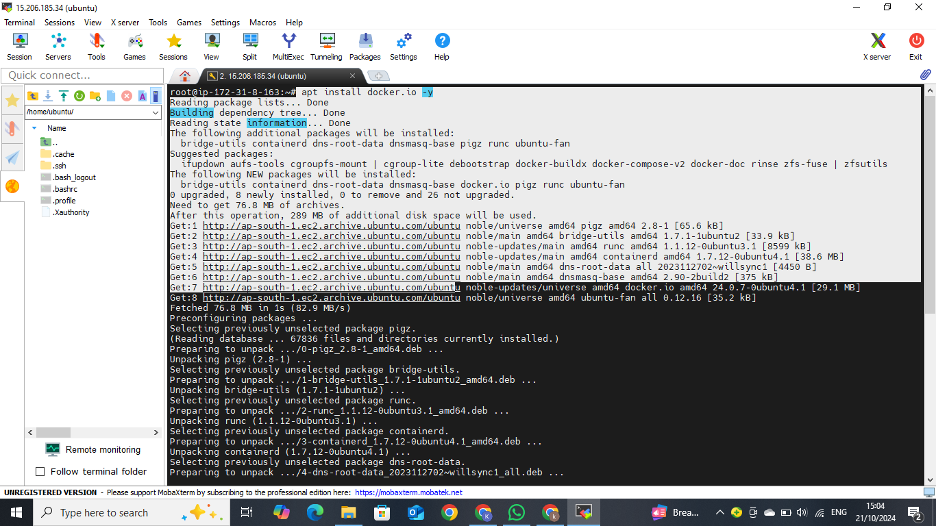
Install Docker on Ubuntu
apt install docker.io -y

Slide 4
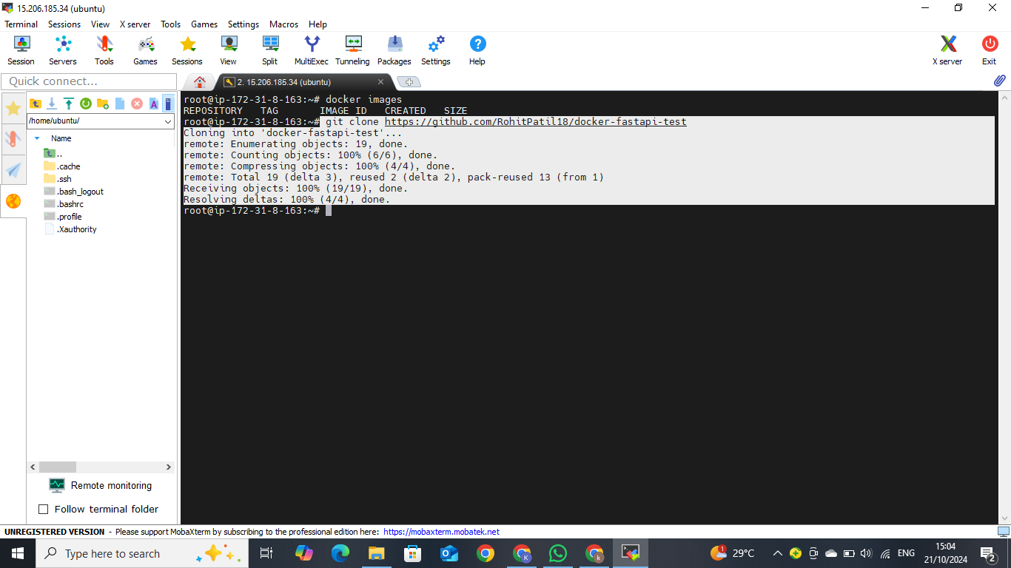
Take a github link and clone it

Slide 5
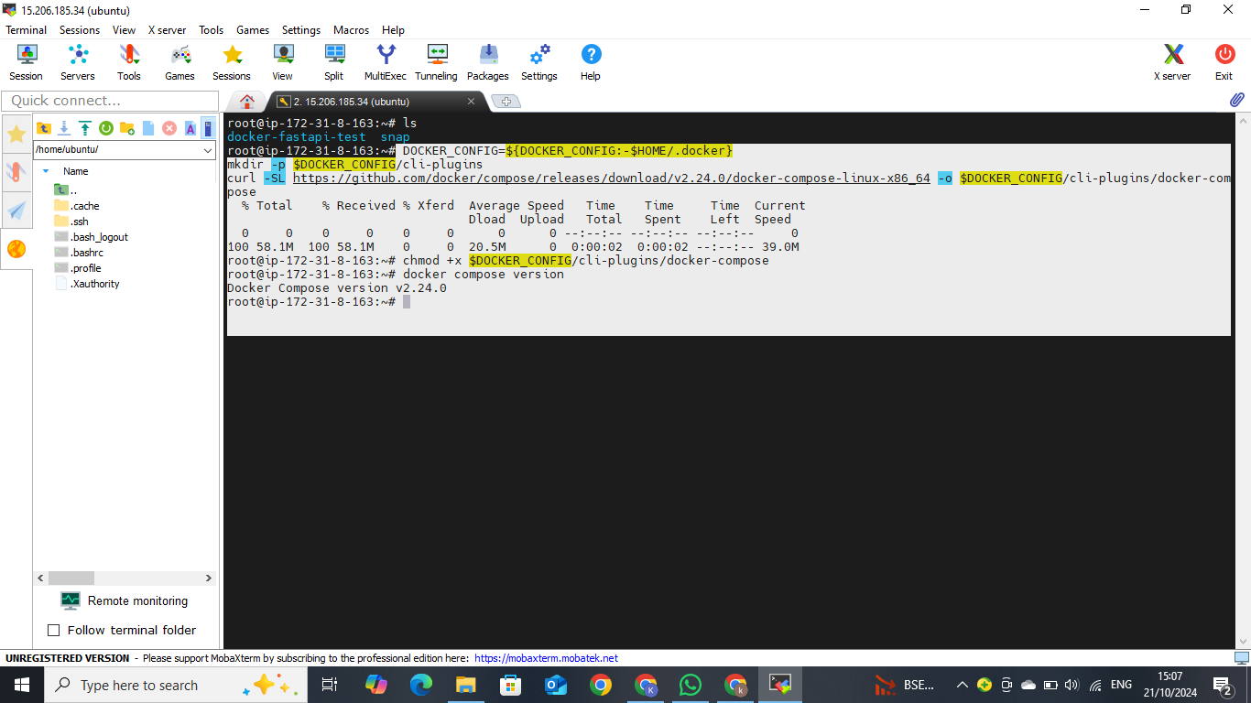
Install Docker Compose
DOCKER_CONFIG=${DOCKER_CONFIG:-$HOME/.docker}mkdir -p $DOCKER_CONFIG/cli-pluginscurl -SL https://github.com/docker/compose/releases/download/v2.24.0/docker-compose-linux-x86_64 -o $DOCKER_CONFIG/cli-plugins/docker-compose
chmod +x $DOCKER_CONFIG/cli-plugins/docker-compose

Slide 6
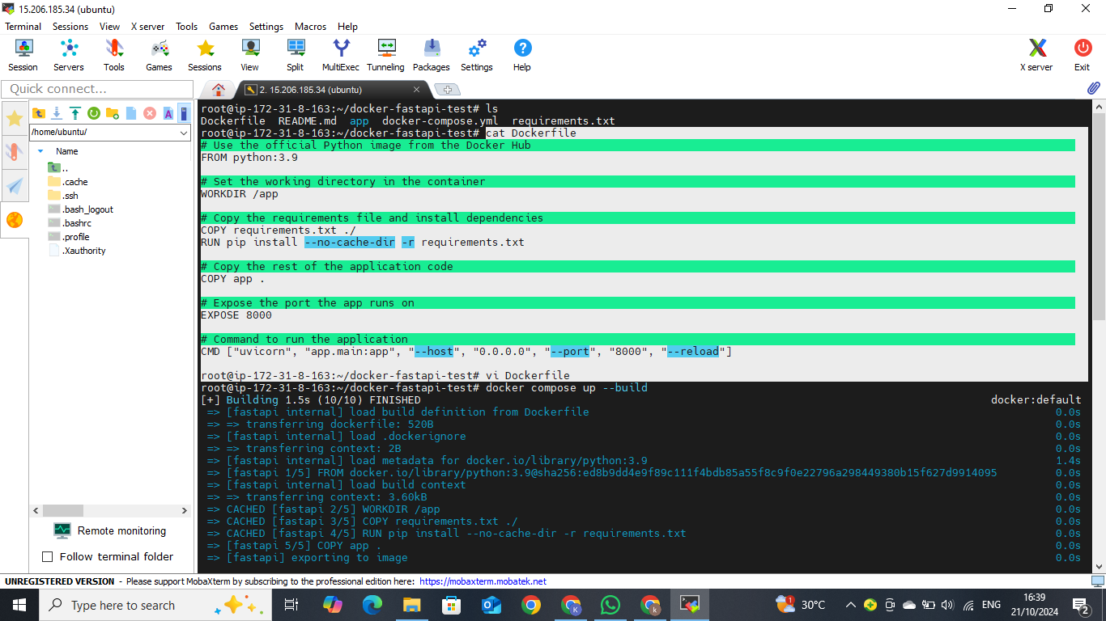
Created a Dockerfile

Slide 7
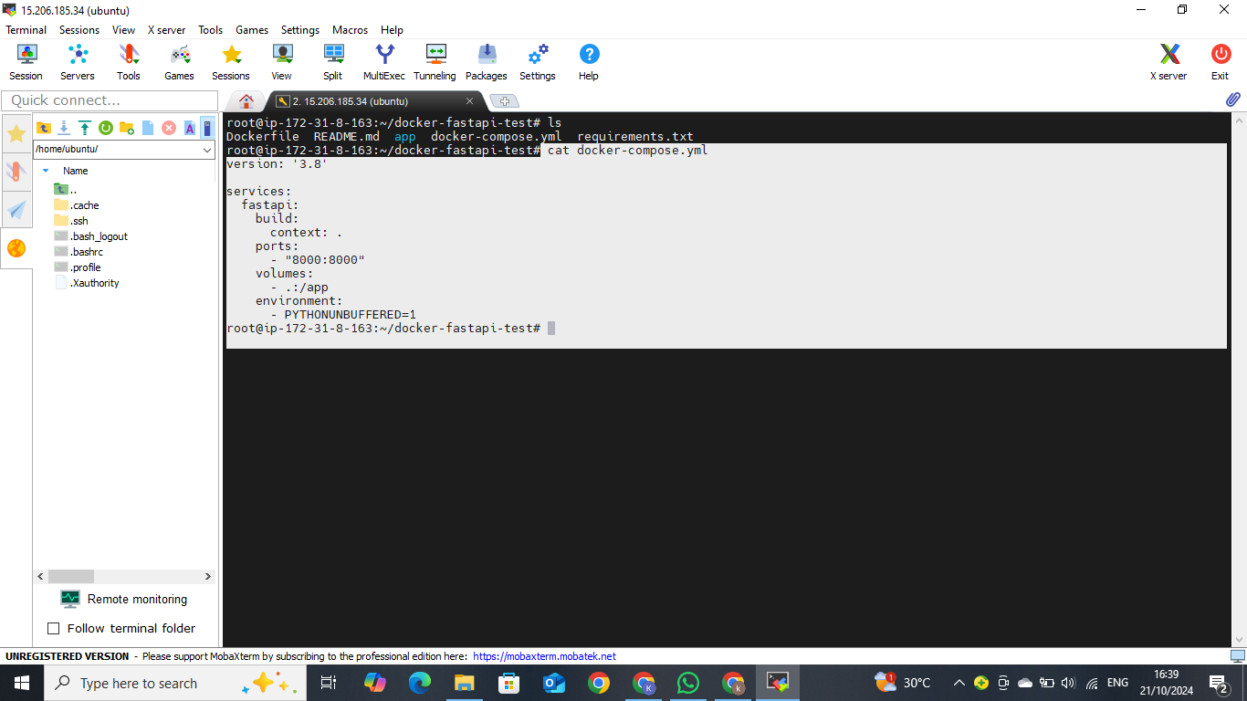
Created Docker-compose.yml File

Slide 8
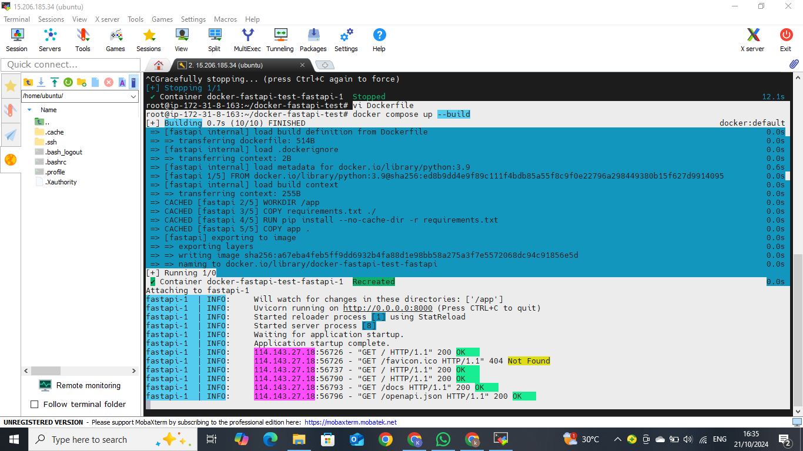
Run docker-compose using command
“docker compose up --build

Slide 9
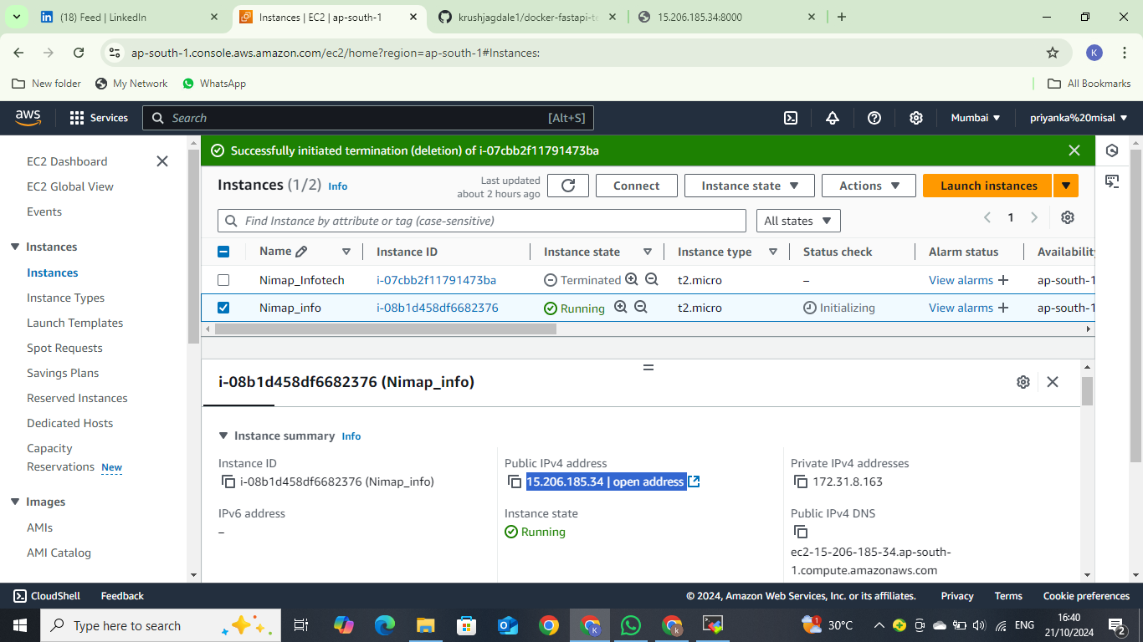
Taken a public ip of instance

Slide 10
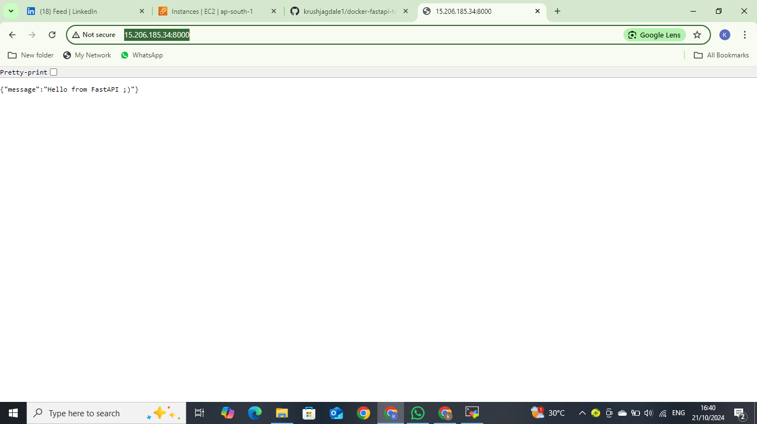
Run on port 8000

Slide 11
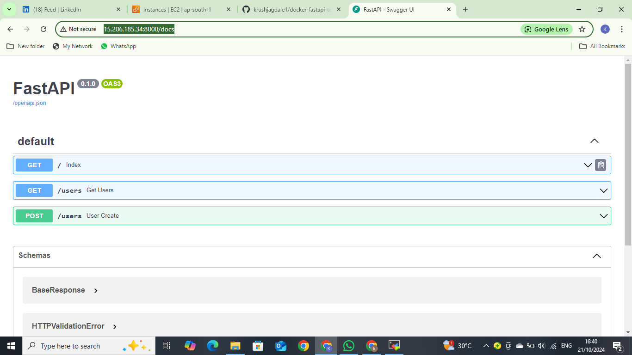

Slide 12
Thank you

