Slide 1
BIKE RENTAL SYSTEM
Ratnesh Patil (229189)
Krushna Bairagi (229165)

Slide 2
Introduction
This system is designed to help the customers to take bikes on rent. It is an Online system through which customers can view available bikes, register, view profile and book bike.
Using this system vehicles owner can register as admin and customers who want to take bikes on rent can register themselves as renters and can take any bike on rent. Address of the both are required as the customer can only take bike by going to the address provided by admin. The customer also has to upload some proofs to take the bike on rent.
Proofs like license is compulsory so that no one could run taking the bike. Any customer whose proofs are not uploaded and are not valid will not be allowed to take any bike on rent. This has one admin account that verifies the registering user and two types of user account.

Slide 3
OBJECTIVE
To produce a web-based system that allow customer to register and book a bike online for some fee specified and for the bikes owner to effectively manage their bike rental business.

Slide 4
SCOPE
The Bike rental system to keep detail records of both the bikes and the customers, the duration they rent bike as well as the type of bike they rent.
The system will be mainly design for small a company that renders bike rental services to customers.
The system will have two levels of access:
The administrator
Customer

Slide 5
SOFTWARE AND HARDWARE CONFIGURATION
Software Configuration :
Browser
Hardware Configuration :
Processor :11th Gen Intel® Core(TM) i5-11300H @3.10GHz 3.11 GHz
RAM : 8.00 GB
System type :64-bit operating system , x64-based processor

Slide 6
TECHNOLOGY
ReactJS
Spring Boot
MySQL

Slide 7
FUNCTIONALITIES
ADMIN :
The admin will the entity that will monitor the activities and the records of the whole system.
The admin account has all the privileges, to check all customers list and check profiles.
Admin can add new bikes , update and delete bikes from the system. Admin can approved the customers payment request.
Admin can view all the bike list , can update list , also see the report.
CUSTOMER / USER :
Customer can register and after login have the access to book bike on rental basis.
Customer can view their profile , see the list of available bikes , book bike and make a payment.

Slide 8
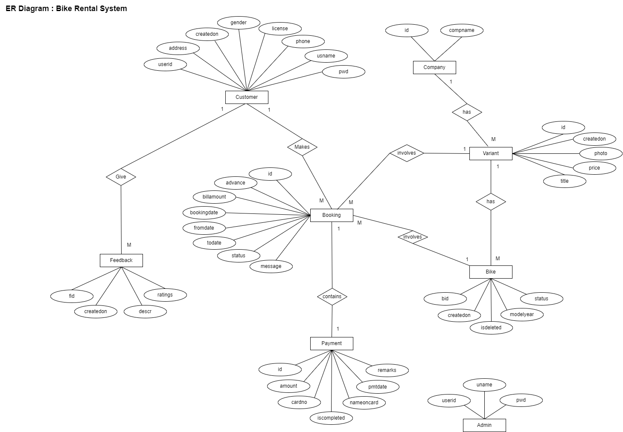
Diagrams
ER Diagram

Slide 9
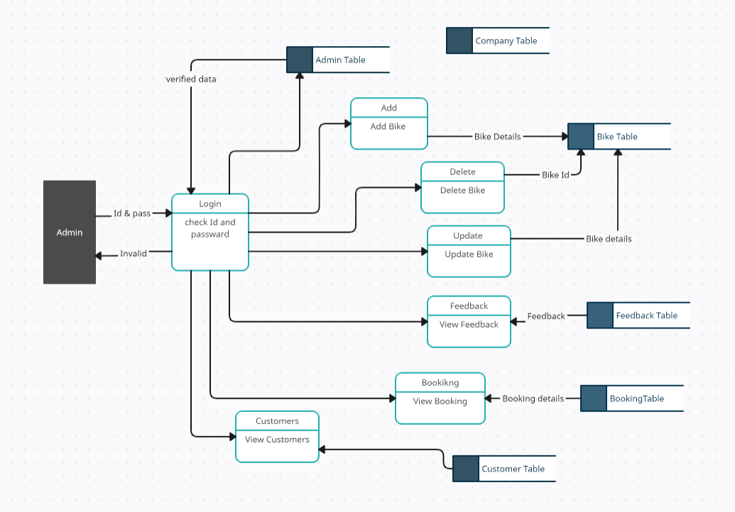
Diagrams
Data Flow Diagram : Admin

Slide 10
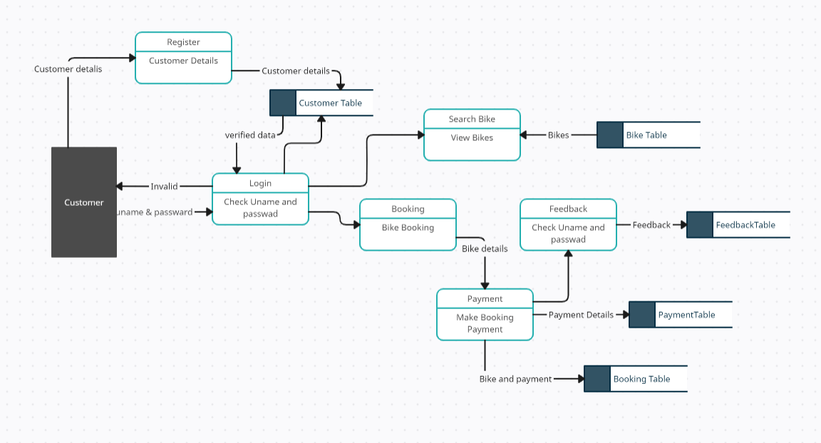
Diagrams
Data Flow Diagram : Customer

Slide 11
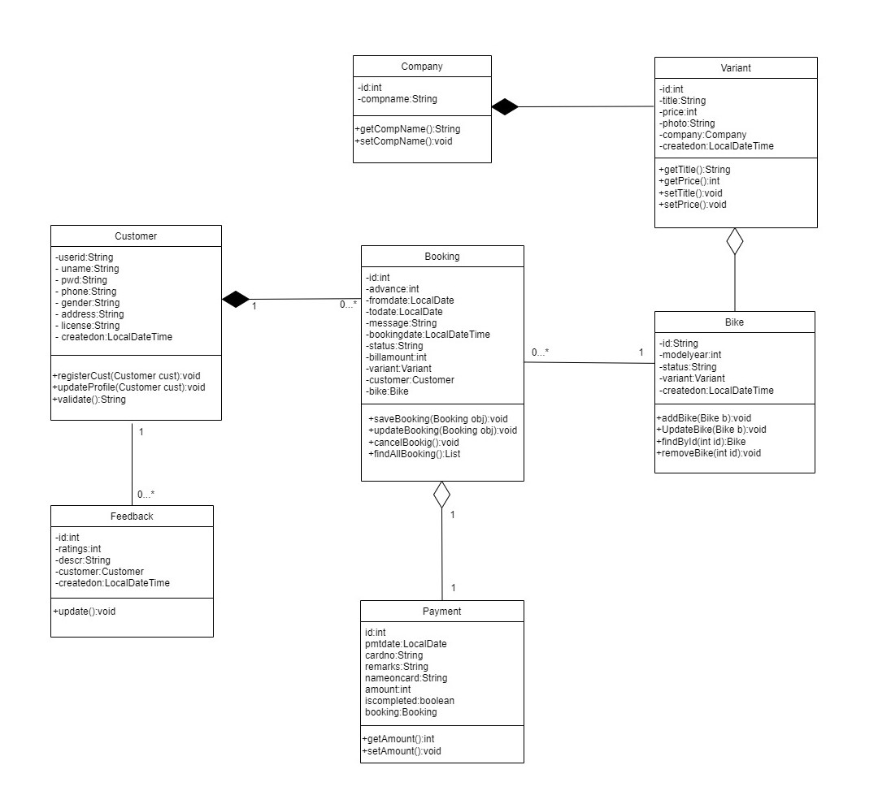
Diagrams
Class Diagram

Slide 12
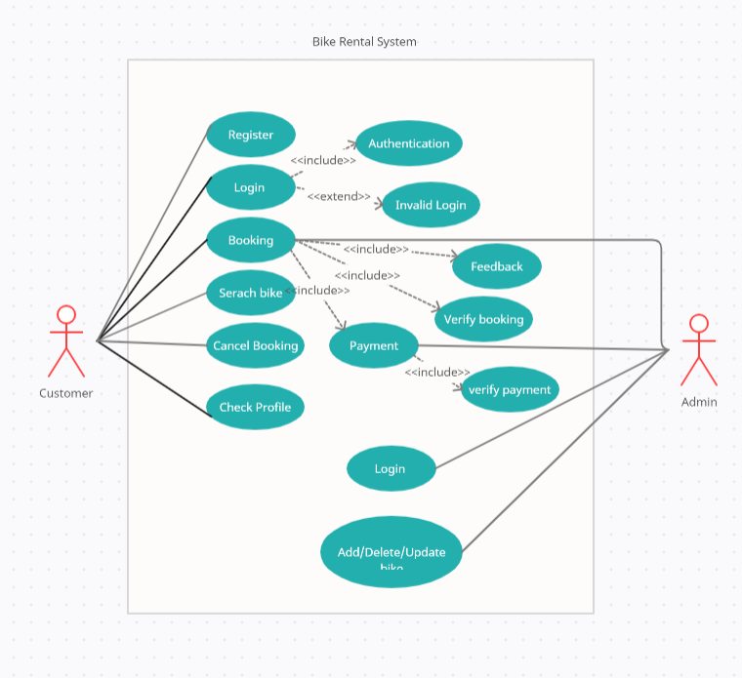
Diagrams
Use-Case Diagram

Slide 13
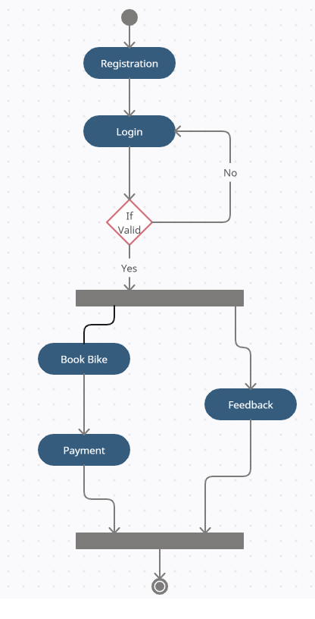
Diagrams
Activity Diagram

Slide 14
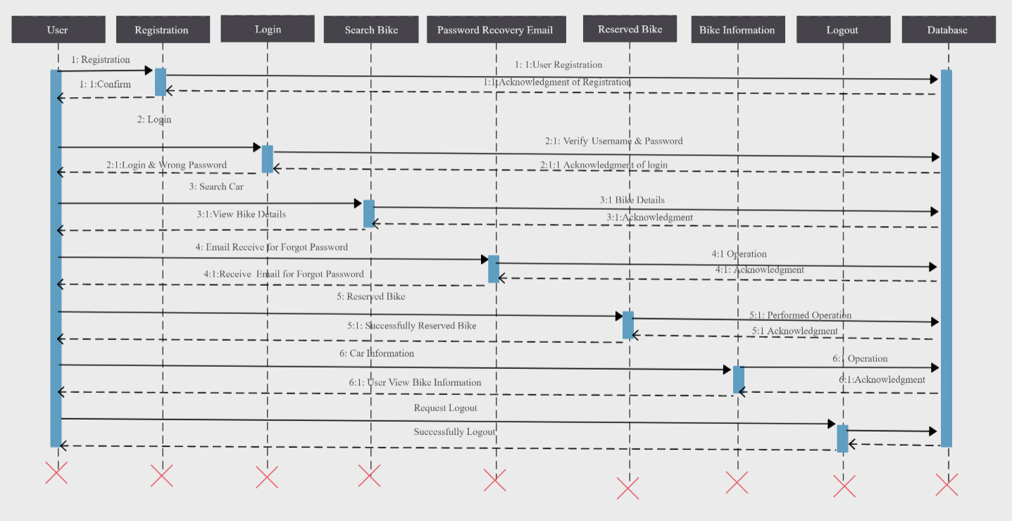
Diagrams
Sequence Diagram

Slide 15
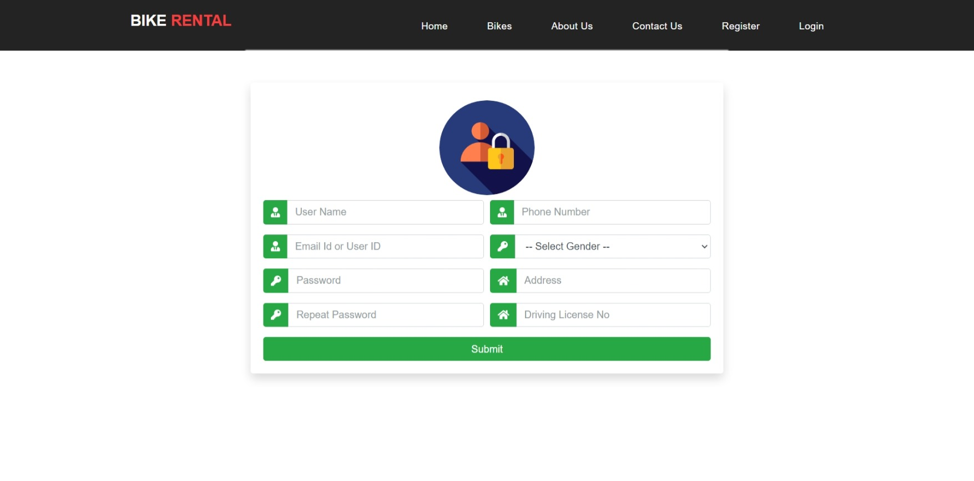
Register

Slide 16
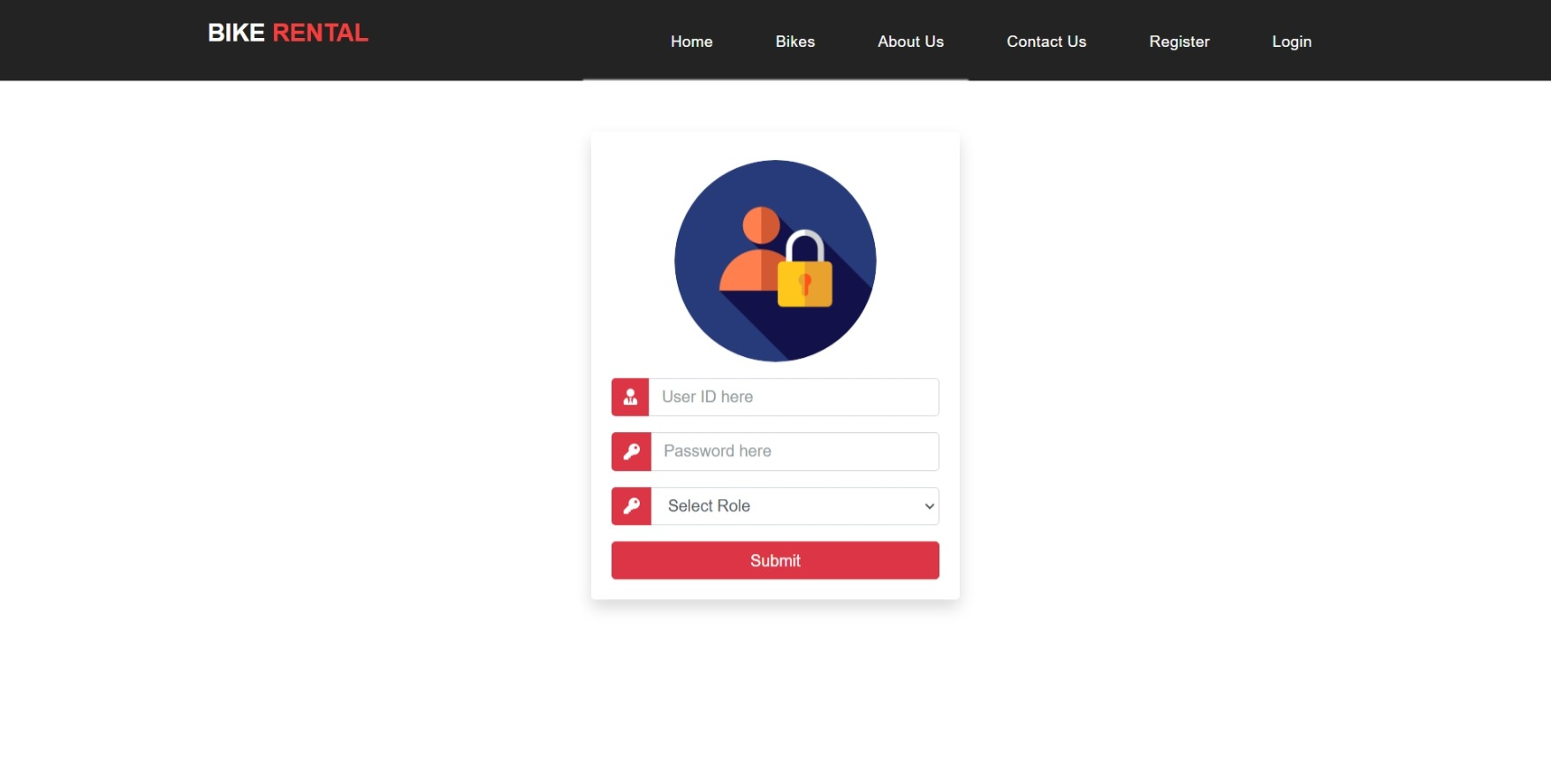
Login

Slide 17
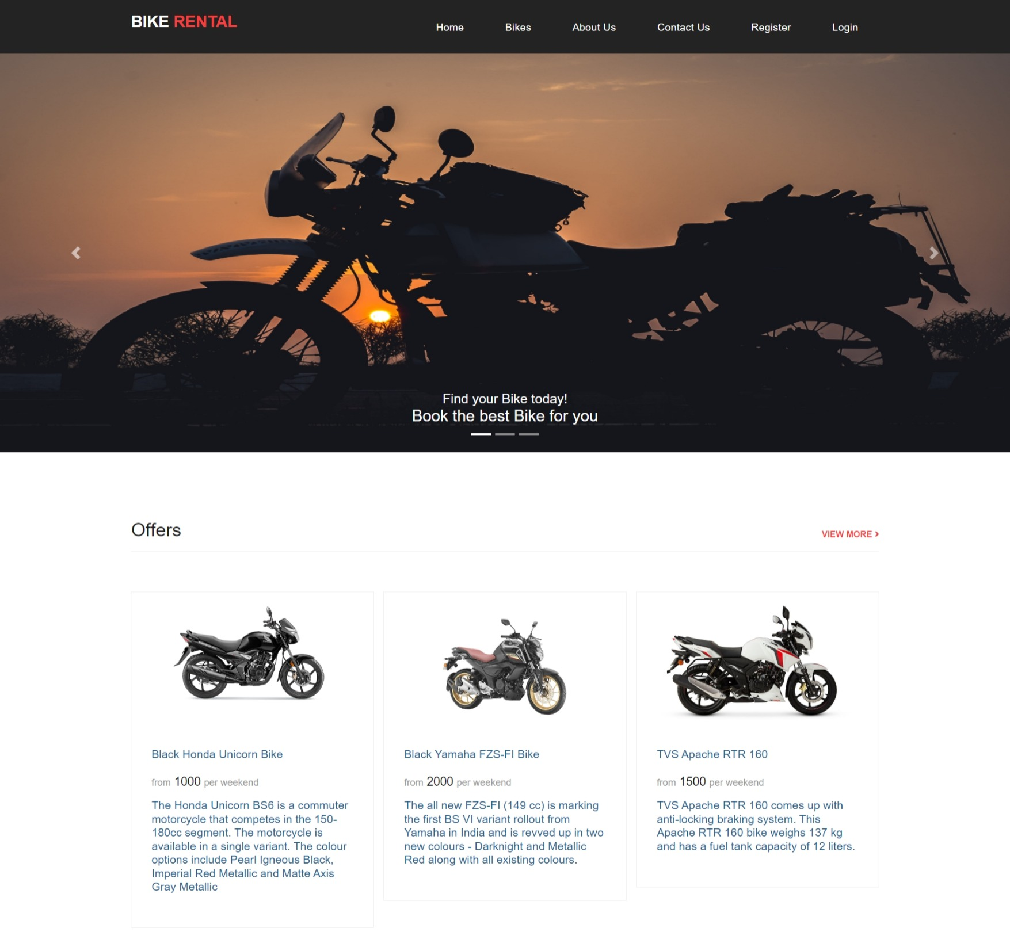
Home Page

Slide 18
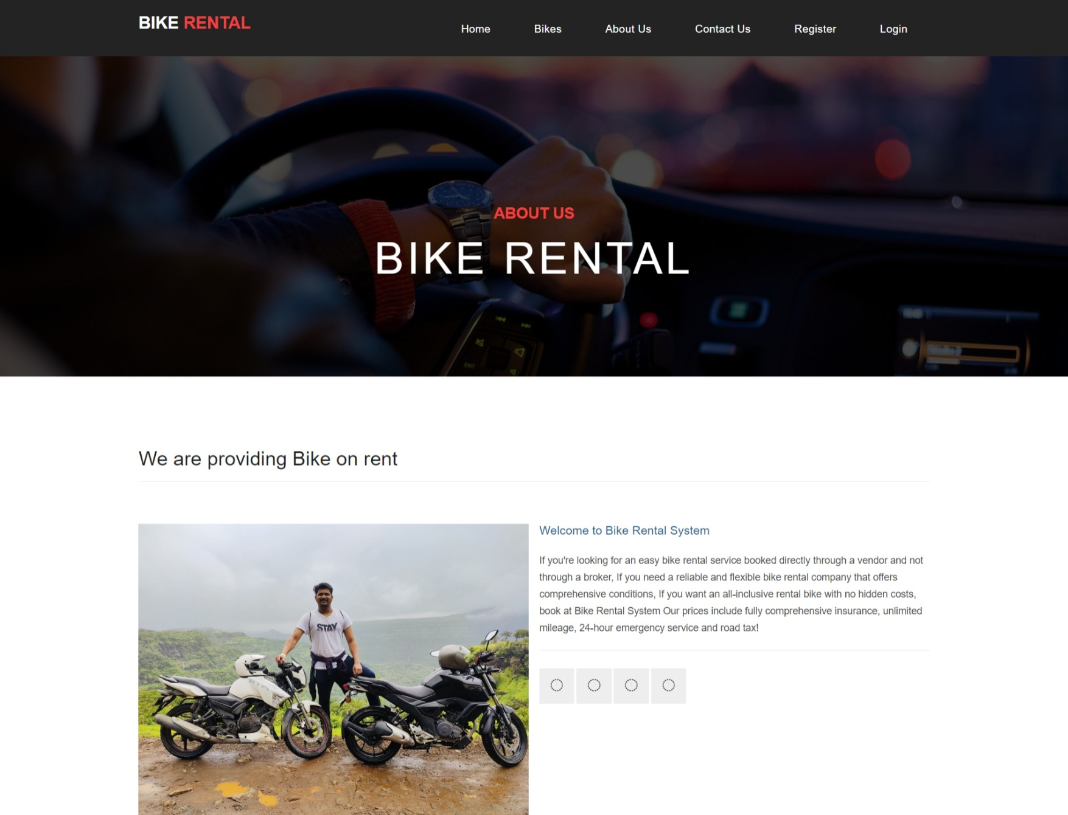
About us

Slide 19
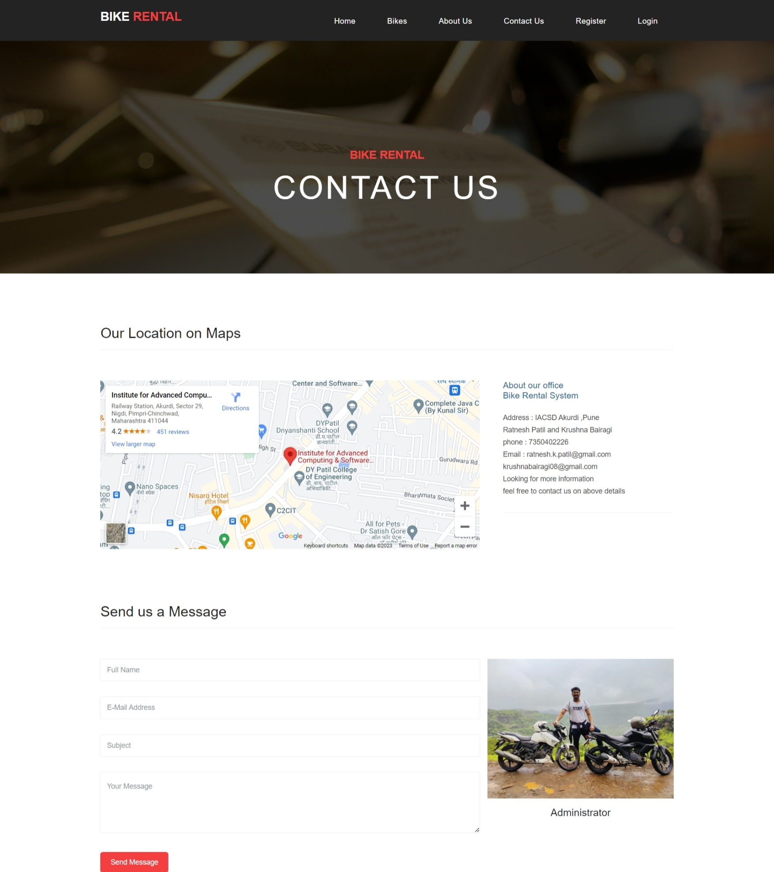
Contact us

Slide 20
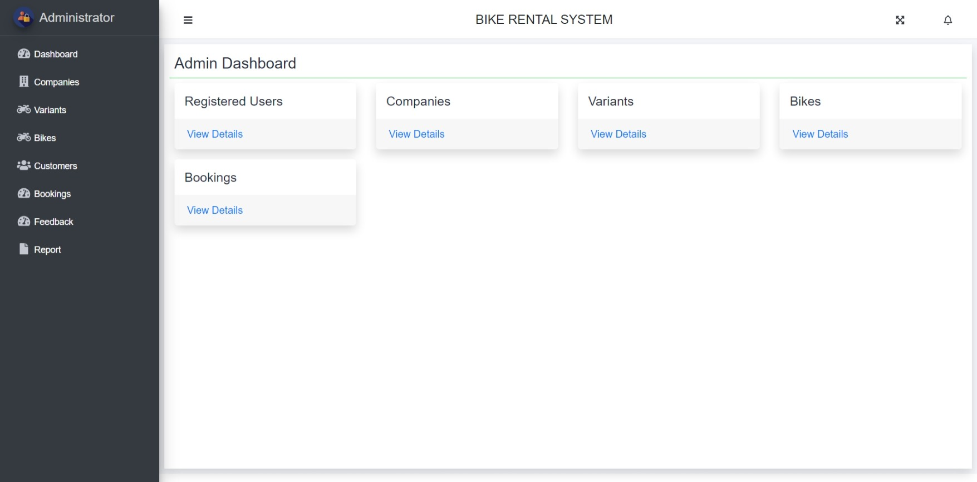
Admin dashboard

Slide 21
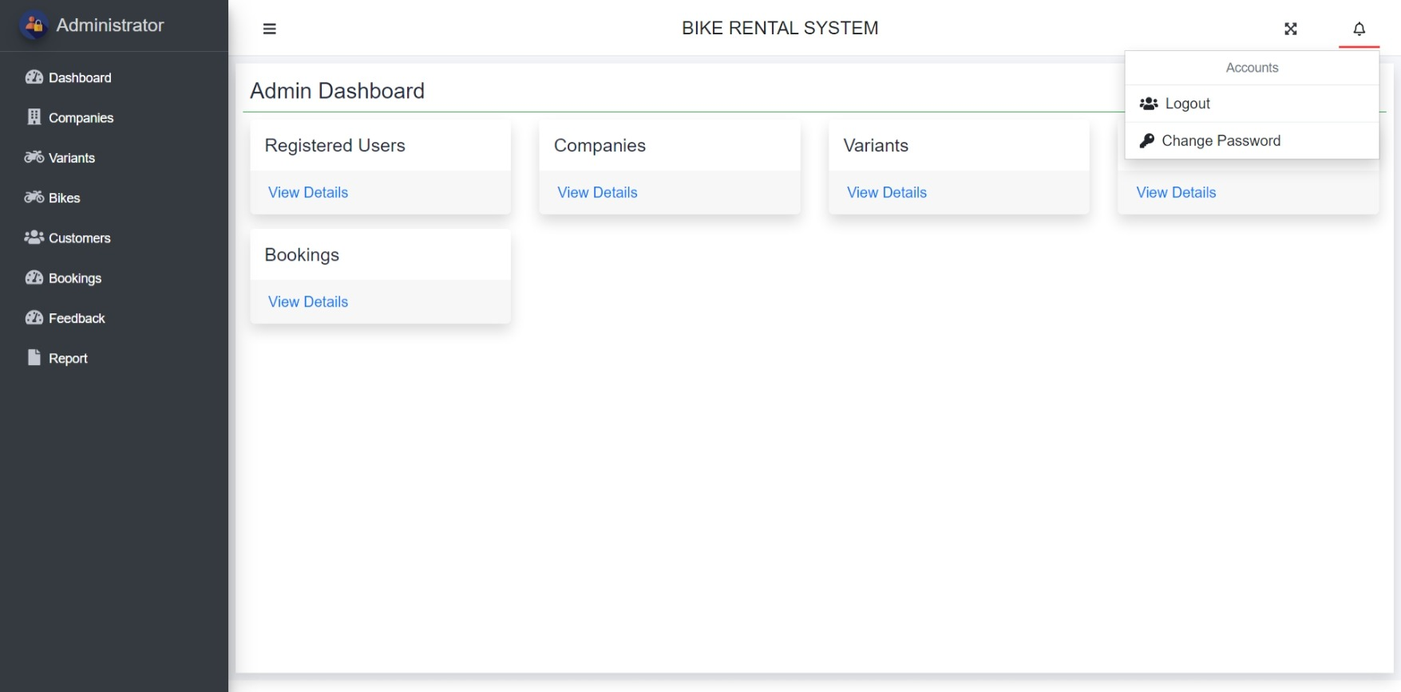
Admin logout option

Slide 22
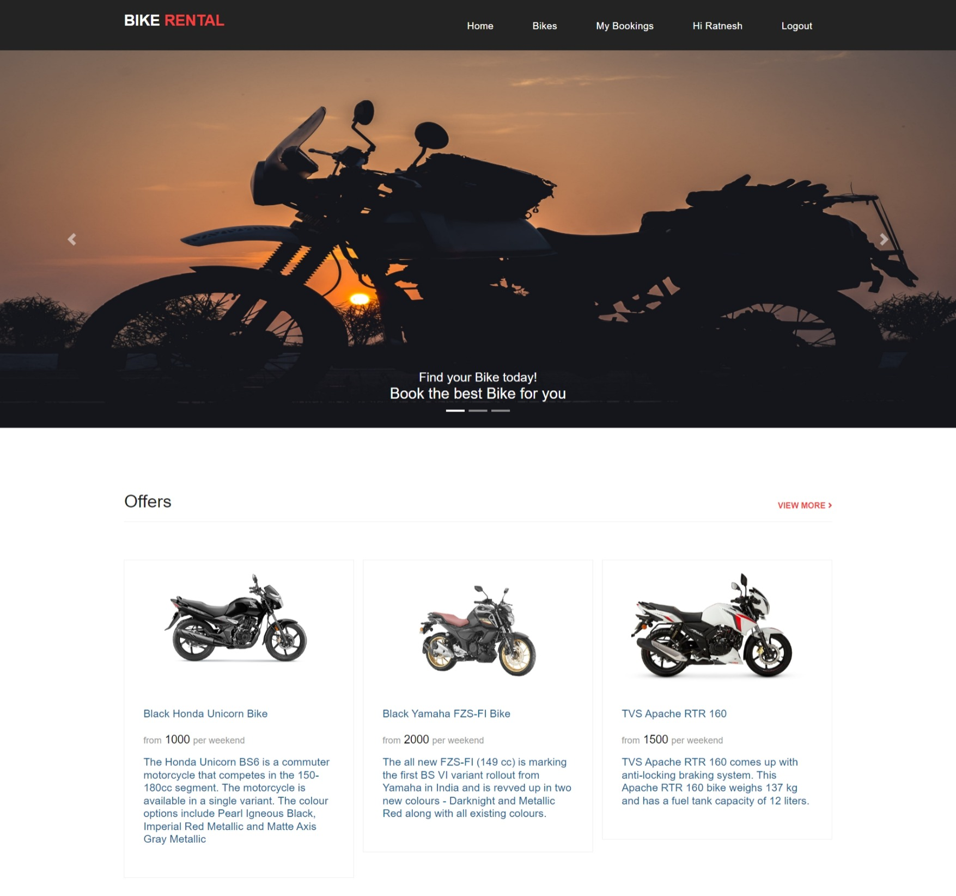
Customer dashboard

Slide 23
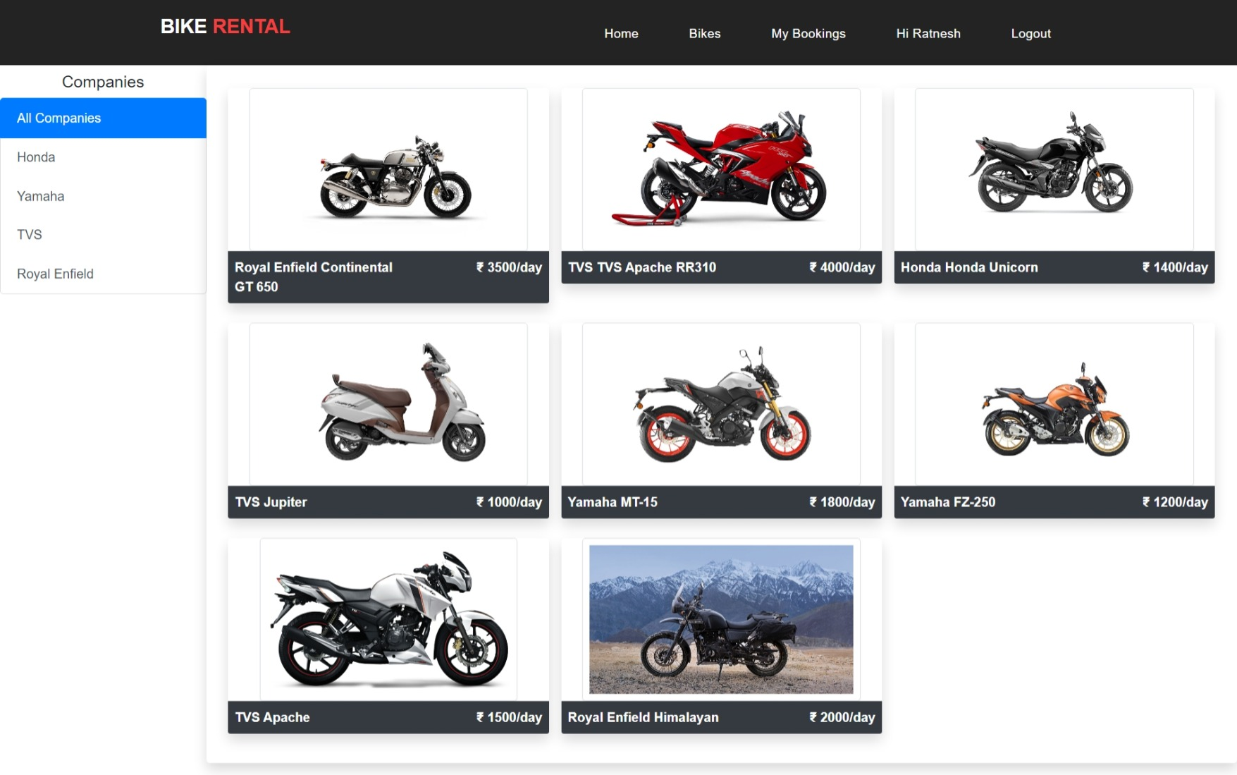
Bike list for customer

Slide 24
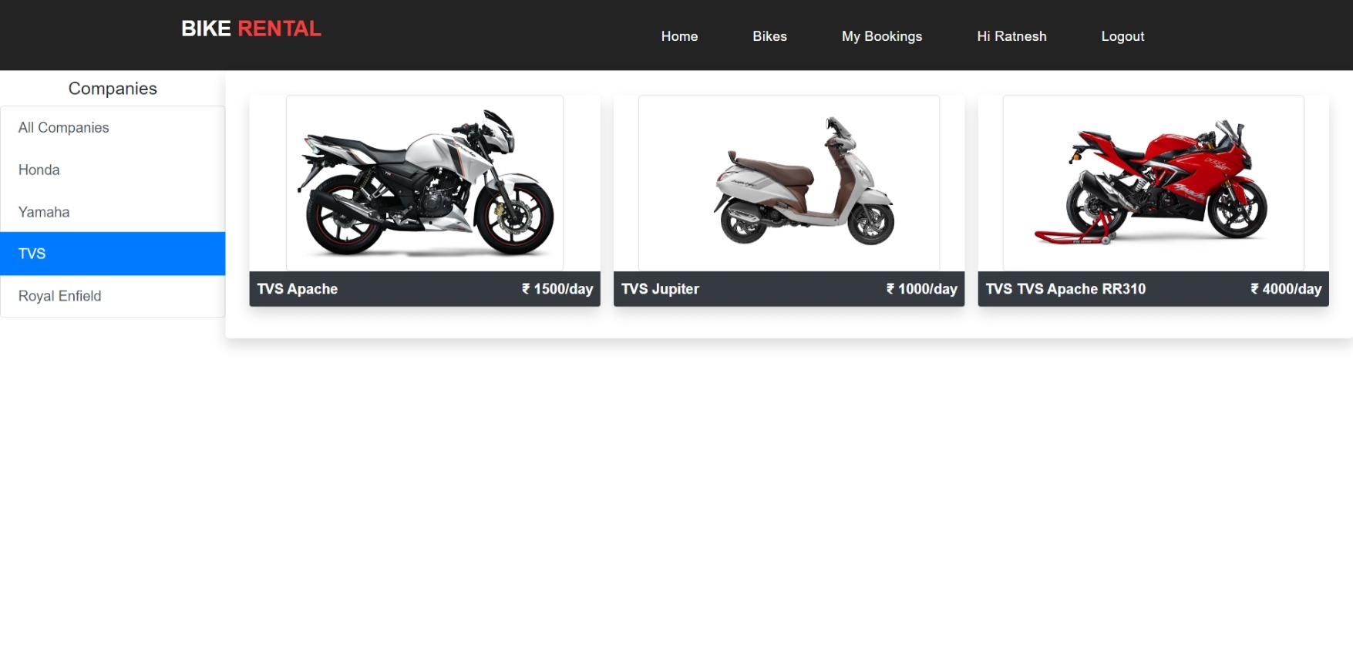
Bike list by company name

Slide 25
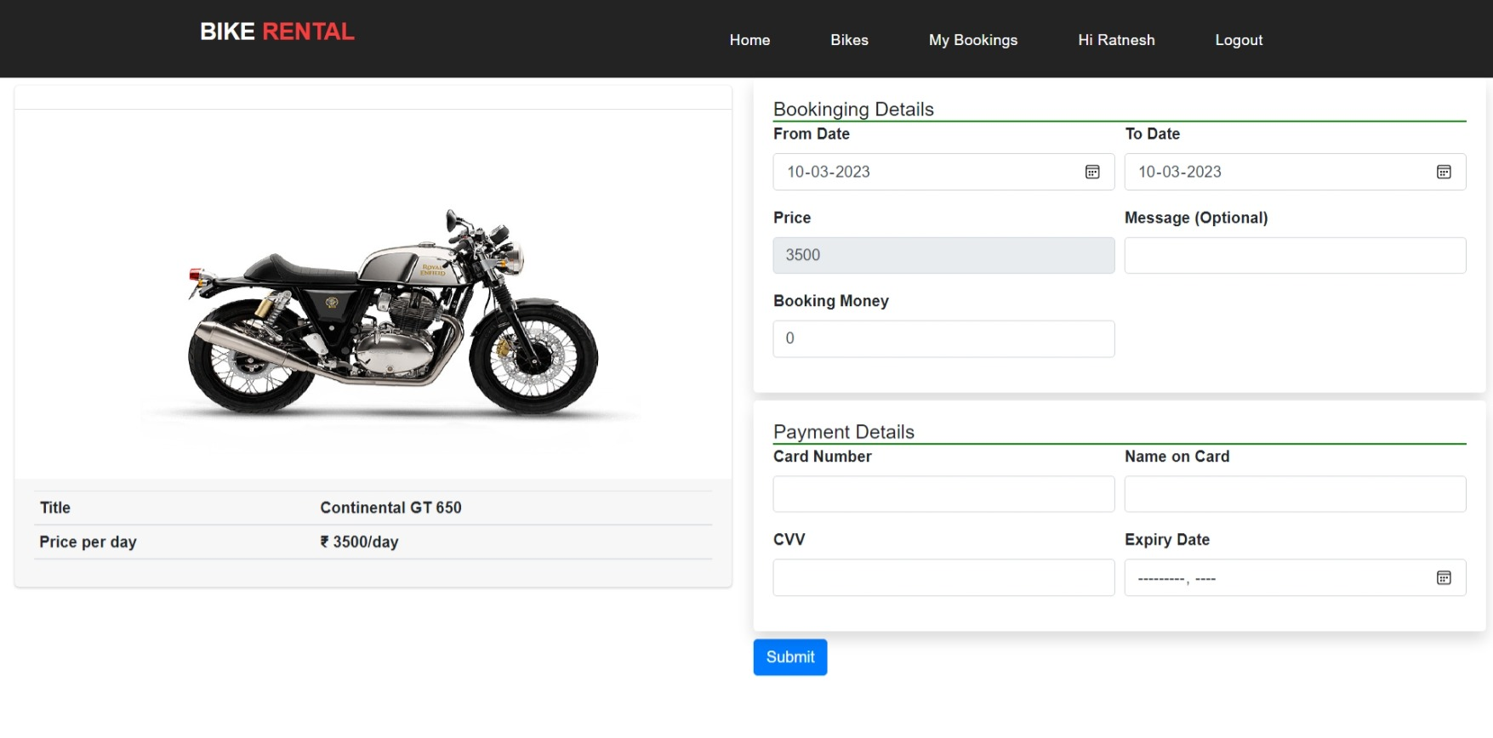
Bike booking details

Slide 26
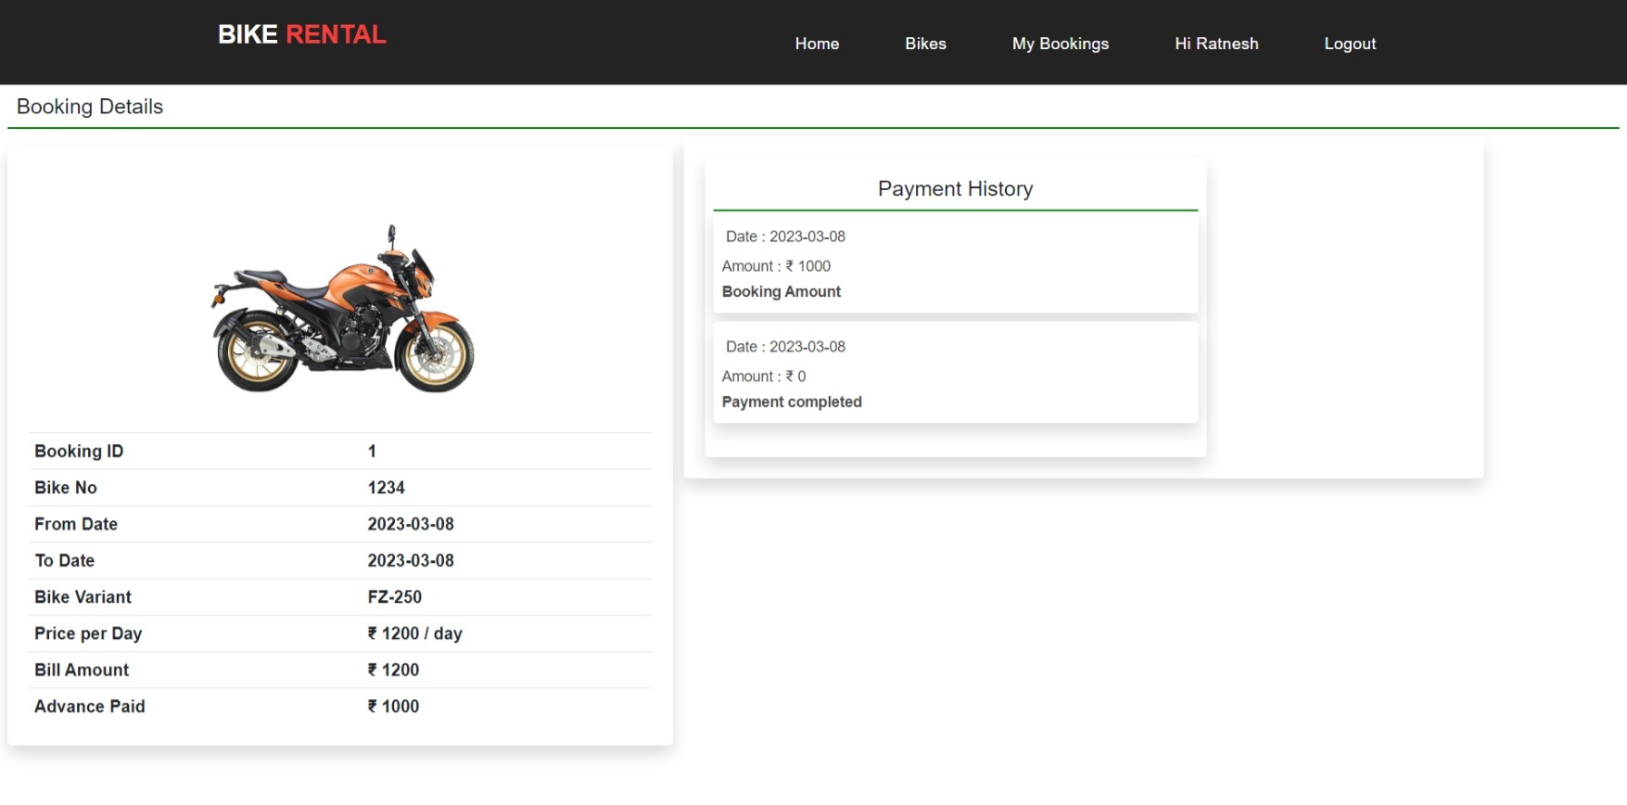
Booking details and payment details

Slide 27
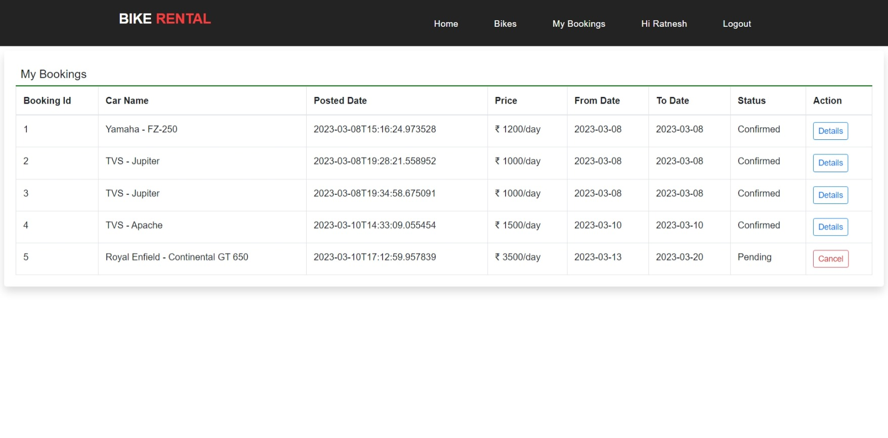
Booking History of customer

Slide 28
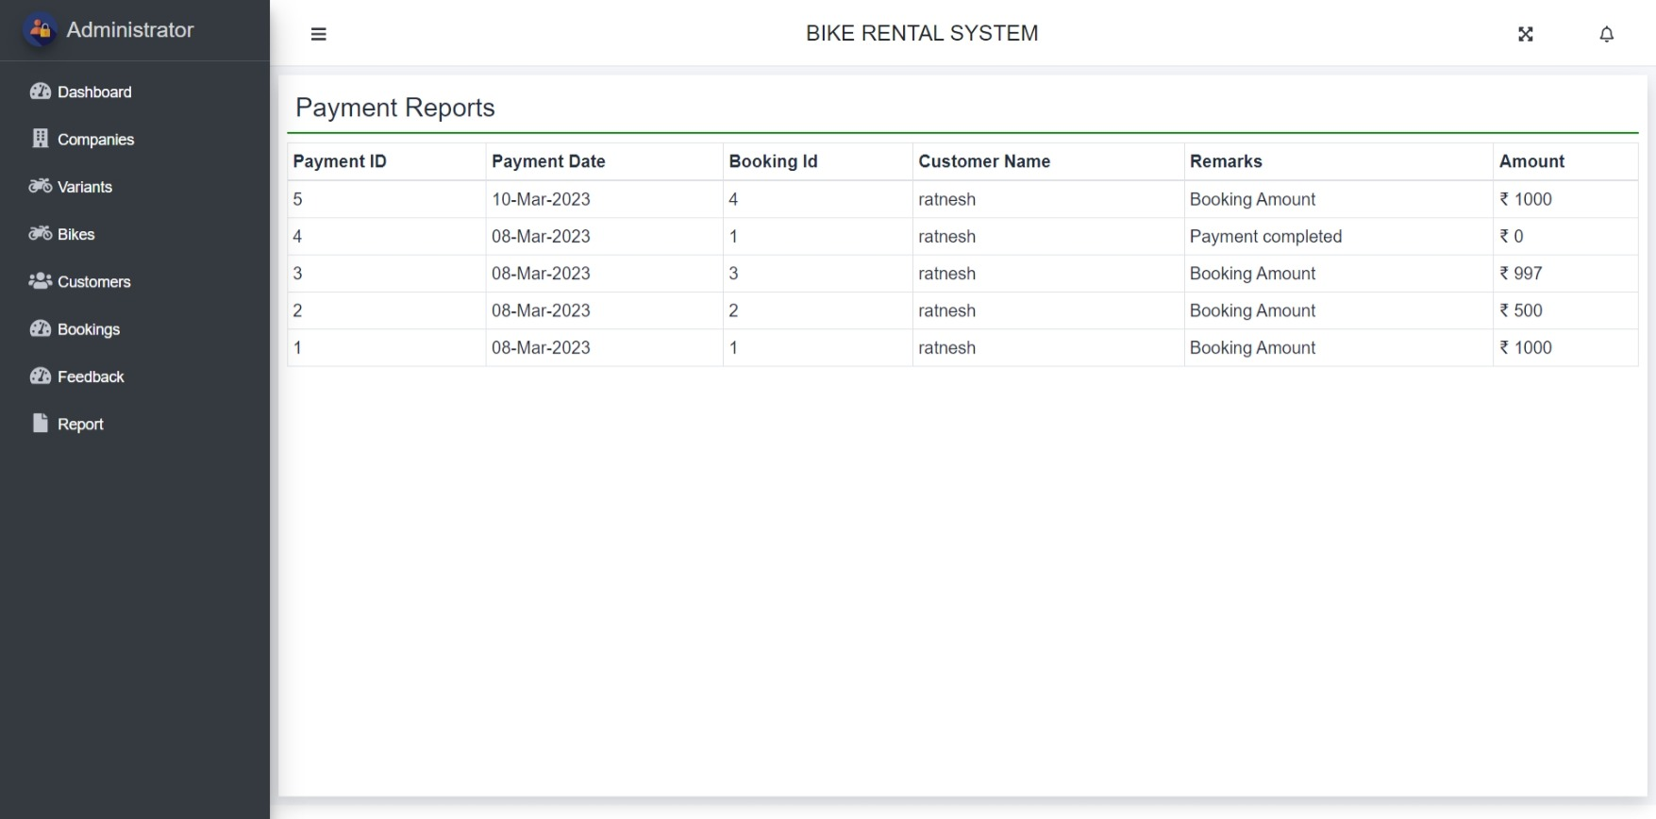
Booking report for admin

Slide 29
Thank you …!

