Slide 1
Capstone Project: Dentistry Data Analysis
By: Krish
Date: March 2025

Slide 2
Introduction
This project aims to analyze dentistry-related data, clean the dataset, and apply machine learning models to gain insights.

Slide 3
Dataset Overview
The dataset contains information on gender distribution, patient details, and related dentistry data. Data preprocessing and cleaning were performed.

Slide 4
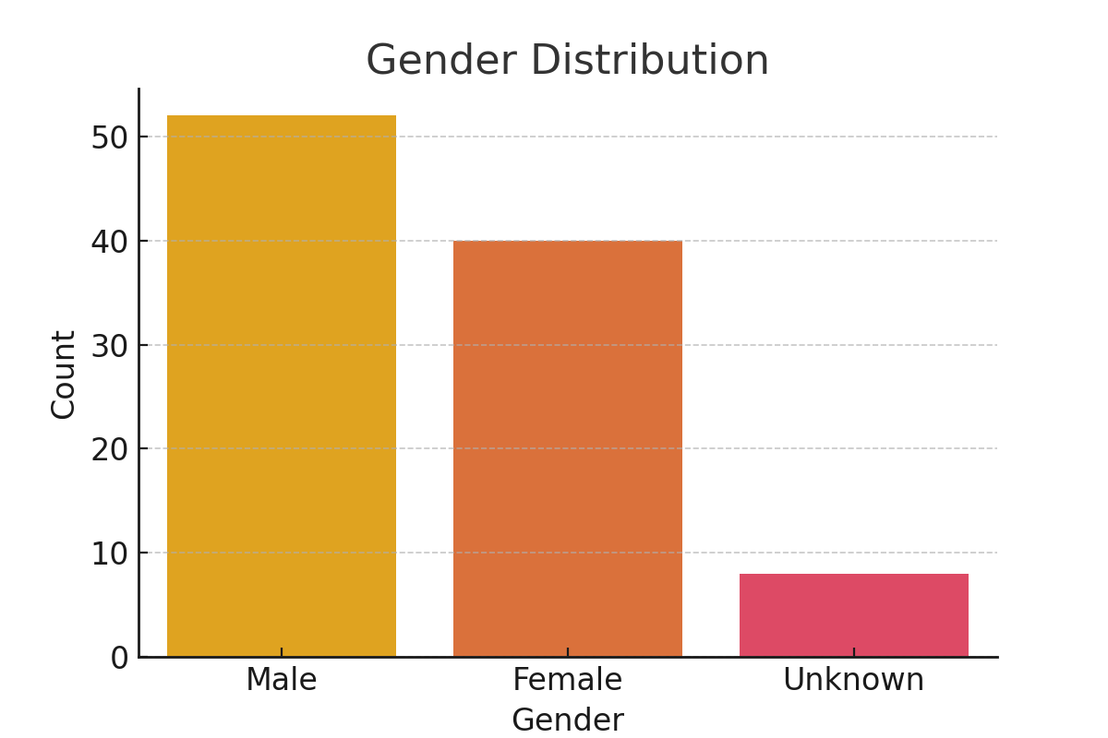
Gender Distribution

Slide 5
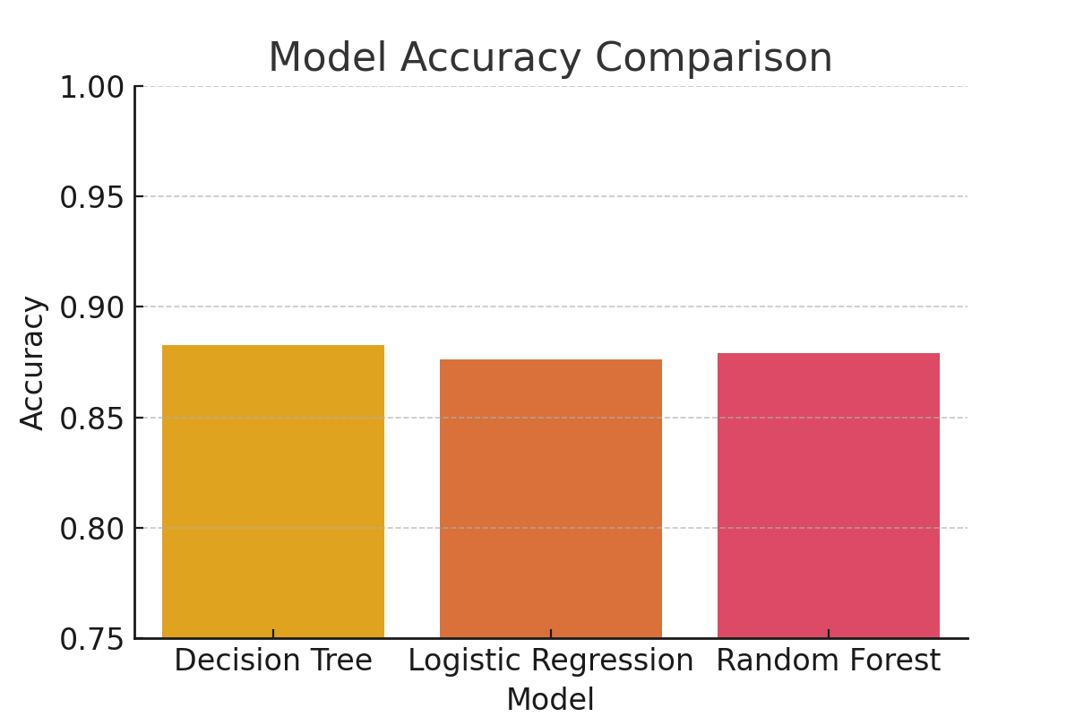
Model Accuracy Comparison

Slide 6
Conclusion & Next Steps
This analysis provided insights into gender distribution and model accuracy. Future improvements include optimizing the model and adding more data points.

