Slide 1
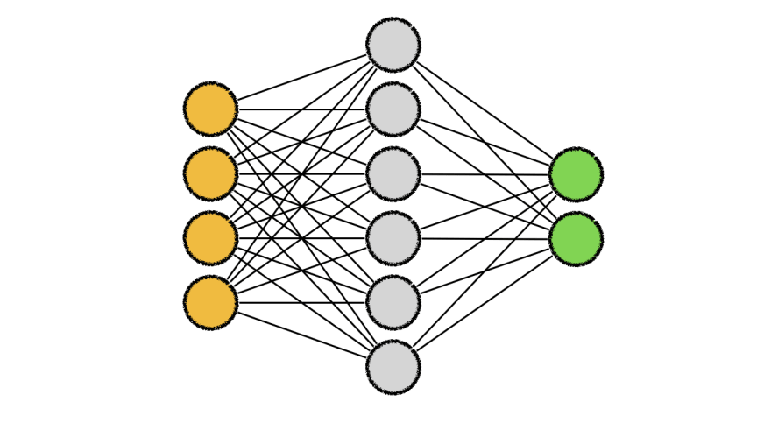
Language Generation
Project Faculty Coordinator
Tirthankara Dasgupta
Project Member s
Abijit Pual (0000158)
Sanath Singavarapu (0000188)
Musale Krushna Pavan (0000150)
Drona Sai Trinath (0000169)
Yelleti Varshith (0000198)

Slide 2
Contents:
» What Is Language Generation?
» Experimental Data
» Data Pre Processing
» Modelling
» Results
» Conclusioin

Slide 3
What is Language Generation
The aim of a typical Language generation system is to produce a text which satisfies some set of pre-stated goals. Such systems are provided with a knowledge base -- which contains information to be expressed -- and a set of goals. The system then organizes this information into sentence-length chunks, realises these chunks as sentences.

Slide 4
Experimental Data
We have used the Flickr8k dataset for our Language Generation model.
About the Flickr8K dataset comprised of more than 8,000 photos and up to 5 captions for each photo and also the tokenized descriptions of the image
1305564994_00513f9a5b.jpg#1
Two racer drive a white bike down a road .
1305564994_00513f9a5b.jpg#3
Two person be in a small race car drive by a green hill
1305564994_00513f9a5b.jpg#4
Two person in race uniform in a street car .

Slide 5
Data Pre processing
Retrieve the Sentences from the Dataset
Converted the Sentences into Individual words obtained from step1
Created a set of unique words from the list of words obtained from step 2
Created a Dictionary(word2num) by mapping a numerical value to each word obtained from step 3
Created a Dictionary(num2word) from the set of words obtained from step 3

Slide 6
Modelling
We have built a sequential model with three Long short term memory(LSTM) layers having 400 units each. The first layer needs to be fed in with the input shape. In order for the next LSTM layer to be able to process the same sequences, we enter the return sequences parameter as True.
The dropout layers with a 20% dropout have been added to check for over-fitting. The last layer outputs a one hot encoded vector which gives the character output.

Slide 7
Results
For this results we have considered 3000 sentences
Epochs : 100
Batch size : 64
Model Loss : 2.05
Validation Loss : 5.9
Accuracy :
Sample Input/output of Model
Input : A man in Street racer
Output : A man in Street racer armour be examine the tyre of another racer.

Slide 8
Conclusion
From the pre conditions i.e. words given by the user we are able generate the sentences with the proposed model.

Slide 9
THANK YOU

