Slide 1
8th Semester Project (CS-812)
Support Ticket Classification
Musale Krushna Pavan (CSE/16159/0000150)
Sanath Singavarapu (CSE/16033/0000188)
Under the supervision of
Bhaskar Biswas

Slide 2
What is Support Ticket?
Support Ticket:
The IT ticket that is raised regarding a particular issue at industry which need to be attended by the support team to resolve the issue.
The support tickets mainly can be divided into following based on its content
'Application’, 'Database’, 'Network’, ‘User Maintenance’, ‘Security'

Slide 3
What is Support Ticket Classification?
Support tickets that are received need to be classified So that they can be assigned to that department to resolve.
Generally the following ways are in practice
1. Human intervention to manually classify
2. Manually assigned by the ticket raising user.

Slide 4
Why Support Ticket Classification?
There is manual intervention in the both the ways.
There goes lot of effort to look into the ticket context and classify the ticket accordingly.
Solution:
We will use machine learning and deep learning algorithms to automate the process of classification and to reduce human involvement.

Slide 5
Problem Statement :
Aim: The main task is to classify the support tickets based on its text content.
Input: The support ticket containing the text description of the problem.
Output: Category to which the support ticket belongs to.

Slide 6
How do we solve this ?
Machine Learning:
Machine learning is the scientific study of algorithms and statistical models that computer systems use to perform a specific task without using explicit instructions, relying on patterns and inference instead.

Slide 7
How do we solve this ?
Deep Learning:
Deep learning is part of a broader family of machine learning methods based on artificial neural networks. Learning can be supervised, semi-supervised or unsupervised.

Slide 8
Methodology:
About the Dataset:
Support ticket classification dataset taken from the UCI repository.
The data set mainly contains 1. Support ticket with text data
2. Category of the ticket

Slide 9
Approach:
Pre-processing the text to fit in model and for better results.
Appling different machine learning algorithms and
Tuning with different parameters
Comparison between the different matrix and algorithms
Considering the one having the best results

Slide 10
Pre-Processing the text data:
Data Cleaning: The data can have many irrelevant and missing parts. To handle this part, data cleaning is done. It involves handling missing data, noisy data etc.
Convert to lower case
Get the labelled data consisting of ticket and its category
Expand the contracted words ( isn’t → is not)
Remove punctuations
Remove special characters
Remove unnecessary digits

Slide 11
Pre-Processing the text data:
2. Data Transformation: This step is taken in order to transform the data in appropriate forms suitable for the mining process. This step involves normalization, attribute selection etc.
Normalization
Attribute selection
3. Data Reduction: It entails reducing the various inflected forms of a word into a single form for easy analysis.
Stemming
Stop word reduction
Vectorizing

Slide 12
Steps followed in ML & DL Approach:
Pre-processing the text data
Set up training data.
Set up the testing data.
Set up model parameters(ML) / create the model(DL).
Train the model.
Predict the test data.
Evaluation.

Slide 13
ML Algorithms and Models:
1. Naive Bayes Classifier
2. Support Vector Machine
3. Logistic Regression Classifier
4. Random Forest Classifier

Slide 14
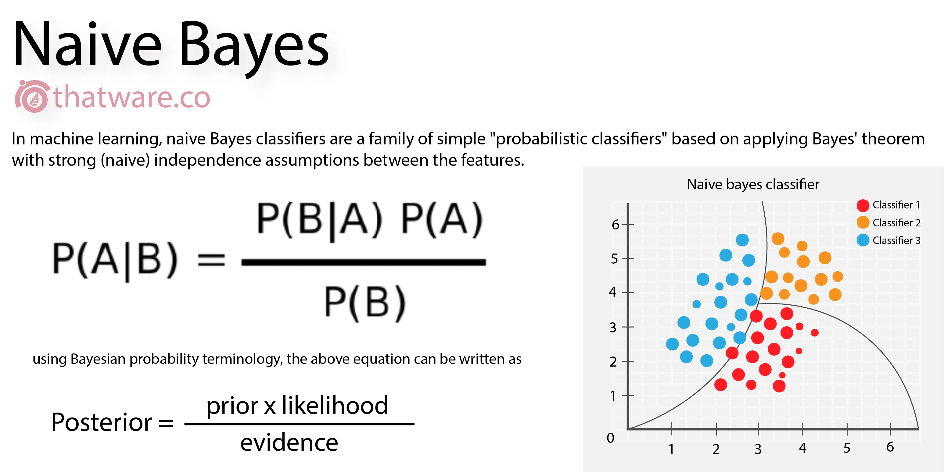
Naive Bayes Classifier:
The accuracy that we get using gaussian Naive Bayes: 69.77%.
The accuracy that we get using multinomial Naive Bayes: 74.4%.
Ref :https://towardsdatascience.com/introduction-to-na%C3%AFve-bayes-classifier-fa59e3e24aaf

Slide 15
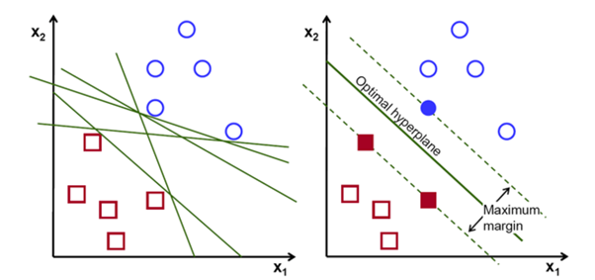
Support Vector Machine:
The accuracy that we get using this model: 84%
Ref : https://medium.com/machine-learning-101/chapter-2-svm-support-vector-machine-theory-f0812effc72

Slide 16
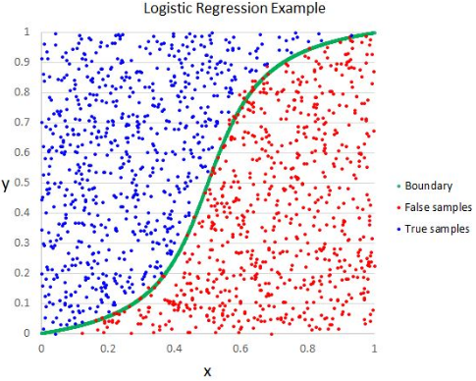
Logistic Regression:
The accuracy that we get using this model: 74.74%

Slide 17
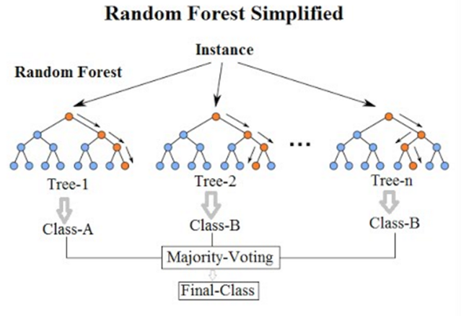
Random Forest Classifier:
The accuracy that we get using this model: 71.34%

Slide 18
Architecture of Deep Learning model:
Consists of following 4 layers
Embedding Layer: The Embedding layer is initialized with random weights and will learn an embedding for all of the words in the training dataset.
2. Drop-Out Layer: randomly selected neurons are ignored during training.
3. LSTM Cells: Artificial recurrent neural network (RNN) architecture
4. Dense Layer: A dense layer represents a matrix vector multiplication
The accuracy that we get using this model: 70.7%

Slide 19
Training a ML model:
Training an ML model involves providing an ML algorithm with training data to learn from.
The training data must contain the correct answer, which is known as a target or target attribute.
The learning algorithm finds patterns in the training data that map the input data attributes to the target and it outputs.

Slide 20
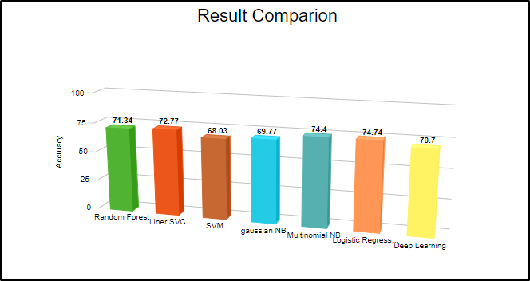
Logistic regression is giving highest accuracy of 74.74% over cross fold validation.

Slide 21
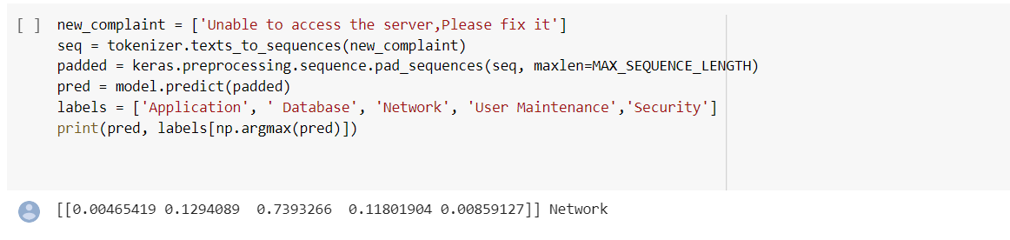
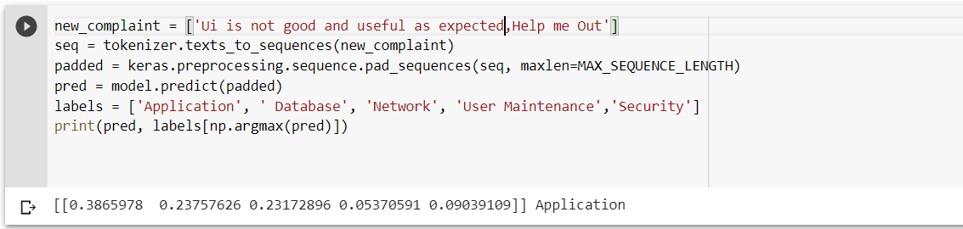
Results :

Slide 22
Conclusion:
Out of all the algorithms that we have used to train and predict , Logistic Regression gave us the best results of all .
This Support ticket classification Model will automatically classify the new tickets into their respective sections.

Slide 23
Thank You

