Slide 1
Software Development
Process Models
Waterfall · Iterative Enhancement · RAD · Evolutionary · Spiral
Presented by :
Sarvesh Kothe BT23F06F031
Krushna Rahate BT23F06F051
Yash Vishwakarma BT23F06F067
Software Engineering — SDLC Model Overview

Slide 2
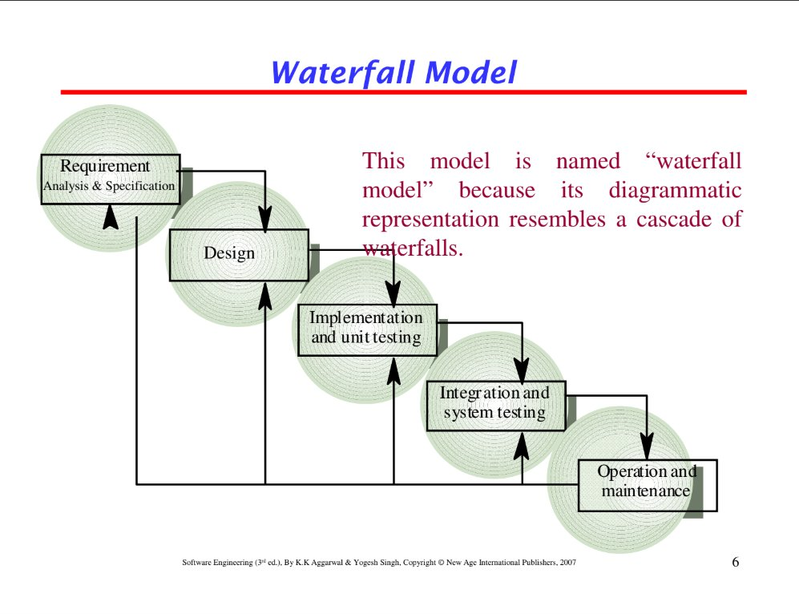
01
Waterfall Model
Each phase must be completed before the next begins — no going back.
Phases: Requirements → Design → Implementation → Testing → Maintenance.
Best for projects with well-defined, stable requirements.
Simple and easy to manage; poor flexibility for changes mid-project.
Named after its cascade-like diagram representation.
Linear & Sequential
Software Engineering — SDLC Models

Slide 3
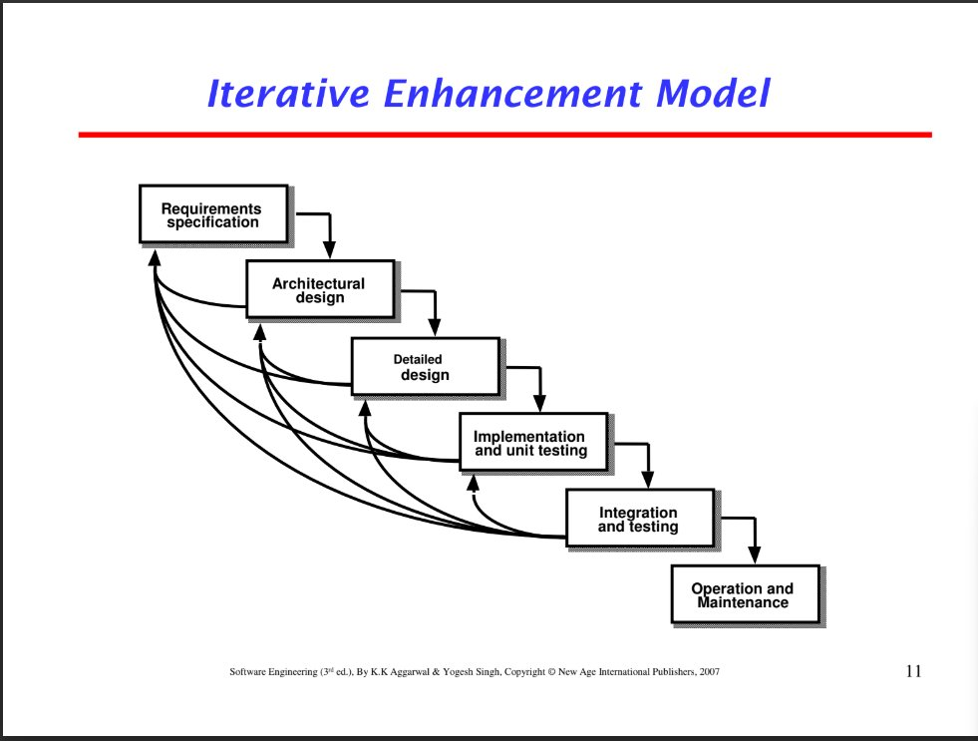
02
Iterative Enhancement Model
Starts with a simple initial implementation, then repeatedly improved.
Each iteration goes through: Requirements → Design → Implementation → Testing.
Feedback from each iteration feeds back into the next cycle.
Handles changing requirements better than the Waterfall model.
Reduces risk by discovering issues early through repeated cycles.
Build, Refine, Repeat
Software Engineering — SDLC Models

Slide 4
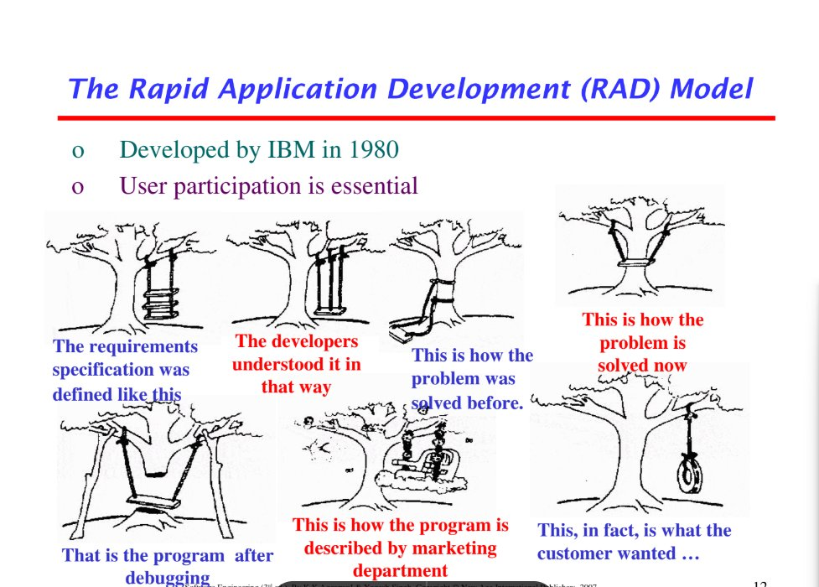
03
RAD Model
Developed by IBM in 1980; user participation is essential throughout.
Focuses on rapid prototyping over lengthy planning and design.
Divides project into small modules developed in parallel by teams.
Extremely fast delivery cycle — typically 60–90 days per module.
Requires skilled developers and active client involvement to succeed.
Rapid Application Development
Software Engineering — SDLC Models

Slide 5
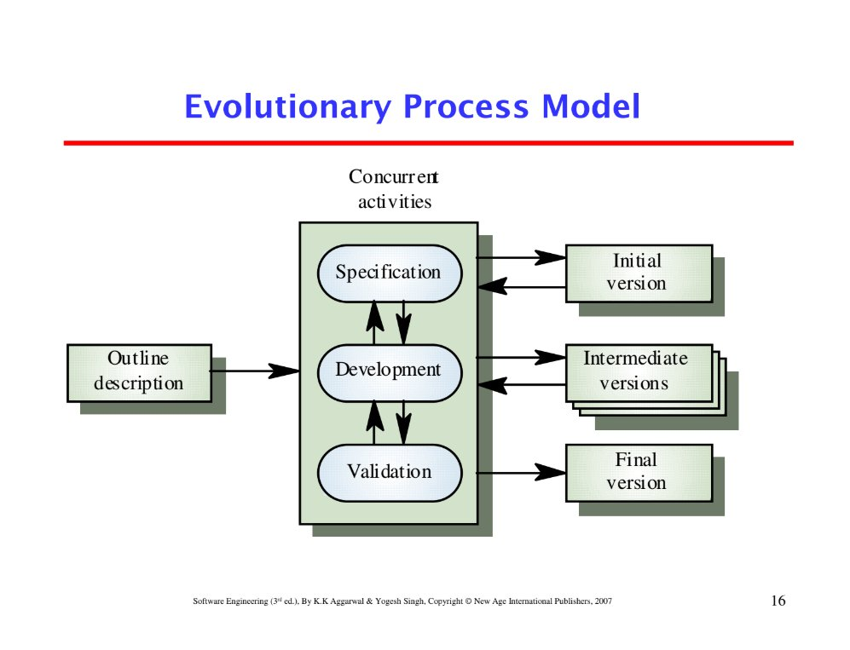
04
Evolutionary Process Model
Starts with an outline description; system evolves through iterations.
Three concurrent activities: Specification, Development, Validation.
Produces Initial, Intermediate, and Final versions progressively.
Ideal when requirements are not fully known at the start.
System 'evolves' like a living organism — flexible and adaptive.
Grow the System Over Time
Software Engineering — SDLC Models

Slide 6
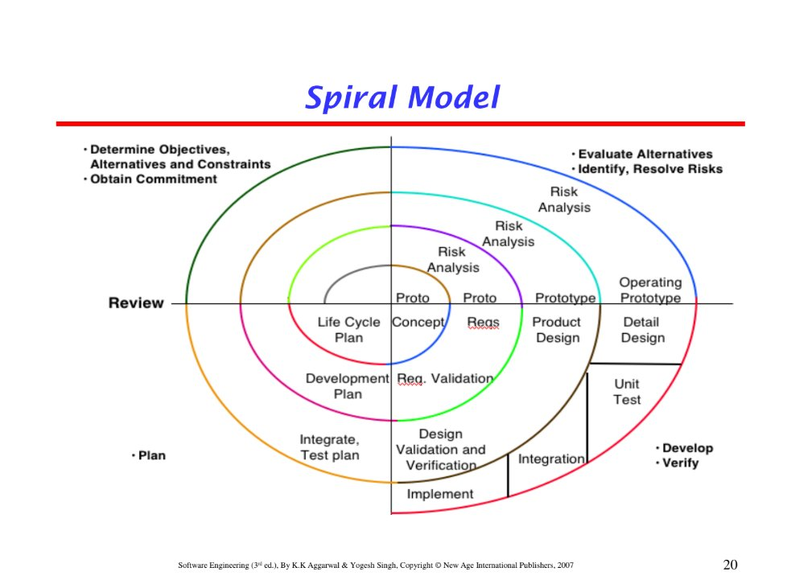
05
Spiral Model
Combines iterative development with systematic risk analysis at every loop.
Four quadrants per loop: Plan → Risk Analysis → Develop → Review.
Each spiral loop produces a more complete version of the software.
Best suited for large, complex, high-risk projects.
Risk identification and mitigation is the core strength of this model.
Risk-Driven & Iterative
Software Engineering — SDLC Models

Slide 7
Quick Comparison
Waterfall
Iterative
RAD
Evolutionary
Spiral
Fixed requirements One-time delivery Low flexibility
Incremental builds Feedback loops Better flexibility
Fast prototyping User-driven Parallel development
Grows over time Concurrent phases Handles unknowns
Risk-focused Repeated loops Best for large projects
Software Engineering — SDLC Model Overview

