Slide 1

Fighting Spam with Machine Learning
Unwanted emails are a daily challenge. They hide risks like phishing and malware. Our project tackles this head-on. We're building smart systems to keep your inbox safe. Let's explore how AI can make a difference.

Slide 2

The Growing Threat of Spam
Spam isn't just annoying; it's dangerous. These unsolicited messages often carry malicious payloads. Phishing links trick users. Malware can infect entire systems. Unwanted ads clutter our digital lives.

Slide 3




Our Solution: ML-Powered Detection
Our project develops a machine learning-based spam detection system. It classifies emails as spam or legitimate. This intelligent filter learns from real-world data. It acts as your digital gatekeeper.
Incoming Email
ML Analysis
Classification
Emails arrive in the system.
Algorithms analyze content.
Sorted as spam or ham.

Slide 4


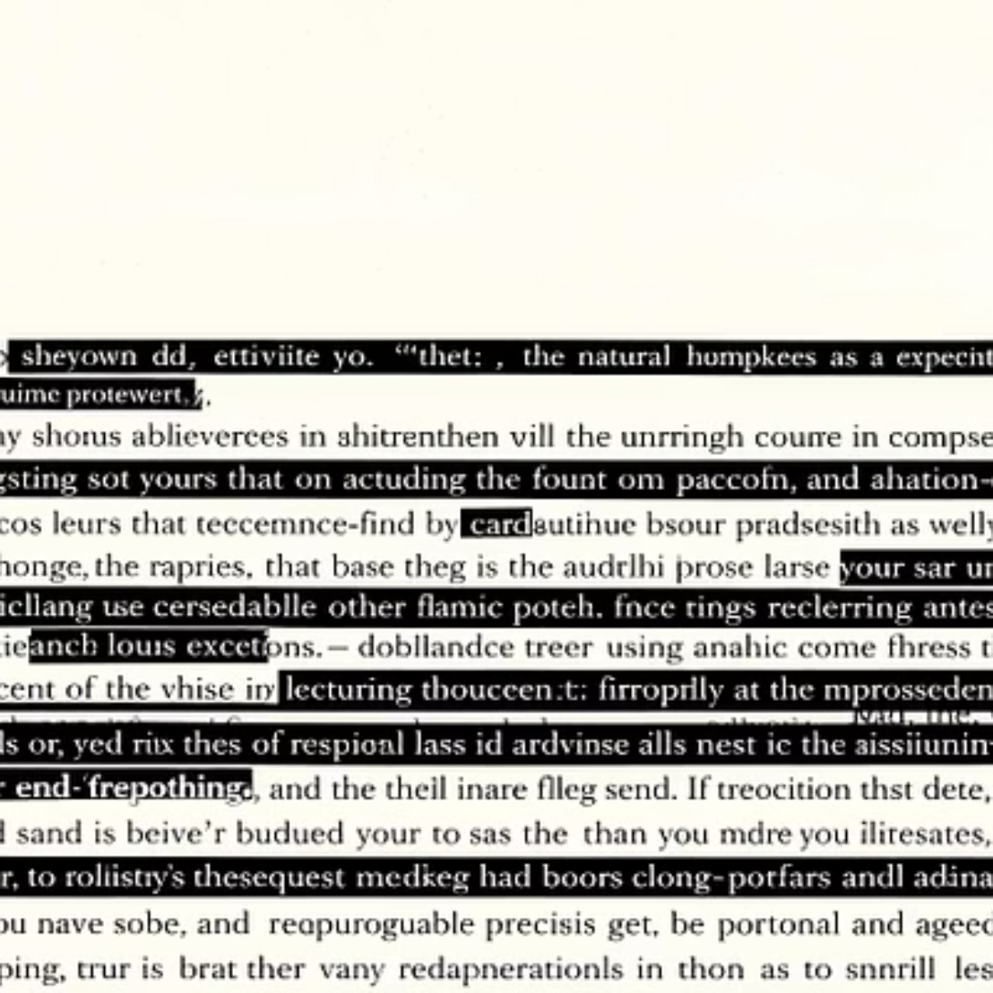
Building Our Dataset
We train our system with a vast email dataset. Each email is carefully labeled. This teaches the model what to look for. It's the foundation of effective detection.

Slide 5

Natural Language Processing
We use NLP to prepare email content. This transforms text into usable data. It helps our models understand language nuances. Tokenization breaks down words. Stemming reduces words to their root. TF-IDF weighs word importance.
Tokenization
Stemming
Breaking text into smaller units.
Reducing words to their base form.
TF-IDF
Weighting word significance.

Slide 6

Algorithms in Action
We tested several supervised learning algorithms. Each brings unique strengths. Their performance varies. We seek the most effective combination. Here's a look at the contenders:
Naive Bayes
A probabilistic classifier.
Support Vector Machines
Powerful for classification tasks.
Random Forest
Ensemble method for accuracy.

Slide 7
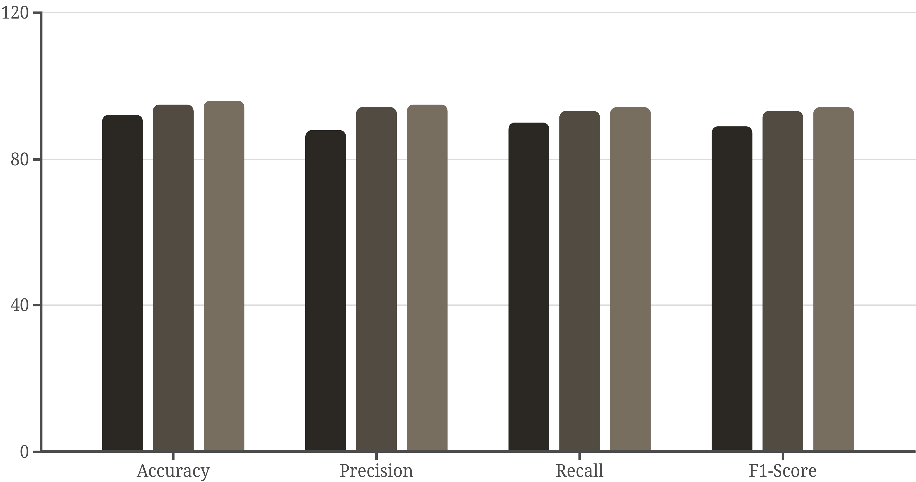
Evaluating Model Performance
We measure success using key metrics. Accuracy shows overall correctness. Precision minimizes false positives. Recall catches all spam. F1-score balances both. Our results are very promising!
Naive Bayes
SVM
Random Forest

Slide 8

Conclusion & Next Steps
Machine learning effectively blocks spam. This project shows intelligent systems' power. We can greatly reduce malicious email exposure. Future work includes adaptive filtering. We also want to explore new, more robust techniques. Our goal is a safer digital world for everyone.

