Slide 1

STANLEY COLLEGE OF ENGINEERING AND TECHNOLOGY FOR WOMEN (AUTONOMOUS) (Affiliated to Osmania University & Approved by AICTE) (All eligible UG Courses are accredited by NBA & Accredited by NAAC with ‘A’ Grade)
Department of Information Technology
Mini Project
Title : Email Spam Detection
Presented by: Guide:
Gundla Harika(160622737025 Dr.Y. Malathi Latha
K.Krushna Sri(160622737035) IT Department
M.Srija(160622737040)

Slide 2
Introduction
In the digital era, email communication is a fundamental part of both personal and professional interactions. However, the rise of unsolicited and harmful messages, commonly known as spam emails, poses serious threats such as phishing attacks, scams, and data breaches. Hence, spam detection systems have become vital for securing communication platforms and ensuring the reliability of email services.
To address this challenge efficiently and iteratively, we adopt the Agile Software Development Model, which emphasizes incremental delivery, continuous improvement, and adaptability to changing requirements. The Agile approach is well-suited for machine learning projects like spam detection, as it allows teams to quickly respond to feedback, incorporate new features, and refine models over time.

Slide 3
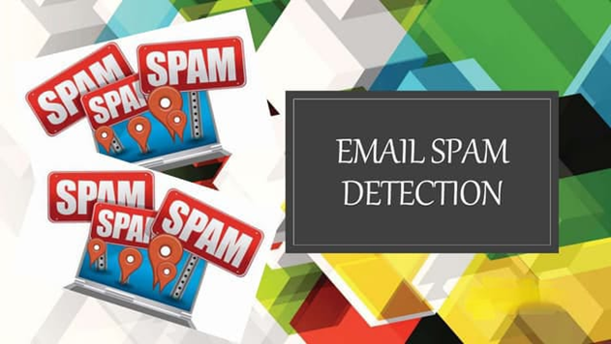
Problem Statement
With the rise of unwanted and malicious emails, traditional spam filters struggle to keep up with evolving spam techniques. There is a need for an intelligent and adaptive system that can accurately detect spam emails.
This project aims to build a machine learning-based spam detection model using the Agile methodology for continuous improvement and quick adaptability.

Slide 4
Objectives
Develop a machine learning model to classify emails as spam or ham.
Implement NLP techniques for text preprocessing and feature extraction.
Ensure high accuracy, precision, and recall in spam detection.
Follow Agile methodology for iterative development and continuous improvement.
Adapt the model to handle evolving spam patterns effectively.
Deploy a user-friendly system for real-time spam detection.

Slide 5
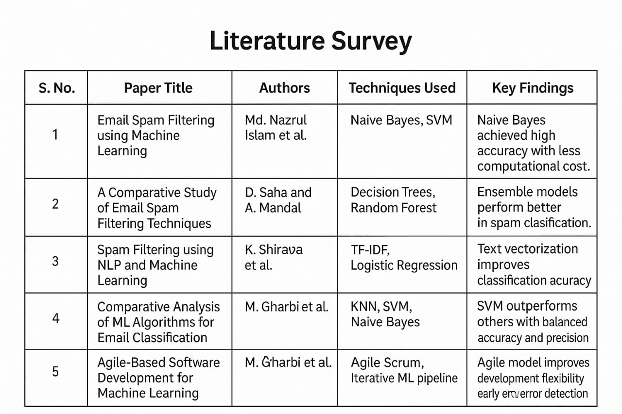

Slide 6
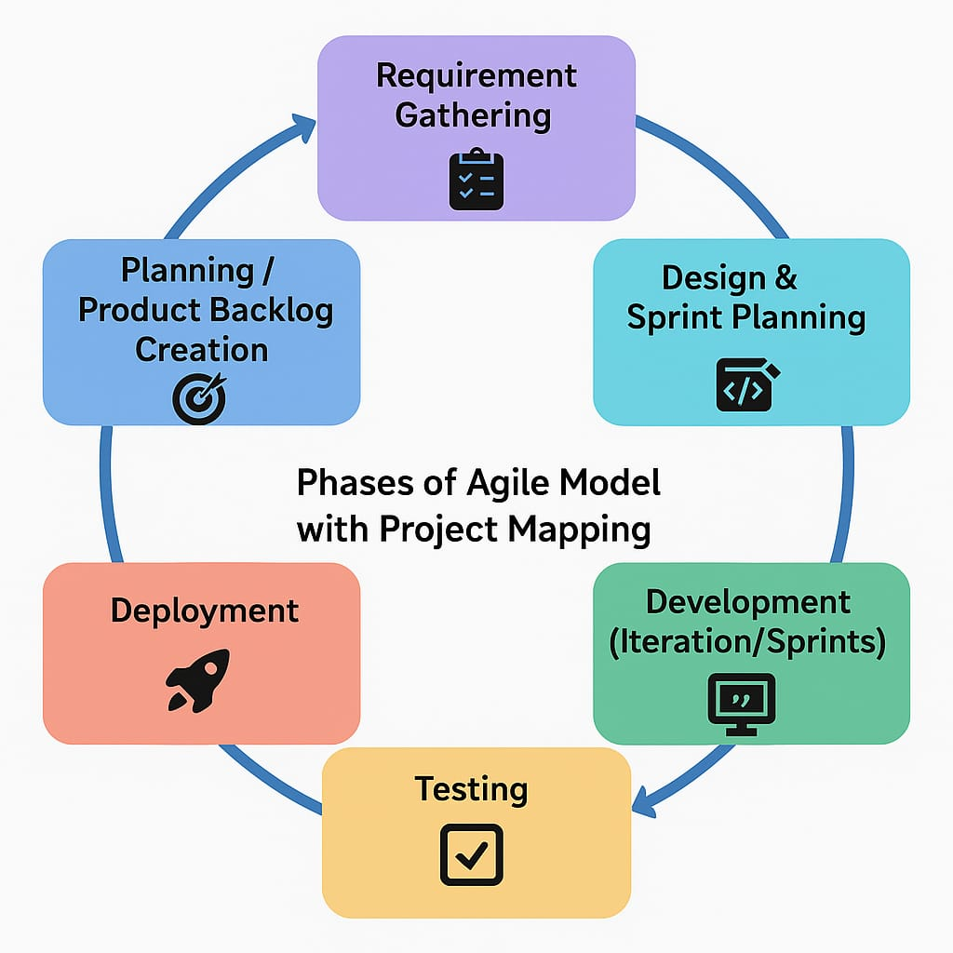
Methodology
1.Requirement Gathering
Identify the need for spam classification, choose dataset (spam.csv), and define evaluation metrics (accuracy, precision).
2. Planning / Backlog Creation
Break down tasks: data cleaning, preprocessing, model training, evaluation, and deployment.
3. Design & Sprint Planning
Design pipeline (preprocessing → vectorization → modeling), select tools (Pandas, NLTK, Sklearn), and plan ML models (Naive Bayes, SVM).

Slide 7
4. Development (Sprints)Sprint-wise implementation
Datacleaning Text preprocessing TF-IDF feature extractionModel training (NB, SVM)Ensemble modelingUI development with Streamlit
5. Testing
Evaluate using accuracy, precision, confusion matrix. Validate model and vectorizer files.
6. Deployment Build frontend using Streamlit
Load models and classify SMS as Spam or Ham in real time.
7. Feedback & Maintenance
Collect user feedback, update dataset with new spam, retrain, and redeploy model periodically.

Slide 8
Tools & Technologies Used
Language:Python
Libraries & Frameworks:
Pandas, NumPy (Data handling)
NLTK, re (Text preprocessing)
Scikit-learn (ML models, TF-IDF, evaluation)
Pickle (Model saving/loading)
Visualization:
Matplotlib, Seaborn
Interface & Deployment:
Streamlit (Web app)
Jupyter Notebook (Development & testing)
Development Methodology:
Agile Model (Iterative, sprint-based development)

Slide 9
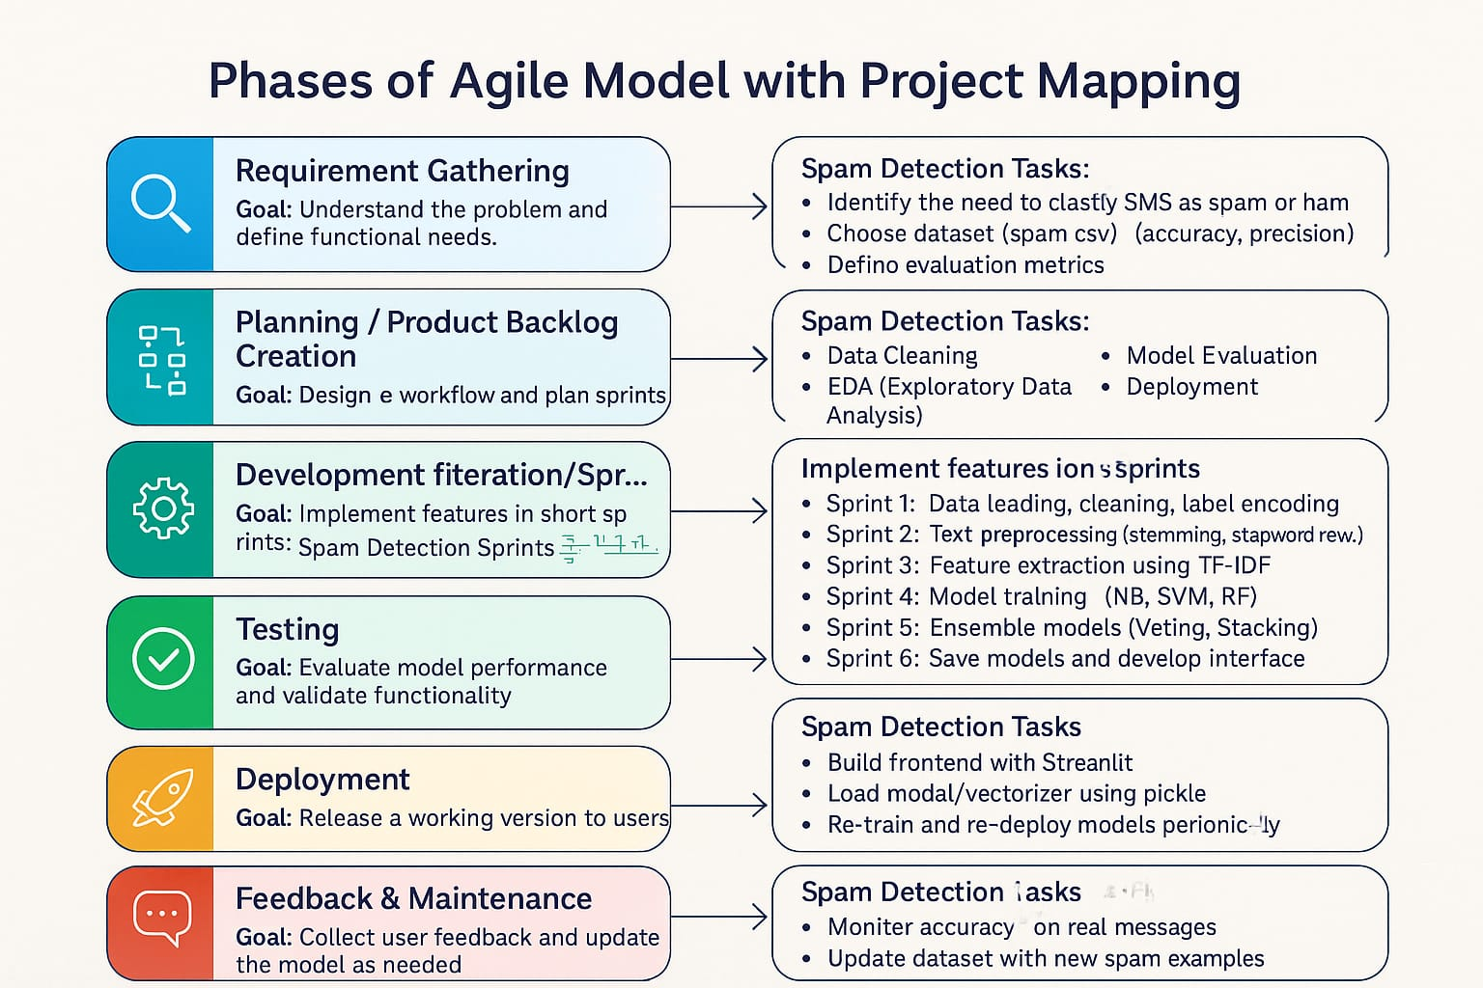
Software Engineering Model Used

Slide 10
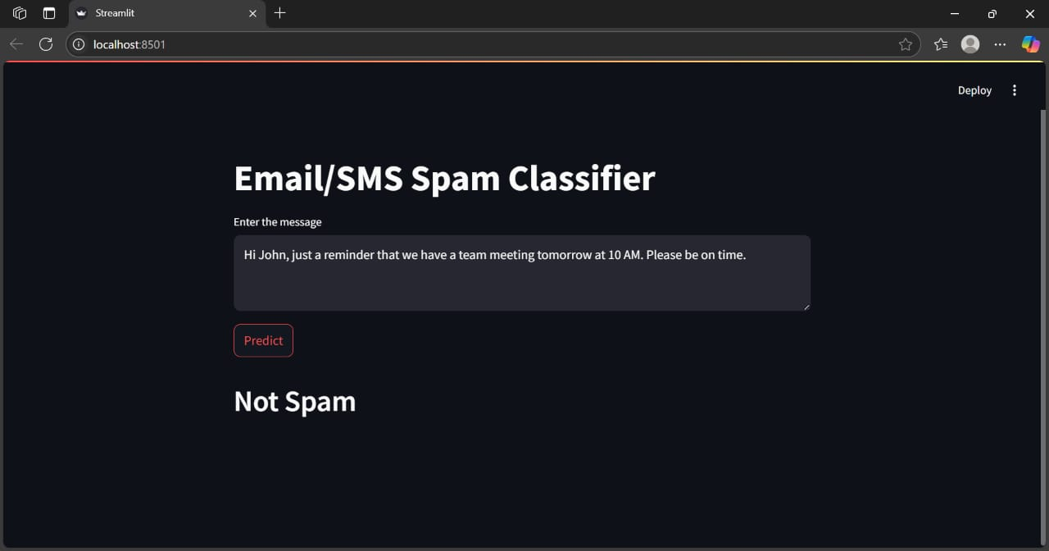
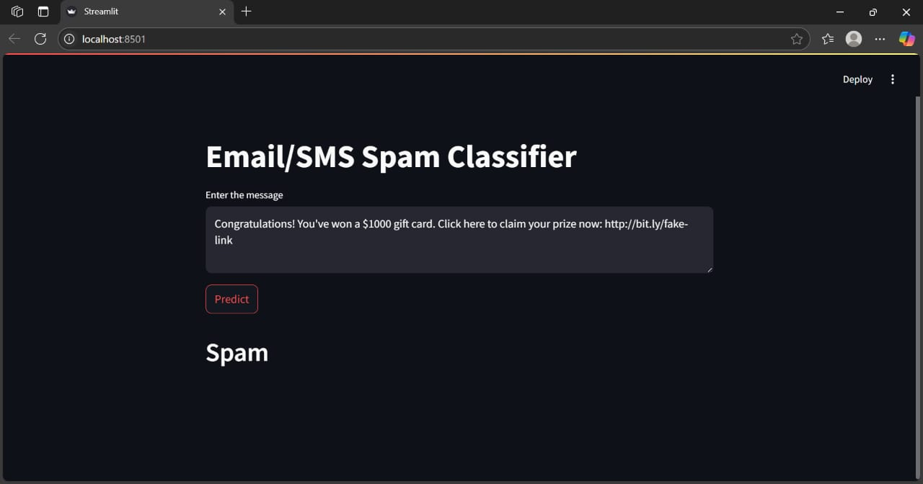
Results

Slide 11
Conclusion
The Email Spam Detection project demonstrates the effective use of Machine Learning and NLP to identify spam messages with high accuracy. Using the Agile development model, the project was built through iterative sprints, enabling continuous refinement and adaptability.
The dataset was preprocessed using techniques like stopword removal and stemming, and features were extracted using TF-IDF vectorization. Models such as Naive Bayes and SVM were trained and evaluated, achieving reliable classification results.
A lightweight and interactive Streamlit interface was developed for real-time spam prediction. The system efficiently classifies user input as spam or ham, making it practical and user-friendly.
With periodic updates and user feedback, the model can be retrained to handle evolving spam patterns. This project showcases a robust, scalable solution for real-world email and SMS filtering.

Slide 12
Future Scope
Integrate with real email platforms for live spam filtering.
Use deep learning models (e.g., LSTM, BERT) for better accuracy.
Support multilingual spam detection.
Enable continuous learning for adapting to new spam types.
Develop a mobile app for SMS spam detection.
Extend to phishing and malware detection.

Slide 13
References
Sahami, M., Dumais, S., Heckerman, D., & Horvitz, E. (1998). A Bayesian Approach to Filtering Junk E-Mail. AAAI Workshop on Learning for Text Categorization.
Islam, M. N., & Hasan, M. K. (2018). Email Spam Filtering using Supervised Machine Learning Techniques. International Journal of Computer Applications, 182(43).
Sharma, A., & Gupta, R. (2019). Spam Filtering using NLP and Machine Learning. International Journal of Scientific Research in Computer Science.
Scikit-learn Documentation. Machine Learning in Python. Available at: https://scikit-learn.org
NLTK – Natural Language Toolkit. Text Processing in Python. Available at: https://www.nltk.org
Scrum.org. (2020). The Scrum Guide – The Definitive Guide to Scrum. Available at: https://scrumguides.org

Slide 14
THANK YOU

