Slide 1
Thesis: We selected a group of publicly traded stocks to measure the affect of various events on each stock. Each group member focused on the event and stocks of their choice. Through data analysis and visualizations, we attempt to answer questions that we are interested in.
My questions:
Can we measure the variance of an event’s effect across different stocks?
Is there different pattern of recovery for each stock price in the time period following the event?
What if we had more time to work on this project?
I would spend the time analyzing a similar event from a different time period. Comparable results would provide a degree of validation of my current observations.

Slide 2
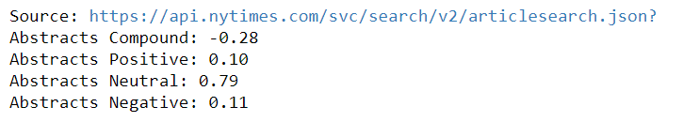
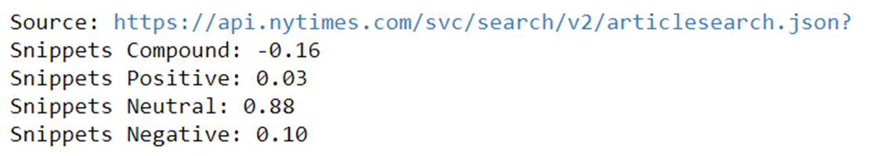
Sentiment Analysis

Slide 3
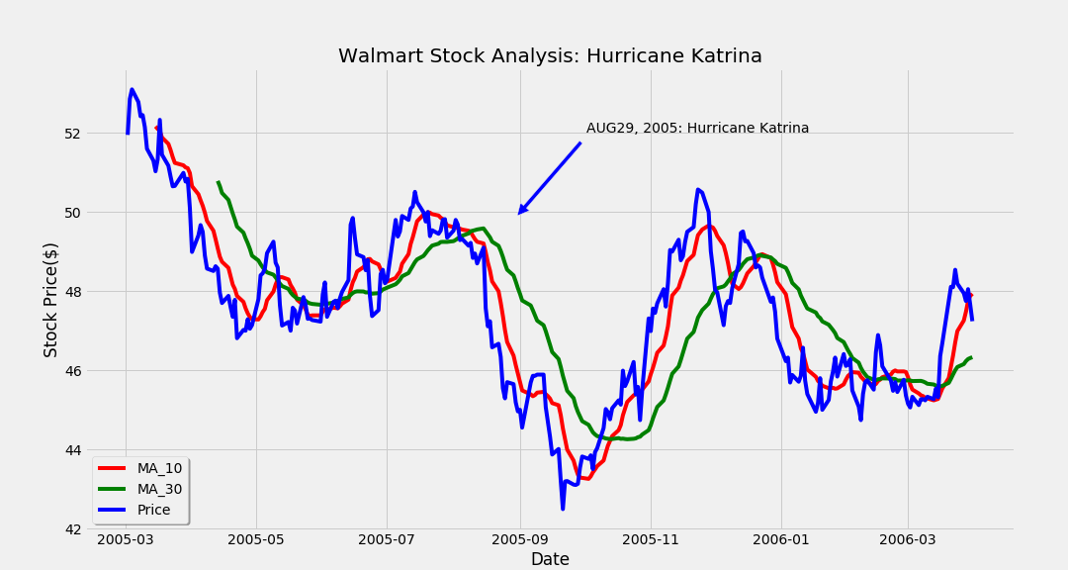

Slide 4
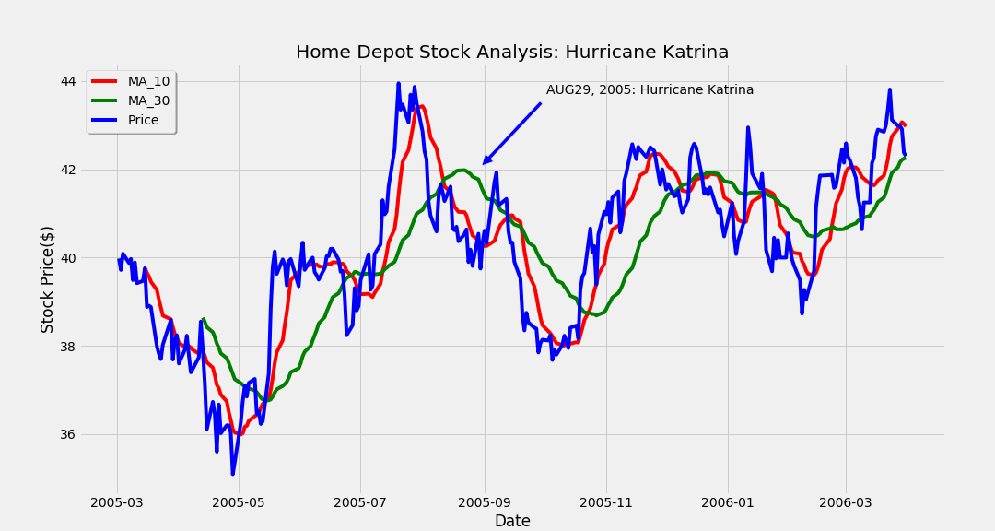

Slide 5
