Slide 1

CREDIT RISK MODELING
Group - 13
Praveen Kumar Uttangi
Priyanka Yadav
Krishna Sai Krutin

Slide 2
Executive Summary
Goal -> The goal of this project is to develop a Default Risk Model to assist in credit approval decisions by defining a new credit card strategy.
Strategy -> conservative and aggressive, are the two strategies which are defined with different acceptance thresholds based on applicant default probability.
Outcome-> Our proposed credit approval decisioning can assist your business in mitigating risks, optimizing decision-making, and gaining a competitive advantage

Slide 3
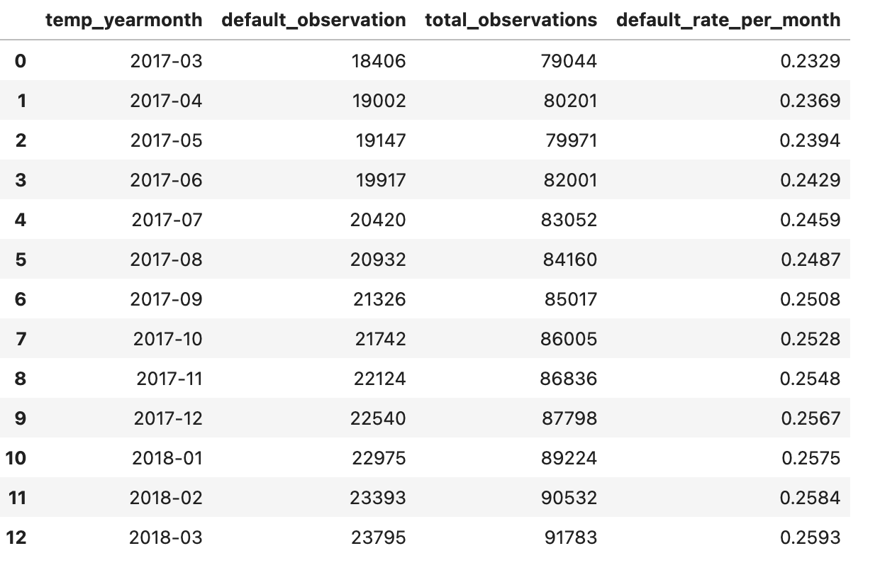
DATA
Our objective is to predict the probability of customers defaulting on their payments. To achieve this, we'll analyze payment behaviors, account balances, risk metrics, delinquency indicators, and spending habits of each customer.
The target variable in our dataset indicates whether a customer has experienced a default, specifically defined as failing to pay their due amount within 120 days after their latest statement date.

Slide 4
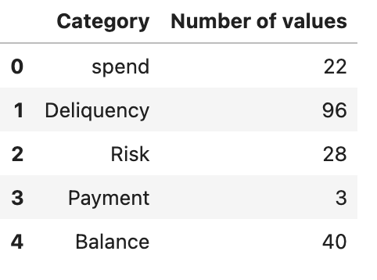
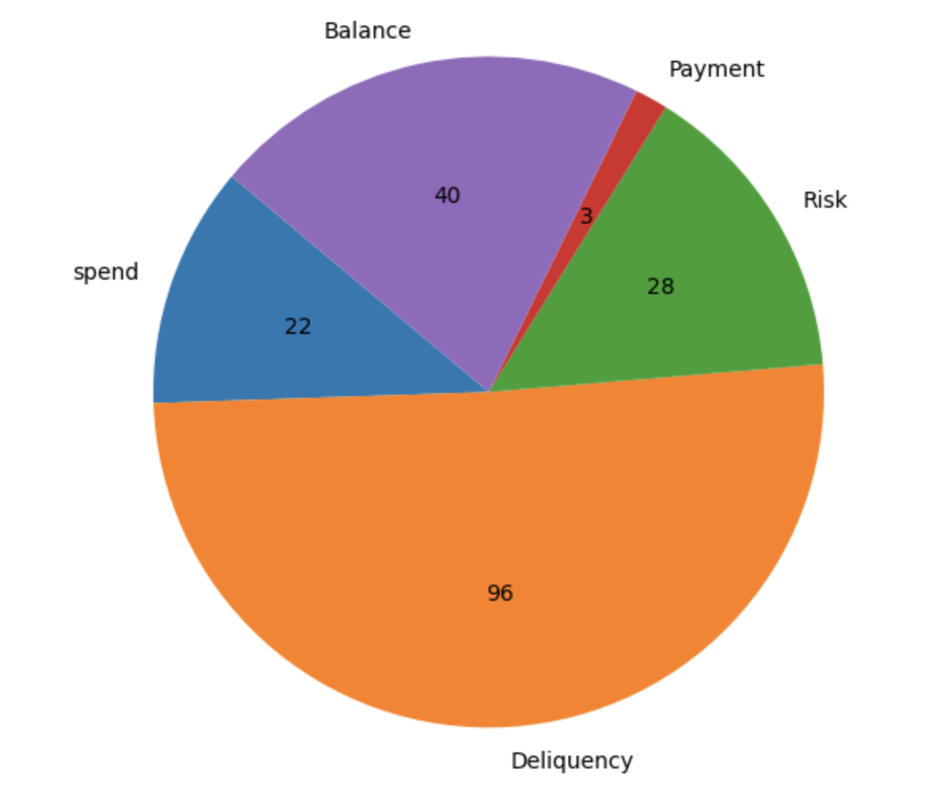

FEATURES
D_ : Delinquency related variables = when a borrower fails to make timely payments on a loan or debt.
S_ : Spend related variables = money used during a specific time period
P_ : Payment related variables = Repaid money to the lender
B_ : Balance related variables = represents the remaining debt owed by a borrower on a loan or credit card.
R_ : Risk related variables = credit risk assessment to evaluate creditworthiness.

Slide 5
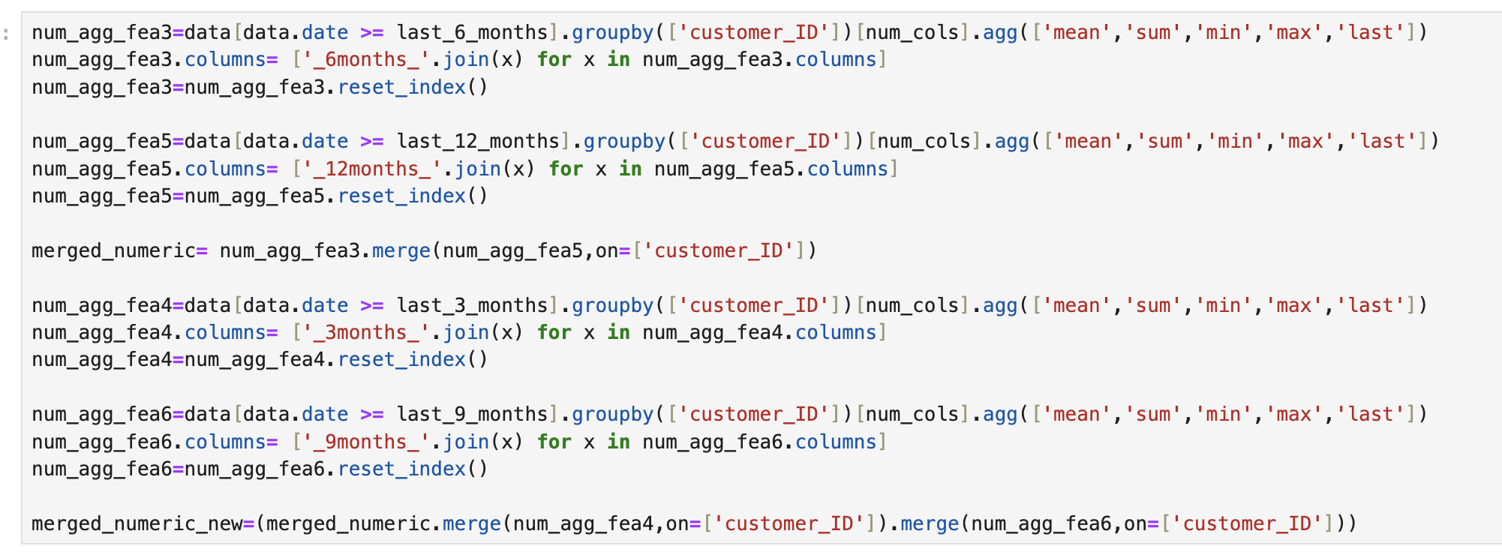
FEATURE ENGINEERING
We performed feature engineering on all numeric columns in the dataset by aggregating their mean, sum, minimum, maximum, and latest value and we did same steps for last 3,6 and 9 months data by grouping by customer ID.
We have 4669 features

Slide 6
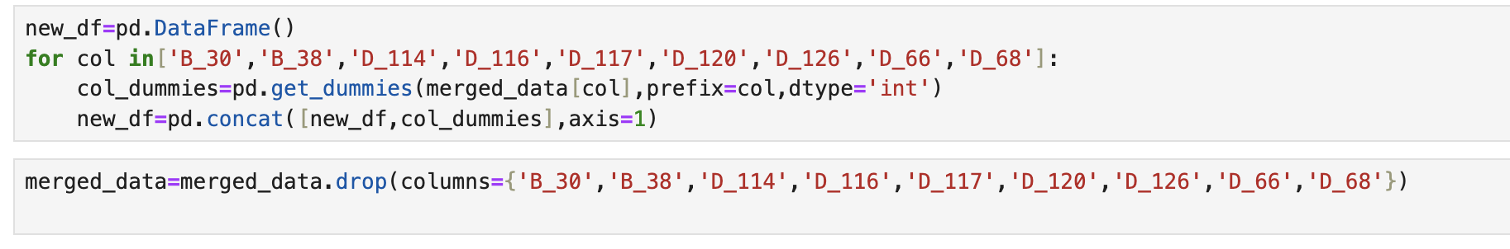
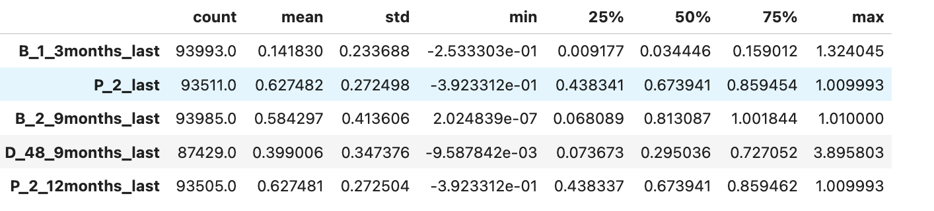
One hot encoding
Summary statistics for the top 5 Features with highest SHAP values in Final Model
11 Categorical features processed with One-Hot Encoding.
45 new features created retaining the original categorical feature name suffixed with discrete values from each category.

Slide 7
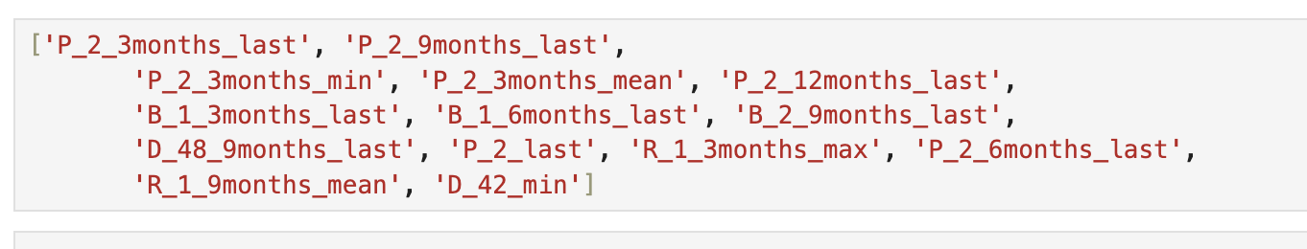
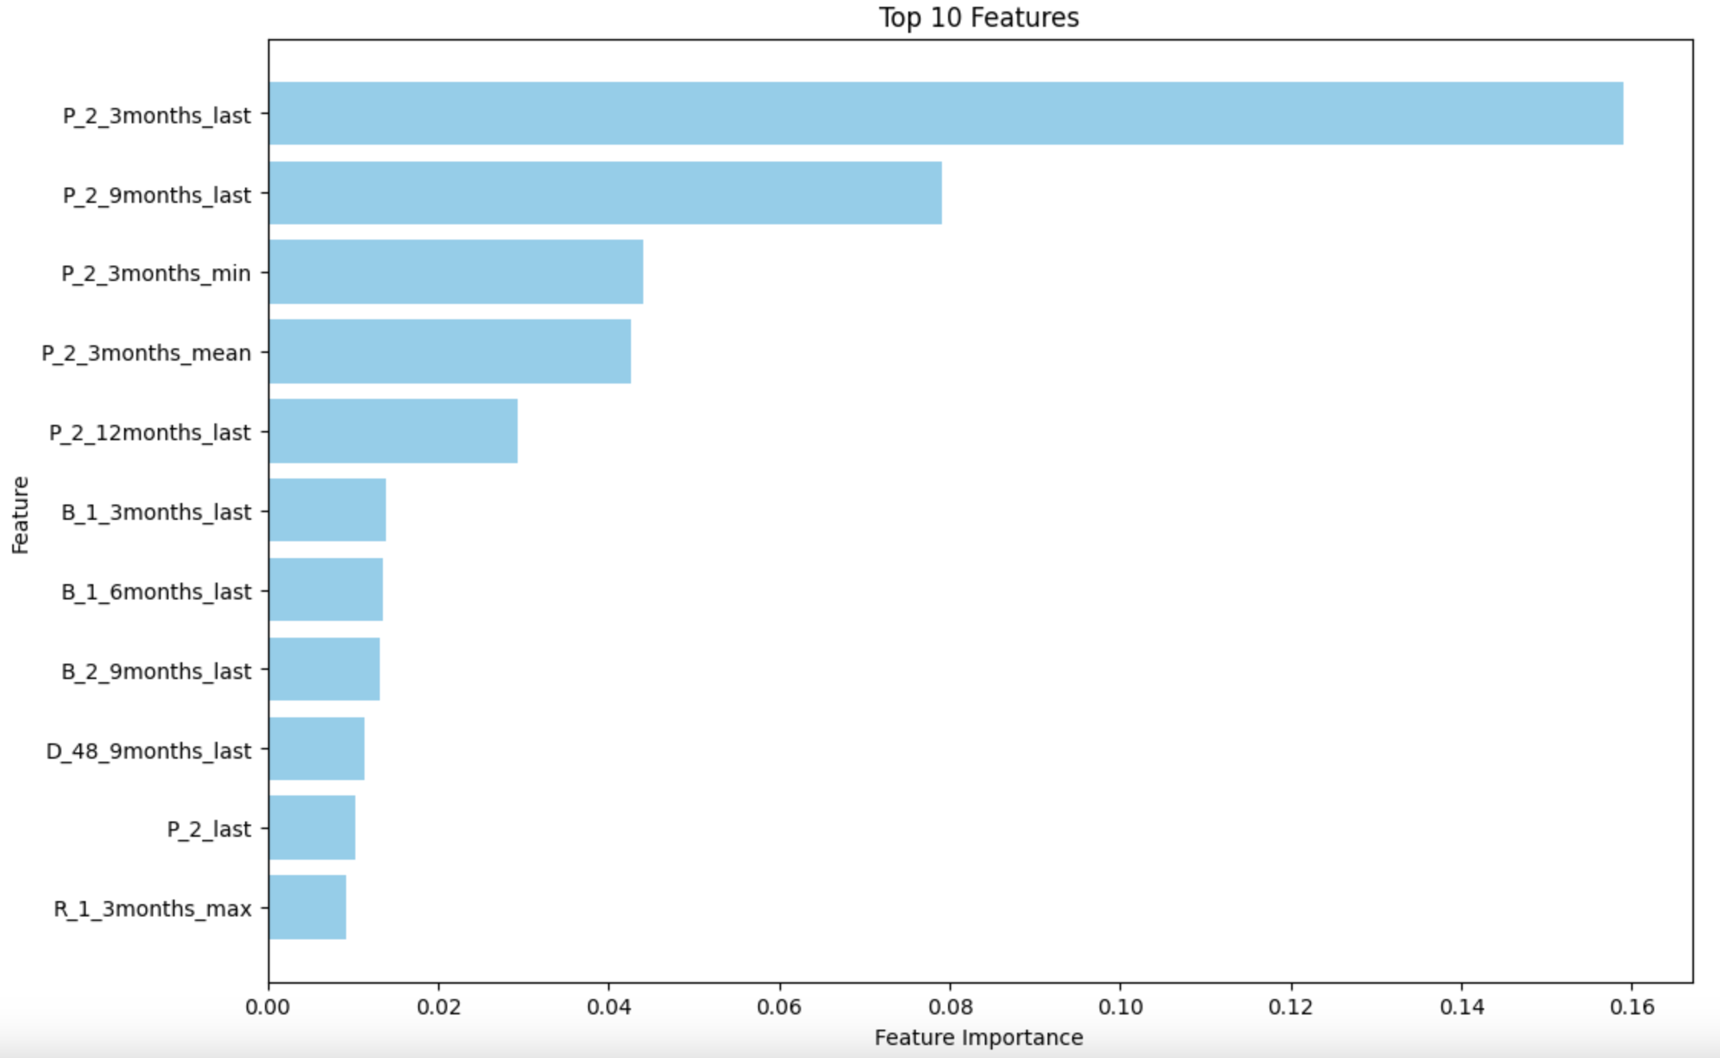
Feature Selection
Feature importance was calculated from two XGBoost models trained on the training dataset.
Selected features have a feature importance of higher than 0.5% in any of the two models.

Slide 8
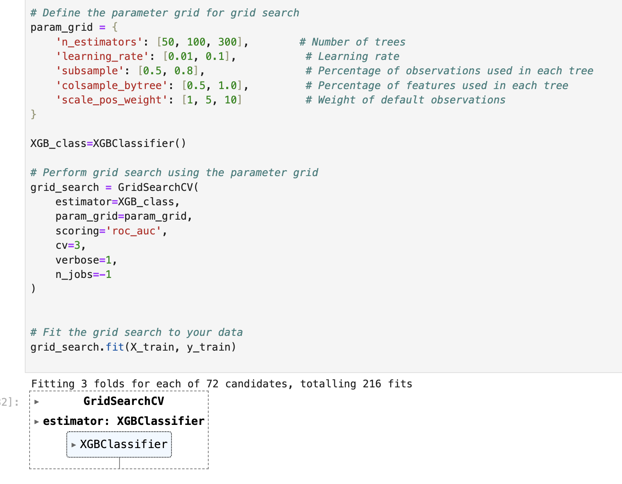
XGBoost – Grid Search
The following parameters are used for the best result
Number of trees: 50, 100, and 300
Learning Rate: 0.01, 0.1
Percentage of observations used in each tree: 50%, 80%
Percentage of features used in each tree: 50%, 100%
Weight of default observations: 1, 5, 10The following

Slide 9
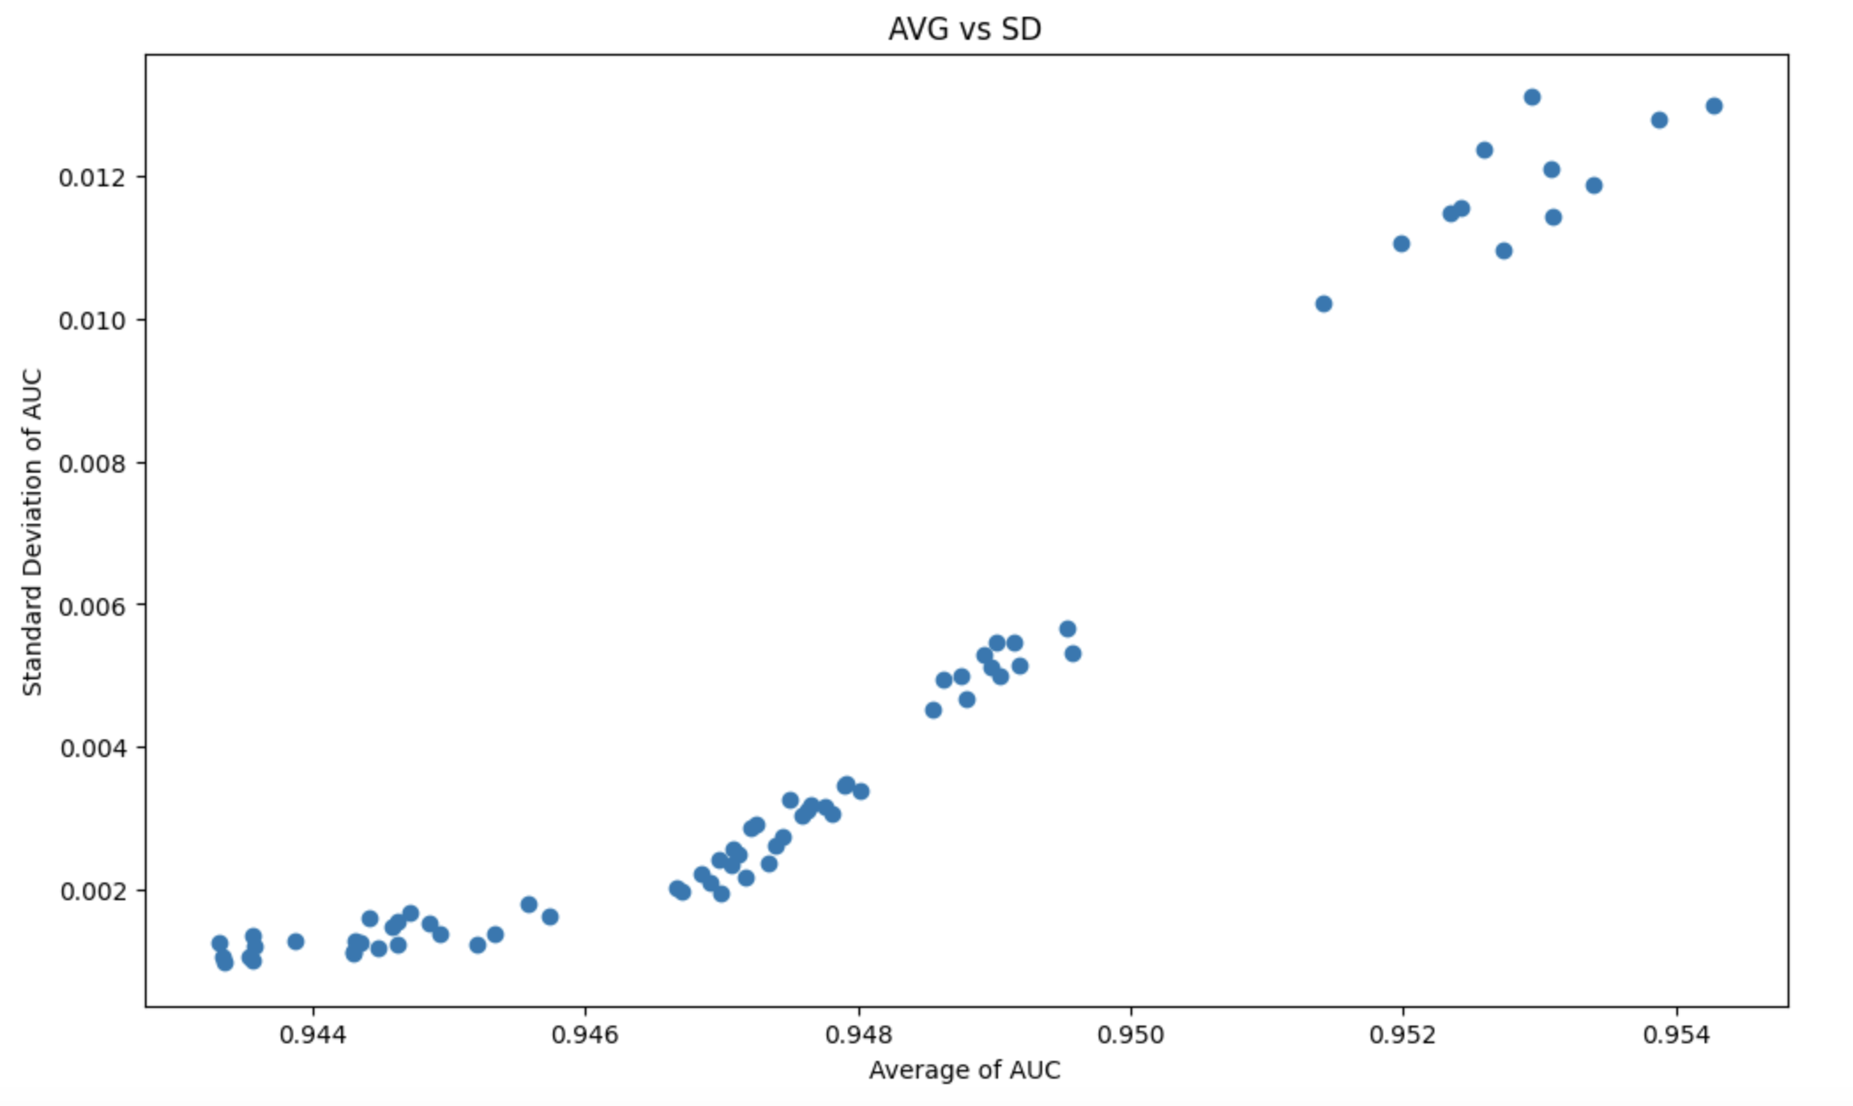
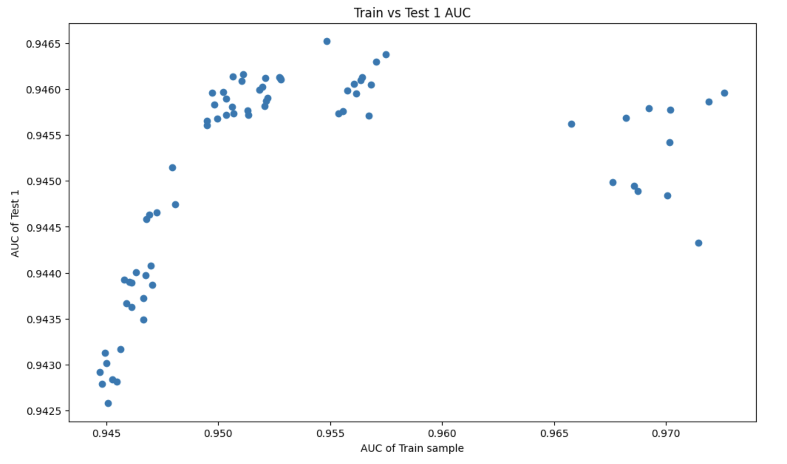
XGBoost – Grid Search
The XGBoost model achieves the highest AUC value when trained on the 'Train' sample and evaluated on the 'Test 1' sample, making it the optimal choice.
High average AUC and a small standard deviation: model consistently performs well across different conditions.
high average AUC and larger standard deviation :model performs well on average but is sensitive to variations in the data or experimental settings.
low average AUC and a small standard deviation: model that consistently performs poorly.
A relationship is not linear between AUC train and AUC test indicates that the model is not consistent. In other words, the model's performance on the training data is not predictive of its performance on unseen test data.

Slide 10
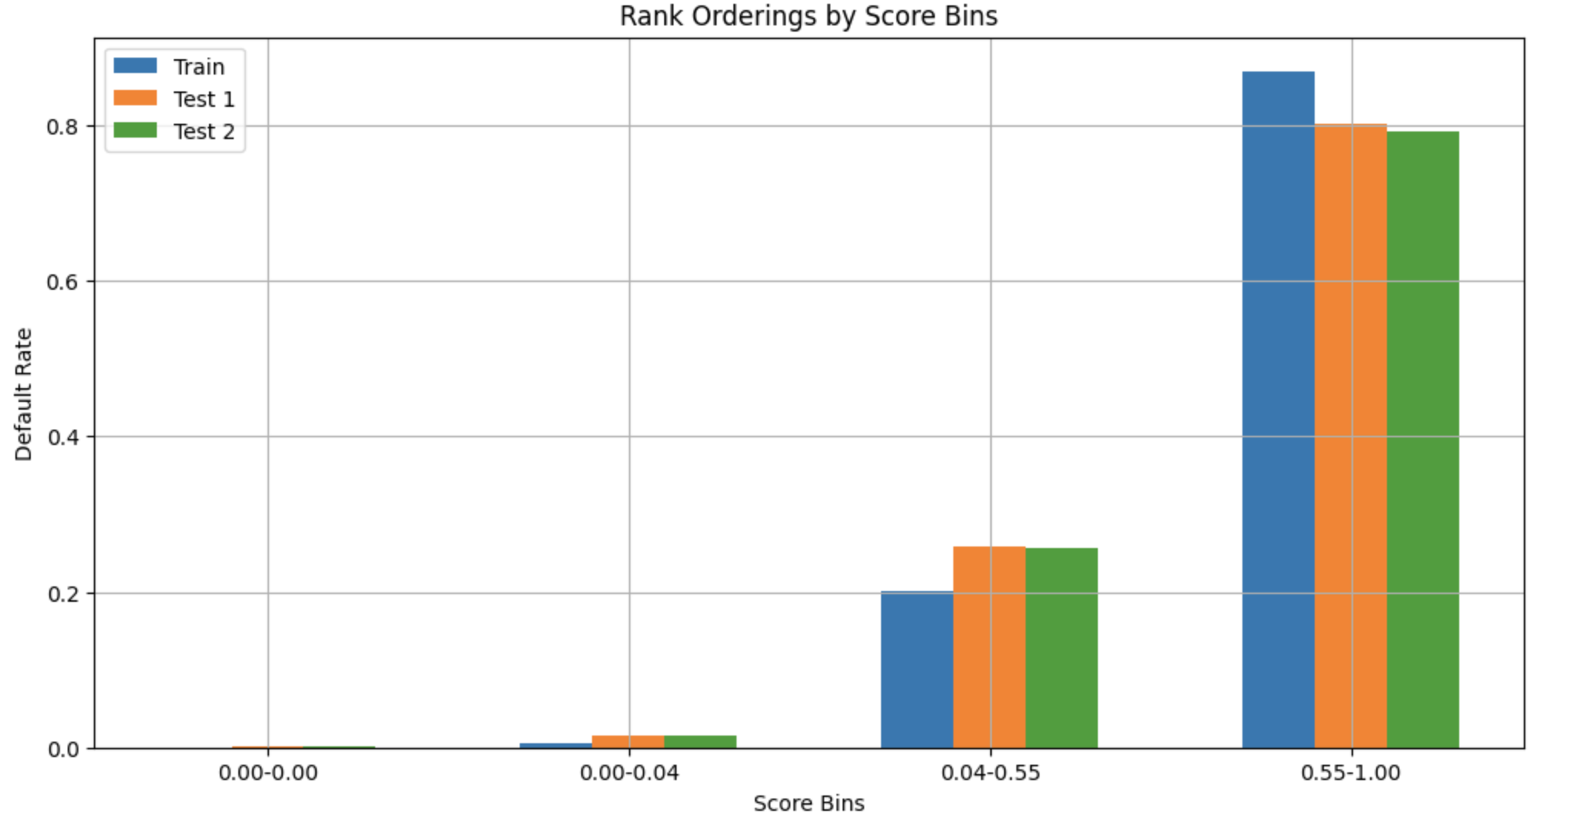
XGBoost – Final Model
best_model_xgb
#Trees | 300
LR | 0.1
Subsample% | 80.0%
Features | 100%
%Wt. of Default | 1
AUC Train | 0.972623
AUC Test 1 | 0.945961
AUC test 2 | 0.944229
AUC Avg | 0.954271
AUC SD | 0.0012996
AUC on train | AUC on test 1 | AUC on test 2
0.9726 | 0.9459 | 0.9442

Slide 11
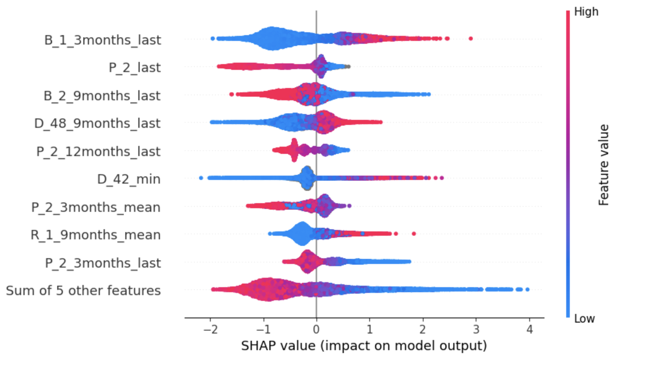
XGBoost SHAP analysis
Observations
High feature values is positively impacting the model
Low Feature values impact the model negatively
Top impacting Features: B-1_3months_last, P_2_last, B_2_9months_last
Top features are from Balance variable : B_1, B_2

Slide 12
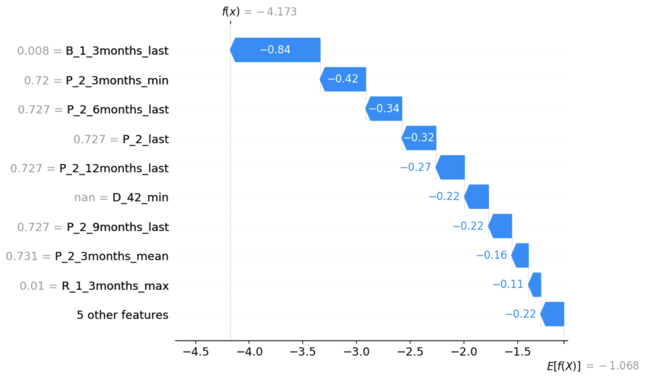
XGBoost SHAP Analysis
Observations
Majorly most of the variable are impacted Negatively impacting the model prediction.
This implies that when the values of these variables increase, they tend to decrease the prediction made by the model.

Slide 13
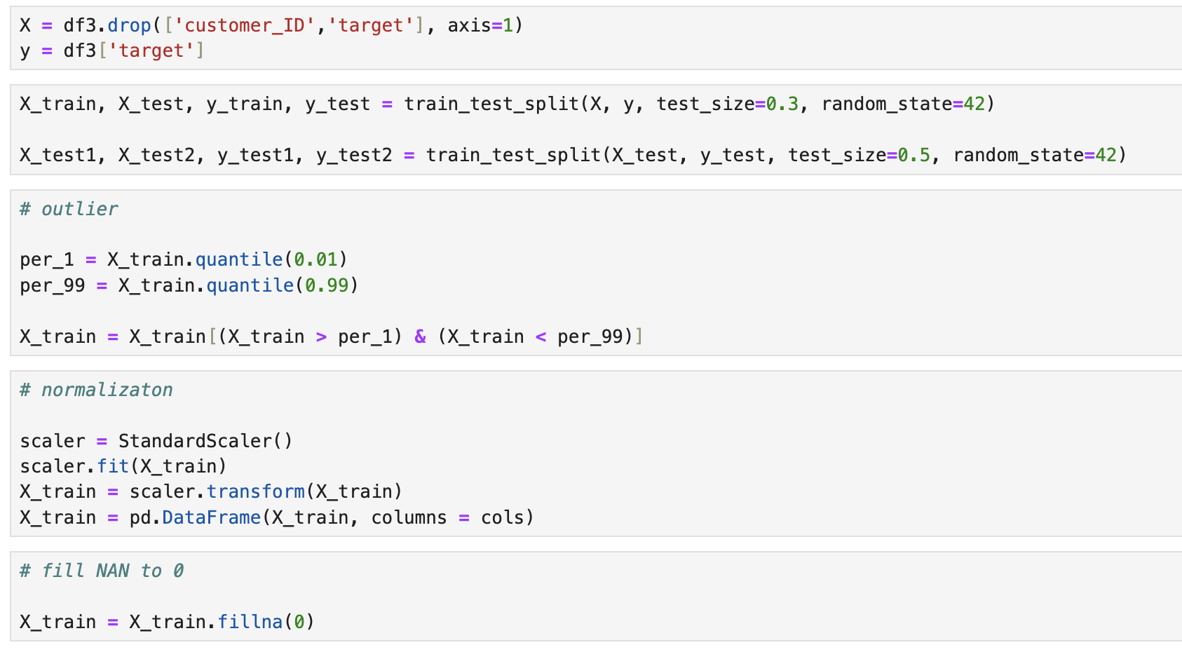
Neural Network- Data Processing
Observation
1. Outlier Handling: We removed outliers by retaining data within the 1st and 99th percentiles of the training dataset.
2. Normalization: Data was standardized using Scikit-Learn's StandardScaler to maintain uniformity across features.
3. Handling Missing Values: Missing data points in X_train were replaced with zeros, ensuring completeness in the dataset.

Slide 14
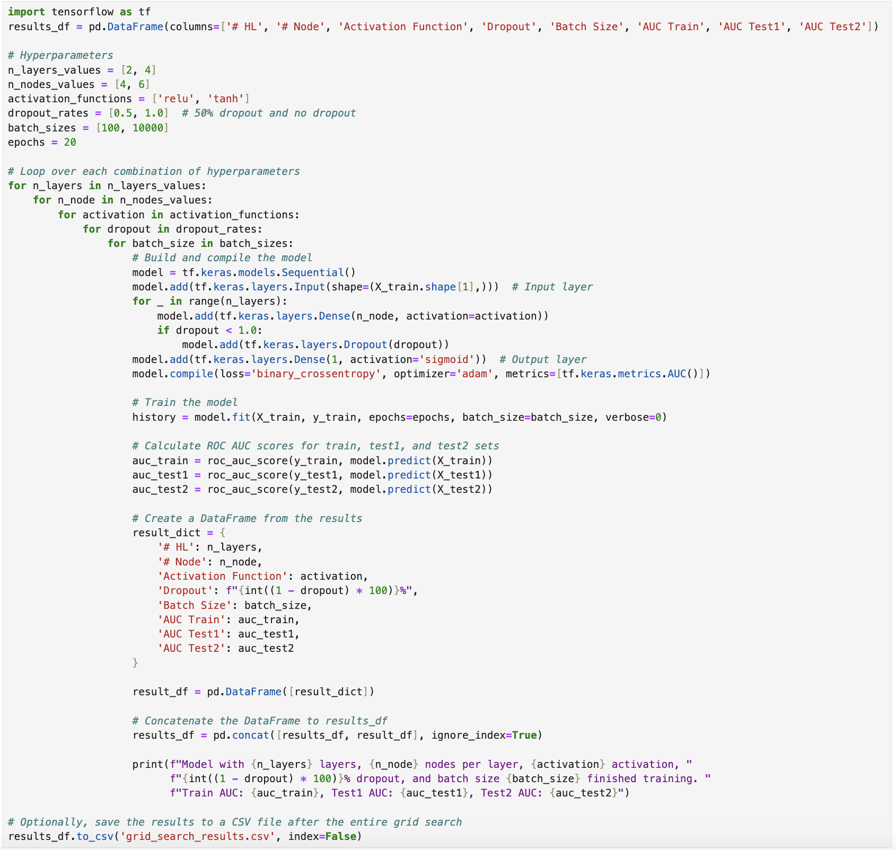
Observations The function goal is to achieve the high accuracy (AUC) on the testing data by achieving low bias and low variance. We need to achieve low bias and variance because it ensures the model accurately understands the data without oversimplifying (low bias) and remains stable against random fluctuations (low variance), resulting in reliable and precise predictions
NEURAL NETWORK Grid Search

Slide 15
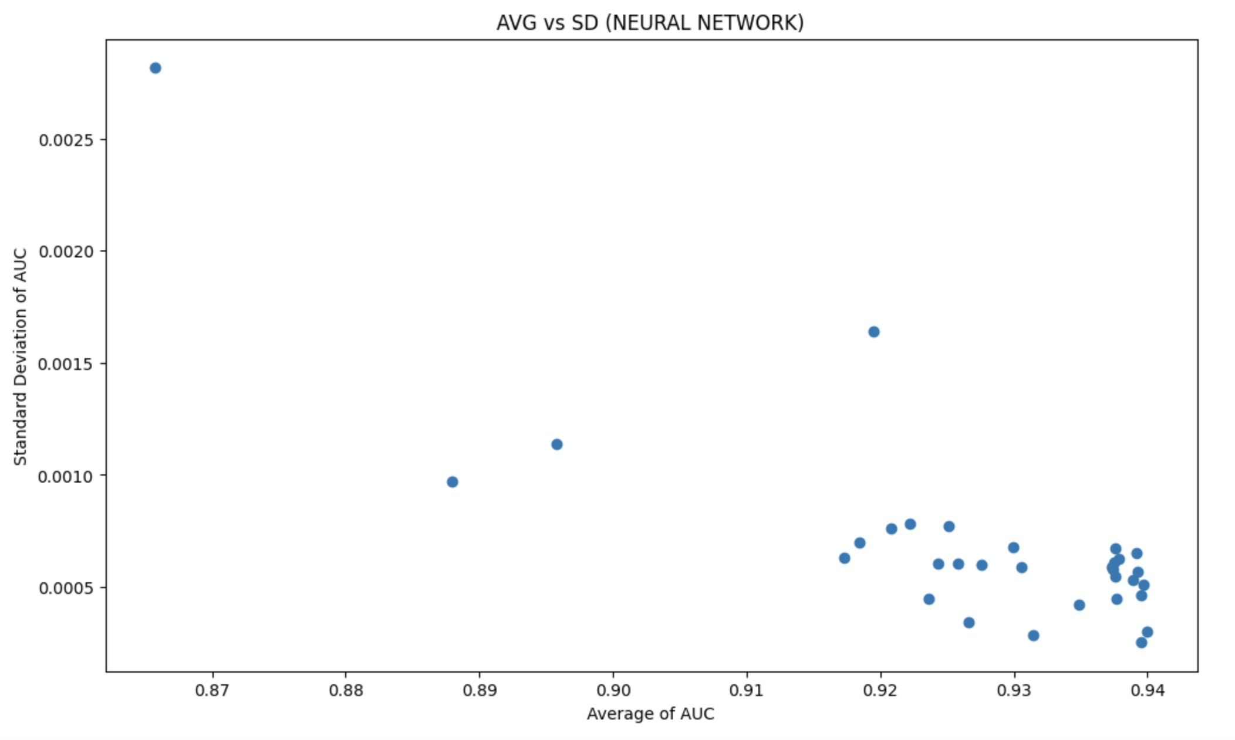
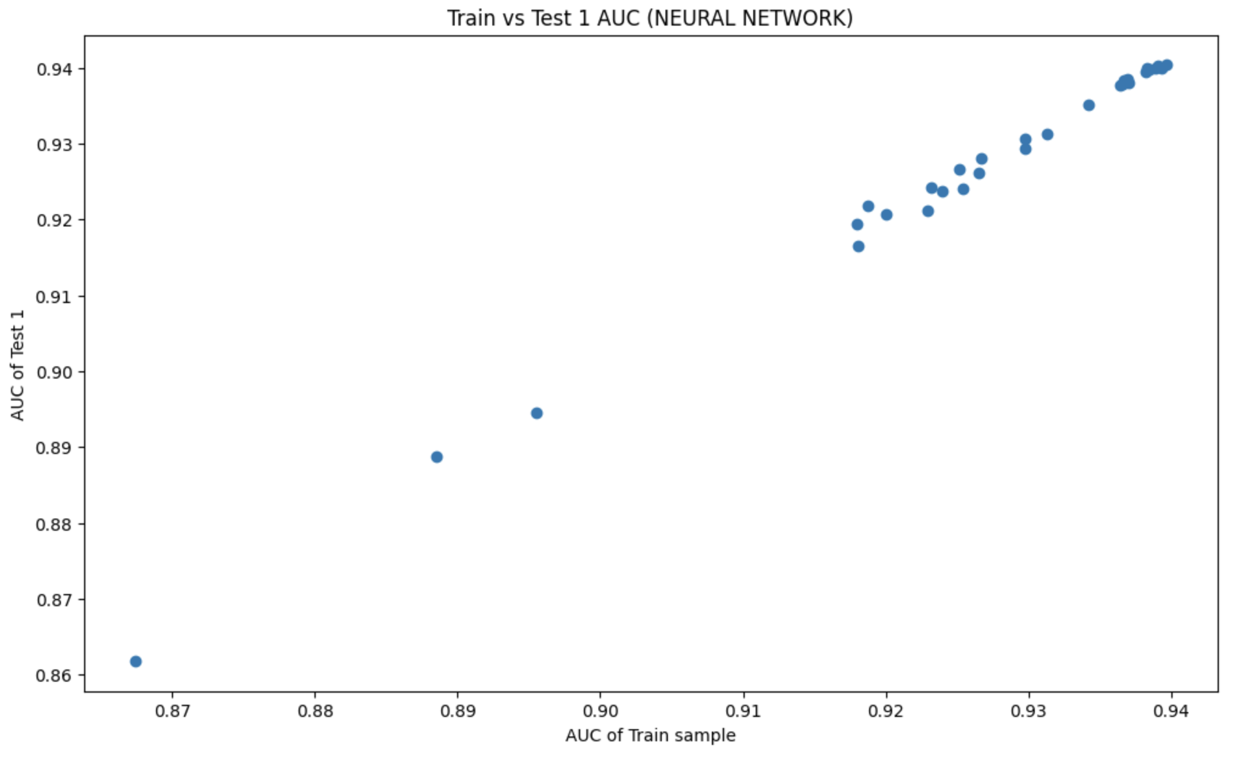
NEURAL NETWORK Grid Search
Train sample vs test 1 sample gives the highest AUC value. Thus, selecting it gives the best Neural Network model
High average AUC and a small standard deviation: model consistently performs well across different conditions.
high average AUC and larger standard deviation :model performs well on average but is sensitive to variations in the data or experimental settings.
low average AUC and a small standard deviation: model that consistently performs poorly.
A linear relationship between AUC train and AUC test indicates that the model is generalizing consistently. In other words, the model's performance on the training data is predictive of its performance on unseen test data.

Slide 16
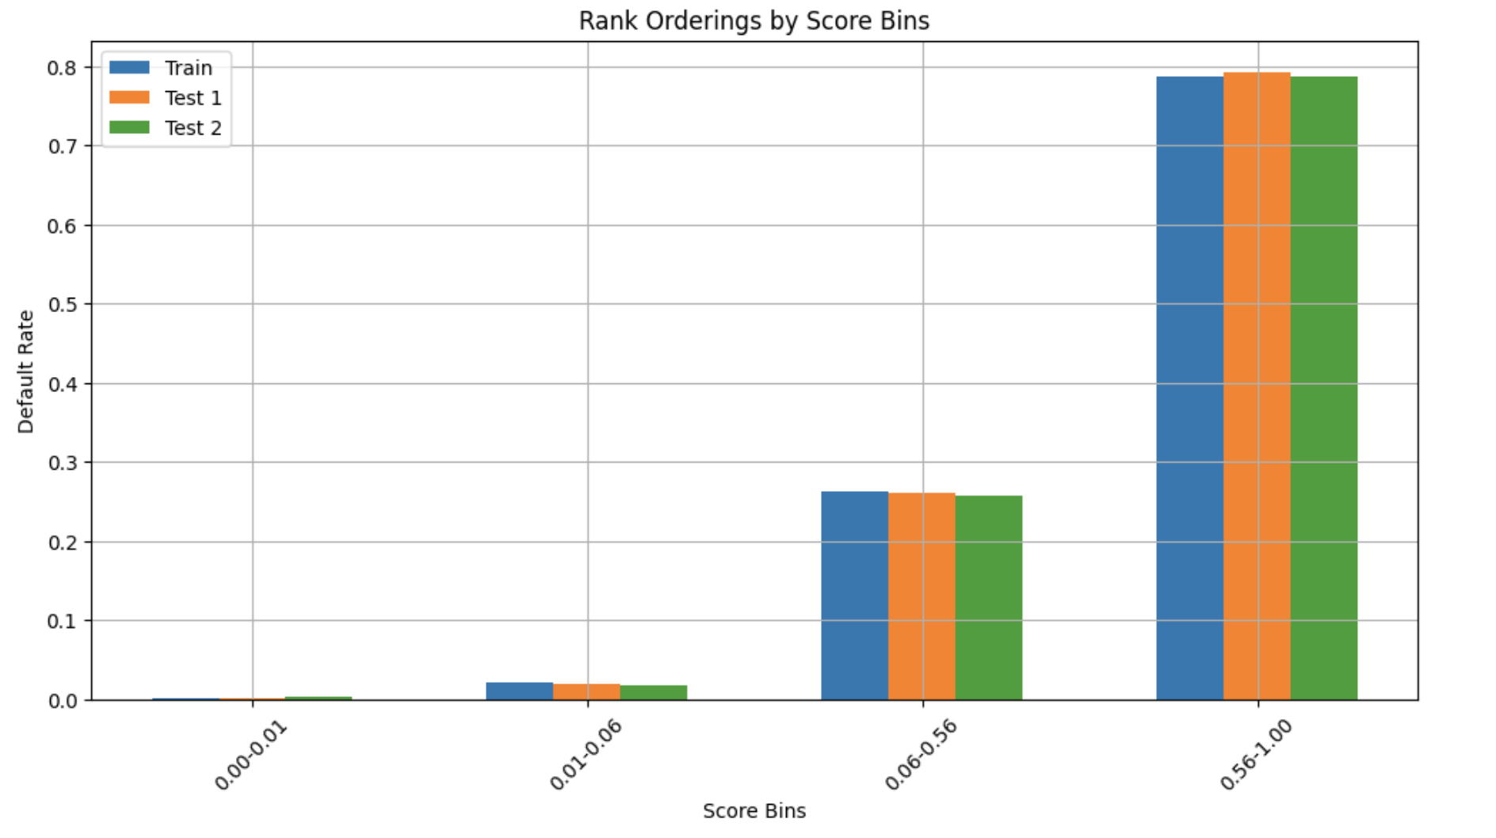
NEURAL NETWORK – Best Model
best_model_Neural_Network
#HL | 2
#Node | 6
Activation Function | Relu
Dropout | 0%
Batch Size | 100
AUC Train | 0.93966
AUC Test 1 | 0.940394
AUC test 2 | 0.939906
AUC Avg | 0.939903

Slide 17
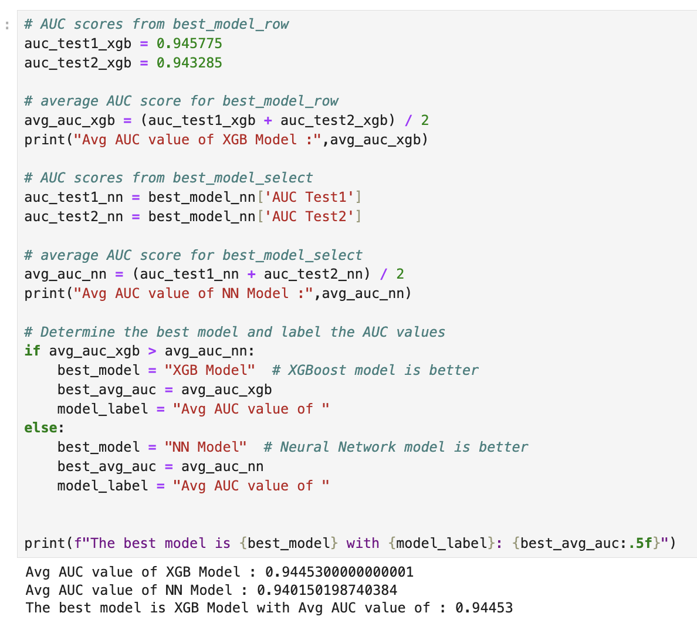
Final Model
best_model_xgb
#Trees | 300
LR | 0.1
Subsample% | 80.0%
Features | 100%
%Wt. of Default | 1
AUC Train | 0.972623
AUC Test 1 | 0.945961
AUC test 2 | 0.944229
AUC Avg | 0.954271
AUC SD | 0.0012996

Slide 18
We calculate Revenue using the formula: Revenue = (Balance Feature * 0.02) + (Spending Feature * 0.001), with chosen default rate thresholds of 30% for the Conservative strategy and 60% for the Aggressive strategy.
STRATEGY
 | Train |  | Test 1 |  | Test 2
Threshold | Default Rate | Revenue | Default Rate | Revenue | Default Rate | Revenue
0.1 | 0.35% | $447.01 | 0.93% | $93.88 | 0.88% | $94.64
0.2 | 0.91% | 491.82 | 1.90% | $104.06 | 1.77% | $103.98
0.3 | 1.62% | 522.15 | 3.03% | $110.68 | 2.78% | $110.76
0.4 | 2.70% | 551.20 | 4.49% | $117.51 | 4.09% | $117.19
0.5 | 4.17% | 579.29 | 6.09% | $123.69 | 5.87% | $124.02
0.6 | 6.22% | 609.63 | 8.14% | $130.32 | 8.01% | $130.41
0.7 | 9.22% | 643.42 | 11.10% | $138.04 | 10.79% | $137.98
0.8 | 13.11% | 680.21 | 14.45% | $145.89 | 14.24% | $146.07
0.9 | 17.91% | 720.92 | 18.58% | $154.26 | 18.60% | $155.21
1 | 26.88% | 792.32 | 27.33% | 1$69.78 | 26.74% | $169.78
Conservative strategy:
We have taken maximum rate one can default is 3%. Therefore optimum threshold for conservative threshold would be 0.3
Aggressive strategy:
We consider companies doesn’t want to default more than 10% so optimum threshold for aggressive would be 0.6

Slide 19
THANK YOU

