Slide 1

Wavecon Telecom Analysis
After 5G launch
Presented by: Krutarth Patel

Slide 2
Agenda
About Company
About Market And Plans
Overview Of The Dashboard
Revenue Impact Of 5G Launch
Underperforming KPI After 5G Launch
Top Performing Plans Post 5G Launch
Underperforming Plans Post 5G Launch
Plans Discontinued After 5G Launch
Recommendations And Strategic Actions

Slide 3

About Company
Wavecon Telecom is one of the leading telecommunication providers in India.
The company offers a total of 13 plan options.
The goal of this analysis is to assess the impact of 5G on revenue, evaluate KPI-driven performance, and analyze the effectiveness of the new 5G plans.

Slide 4
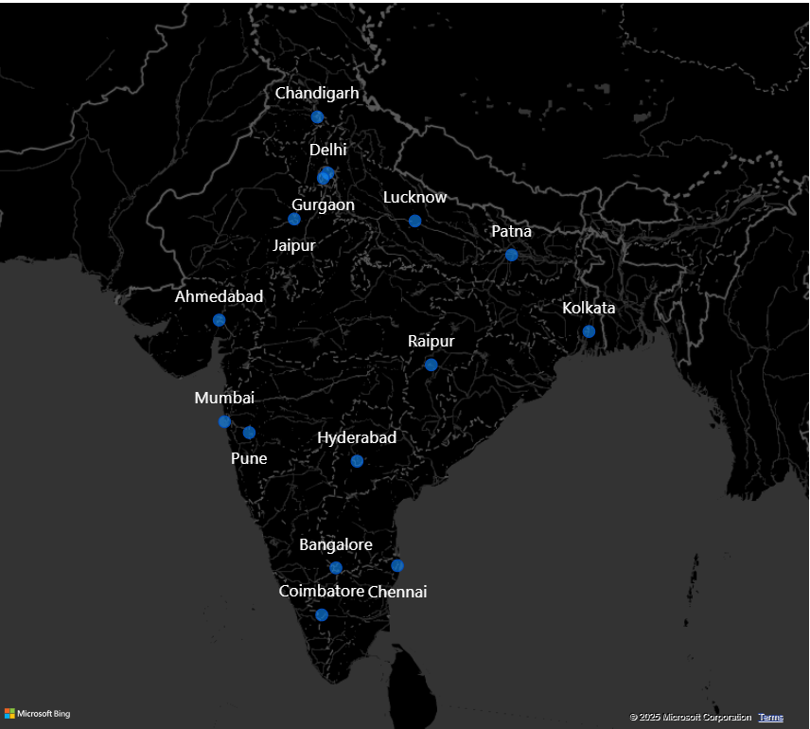
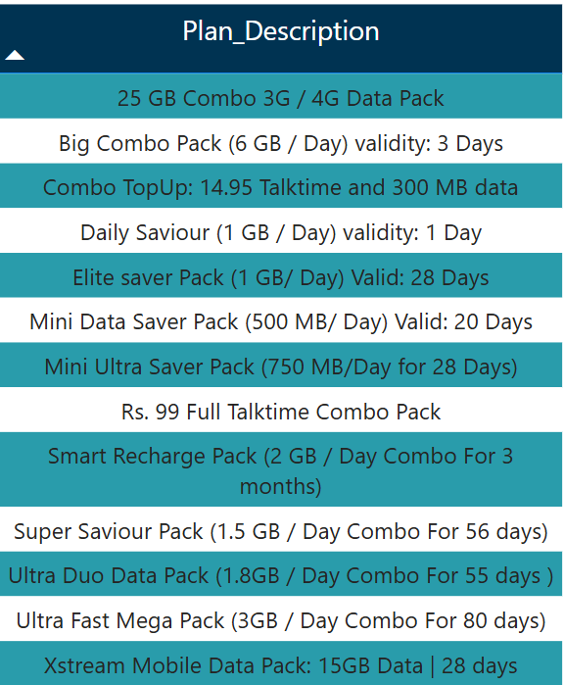
About Market and Plans
Company’s Market
Company’s Plan_Description

Slide 5

Overview of the Dashboard

Slide 6

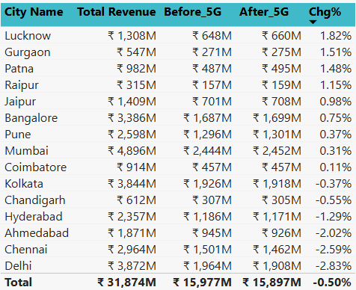
Revenue Impact Of 5G Launch
What is the impact of the 5G launch on our revenue?
Total revenue
₹ 31.9 bn
INSIGHTS
Total revenue decreased from ₹16.0 billion to ₹15.9 billion after the launch of 5G.
This represents an overall revenue decline of 0.50% due to the introduction of 5G.
Among all cities, Delhi faced the most significant impact, with a revenue decline of 2.83%, making it the hardest-hit city post-launch.

Slide 7




Underperforming KPI After 5G Launch
2. Which KPI is underperforming after the 5G launch?
Total Active Users
Total Unsubscribed Users
INSIGHTS
The underperforming KPI are Total Active Users (TAU) and Total Unsubscribed Users (TUsU).
TAU declined by 8.28%, from 84.4 million to 77.4 million, reflecting a drop in user engagement and retention.
TUsU increased by 23.50%, equating to approximately 1.4 million users cancelling their subscriptions after 5G rollout. This signals customer dissatisfaction and directly impacts revenue streams.

Slide 8
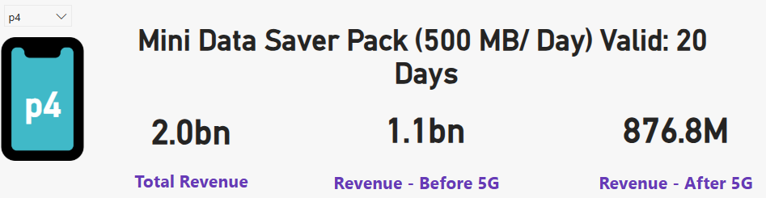
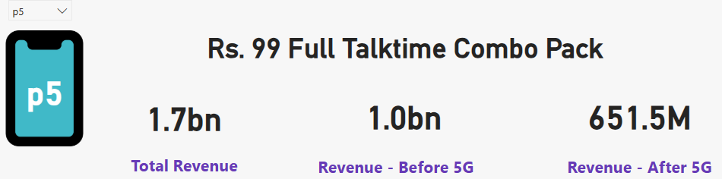
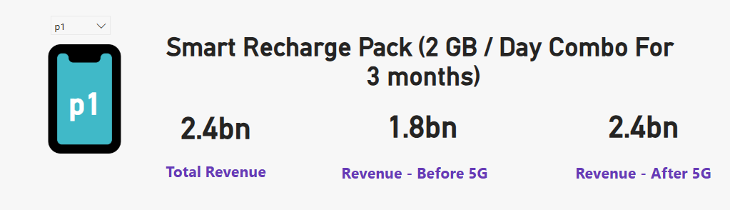
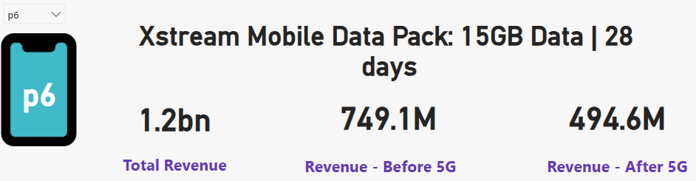
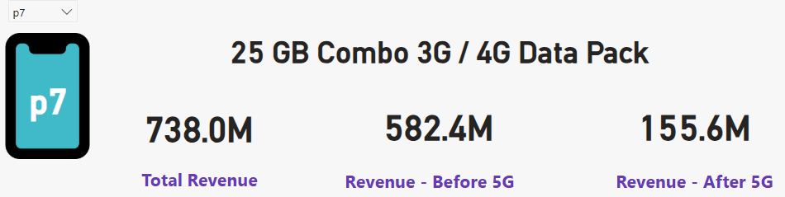
Top Performing Plans Post 5G Launch
3. After the 5G launch, which plans are performing well in terms of revenue? Which plans are not performing well?
Not Performing Well
Performing Well
INSIGHTS
After the 5G launch, Plan P1 emerged as a top performer, with revenue increasing by 33.33% compared to pre-5G levels.
On the other hand, Plans P4, P5, P6, and P7 showed significant revenue declines of 20.29%, 34.85%, 33.97%, and 73.28%, respectively, resulting in an average decline of 40.60%,highlighting a sharp decrease in their post-5G performance.

Slide 9
Underperforming Plans Post 5G Launch
4. Is there any plan affected largely by the 5G launch? Should we continue or discontinue that plan?
73.38 %
INSIGHTS
The introduction of 5G has resulted in a significant revenue decline of 73.28% for Plan P7, making it the most unfavourably impacted plan.
Revenue for Plan P7 decreased from 582.4 million to 155.6 million, indicating a substantial shift in customer preferences towards 5G plans.
This decline suggests that Plan P7 is no longer aligned with market demands in the evolving 5G landscape.
It is recommended that WaveCon consider discontinuing Plan P7 to optimize profitability and allocate resources toward more competitive and future-focused offerings.

Slide 10
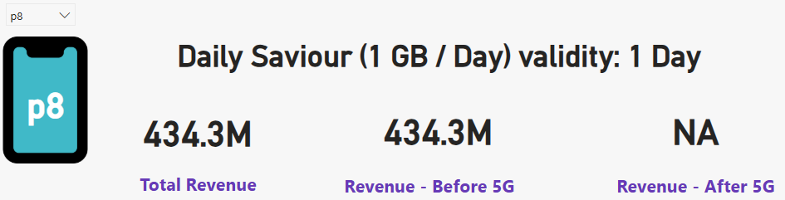
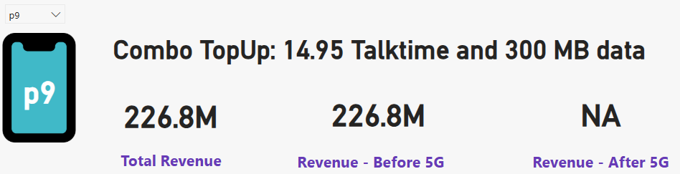
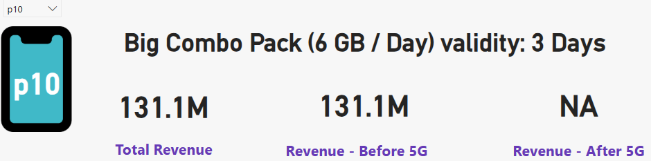
Plans Discontinued After 5G Launch
5. Is there any plan that is discontinued after the 5G launch? What is the reason for it?
INSIGHTS
Plans 8, 9, and 10 were discontinued as their data limits were insufficient to support the needs of 5G users.
These plans demonstrated low adoption rates and contributed minimally to revenue generation.
The decision to discontinue these plans was a strategic measure aimed at minimizing financial losses.

Slide 11
Recommendations And Strategic Actions
Amplify High-Performing Plans: Channel marketing efforts toward plans like Plan P1, which have driven substantial revenue growth post-5G rollout, to maximize impact.
Eliminate Low-Performing Plans: Phase out plans such as Plan P7 and similar low-revenue options to streamline offerings and enhance profitability.
Enhance Data Limits: Redesign discontinued and underperforming plans with upgraded data limits to meet the evolving demands of 5G users.
Strengthen Customer Retention: Tackle the rise in user churn by improving customer support services and introducing more attractive, competitive data plans.
Unlock Growth Potential in Key Cities: Focus on cities like Pune, Lucknow, and Chennai, leveraging their positive active user growth since the 5G launch to drive expansion.

Slide 12
Thank You

