Slide 1

Face Ventura: The Face Detective

Slide 2
Introduction

Slide 3
Why Facial Recognition ?
A good programming challenge
Example code for integration into other systems
Learning Tool

Slide 4
Facial Recognition Facts
What is Facial Recognition ?
The ability to match a face to a name (or other information usually in a database)
The Components of Facial Recognition
Facial Detection
Facial Tracking
Facial Recognition

Slide 5
Facial Detection
The ability to detect a face in an image
How ?
Eigenfaces (Eigenvectors)
Fisherfaces
Many others

Slide 6
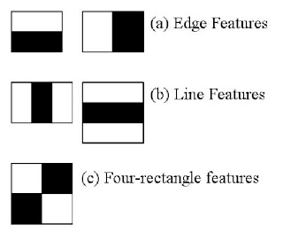
Viola-Jones & Haar Features
An object detection algorithm proposed in 2001 by Paul Viola and Michael Jones.
Goal: Fast efficient algorithm for real time face detection
Algorithm uses Haar features
Haar Features
Each Haar feature is a simple rectangular or square polygon with one or more shaded regions.

Slide 7
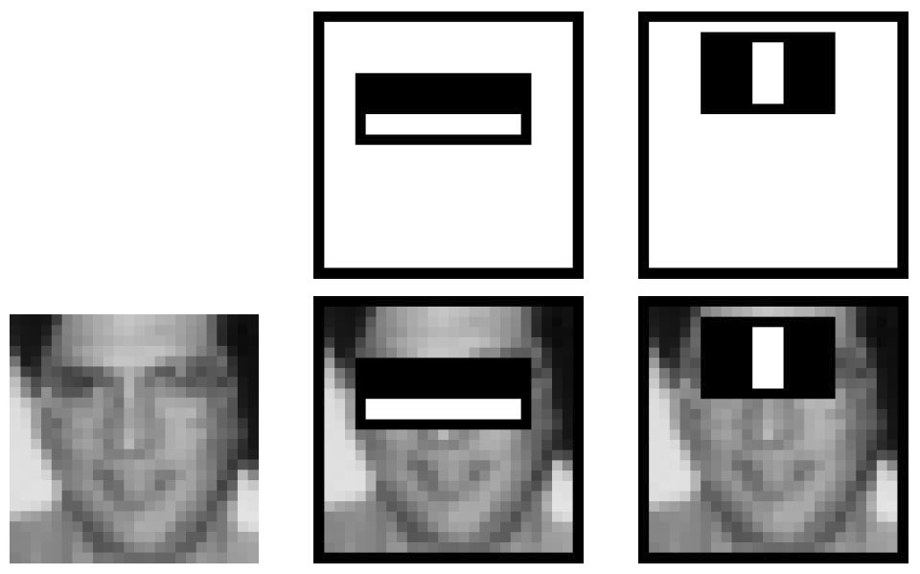
Haar features and faces
A face detector will look for
certain Haar features in
certain places in an attempt to
identify a face
This takes advantage of the
observable differences in
brightness of certain parts of the face

Slide 8
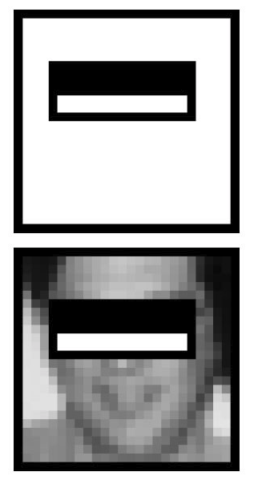
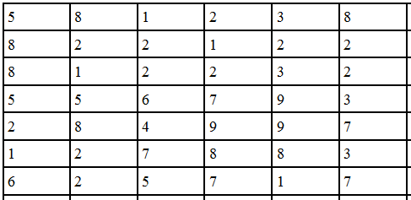
The Search for Haar Features
Table representing image sub rectangle
Each cell number represents brightness of pixel

Slide 9
Integral Image
An Integral Image, also known as a Summed Area Table, is a data structure used to decrease the computational complexity of the face detection algorithm
The integral image is calculated from a grayscale image
The integral image can quickly generate the sum of values in a subset of an image
These sums are used to search for Haar Features

Slide 10
Creating the Integral Image
Any point in the integral image, is the sum of all pixels above and to the left
Of the point
The Integral Image can be quickly calculated in one pass over the Image
The Integral Image, once calculated, allows constant time evaluation of
Any sub rectangle in the image

Slide 11
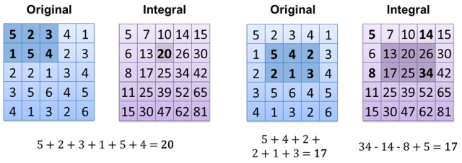
Integral Image Examples
http://www.codeproject.com/KB/graphics/441226/integral-image-example.png

Slide 12
Haar Cascades
A Haar Cascade is a method for evaluating a subrectangle using Haar Features
A sub rectangle of an image is analyzed, first with generic Haar features.
Look for these generic Haar Features, if they are not found, the sub rectangle is discarded
If Haar Features found, the rectangle is analyzed again, with more specific Haar Features (cascading)

Slide 13
Facial Tracking
Face tracking accomplished the same way as detection
In a video, each frame is analyzed, and treated the same as any image
If a face is detected, its location is shown
If a face moves in the next frame, its location will move accordingly

Slide 14
Facial Recognition

Slide 15
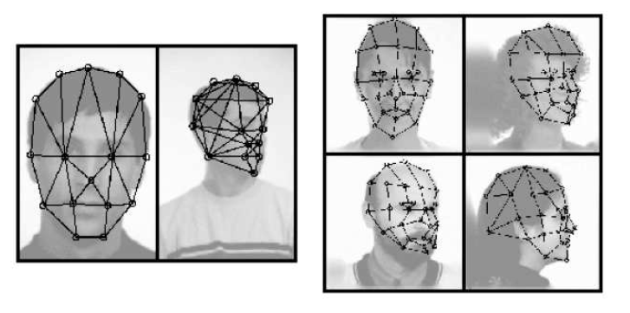
Early Techniques of Facial Recognition
Geometric: This was the early stages of facial recognition which involved selecting points on the face then comparing the different polygons.

Slide 16
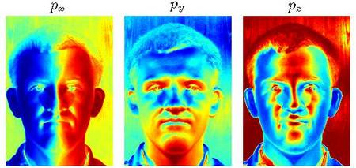
Early Techniques of Facial Recognition (cont.)
Photometric: A technique in computer vision for estimating the surface normal of objects under different lighting conditions.

Slide 17
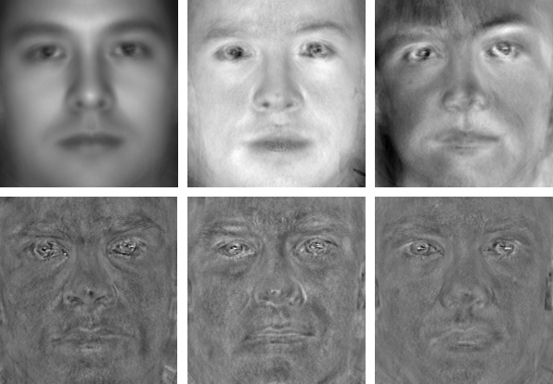
Evolved Techniques
Eigen faces: Captures the variation in a collection of facial images and encodes it. Then compares the image of an individual face in a holistic manner.

Slide 18
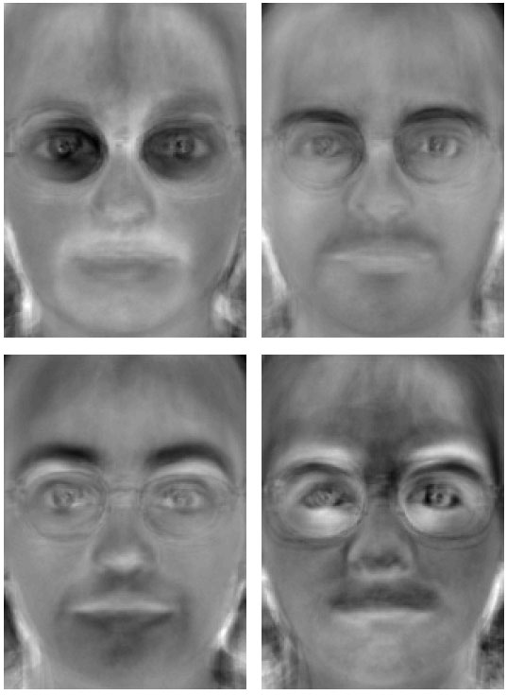
Evolved Techniques (cont.)
Fisher faces : Appropriate data representation is a vital task for computer vision, so fisher faces uses Principal Components Analysis(PCA).
Principal Components Analysis is a statistical procedure that uses orthogonal transformation.
It transforms data into a new coordinate system.

Slide 19
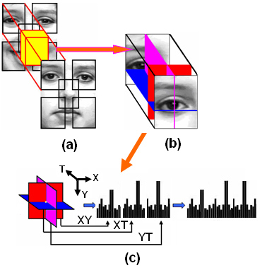
Evolved Techniques (cont.)
Local Binary Patterns Histogram: Texture operation which labels the pixel of an image by thresholding the neighborhood of each pixel and considers the result as a binary number.

Slide 20
Available Algorithms:
EigenFaces
FisherFaces
Local Binary Pattern Histograms.
We chose the Local Binary Pattern Histograms Algorithm.

Slide 21
LBPH vs EigenFace
The Eigenfaces algorithm maximizes the total scatter, which can lead to problems if the variance is generated by an external source.
To preserve some discriminative information we applied a Linear Discriminant Analysis and optimizations as described in the Fisherfaces method.

Slide 22
LBPH vs FisherFace
The Fisherface algorithm can not guarantee perfect light settings in images.
What if there’s only one image for each person?
In order to get good recognition rates you’ll need at least 12(+-1) images for each person and the Fisherfaces method does not help here.
LBPH overcomes this issue.

Slide 23
How LBPH works ?
Idea: Local Binary Patterns is to summarize the local structure in an image by comparing each pixel with its neighborhood. Take a pixel as the center and threshold its neighbors against the center pixel. If the intensity of the center pixel is equal to or greater than its neighbor, then denote that pixel with 1 otherwise a 0. You will end up with a binary number for each pixel, just like 11001111.
So with 8 surrounding pixels you’ll end up with 2^8 possible combinations, called Local Binary Patterns or sometimes referred to as LBP codes.

Slide 24
How We Implemented This Algorithm (OpenCV)
We used OpenCV version 2.4.10.
OpenCV is a popular vision library started by Intel in 1999.
Focuses on real-time image processing and the latest computer vision algorithms.
Written in C/C++.
Designed for Windows, Linux, Mac OS, iOS and Android.

Slide 25
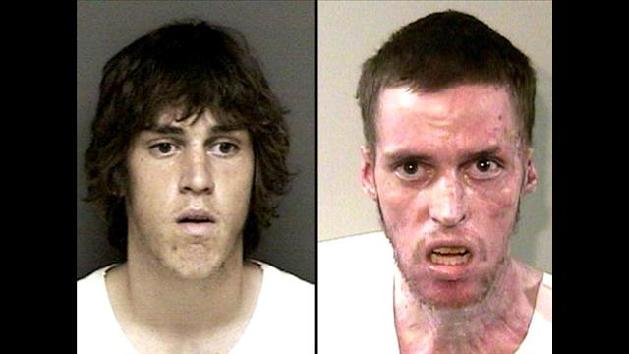
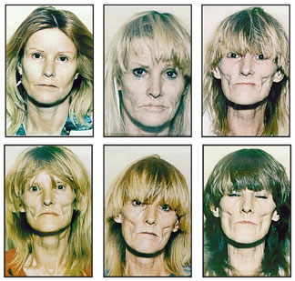
Facts About Facial Recognition
It’s inaccurate
Peoples faces can change drastically over time.
Even given an ideal situation the accuracy could still be quiet low

Slide 26
Misconceptions About Facial Recognition
Facial Recognition is a science and therefore it is infallible.
In 2001, the Tampa Police Department installed police cameras equipped with facial recognition technology in their City nightlife district in an attempt to cut down on crime in the area. The system failed to do the job, and it was scrapped in 2003 due to ineffectiveness. People in the area were seen wearing masks and making obscene gestures, prohibiting the cameras from getting a clear enough shot to identify anyone.

Slide 27
Initial Plans
Initial features:
Select an image (from filesytem)
Detect a face
Planned features if time allowed:
Face tracking
Language, Environment, Library:
Java
Eclipse
JavaCV

Slide 28
The Struggle Was Real
Group issues, other problems
Programmers Coding in Java
JavaCV vs OpenCV
Group Unity

Slide 29
We Are United (Again)
Steps we took to get back on track
One member researched alternative languages
After deciding on a new language one member started to rewrite the existing code
Frequent group meetings to unite the group and unify ideas into a singular project vision
Frequent communication between group members and professor

Slide 30
The New Plan
Two developers with unified vision
Each of the remaining members assigned to a section of the report
Projected early completion after many hours of research and implementation
Started research of facial tracking
Still projected to finish early and researched facial recognition
Implemented facial recognition phase 1 (single face at a time)
Implemented facial recognition phase 2 (multiple faces at a time)
Researched other areas of image processing
Implemented motion tracking

Slide 31
Added Features
Recap of Initial Features:
Facial Detection
Added Features:
Facial Tracking
Facial Recognition (multiple faces at once)
Motion Tracking

Slide 32
Future Plans
Gesture recognition
Object recognition
Motion sensitive security systems
Visual pin code system with facial recognition

Slide 33
Conclusion

Slide 34
References
http://electronics.howstuffworks.com/gadgets/high-tech-gadgets/facial-recognition.htm
http://en.wikipedia.org/wiki/Facial_recognition_system
http://vimeo.com/12774628
http://docs.opencv.org/modules/contrib/doc/facerec/facerec_tutorial.html#face-recognition-with-opencv
http://en.wikipedia.org/wiki/Facial_recognition_system
http://docs.opencv.org/modules/contrib/doc/facerec/facerec_tutorial.html
http://electronics.howstuffworks.com/gadgets/high-tech-gadgets/facial-recognition.htm
http://news.cnet.com/Tampa-drops-face-recognition-system/2100-1029_3-5066795.html
http://abcnews.go.com/Technology/story?id=97541

Slide 35
Questions ?

Slide 36

Two Challenges !
Draw a face on your balloon and see if you can draw one that will be detected by the system
Based on the information you’ve learned from this lecture, try to alter the already detected image and try to make it undetectable using minimal manipulation

