Slide 1
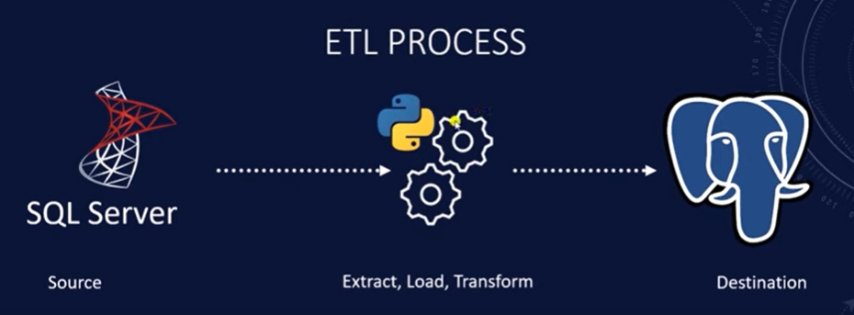
Lab -3 : ETL Pipeline Implementation: Exporting Data from SQL Server to PostgreSQL

Slide 2
Install SQL Server Express Step by Step
https://www.microsoft.com/en-in/sql-server/sql-server-downloads
Install SQL Server Management Studio | Microsoft Learn

Slide 3
Microsoft sample Database
https://learn.microsoft.com/en-us/sql/samples/adventureworks-install-configure?view=sql-server-ver15&tabs=ssms

Slide 4
How to install PostgreSQL on windows
https://www.enterprisedb.com/downloads/postgres-postgresql-downloads
Password: 12345

Slide 5
PostgreSQL Sample Database Tables
https://neon.com/postgresql/postgresql-getting-started/postgresql-sample-database

Slide 6
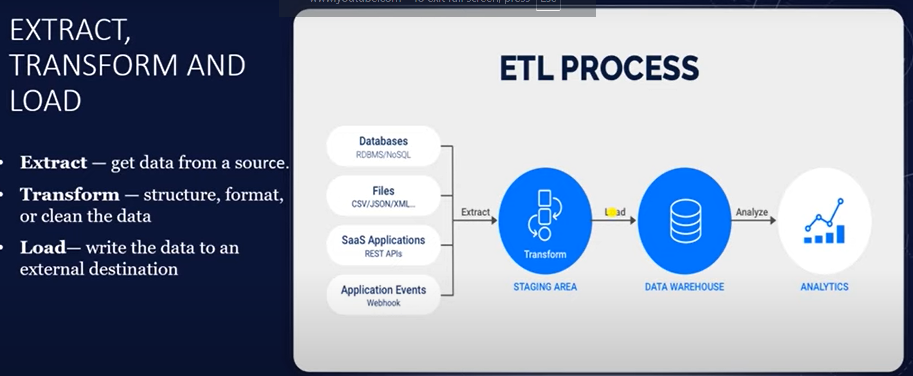

Slide 7
Creating the Database
CREATE DATABASE adventureworks
WITH OWNER = postgres
ENCODING = 'UTF8'
LC_COLLATE = 'English_India.1252'
LC_CTYPE = 'English_India.1252'
LOCALE_PROVIDER = 'libc'
TABLESPACE = pg_default
CONNECTION LIMIT = -1
IS_TEMPLATE = False;

Slide 8
Creating the Role and Granting the privileges
CREATE ROLE etl WITH
LOGIN
PASSWORD 'demopass';
-- Step 2: Grant privileges on the AdventureWorks database
GRANT ALL PRIVILEGES ON DATABASE adventureworks TO etl;

Slide 9
-- Run this while connected to adventureworks
GRANT USAGE, CREATE ON SCHEMA public TO etl;
GRANT ALL PRIVILEGES ON ALL TABLES IN SCHEMA public TO etl;
GRANT ALL PRIVILEGES ON ALL SEQUENCES IN SCHEMA public TO etl;
ALTER DEFAULT PRIVILEGES IN SCHEMA public
GRANT ALL PRIVILEGES ON TABLES TO etl;
ALTER DEFAULT PRIVILEGES IN SCHEMA public
GRANT ALL PRIVILEGES ON SEQUENCES TO etl;

Slide 10
https://learn.microsoft.com/en-us/sql/connect/odbc/download-odbc-driver-for-sql-server?view=sql-server-ver17

Slide 11
USE master;
GO
CREATE LOGIN etl
WITH PASSWORD = 'demopass',
DEFAULT_DATABASE = AdventureWorksDW2022;
GO
USE AdventureWorksDW2022;
GO
CREATE USER etl FOR LOGIN etl;
GO
GRANT CONNECT TO etl;
GO

