Slide 1
Exploring and Querying a Graph Database Using Neo4j
Neo4j is a NoSQL graph database designed to efficiently store, query, and manage data as nodes and relationships.
Why Graph Databases?
Traditional relational databases struggle with highly connected data. Graph databases model these connections naturally.
Core Concept:
Nodes → represent entities (e.g., People, Products)
Relationships → represent connections (e.g., FRIEND_OF, PURCHASED)
Properties → store attributes on both nodes and relationships

Slide 2
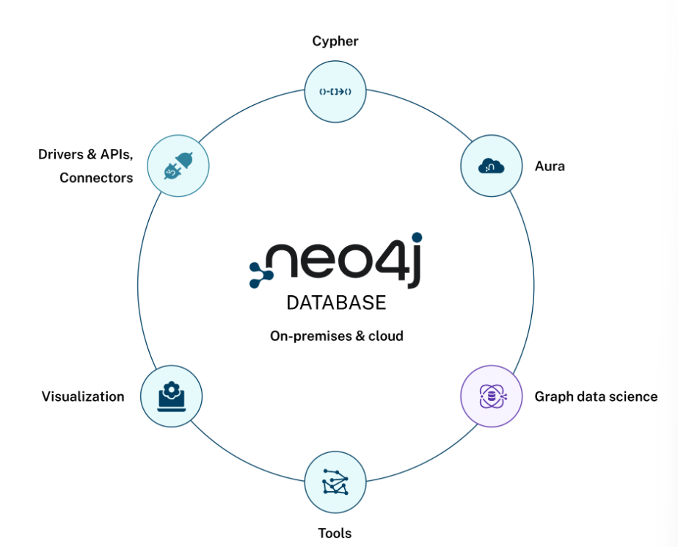

Slide 3
Use Case Examples:
Social networks
Fraud detection
Recommendation engines
Knowledge graphs

Slide 4
CREATE
(alice:Person {name: 'Alice', age: 30}),
(bob:Person {name: 'Bob', age: 28}),
(carol:Person {name: 'Carol', age: 35}),
(david:Person {name: 'David', age: 40}),
(neoTech:Company {name: 'NeoTech', location: 'Bengaluru'}),
(alice)-[:FRIEND_OF]->(bob),
(bob)-[:FRIEND_OF]->(carol),
(carol)-[:FRIEND_OF]->(david),
(alice)-[:WORKS_WITH]->(carol),
(david)-[:MENTORS]->(bob),
(alice)-[:WORKS_AT]->(neoTech);

Slide 5
SHOW DATABASES;
CALL db.labels();
CALL db.relationshipTypes();
CALL db.propertyKeys();
CALL db.schema.visualization();

Slide 6
Visulaize the graph:
MATCH (n)-[r]->(m)
RETURN n, r, m;

Slide 7
