Slide 1
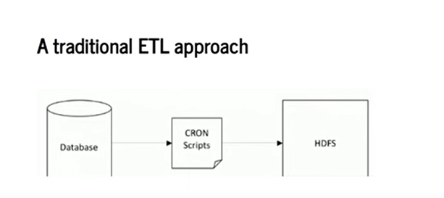
Apache Airflow
Apache Airflow is an open-source platform created by Airbnb (now part of the Apache Software Foundation) for programmatically authoring, scheduling, and monitoring workflows. It is widely used in data engineering and ETL (Extract, Transform, Load) pipelines.

Slide 2

Apache Airflow

Slide 3
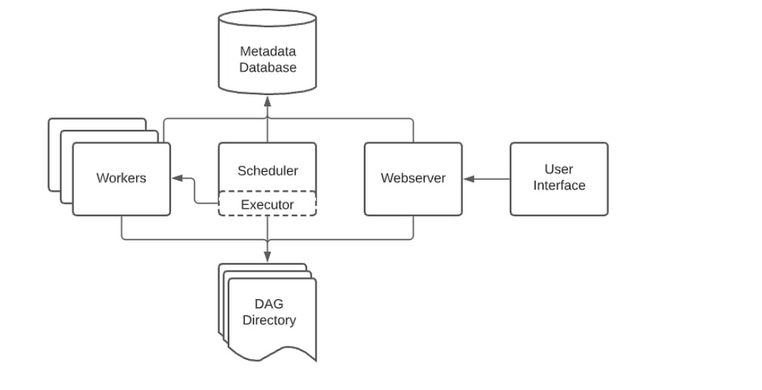
Apache Airflow key components

Slide 4
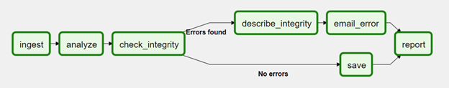
DAG (Directed Acyclic Graph)
The central concept in Airflow.
Defines the workflow as a graph of tasks (nodes) with dependencies (edges).
Written in Python code.
Example: ETL pipeline → extract → transform → load.

Slide 5
Task
A unit of work in a DAG. Each task is defined using an Operator (e.g., Bash Operator, Python Operator).
Tasks have dependencies like task1 >> task2.

Slide 6
Operator
Defines what a task will do.
Types: Action Operators: Run a command/script (BashOperator, PythonOperator).
Transfer Operators: Move data (e.g., S3ToRedshiftOperator).
Sensor Operators: Wait for an external condition (e.g., file arrival).

Slide 7
Scheduler
Decides when and in what order tasks should run.
Reads DAGs, schedules jobs, and submits them to the Executor.

Slide 8
Executor
Defines how tasks are executed.
Executor is process.
Sequential Executor (default, runs one task at a time).
Local Executor (parallel on one machine).
Celery Executor (distributed across workers).
Kubernetes Executor (tasks in separate pods).

Slide 9
Workers
Machines/containers that actually run the tasks (commands, scripts, SQL, etc.).
Used in distributed execution (Celery/Kubernetes).

Slide 10
Web Server (UI)
Provides a rich web-based dashboard to:
Monitor DAGs
Trigger runs manually
Retry failed tasks
View logs

Slide 11
Metadata Database
Stores Airflow’s state:
DAG runs
Task status (success, failed, skipped, queued)
Scheduling information
Commonly PostgreSQL or MySQL.

Slide 12
Install Apache Airflow for Windows PC

Slide 13
Install Apache Airflow for Windows PC
docker build -t airflowsqlserver -f Dockerfile --no-cache .
docker-compose up

Slide 14
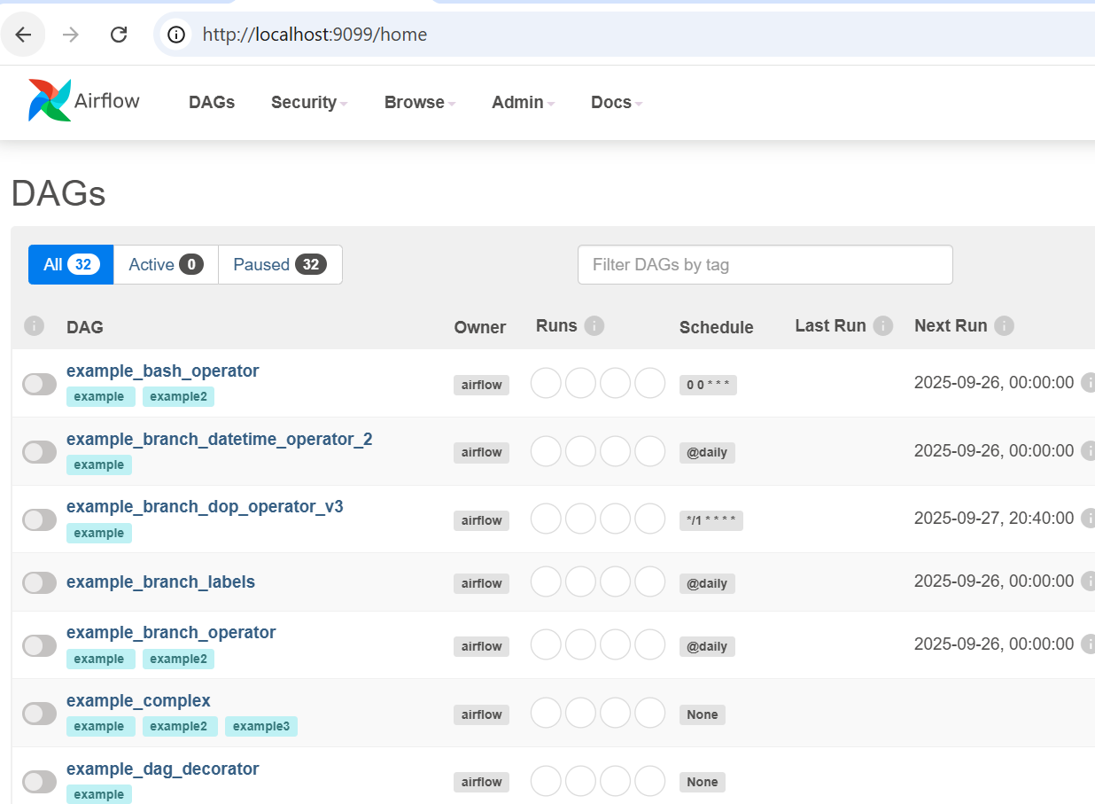
Install Apache Airflow for Windows PC
http://localhost:9099/home

Slide 15
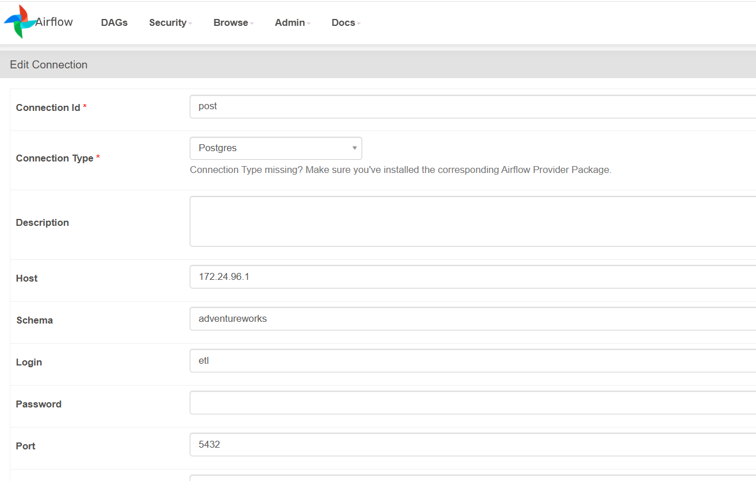

Slide 16
CREATE SCHEMA IF NOT EXISTS etl_staging;
GRANT ALL PRIVILEGES ON SCHEMA etl_staging TO etl;

