Slide 1
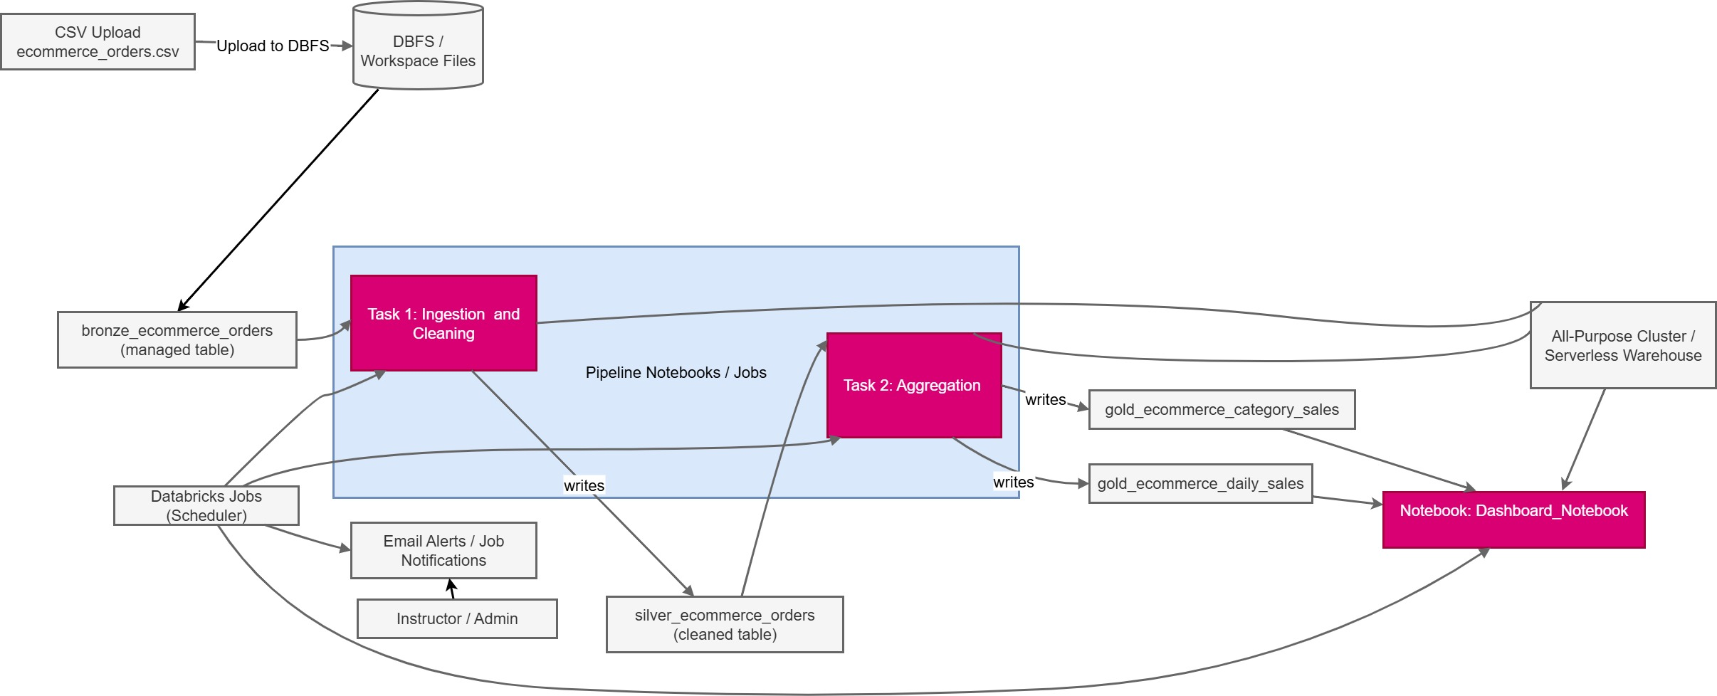
Lab -4 : Building and Automating Pipeline in Databricks for an E-Commerce Dataset

Slide 2
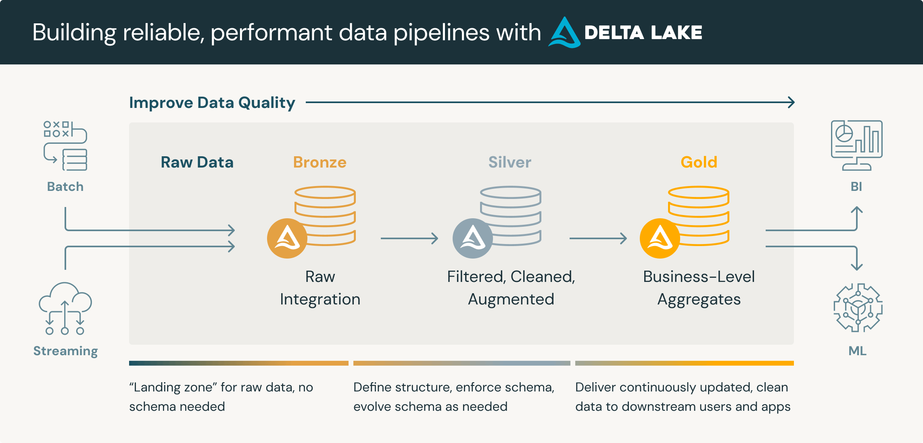
Bronze = raw, less valuable, but still useful as a source of truth.
Silver = cleaner, more valuable, ready for analytics.
Gold = the most valuable, directly supporting business decisions.

Slide 3
Task1_Ingestion_Cleaning
from pyspark.sql.functions import col, to_date
df_raw = spark.table("ecommerce_orders")
df_cleaned = (
df_raw.withColumn("order_date", to_date(col("order_date"), "yyyy-MM-dd"))
.withColumn("total_value", col("quantity") * col("price"))
)
# Save as a managed Silver table
df_cleaned.createOrReplaceTempView("tmp_ecommerce_orders_cleaned")
spark.sql("""
CREATE OR REPLACE TABLE silver_ecommerce_orders AS
SELECT * FROM tmp_ecommerce_orders_cleaned
""")

Slide 4
Task2_Aggregation_Reporting
from pyspark.sql.functions import sum as spark_sum
df_cleaned = spark.table("silver_ecommerce_orders")
# Revenue by product category (Gold layer)
df_category_sales = (
df_cleaned.groupBy("product_category")
.agg(spark_sum("total_value").alias("total_revenue"))
)
df_category_sales.createOrReplaceTempView("tmp_ecommerce_category_sales")
spark.sql("""
CREATE OR REPLACE TABLE gold_ecommerce_category_sales AS
SELECT * FROM tmp_ecommerce_category_sales
""")
df_daily_sales = (
df_cleaned.groupBy("order_date")
.agg(spark_sum("total_value").alias("daily_revenue")) )

Slide 5
df_daily_sales.createOrReplaceTempView("tmp_ecommerce_daily_sales")
spark.sql("""
CREATE OR REPLACE TABLE gold_ecommerce_daily_sales AS
SELECT * FROM tmp_ecommerce_daily_sales
""")

Slide 6
Dashboard
https://drive.google.com/file/d/1RFgS7USWd-zCTmfJgoJUlyhUYUHKu_Bg/view?usp=drive_link

Slide 7
Problem Statement: The healthcare industry generates vast amounts of transactional and operational data, ranging from patient consultations to lab tests, pharmacy sales, and diagnostic services. Analyzing this data in near real-time is crucial for improving patient care, optimizing resource allocation, and monitoring revenue trends across service categories and locations.In this project, the goal is to design and implement a data pipeline on Databricks using the healthcare_orders.csv dataset (1000 rows). The pipeline will demonstrate the medallion architecture (Bronze → Silver → Gold), with the following stages:

Slide 8
Ingestion & Cleaning (Bronze → Silver)
Problem: The raw healthcare orders data uploaded by hospitals and clinics may contain inconsistent date formats, unstructured columns, and missing values. Without cleaning, analytics will be inaccurate.
Objective:Ingest healthcare_orders.csv into Databricks (Bronze table).Convert dates into standard format (yyyy-MM-dd).Calculate the total bill value as quantity × price.Save the cleaned dataset as a Silver table (silver_healthcare_orders).

Slide 9
2. Aggregation & Enrichment (Silver → Gold)
Problem: Healthcare administrators need aggregated insights (e.g., revenue by service type, revenue trends over time, city-level performance) rather than raw transactions.
Objective:
Compute total revenue per service_category (gold_healthcare_service_sales).
Generate daily revenue trends (gold_healthcare_daily_sales).
Store results in Gold tables for downstream consumption.

Slide 10
3. Dashboard & Visualization
Problem: Decision-makers cannot interpret SQL tables directly; they need interactive charts.
Objective:
Build dashboards in Databricks Notebooks.
Visualize service-wise revenue (Bar Chart).
Plot daily revenue trends (Line Chart).
Enable filtering by city and payment method.

Slide 11
4. Automation & Scheduling
Problem: Manual pipeline execution is inefficient and error-prone. The healthcare dataset needs to be refreshed periodically as new data is uploaded.
Objective:
Use Databricks Jobs to schedule pipeline execution.
Configure daily or weekly refresh of Bronze → Silver → Gold layers.
Automate dashboard updates after pipeline completion.

Slide 12
5. Email Notifications & Alerts
Problem: Hospital administrators and data engineers need timely notifications of pipeline failures or successful updates.
Objective:
Configure Databricks Job notifications to send emails on success and failure events.
Ensure engineers are alerted for debugging if ingestion or transformations fail.

