Slide 1
Python Modules & functions data manipulation

Slide 2
INTRODUCTION
In Python, modules are files containing Python code that can be imported into other programs. They help organize code into reusable units. Functions, on the other hand, are blocks of code within modules that perform specific tasks. They promote code reusability and modularity by encapsulating functionality. You can import modules and call functions to simplify and structure your Python programs effectively.

Slide 3
functions
Function is block of organized and reusable program code that performs a single , specific and well defined task.
Types of function
-built-in:- built in function are part of language , which are predefined in
python.
-user defined:- these function are created by user in their programs using
def keyword.

Slide 4
Modules
Modules are nothing but group of functions variables and class that are saved to file.
Module is file with .py extension that has definations of all functions and variables.
Syntax to use module
import module
Syntax to use functions or variables from module
module.function( )
module.variable

Slide 5
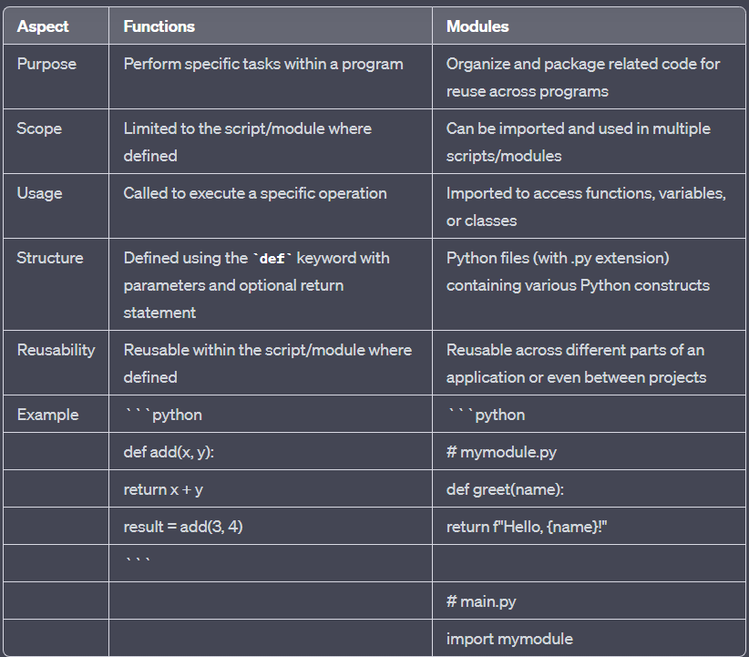
Functions VS modules

Slide 6
Data manipulation
Data manipulation in Python refers to the process of modifying, extracting, or transforming data to meet specific requirements or analysis needs. This can include tasks like filtering, sorting, modifying values, or aggregating data. Python provides various libraries and tools, such as NumPy, pandas, and built-in functions, to perform data manipulation efficiently, making it a powerful language for data analysis and processing tasks.

Slide 7
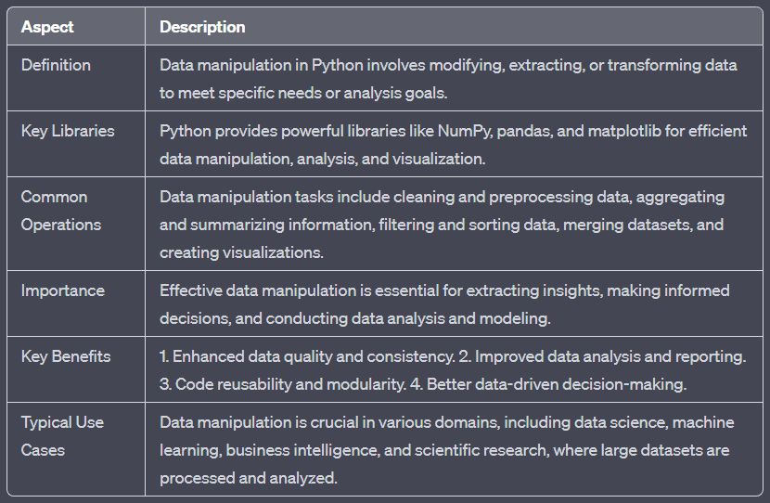
Data manipulation

Slide 8
“Python: Where simplicitymeets limitless possibilities.”

Slide 9
THANK YOU
A S Kruthik
Kruthik.cse.rymec@gmail.com

