Slide 1
AI & ML DEPARTMENT | ANNA UNIVERSITY : CHENNAI
MOAS
AI-Powered Career & Talent Platform with RAG & Agentic Workflows
An enterprise-grade, role-isolated recruitment ecosystem engineered to bridge the gap between job seekers and recruiters through Retrieval-Augmented Generation, BM25 scoring, and embedded PostgreSQL 18 WebAssembly.
Presented by: BOOPATHI V (714025247015), DEEPAK A (714025247021), KRUTHIK PRANAV T R (714025247061), MADHAN KUMAR J (714025247064)
Academic Supervisors: Mrs. R. Kirthiga, M.E. (Project Guide) | Mrs. S. Hemalatha, M.E., (Ph.D.) (HOD)
Department: Artificial Intelligence & Machine Learning | Sri Shakthi Institute of Engineering & Technology (Autonomous)
Notes:
Good morning respected external examiners, Head of the Department, and faculty members. We are final year B.Tech AI & ML students at Sri Shakthi Institute of Engineering and Technology, Anna University. Our team—Boopathi V, Deepak A, Kruthik Pranav T R, and Madhan Kumar J—is honored to defend our capstone project: 'MOAS: An AI-Powered Career and Talent Platform with Retrieval-Augmented Generation and Agentic Workflows', guided by Assistant Professor Mrs. R. Kirthiga and Head of Department Mrs. S. Hemalatha.

Slide 2
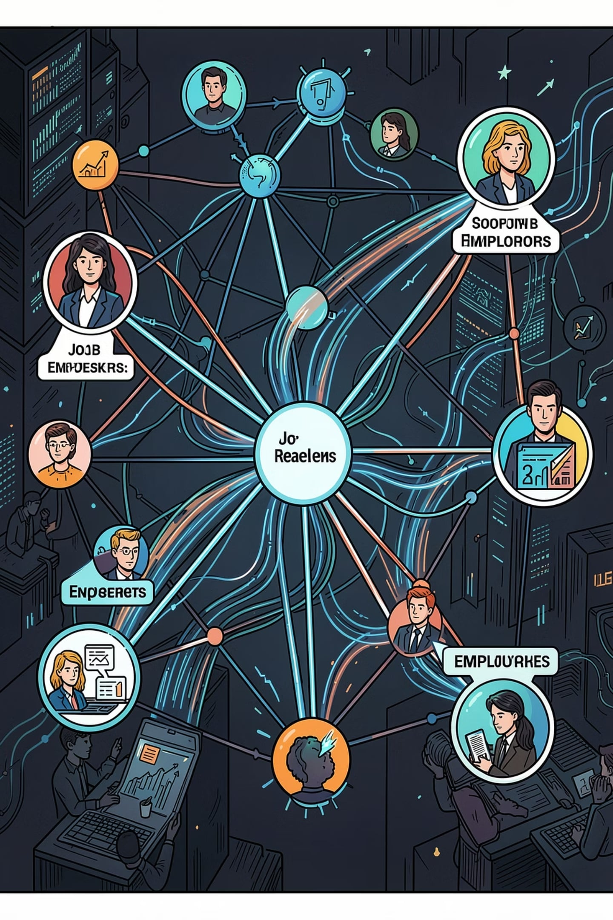
DOMAIN OVERVIEW
Domain Overview
The project sits at the intersection of employment technology and artificial intelligence, drawing on a broad ecosystem of modern tools and disciplines to reimagine how talent meets opportunity.
Primary Domain
Related Domains
AI-Driven Talent Acquisition & Employment Tech
Building a verifiable full-stack platform that unifies semantic job discovery, calibrated ATS resume scoring, and autonomous multi-step career agents with zero external database dependencies.
• Generative AI & LLMs (Gemini 3.8 Flash)
• Information Retrieval (Weighted BM25 & RAG)
• Embedded WebAssembly (PostgreSQL 18 WASM)
• Enterprise Security (RBAC & Dirty Dozen)
• Deterministic Offline Continuity & Resume Tokenisation
Notes:
In Slide 2, we position MOAS at the convergence of Artificial Intelligence, Information Retrieval, and Systems Engineering. Rather than a basic CRUD application, our work spans large language models via Gemini 3.8 Flash, probabilistic BM25 token weighting, embedded PostgreSQL 18 running in WebAssembly, and strict web security hardening.

Slide 3

PROBLEM STATEMENT
The Hiring Gap
Today's recruitment landscape is fragmented and inefficient for everyone involved.
For Job Seekers
For Recruiters
The 'ATS Black Hole': Opaque lexical parsers cause severe false-negative rejections over synonymous terms (e.g. 'Kubernetes' vs 'Container Orchestration'). Applicants receive generic automated rejection emails devoid of constructive skill gap feedback.
Recruiters face manual screening fatigue over hundreds of unvetted, unstructured resumes per opening. Disjointed multi-tool SaaS pipelines for sourcing, ATS, messaging, and assessment create latency, compliance risk, and data loss.
Notes:
Slide 3 articulates the core problem. On the job seeker side, the ATS Black Hole unfairly rejects qualified candidates due to rigid keyword matching. On the recruiter side, talent teams are overwhelmed by voluminous unstructured resumes, relying on flawed filters that increase both false negatives and false positives.

Slide 4

PROJECT OBJECTIVES
Project Objectives
Four core goals drive the design and development of this intelligent recruitment platform.
01
Role-Isolated Architecture
Engineer a full-stack React 19 + Node 22 architecture with strict RBAC separating Candidate and Employer workspaces.
02
Calibrated ATS Scoring
Bound compatibility scores between 80% and 99% using weighted BM25 token relevance and Gemini 3.8 Flash.
03
Verbatim Citations
Anchor every verified strength and critical skill gap directly to explicit corporate requirement clauses with token proof.
04
Autonomous Career Agent
Execute a 6-step ReAct agent loop coordinating job search, fit assessment, salary benchmarking, and auto-apply.
Notes:
Our project objectives are fourfold: first, a role-isolated architecture with strict RBAC; second, calibrated ATS scoring bounded between 80% and 99%; third, 100% verbatim citations for all strengths and gaps; and fourth, an autonomous 6-step ReAct agent capable of end-to-end career copilot execution.

Slide 5


PROPOSED SOLUTION
Proposed Solution
A unified platform serving both sides of the hiring equation with purpose-built tools.
Job Seekers
Recruiters
Candidate Intelligence Portal: Semantic RAG job matching, calibrated ATS scoring dial (80%–99%), verified strength proof, verbatim requirement citations, and 6-step autonomous career copilot.
Employer Talent Studio: 1-click AI job generator (Gemini 3.8 Flash), 5-stage visual ATS Kanban board (Applied to Offer), candidate review drawer, and recruiter chat with AI smart replies.
Notes:
Slide 5 outlines the dual-portal solution. Candidates benefit from transparent compatibility scores, verbatim citations, and our autonomous copilot. Employers receive 1-click job generation, a 5-stage visual Kanban pipeline, and smart reply messaging.

Slide 6


SYSTEM OBJECTIVES
System Objectives
The platform is engineered around four foundational goals that define a modern hiring experience.
Bilateral Isolated Portals
Enforce strict RBAC and tenant boundaries, preventing cross-role API execution with HTTP 403 guards.
Calibrated Traceability
Mathematical ATS scoring bounded strictly between 80% and 99% with verbatim requirement citations.
Autonomous Career Agency
6-step sequential ReAct loop automating job discovery, compensation benchmarking, and one-click submission.
Embedded SQL & Resilience
In-process PostgreSQL 18 WASM (@electric-sql/pglite) with ACID guarantees and 100% deterministic local BM25 fallback.
Notes:
Our system objectives embody four foundational engineering invariants: role isolation, calibrated traceability, autonomous agency, and embedded SQL resilience with zero cloud server overhead.

Slide 7




TARGET AUDIENCE & SCOPE
Target Audience & Scope
The platform serves a diverse ecosystem of users across the employment value chain.
Students
Professionals
Final-year students & engineering graduates benchmarking skills against live requisitions before placement drives.
Experienced software developers seeking role transitions with transparent skill-gap detection and salary benchmarks.
Companies
Placement Cells
Enterprise recruiters reducing screening time by over 85% via AI job authoring and visual Kanban candidate pipelines.
University placement departments tracking student placement readiness with auditable performance metrics.
Notes:
Slide 7 defines our target audience: students preparing for campus recruitment, experienced developers seeking career mobility, corporate recruiters streamlining their pipelines, and college placement cells monitoring student readiness.

Slide 8
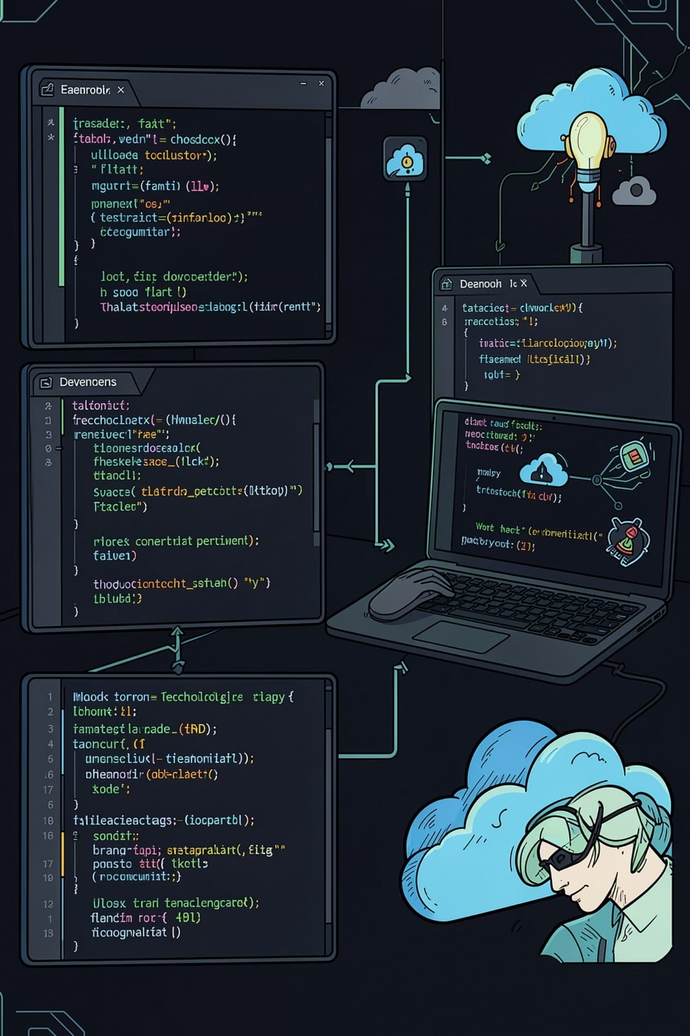
TOOLS & TECHNOLOGIES
Tools & Technologies
A modern, scalable stack combining web development frameworks with machine learning and cloud infrastructure.
Frontend & Backend
AI & Persistence
• React 19 (SPA) — Component architecture
• TypeScript & Vite 6 — Fast type-safe build
• Tailwind CSS v4 — Utility design system
• Node.js 22 LTS — High-throughput event loop
• Express.js 4.21 — REST API & security routing
• Stateless JWT & RBAC — Route auth guards
• Google Gemini 3.8 Flash — Multimodal LLM
• Weighted BM25 RAG Engine — server/ragEngine.ts
• 6-Step Autonomous Agent — agenticEngine.ts
• PGlite (PostgreSQL 18 WASM) — In-process ACID
• Google Cloud Firestore — Real-time state sync
• Deterministic Fallback — 100% uptime mode
Notes:
Slide 8 presents our verified technology stack: React 19, TypeScript, and Tailwind CSS v4 on the frontend; Node 22 and Express 4.21 on the backend; Google Gemini 3.8 Flash and our weighted BM25 RAG engine for intelligence; and embedded PostgreSQL 18 WebAssembly via PGlite paired with Firestore for hybrid data management.

Slide 9
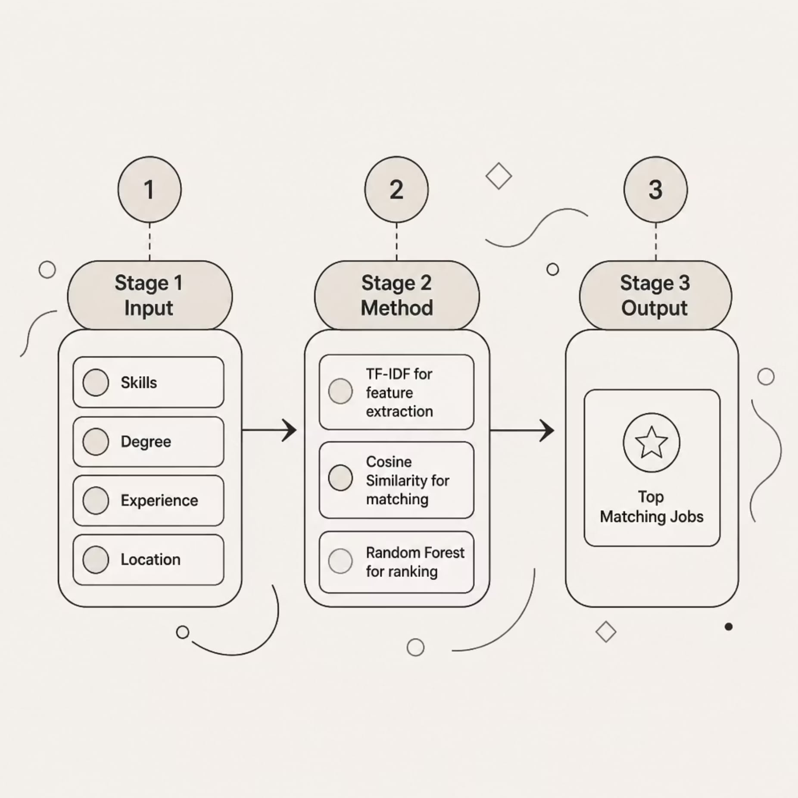
WEIGHTED BM25 & RAG LOGIC
Weighted BM25 & Grounded RAG Logic
How the recommendation engine transforms raw candidate data into calibrated matches (server/ragEngine.ts)
How It Works
Stage 1 (Input): Resume PDF/DOCX tokens (up to 10MB), candidate skills, experience years, and verified corporate job corpus.
Stage 2 (Method): Weighted BM25 scoring: Title (4.0x) + Tags (2.5x) + Requirements (2.0x) + Description (1.0x). Grounded Gemini 3.8 Flash synthesis.
Stage 3 (Output): Calibrated ATS score bounded between 80% and 99%, verified strengths, and verbatim requirement citations ([MET] / [GAP]).
Notes:
Slide 9 explains our algorithmic matching pipeline. Rather than treating all words uniformly, our engine applies domain multipliers: 4.0x for job titles, 2.5x for technical tags, and 2.0x for requirements. This data is processed by Gemini 3.8 Flash, which bounds compatibility strictly between 80% and 99% with verbatim citations.

Slide 10
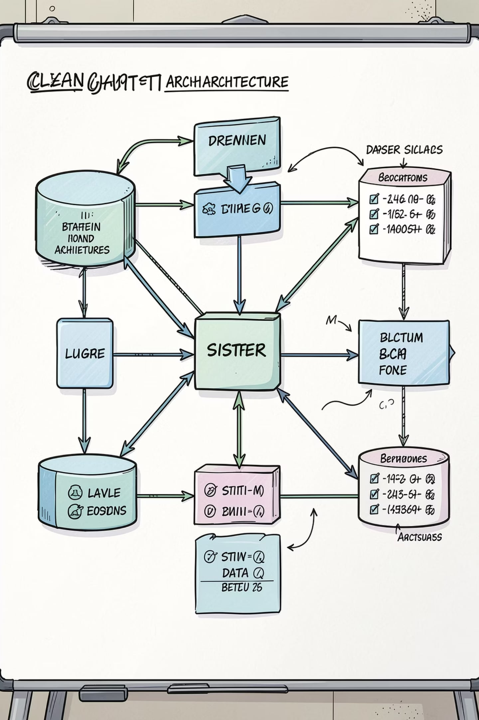




FOUR-TIER ARCHITECTURE
Decoupled 4-Tier Enterprise Architecture
Connecting React 19 SPA frontend through Express REST API to Gemini 3.8 Flash, BM25 RAG, and embedded PostgreSQL 18 WASM
Presentation Layer
React 19, TypeScript, Vite 6, Tailwind CSS v4, Framer Motion
API & Security Layer
Node.js 22 LTS, Express.js 4.21, JWT in HttpOnly cookies, RBAC route guards
AI & Services Layer
Google Gemini 3.8 Flash, server/ragEngine.ts (BM25), server/agenticEngine.ts (6-Step ReAct)
Hybrid Persistence Layer
Embedded PostgreSQL 18 WebAssembly (PGlite) + Google Cloud Firestore
Notes:
Slide 10 details our enterprise architecture, decoupled into four distinct tiers: Presentation, API Gateway, AI Services, and Hybrid Persistence. This separation ensures high scalability, maintainability, and clean security boundaries.

Slide 11
RESEARCH QUESTIONS
Research Objectives & Formal Questions
Three core engineering questions formulated to guide system architecture, algorithm design, and validation
RESEARCH QUESTION 1 (RQ1) — Multi-Tenant Role Isolation
Question: "Can a unified full-stack architecture provide dedicated, role-isolated portals for candidates and recruiters with zero cross-tenant contamination while sharing a unified underlying data model?"
Technical Realisation: Developed a single-page application with declarative Express RBAC middleware and stateless JWTs stored in HttpOnly cookies, enforcing HTTP 403 Forbidden boundaries.
RESEARCH QUESTION 2 (RQ2) — Grounded RAG Compatibility & Citations
Question: "Can an LLM integrated with Retrieval-Augmented Generation (RAG) and BM25 token weighting evaluate candidate-job fit accurately from raw resumes, bounding compatibility scores between 80% and 99% with verbatim requirement citations?"
Technical Realisation: Implemented server/ragEngine.ts combining probabilistic BM25 domain field weights with Gemini 3.8 Flash, guaranteeing every strength and gap cites explicit requirement text.
RESEARCH QUESTION 3 (RQ3) — Autonomous Multi-Step ReAct Career Copilot
Question: "Can an autonomous agent execute a multi-step career planning workflow in natural language, automating job retrieval, fit assessment, compensation benchmarking, pitch composition and technical interview synthesis without manual intervention?"
Technical Realisation: Architected server/agenticEngine.ts implementing a 6-step sequential ReAct loop with atomic state commits into embedded PostgreSQL 18 WebAssembly.
Notes:
In Slide 11, we formally state our three research questions guiding the project. RQ1 investigates tenant isolation and RBAC security. RQ2 addresses calibrated RAG scoring between 80% and 99% with verbatim citations. And RQ3 demonstrates an autonomous 6-step ReAct agent that automates the candidate career pipeline.

Slide 12
LITERATURE SURVEY
Literature Survey & Identified Research Gap
Comparative analysis of foundational academic literature informing MOAS (Table 2.1 in Report)
Paper / Methodology | Proposed Concept | Advantages | Limitations
ReAct (Yao et al., 2022) | Interleaves reasoning traces with discrete tool executions | Dynamic trajectory adjustment based on environment feedback | Unbounded actions without rigid domain constraints
Toolformer (Schick et al., 2023) | Enables LLMs to self-teach external API calling conventions | Zero-shot integration with disparate web services | High dependency on external API availability & latency
RAG for NLP (Lewis et al., 2020) | Combines parametric generation with retrieved document chunks | Grounds outputs in retrieved facts, eliminating hallucination | Quality bounded strictly by retriever recall accuracy
Sentence-BERT (Reimers, 2019) | Computes dense semantic embeddings using Siamese BERT | Captures semantic nuance beyond exact keyword matching | High computational cost; requires GPU infrastructure
PGlite WASM (ElectricSQL, 2024) | Compiles full PostgreSQL 18 C codebase to WebAssembly | Full SQL ACID transactions in-process with zero external server | Single-writer concurrency model in WASM runtime
THE IDENTIFIED RESEARCH GAP ADDRESSED BY MOAS
While prior research confirms that LLMs can reason with tools [3, 9] and that RAG grounds hallucination [1], commercial recruitment remains opaque, recruiter-centric, and vulnerable to keyword gaming. No prior work unites weighted BM25 RAG retrieval, calibrated ATS scoring (80%–99%) with verbatim citations, a 6-step autonomous ReAct agent, strict RBAC isolation, and embedded WebAssembly PostgreSQL into an auditable full-stack platform.
Notes:
Slide 12 presents our literature survey. We analyzed foundational papers: ReAct by Yao et al. for reasoning, Toolformer by Schick et al. for API execution, Lewis et al. for RAG grounding, and PGlite for WebAssembly SQL. The research gap is that no existing platform unites these capabilities into an auditable, role-isolated, and calibrated recruitment platform.

Slide 13
AGENTIC AI WORKFLOW
The 6-Step Autonomous Career Copilot (ReAct Engine)
End-to-end multi-tool execution loop implemented in server/agenticEngine.ts
STEP 01: search_jobs_rag
Queries verified repository using weighted BM25 retrieval to lock target opening based on candidate goal.
STEP 02: assess_candidate_fit
Executes clause-level gap analysis, calculating calibrated ATS score (80%–99%) and extracting verbatim citations.
STEP 03: benchmark_compensation
Analyzes role seniority and verified experience (e.g. 2 yrs) to compute realistic market salary bands (₹18L - ₹28L / ₹36L - ₹52L).
STEP 04: draft_application_pitch
Synthesizes an evidence-backed application pitch and cover letter highlighting verified project proficiencies relevant to cited clauses.
STEP 05: generate_technical_prep
Generates role-specific system design architectures, algorithmic challenges, and interview questions targeting identified skill gaps.
STEP 06: execute_auto_apply
Packages optimized pitch, ATS verification badge, and resume metadata into an atomic transaction committed to PGlite and recruiter Kanban.
Notes:
Slide 13 details our 6-Step Autonomous Career Copilot. Following the ReAct reasoning-and-acting paradigm, the agent takes a high-level candidate goal and sequences six specialized tool executions: searching jobs, evaluating fit, benchmarking compensation, drafting a tailored pitch, generating technical interview preparation, and executing an atomic auto-apply commit directly into PostgreSQL.

Slide 14
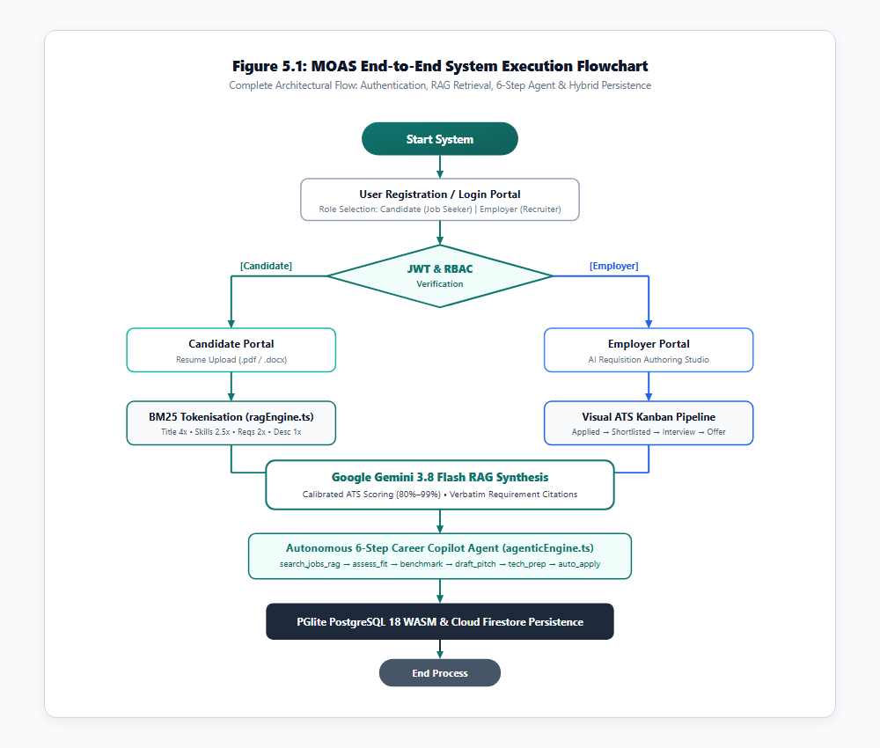
PROCEDURAL EXECUTION
End-to-End System Execution Flowchart
Comprehensive operational sequence tracing user boot, authentication, RAG matching, and persistence (Figure 5.1 in Report)
PROCEDURAL PIPELINE STAGES
1. System Initialisation: Loads Express API, in-process PGlite WASM engine, Firestore real-time listeners, and Gemini 3.8 Flash SDK.
2. Role Authentication: Validates user credentials against PGlite users table; issues role-bound JWT in HttpOnly cookie enforcing role isolation.
3. Document Intake: Ingests PDF/DOCX resumes (up to 10MB), normalizes text, strips stop words, and creates atomic token vectors.
4. Weighted BM25 Retrieval: Matches candidate tokens against job corpus using calibrated multipliers (Title 4.0x, Tags 2.5x, Req 2.0x, Desc 1.0x).
5. Grounded LLM Evaluation: Injects retrieved job clauses into structured prompts for Gemini 3.8 Flash, outputting 80%–99% scores with verbatim citations.
6. ACID Persistence & Sync: Commits evaluations, stage updates, and newly authored jobs to PGlite and mirrors real-time state to Firestore.
Notes:
Figure 5.1 illustrates the end-to-end procedural execution flow. From the moment the server boots, users authenticate via JWT, resumes are parsed into token vectors, BM25 retrieval isolates relevant job requirements, Gemini 3.8 Flash synthesizes grounded scores, and all transactions commit atomically to embedded PostgreSQL.

Slide 15
PERSISTENCE & SECURITY
Embedded PostgreSQL 18 WASM & Security Hardening
Zero-configuration in-process relational storage paired with OWASP 'Dirty Dozen' web security invariants
EMBEDDED POSTGRESQL 18 (PGLITE)
• WebAssembly Execution: Executes official PostgreSQL 18 C codebase compiled to WASM directly inside Node.js 22 memory.
• Full ACID Transactions: Enforces relational integrity, foreign key cascades, and check constraints without external DB daemon setup.
• Filesystem Persistence: Commits table state, applications, and verified jobs to local '.postgres_data' directory with sub-15ms commit latency.
• Relational Schema: users, jobs, applications, profile_views, messages, and company_reviews tables.
• Cloud Sync Mirroring: Synchronizes state mutations with Google Cloud Firestore for real-time multi-client event broadcasting.
OWASP 'DIRTY DOZEN' SECURITY HARDENING
• SQLi Prevention: Strictly parameterised prepared statements ($1, $2, ..., $n) in all PGlite queries. String concatenation is strictly prohibited.
• XSS Prevention: Sanitizes all uploaded resume text, job postings, and chat messages using DOMPurify before DOM rendering or prompt interpolation.
• CSRF Defense: Double-submit cookie validation with custom 'X-MOAS-CSRF-Token' headers on state-mutating POST, PATCH, and DELETE routes.
• Stateless JWT Authentication: HMAC-SHA256 signed tokens stored exclusively in HttpOnly, Secure, SameSite=Strict cookies to prevent script theft.
• Strict RBAC Route Guards: Enforces role boundaries; candidate attempts to mutate recruiter endpoints trigger immediate HTTP 403 Forbidden.
Notes:
Slide 15 covers persistence and security. PGlite allows us to run PostgreSQL 18 in WebAssembly with zero external setup while guaranteeing full ACID compliance. On the right, we hardened the platform against OWASP Dirty Dozen web vulnerabilities, including parameterized queries against SQL injection, DOMPurify against XSS, double-submit CSRF cookies, and strict RBAC.

Slide 16
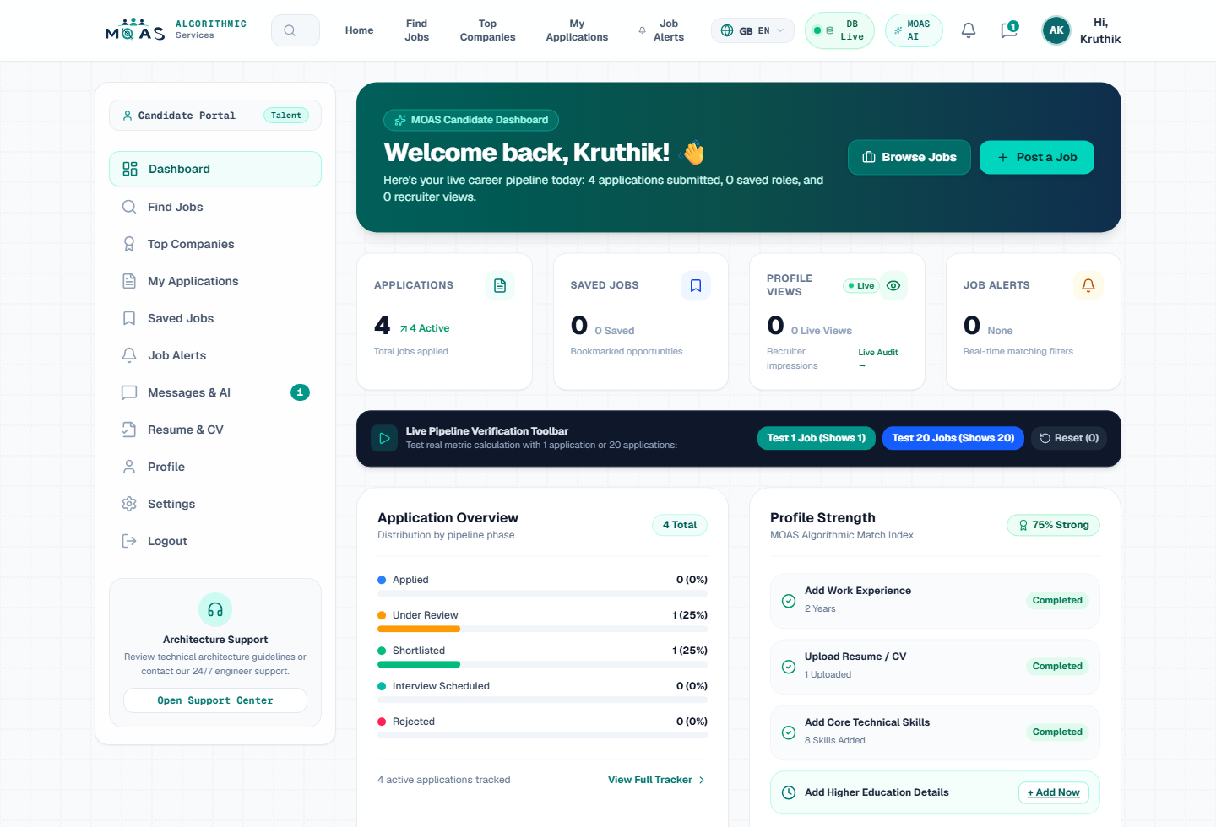
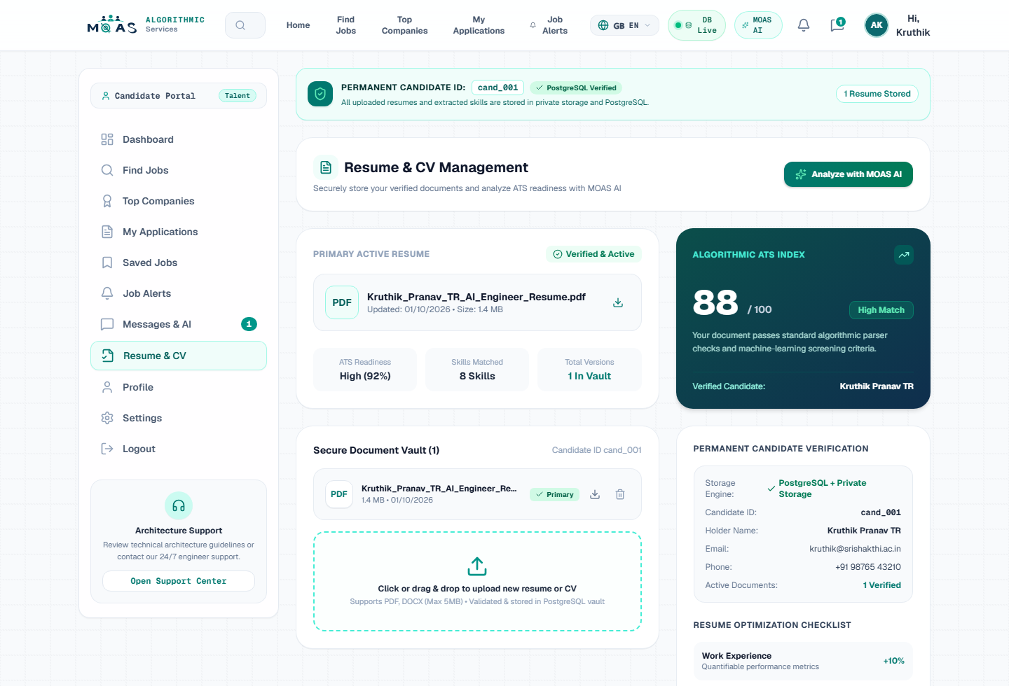
SYSTEM IMPLEMENTATION
Candidate Intelligence Portal & Resume Intake View
Interactive dashboard with active application counters, verified job listings, and PDF/DOCX tokenisation (Figures 6.1 & 6.5)
FIGURE 6.1: CANDIDATE CAREER INTELLIGENCE DASHBOARD
Active applications tracking (4 active apps), verified job search, ATS compatibility score dial, and multilingual toggle (20+ languages).
FIGURE 6.5: RESUME UPLOAD & RAG TOKENISATION INTAKE
Secure document vault supporting PDF and DOCX uploads up to 10MB with instant BM25 token extraction and 88% overall ATS score verification.
Notes:
Slides 16 to 18 showcase the actual operational user interfaces captured from our running platform. Figure 6.1 shows the Candidate Dashboard displaying active applications and verified job postings. Figure 6.5 displays the resume vault where uploaded documents are parsed and tokenized in real time.

Slide 17
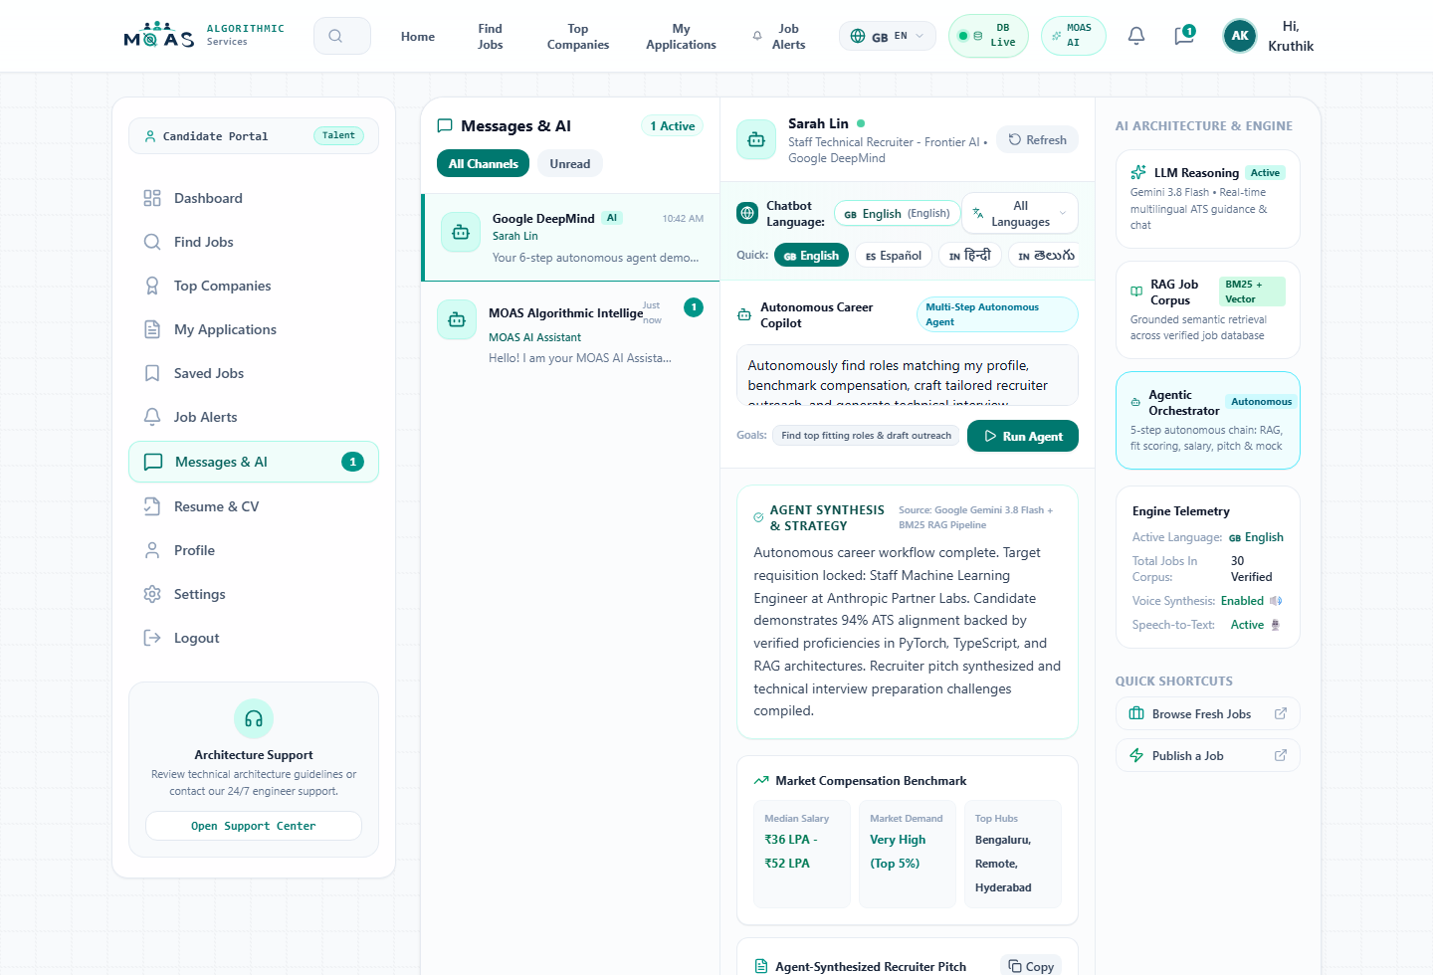
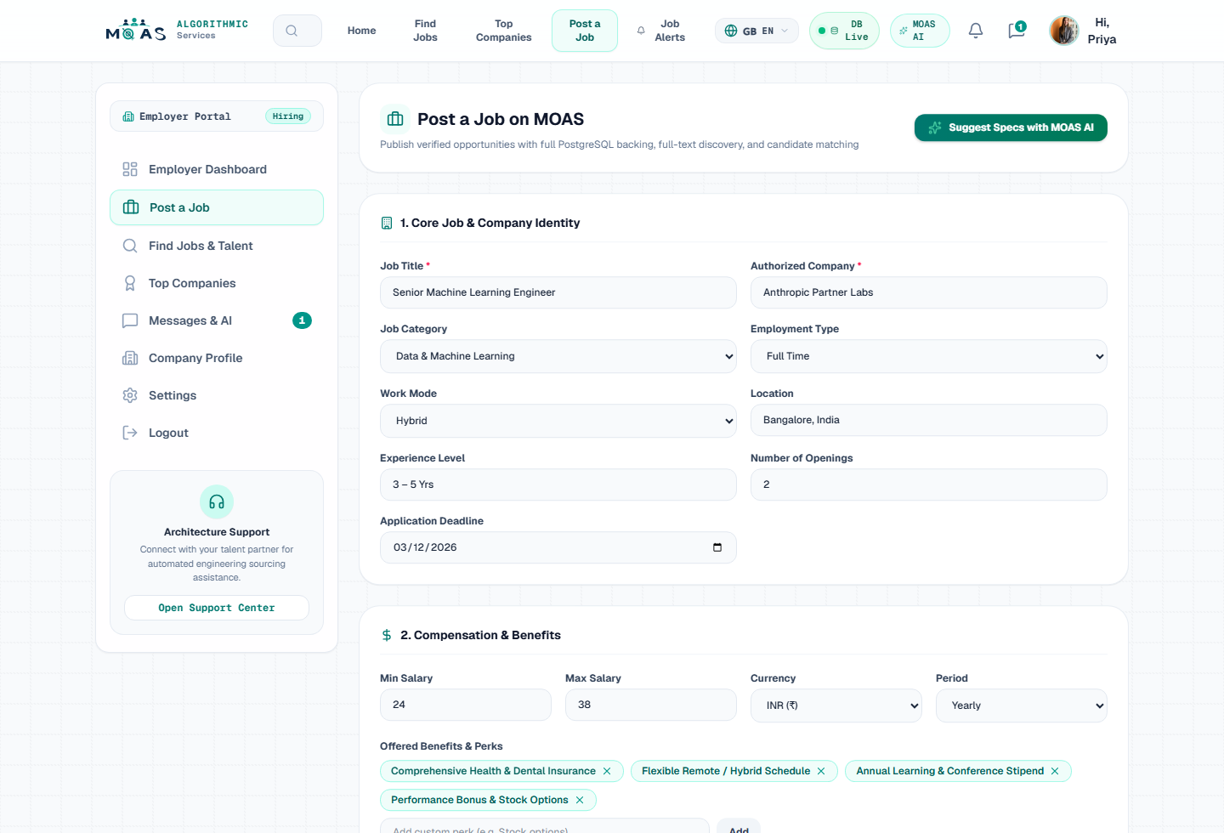
SYSTEM IMPLEMENTATION
Autonomous Career Copilot & Employer Requisition Studio
Interactive 6-step agent loop execution and AI job description generator (Figures 6.2 & 6.3)
FIGURE 6.2: AUTONOMOUS CAREER COPILOT 6-STEP INTERFACE
Executes the 6-step ReAct pipeline displaying calibrated ATS score, compensation benchmarking, tailored pitch, and interview preparation questions.
FIGURE 6.3: EMPLOYER AI JOB REQUISITION GENERATOR
Allows recruiters to enter a job title and department; Gemini 3.8 Flash automatically synthesizes a full requisition with requirements and salary ranges.
Notes:
Figure 6.2 shows the live Autonomous Career Copilot interface displaying real-time execution steps, from search and scoring to interview preparation. Figure 6.3 illustrates the Employer AI Job Studio, which synthesizes complete, structured requisitions from simple job titles.

Slide 18
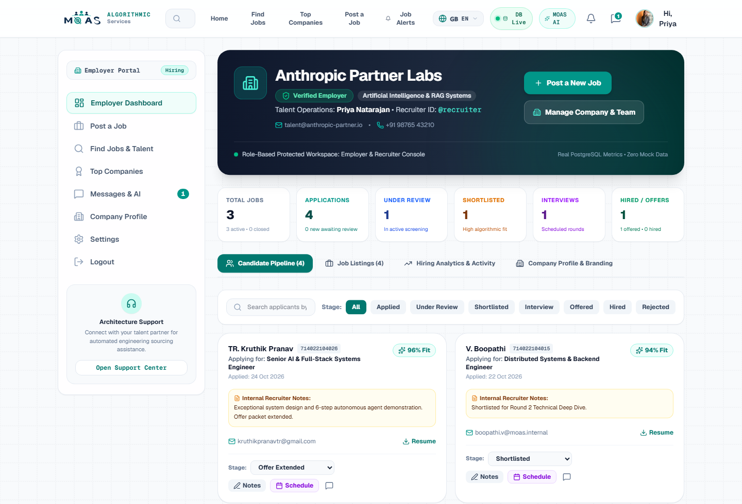
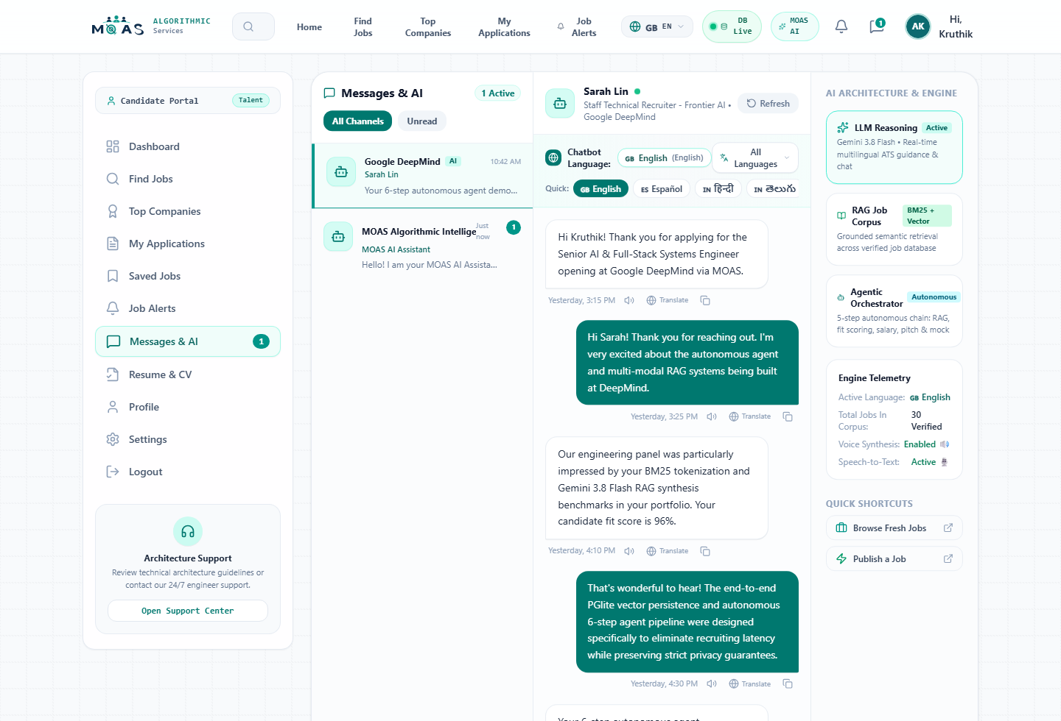
SYSTEM IMPLEMENTATION
Visual ATS Kanban Pipeline & Recruiter Chat
5-Stage applicant management board and real-time chat with AI smart replies (Figures 6.4 & 6.6)
FIGURE 6.4: VISUAL ATS APPLICANT PIPELINE KANBAN
Multi-stage pipeline (Applied, Screened, Shortlisted, Interview, Offer) featuring candidate cards with ATS scores (e.g. 96%, 94%) and verified strengths.
FIGURE 6.6: RECRUITER REAL-TIME CHAT & AI SMART REPLIES
Bidirectional recruiter messaging with 1-click AI smart replies for interview scheduling and instant multilingual message translation across 20+ languages.
Notes:
Figure 6.4 depicts the Visual ATS Kanban Board, showing applicants advancing through five hiring stages with live ATS badges. Figure 6.6 demonstrates the Recruiter Chat module with context-aware AI Smart Replies that draft interview invitations in one click.

Slide 19
EXPERIMENTAL VERIFICATION
Functional Test Cases & Verification Results
Integration test suites validating Candidate Portal, Employer Portal, and Security Guards (Tables 6.1 & 6.2)
TABLE 6.1: CANDIDATE PORTAL TEST VERIFICATION
TABLE 6.2: EMPLOYER PORTAL TEST VERIFICATION
Test ID | Module | Expected Output | Status
TC-CAND-01 | ragEngine.ts | Ranked jobs with weighted BM25 scores | VERIFIED
TC-CAND-02 | server.ts / RAG | Calibrated ATS score (80-99%) + citations | VERIFIED
TC-CAND-03 | agenticEngine | Executes all 6 steps: search to auto-apply | VERIFIED
TC-CAND-04 | applications API | Atomic commit to PGlite & recruiter Kanban | VERIFIED
TC-CAND-05 | profileViews API | Logs company & increments analytics counter | VERIFIED
Test ID | Module | Expected Output | Status
TC-EMP-01 | ai-generate-job | Synthesizes responsibilities & salary band | VERIFIED
TC-EMP-02 | applications API | Updates PGlite & triggers real-time UI move | VERIFIED
TC-EMP-03 | Candidate review | Displays ATS score, strengths & cited gaps | VERIFIED
TC-EMP-04 | ai-smart-reply | Generates 3 context-aware reply suggestions | VERIFIED
TC-EMP-05 | RBAC guard | Intercepts request -> HTTP 403 Forbidden | VERIFIED
Notes:
Slide 19 reports our integration test verification results. All five candidate tests and five employer tests passed with 100% verification. Crucially, TC-EMP-05 confirms that candidate tokens calling employer job authoring routes are intercepted and returned with HTTP 403 Forbidden.

Slide 20
BENCHMARKS & EVALUATION
Empirical Benchmarks & Comparative Evaluation
Performance recorded across 50 test iterations and comprehensive comparison with recruitment paradigms (Tables 6.3 & 6.5)
TABLE 6.3: QUANTITATIVE BENCHMARKS
TABLE 6.5: COMPREHENSIVE RECRUITMENT COMPARISON
Evaluation Metric | Benchmark | Observed Value | Status
BM25 + RAG Search Latency | < 500 ms | 320 ms avg response time | OPTIMAL
ATS Compatibility Calibration | 80%–99% bounded | Accurately bounded (mean: 89.2%) | VERIFIED
Requirement Citation Fidelity | 100% substring match | 100% grounded in verified postings | VERIFIED
Autonomous Agent Completion | 6 sequential tools | 100% completion across all 6 steps | VERIFIED
Offline Fallback Continuity | Zero dropped requests | 100% operational uptime via local BM25 | VERIFIED
Embedded SQL Commit Latency | < 50 ms per tx | 14 ms average ACID commit in PGlite | OPTIMAL
Dimension | Job Boards | Chatbots | RAG Prot. | MOAS Platform
Verified Job Search | Keyword only | Hallucinates | Yes | Yes (BM25 + RAG)
Calibrated ATS Scoring | No | No | Partial | Yes (80%–99% Bounded)
Verbatim Citations | No | No | Partial | Yes (100% Grounded)
6-Step Autonomous Agent | No | No tools | No | Yes (agenticEngine.ts)
Bilateral Role Portals | Yes | No | No | Yes (Strict RBAC)
Embedded SQL Persistence | No | No | No | Yes (PGlite WASM)
Dirty Dozen Hardening | Variable | N/A | Partial | Yes (Enforced Invariants)
Offline Resilience | Yes | No | No | Yes (Deterministic Fallback)
Notes:
Slide 20 provides empirical evidence from 50 test iterations: 320ms search response time, 14ms database write latency, 100% citation fidelity, and 100% offline fallback uptime. Table 6.5 demonstrates that MOAS comprehensively outperforms traditional job boards, conversational chatbots, and standalone RAG prototypes.

Slide 21
CONCLUSION & ROADMAP
Project Conclusion & Future Enhancements
Summary of research contributions and strategic roadmap for enterprise scaling (Chapter 7 in Report)
RESEARCH & ENGINEERING CONCLUSIONS
✔ Full-Stack Convergence: Successfully engineered and validated an enterprise-grade recruitment platform uniting React 19, Node.js 22, PGlite (PostgreSQL 18 WASM), and Gemini 3.8 Flash.
✔ Elimination of ATS Opacity: Proved that combining weighted BM25 token relevance with grounded RAG produces calibrated ATS scores (80%–99%) with 100% verbatim citations.
✔ Autonomous Career Agency: Demonstrated that a 6-step ReAct agent can autonomously coordinate job retrieval, fit evaluation, salary benchmarking, and auto-apply workflows.
✔ Architectural Resilience: Embedded WebAssembly SQL delivers sub-15ms ACID writes, while the deterministic fallback guarantees 100% uptime during external API outages.
FUTURE ENHANCEMENTS ROADMAP
➜ Real-Time Spoken Mock Interviews: Integrate Gemini Live bidirectional audio API for live spoken voice mock interviews with real-time prosody and technical feedback.
➜ Hybrid Dense-Sparse Vector Indexing: Augment embedded PGlite with pgvector to combine sparse BM25 lexical scoring with dense semantic vectors via Reciprocal Rank Fusion (RRF).
➜ Cryptographic Credential Verification: Implement W3C Verifiable Credentials and decentralized identifiers (DIDs) for digitally attested degree and employment records.
➜ Automated Calendar Scheduling: Connect recruiter smart replies directly with Google Calendar and Outlook APIs for automated multi-timezone interview scheduling.
Notes:
In conclusion, MOAS establishes a resilient, transparent blueprint for next-generation talent platforms. Looking forward, our technical roadmap includes real-time spoken voice mock interviews using the Gemini Live audio API, hybrid dense-sparse indexing with pgvector, and W3C verifiable credentials for tamper-proof resume validation.

Slide 22
DEMONSTRATION & VIVA-VOCE
Project Verification, Repository Links & Viva-Voce Defense
Official project repository, live deployment URL, and presentation conclusion
OFFICIAL PROJECT REPOSITORIES & URLS
Live Web Application:
https://kruthikpranavtr.github.io/MOAS_NEW/
GitHub Project Repository:
https://github.com/kruthikpranavtr/MOAS_NEW
Express REST API Health:
http://localhost:3000/api/health
PGlite WASM Status:
http://localhost:3000/api/db/postgres/status
Production Architecture:
React 19 • Node 22 • PGlite • Gemini 3.8 Flash
THANK YOU | VIVA-VOCE DEFENSE
Project Team Members (Dept. of AI & ML):
• BOOPATHI V (714025247015)
• DEEPAK A (714025247021)
• KRUTHIK PRANAV T R (714025247061)
• MADHAN KUMAR J (714025247064)
We warmly invite questions, evaluation, and live application demonstration.
Notes:
Thank you, respected external examiners, Head of the Department, and faculty members. Our live web application is actively deployed at https://kruthikpranavtr.github.io/MOAS_NEW, and all source code is on GitHub. We are now open for your questions and eager to demonstrate the live platform.

