Slide 1

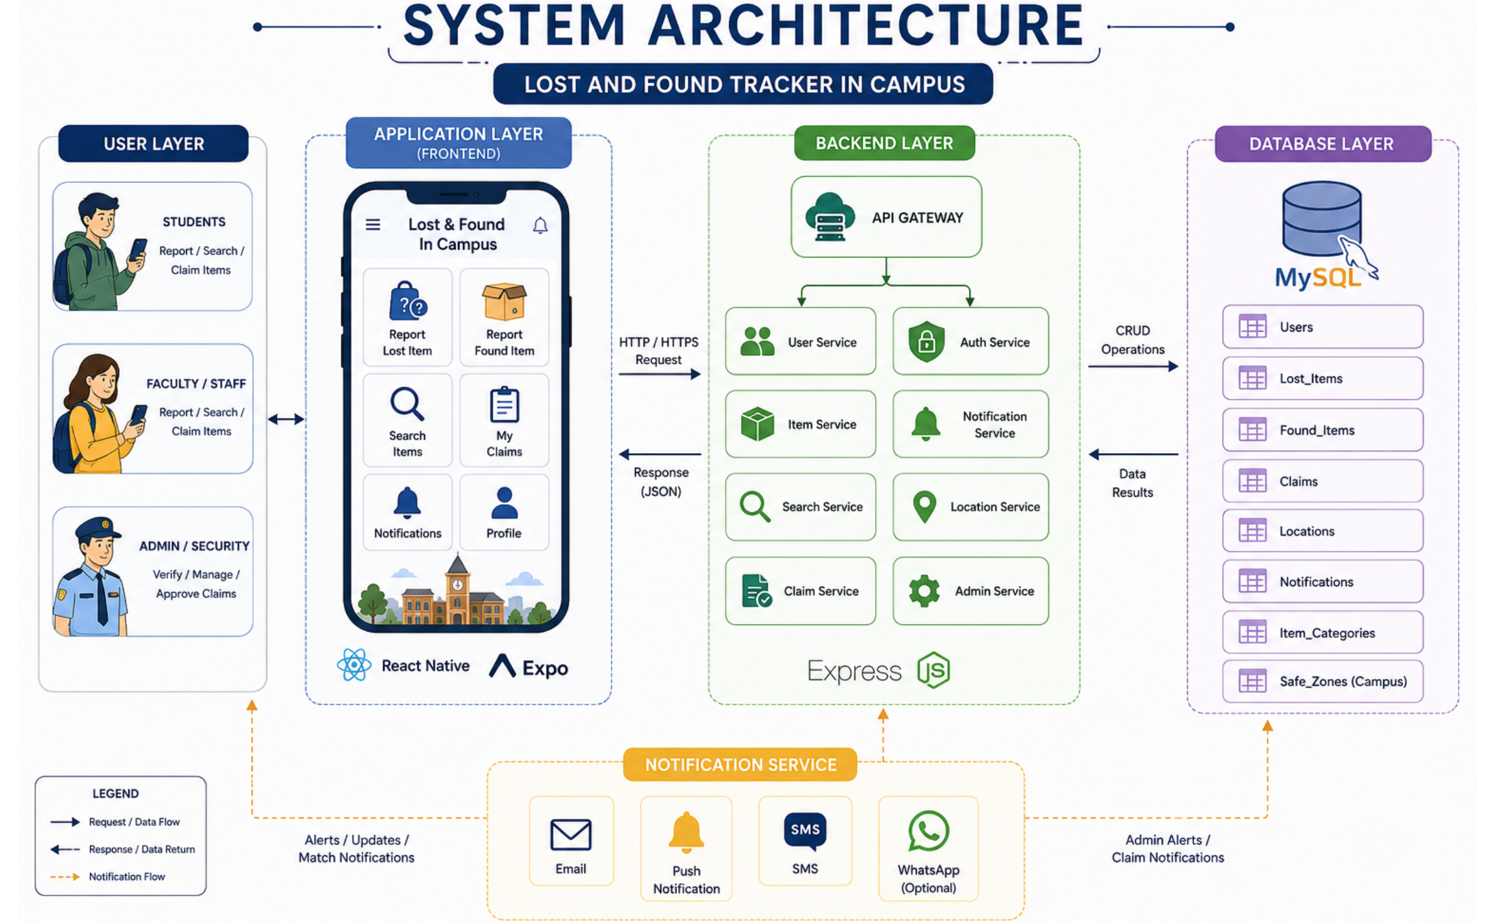
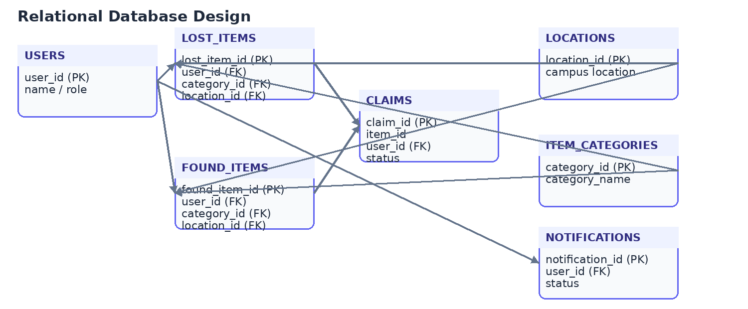
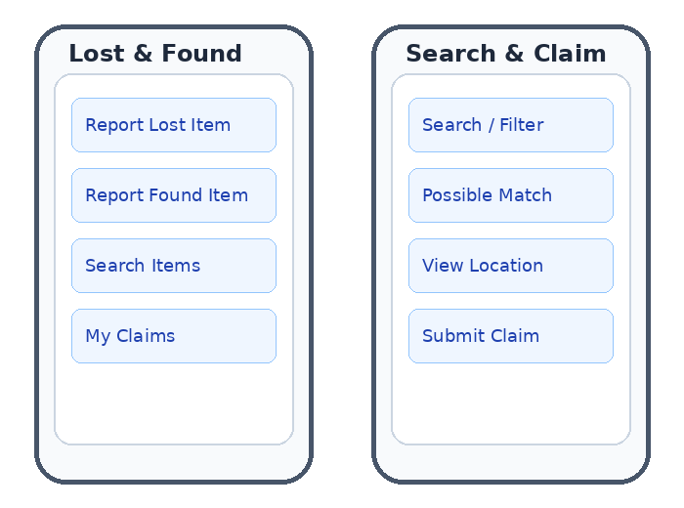
LOST & FOUND ITEM TRACKER FOR CAMPUS
TEAM ID: 16 | SECTION: [S__] | GUIDE: DR. RAMYA KRISHNA
MEMBERS: CH. HASIKA – 2520030372 | V. SRIKRUTHI – 2520030340 | P. BHAVANA MANASWINI – 2520030154
DATABASE SYSTEMS ENGINEERING AND DISTRIBUTED BACKEND DEVELOPMENT (25CS1302E)
KLH BACHUPALLY CAMPUS, CSE | PBL 2026–27
Abstract
Tools & Technologies
• A centralized campus platform for students and staff to report, search and recover lost or found belongings.
• Captures item name, category, description, location, date and images, with search/filtering and possible-match notifications.
• Relational database stores users, items, claims, locations and status for organized tracking.
Front-End: React Native + JavaScript
Back-End: Node.js + Express.js
Database: MySQL (relational database)
Location & Maps: Expo Location + Google Maps
Development: VS Code
Problem Statement & Objectives
Problem: Lost-and-found information is scattered across classmates, groups and security offices, making reporting, searching, matching and recovery time-consuming.
Objective 1: Centralize lost and found item reporting.
Objective 2: Enable search, filtering and lost–found matching.
Objective 3: Support structured claims, verification and notifications.
Scope: Students, faculty/staff and admin/security; reporting, search, claims, locations, notifications and item-status management.
System Architecture
Existing vs Proposed System
Feature | Existing System | Proposed System
Search | Difficult to locate matching posts | Search + filters by item details
Matching | No systematic matching | Lost–found item matching
Claims | Mostly manual verification | Structured claim & verification
Records & alerts | Scattered / incomplete records | Central database + notifications
[Limitation / Gap] | [ ] | [How we solve it]
ER Diagram & Database Design
Feasibility Study
Technical: React Native/JavaScript frontend, Node.js + Express.js backend, MySQL database, and location/map services are supported by the proposed architecture.
Economic: Uses a practical software stack and standard development tools; no specialized hardware is required.
Operational: Simple reporting, search and claim workflows support students, staff and administrators.
Schedule: Modular design allows database, backend, frontend and notification components to be developed and tested within the semester.
Key Module Views
Results & Testing
Conclusion
Future Scope
CRUD operations support users, items, claims and related records.
Validation and status tracking organize reports and claims.
Search, filtering and notifications support faster item discovery and recovery.
Provides a centralized campus workflow for reporting, searching, matching and claiming lost/found items.
Connects application services with a structured relational database for consistent records.
Improve automated matching using richer item attributes and images.
Add stronger identity/claim verification and broader notification channels.
Extend analytics for frequently lost locations and item categories.
References: [1] MySQL Documentation [2] Node.js / Express.js Documentation [3] React Native Documentation [4] Google Maps / Expo Location Documentation
GITHUB
QR

