Slide 1

Unsupervised - Machine Learning Project
By Kruti Kikani

Slide 2
Process of Project
Project Goal
EDA – Exploratory Data Analysis
K-mean Cluster
Hierarchical Cluster
PCA
Conclusion

Slide 3
Project Goal
The ultimate goal of the project is to gain insights from the data sets and communicate these insights
using appropriate visualizations and metrics to make informed decisions

Slide 4

Exploratory Data Analysis

Slide 5
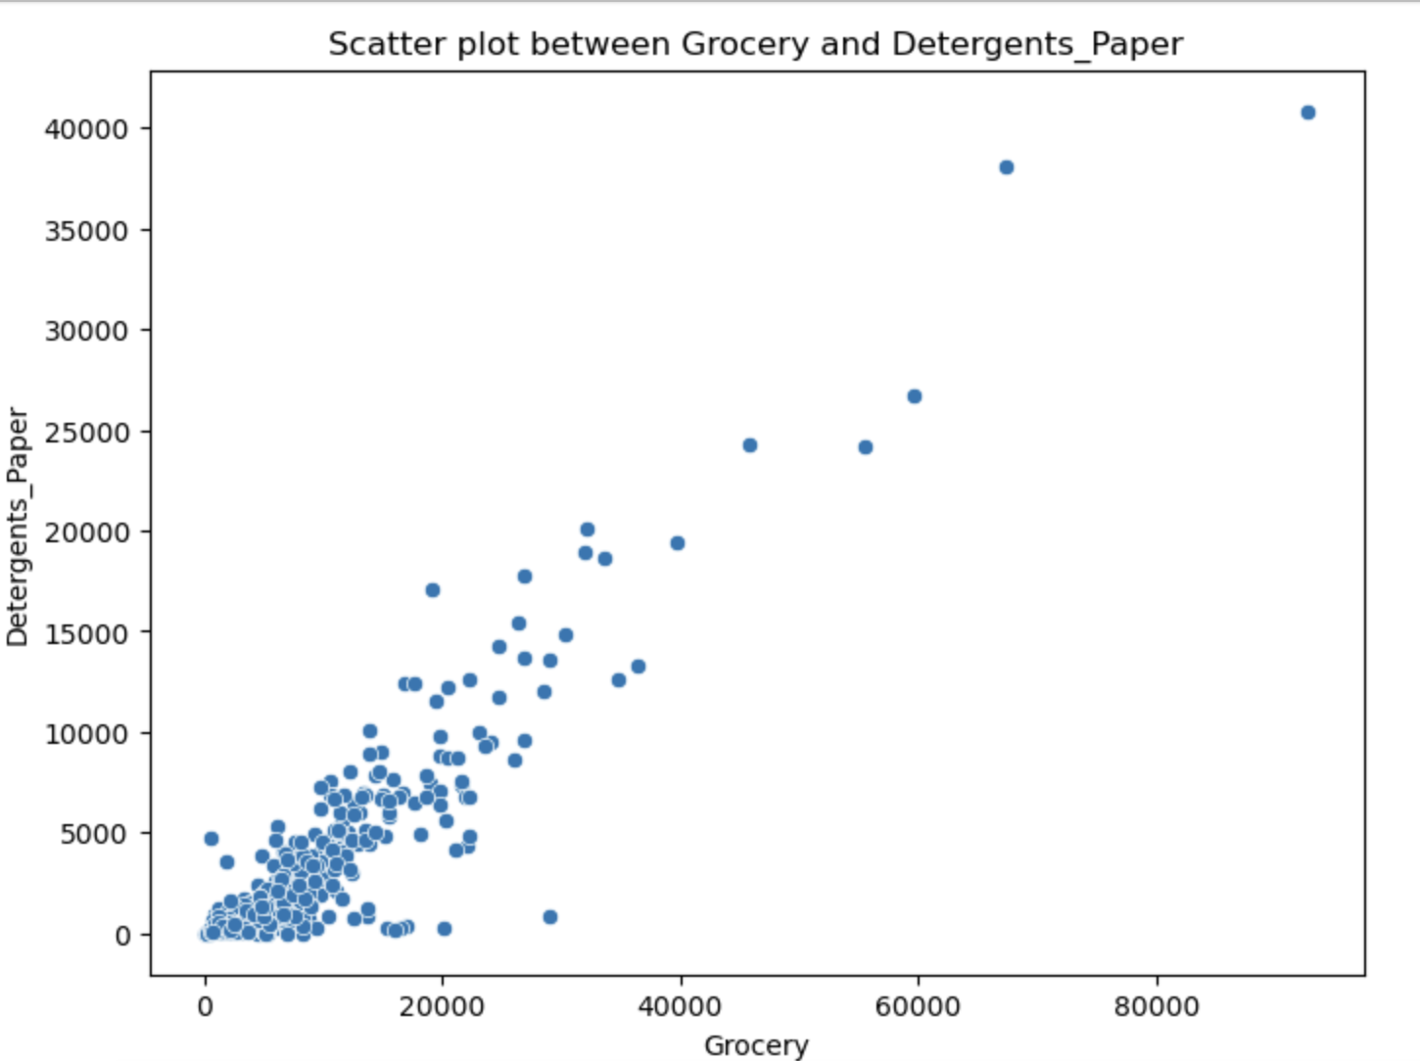
Relationship Between Grocery VS Detergents paper

Slide 6
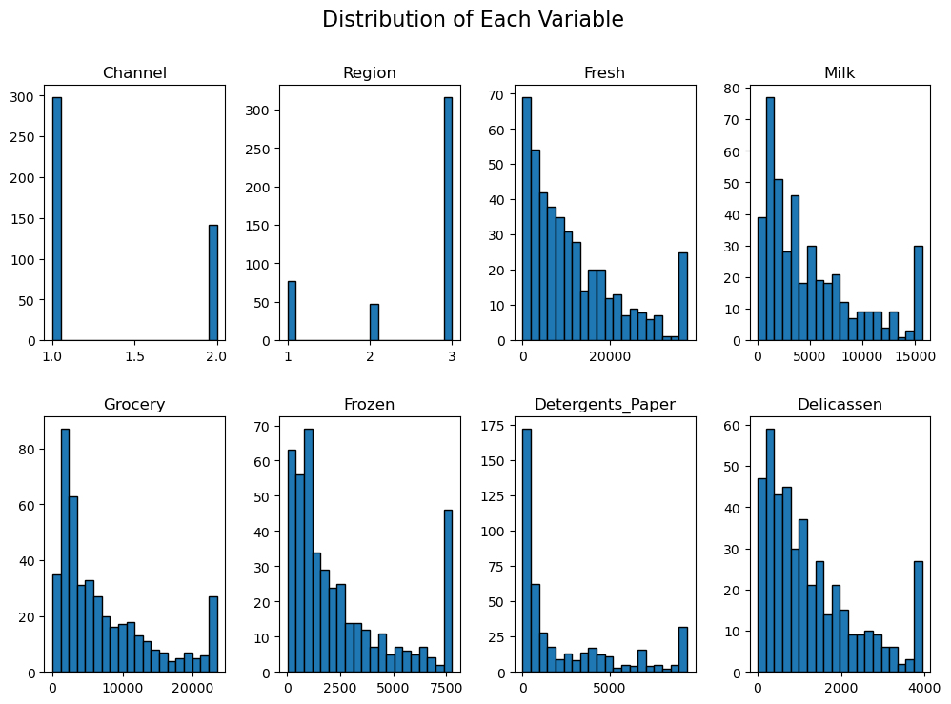
Distribution Of Each Variable

Slide 7
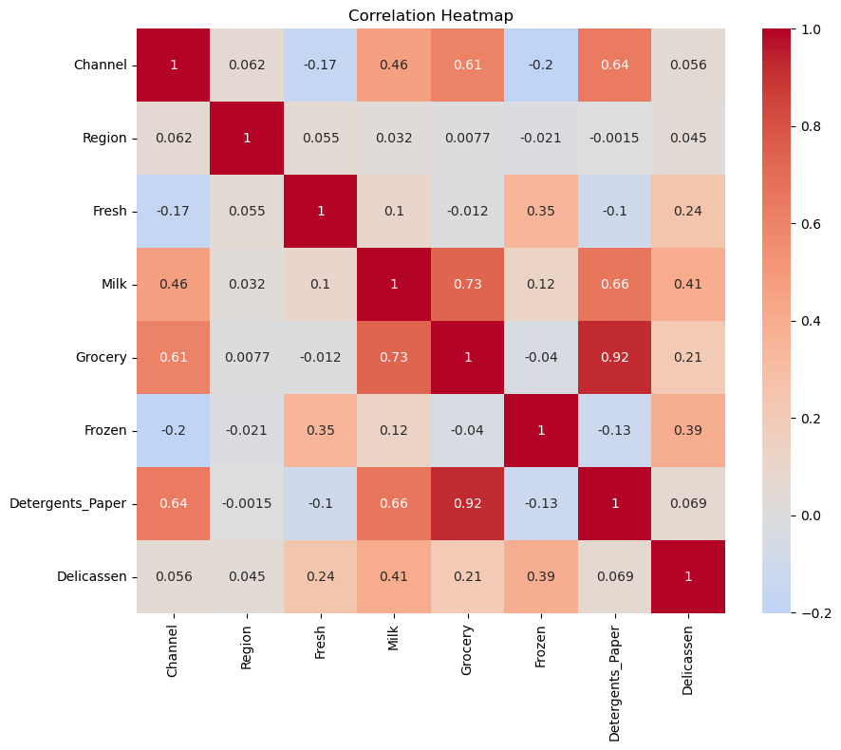
Correlation Heatmap

Slide 8

K Means Clustering

Slide 9
grouped similar products together into clusters based on their attributes such as fresh, milk, grocery, frozen, detergents_paper, and delicatessen
Used Elbow Method to determine K value
Used k mean clustering
As K-Means is a distance-based algorithm, the scale of the variables matters. Any variables on a large scale will have a much larger effect on the distance between the observations. So, scaling your data to have the same range is generally a good idea

Slide 10
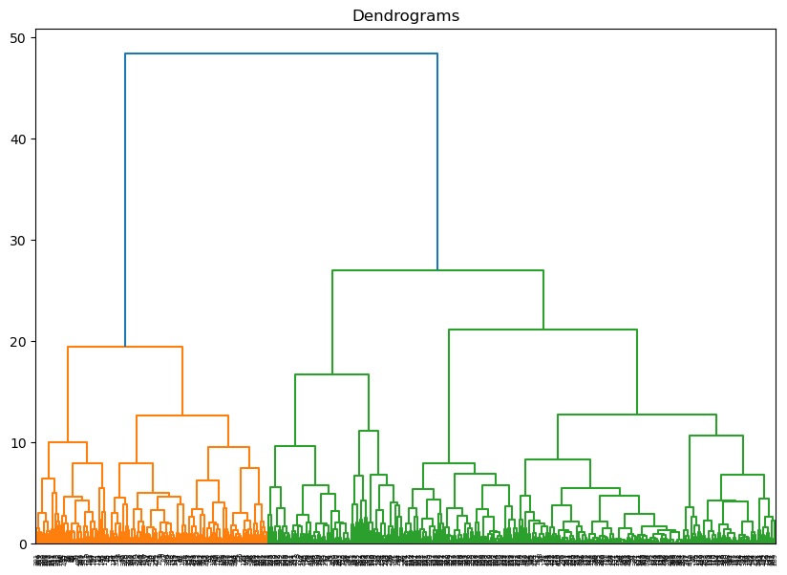
Dendrogram No of clusters = 4

Slide 11
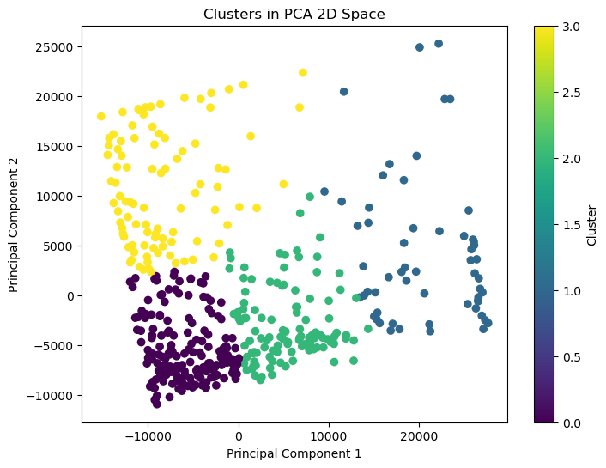
PCA

Slide 12
Conclusion
Cluster Analysis:
The K-means clustering algorithm identified four distinct clusters within the dataset
Each cluster represents a different group of customers with distinct purchasing behaviors.
Cluster 0 (about 40% of the data) customers with lower spending on most product categories,
Cluster 1 (about 26% of the data) high-spenders on Fresh, Milk, and Grocery.
Cluster 2 (about 25% of the data) customers with moderate spending across various product categories
Cluster 3 (about 9% of the data) customers with high spending on Milk, Grocery, and Detergents_Paper.

Slide 13
Continue…
Data Dimensionality Reduction:
The Principal Component Analysis (PCA) was applied to reduce the dimensionality of the dataset while preserving the most important information. The first two principal components explained around 93% of the total variance in the data.

Slide 14
Thank you

