Slide 1
Hydra
Built by: Kruti Deepan Panda
V Kartikeya
The snake and ladder bot

Slide 2
About the Bot

Slide 3
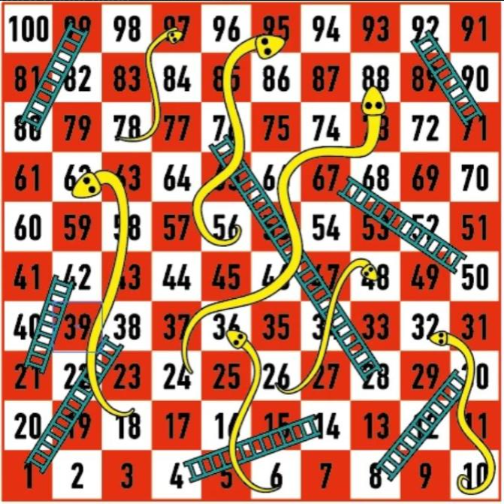
Features of the Bot
Can play snake and ladder
Minimum two players
Maximum four players
Fixed game board
Option to forfeit

Slide 4
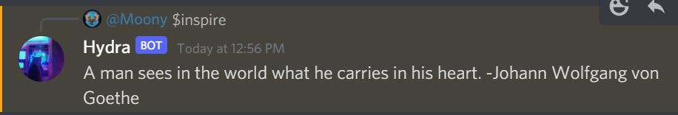
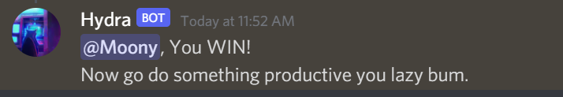
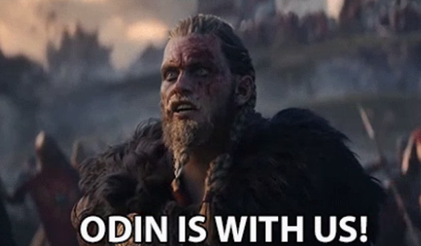
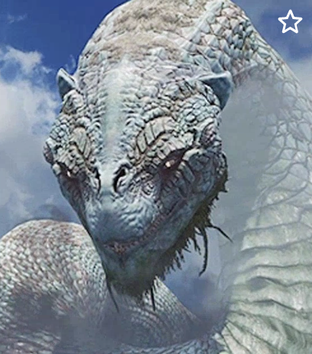
Additional features of the bot
Can send inspirational quotes
Has a mean personality
Sends GIFs for snakes or ladders

Slide 5
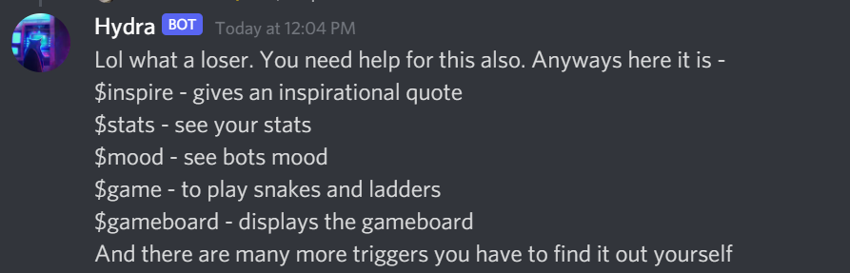
Commands
$help
$inspire - gives an inspirational quote
$stats - see your stats
$mood - see bots mood
$game - to play snakes and ladders
$gameboard - displays the gameboard
$gamerule - to see all the rules of the game
$roll

Slide 6
Approach
Chose python as language for the bot as it was already familiar
Devised an algorithm for the bot to follow while playing snakes and ladders
Implemented the algorithm in python
Added additional features like GIFs, quotes etc.
Tested with 2 players, 3 players, 4 players and fixed a lot of bugs

Slide 7
Algorithm for snake and ladders
Start
Wait for more players to join
Check
number of players
1
If more people join
Confirm if game has to be started
Yes
Start game
No

Slide 8
Algorithm for snake and ladders
Next turn
Roll the die
Add the number on the die to your position
Turn starts
Subtract the number of die from current position and restore the original
Yes
Check if greater than 100
No
Update the destination to bottom of the snake
Snake
Encounter snake or ladder triggers
Ladder
Update the destination to top of the ladder
Turn ends

Slide 9
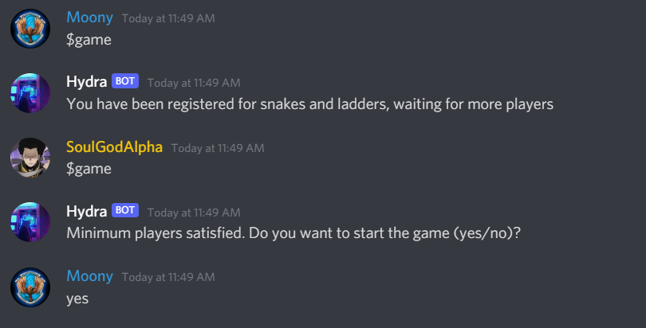
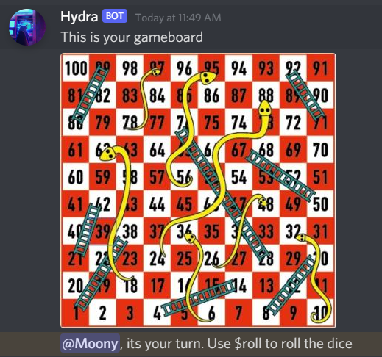
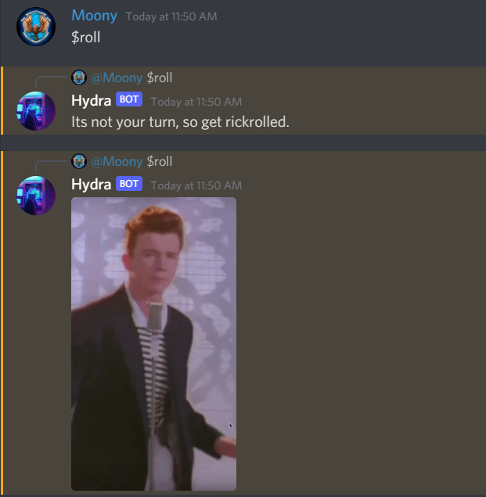
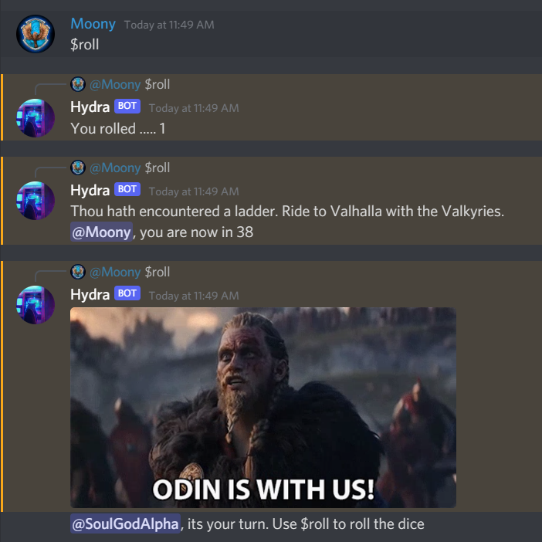
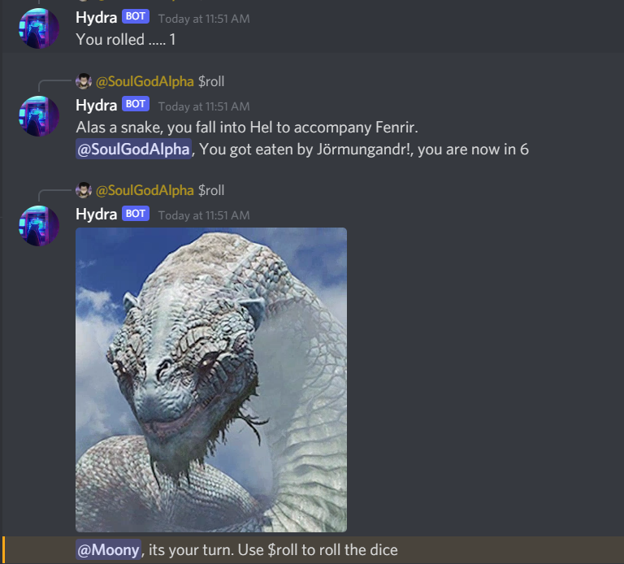
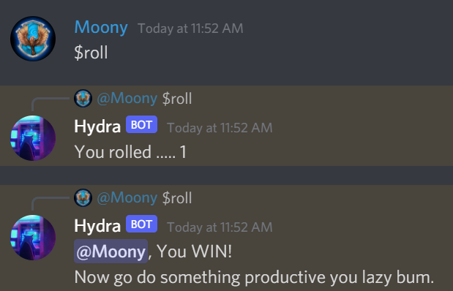
Gameplay

Slide 10
CODE
Available in the github repo:
https://github.com/krutideepanpanda/Hydra_Bot_the_builder

Slide 11
Thank you

