Slide 1

MOODLAKATTE INSTITUTE OF TECHNOLOGY
Dept of Computer Science And Engineering
PROJECT TITLE : - Machine Learning-Based Voting Classifier Model for Optimal Crop Recommendations
PRESENTED BY :-
KRUTIK K M 4MK21CS020
PRAJWAL K B 4MK21CS034
PRAMOD R 4MK21CS035
VINOD R 4MK21CS062
UNDER THE GUIDENCE :-
Mr. MURALIDHARA B K
Head of Department, CSE

Slide 2
TABLE OF CONTENTS
SI NO | CONTENT
1 | INTRODUCTION
2 | PROBLEM STATEMENT
3 | OBJECTIVES
4 | LITERATURE SURVEY
5 | METHODOLOGY
6 | REQUIREMENTS
7 | APPLICATIONS
8 | CONCLUSION
9 | REFERENCES

Slide 3
INTRODUCTION :-
This project presents an advanced crop recommendation system powered by machine learning techniques.
The system uses a comprehensive dataset of essential soil parameters and climatic factors
An advanced crop recommendation system utilizing machine learning techniques is introduced, featuring a Voting Classifier that integrates the strengths of multiple models.
The user-friendly web application enables farmers to input local soil and climate conditions, helping them make informed decisions to enhance productivity and tackle economic challenges.

Slide 4
PROBLEM STATEMENT
Indian agriculture faces challenges from diverse environmental conditions and soil characteristics, making crop selection difficult for farmers. This project proposes a crop recommendation system using advanced machine learning to analyze soil and climate. It aims to provide accurate crop suggestions, enhancing productivity and promoting sustainable practices.

Slide 5
OBJECTIVES
Data Preparation and Cleaning
Machine Learning Implementation
Voting Classifier Development
User -Friendly Web Application
Enhancing Decision-Making

Slide 6
LITERATURE SURVEY
SI NO | AUHTOR | PAPER TITLE | YEAR | PROPOSED MODEL | ACCURACY
1 | Ajay Lokhande | Crop Recommendation System Using Machine Learning | 2022 | Logistic Regression Support Vector Machine Random Forest Decision Tree | 99.9%
2 | Dr. V.Geetha | An Effective Crop Prediction Using Random Forest Algorithm | 2020 | Random Forest | 95%
3 | Atharva Jadhav | Crop Recommendation System Using Machine Learning Algorithms | 2022 | Random Forest XGBoost Logistic Regression Decision Tree | 98.9%
4 | Mrs. N. Saranya | Classification of Soil and Crop Suggestion using Machine Learning Techniques | 2020 | K-Nearest Neighbor Decision Tree Random Forest | 99.32%
5 | SHILPA MANGESH PANDE | Crop Recommender System Using Machine Learning Approach | 2021 | Support Vector Machine Random Forest K-Nearest Neighbour | 95%

Slide 7
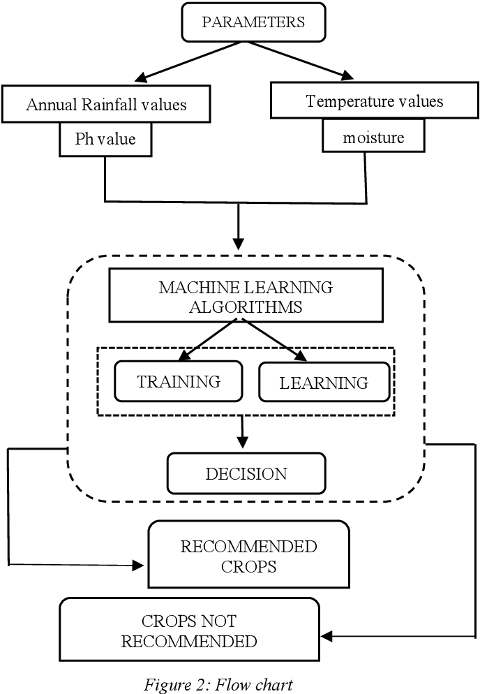

METHODOLOGY
LOGIN/REGISTER
INPUT THE DATA
TRAIN THE MODEL
PREDICTED CROP
Fig : System Architecture
Fig : Flow Diagram of Project

Slide 8
1 Data Collection
The dataset used in this study was obtained from Kaggle's Crop Recommendation dataset.
This dataset was build by augmenting datasets of rainfall, climate and fertilizer data available for India.
Number of Samples: Approximately 2,200 rows.
Crop Diversity: Includes recommendations for 22 different crops such as rice, maize, chickpea, and banana.
DATA FIELDS | DESCRIPTION
N | ratio of Nitrogen content in soil
P | ratio of Phosphorous content in soil
K | ratio of Potassium content in soil
humidity | relative humidity in %
Temperature | temperature in degree Celsius
ph | ph value of the soil
rainfall | rainfall in mm
Table :Data fields

Slide 9
2 Data Preprocessing
Normalization:
Numerical features (N, P, K, temperature, humidity, pH, rainfall) were normalized using StandardScaler to have a mean of 0 and a standard deviation of 1.
Encoding:
Categorical features (e.g., crop type) were encoded using convert categorical variables into a suitable format for machine learning algorithms.
3 Model Development and Training
Base Models : Random Forest, SVM, Linear Regression, K-NN, XG-Boost, Naïve Bayse, Bagging Classifier, Gradient Boosting
Ensemble Learning: Implement a voting classifier that combines the predictions of the selected base models.

Slide 10
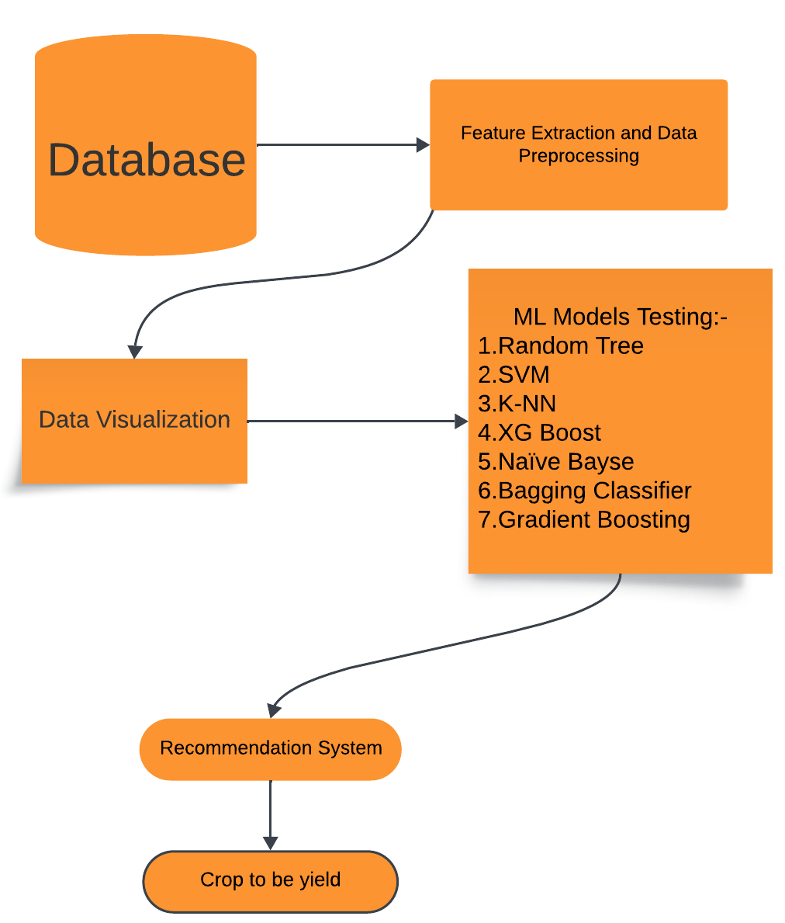
4 Model Evaluation and Validation
Performance Metrics: Evaluate using accuracy, precision, recall, F1-score, and ROC-AUC with cross validation.
5 User Interface
Application Design: Create a user-friendly web interface for farmers to input local conditions.
Fig :-Process Flow and Algorithms

Slide 11
SOFTWARE/HARDWARE REQUIREMENTS
Software Requirements:
Programming Language: Python
Libraries and Frameworks: Flask, HTML/CSS/JavaScript
Software: Jupiter Notebook for model development and testing , Pycharm,Vs Code, Git for Deployement
Database Technologies: MangoDb
Machine Learning Libraries: Scikit-learn, Naïve Bayes, XGBoost, Pandas, NumPy
Hardware Requirements:
Graphics Processing Unit (GPU)
Central Processing Unit (CPU)
RAM (Random Access Memory) : Minimum 8 GB for basic development.

Slide 12
Applications:-
Optimized Crop Selection
Increased Crop Yield
Soil Health Management
Economic Improvement:
Efficient Resource Utilization
Decision Support for Crop Diversification
Adaptation to Changing Climate Patterns
Reduction in Economic Losses
Improvement in Agricultural Productivity

Slide 13
CONCLUSION
The crop recommendation system utilizes advanced machine learning techniques to offer tailored crop suggestions based on local soil and climatic conditions. By combining multiple models through a Voting Classifier, it enhances prediction accuracy for farmers. The user-friendly web application facilitates easy access to these insights, promoting improved agricultural productivity. Ultimately, this system aims to empower farmers and boost the agricultural sector in India

Slide 14
REFERENCES
[1], Saranya, N., & Mythili, A. (2020). Classification of Soil and Crop Suggestion Using Machine Learning Techniques. International Journal of Engineering Research & Technology (IJERT), 9(02), 78–84.
[2], Geetha, V., Punitha, A., Abarna, M., Akshaya, M., Illakiya, S., & Janani, P. (2020). An Effective Crop Prediction Using Random Forest Algorithm. Pondicherry Engineering College, Puducherry, India. DOI: 10.1109/ICCPEIC48611.2020.9079035
[3], Vanadana Kale, V., & Mohapatra, B. N. (2024). Crop Recommendation System Using Machine Learning. Journal of Engineering and Technology for Industrial Applications (JETIA), 10(48), 63-68. DOI: 10.5935/jetia.v10i48.1186
[4], Ajay Lokhande, A., & Dixit, M. (2022). Crop Recommendation System Using Machine Learning. International Research Journal of Engineering and Technology (IRJET), 9(5), 3584-3590.
[5], Shilpa Mangesh Pande, S. M., Kumar, P. R., Anmol, A., Raishwarya, B., Rohilla, K., & Shaurya, K. (2021). Crop Recommender System Using Machine Learning Approach. Proceedings of the Fifth International Conference on Computing Methodologies and Communication (ICCMC 2021), 1066-1071. DOI: 10.1109/ICCMC51019.2021.9418351

Slide 15


