Slide 1
Red n White Wine Quality Prediction Using Machine Learning
Presented By:
Krutika Yeola
Mansi Patil
Utkarsha Patil
Guided By:
Ashwini Kakade

Slide 2
Outline :-
INTRODUCTION
PROBLEM STATEMENT
DATASET
ML ALGORITHMS

Slide 3

Introduction
Wine is a beverage produced from the fermentation of grapes and other fruits, resulting in varying alcohol levels.
Evaluating wine quality and ensuring its safety is a complex and costly process.
Our model streamlines this process by predicting analysis outcomes.
The predictive model enhances the efficiency of quality control processes in the wine industry.

Slide 4

Problem Statement
Assessing wine quality and safety involves complex and labor-intensive laboratory tests.
Traditional testing methods are expensive due to the need for specialized equipment and expertise.
There's a need for a more efficient, cost-effective, and less labor-intensive solution.
Our project uses machine learning to predict wine quality, aiming to streamline and simplify the assessment process.

Slide 5
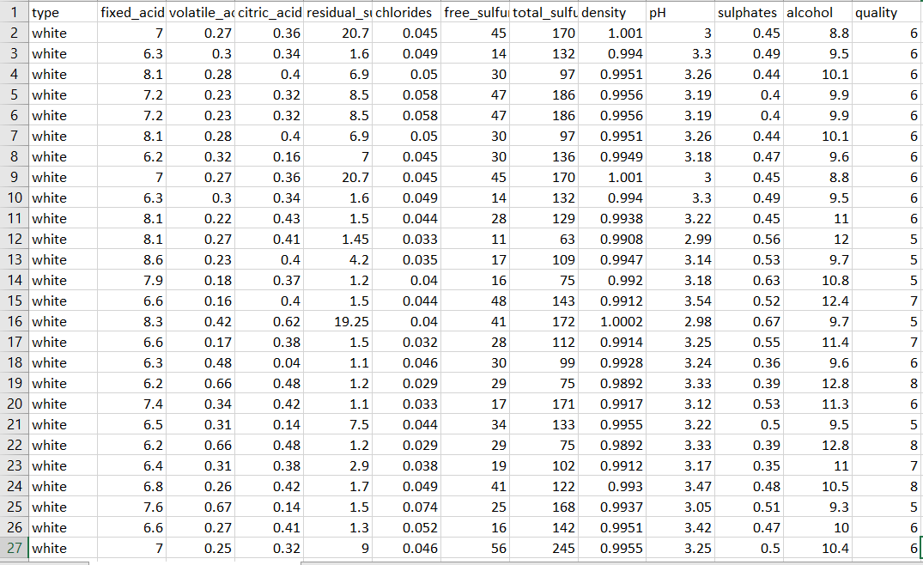
Dataset

Slide 6

About Dataset
Dataset Name: wine-quality-white-and-red.csv.
Shape of dataset: (6497,13)
Missing values : 0
Input columns: Type , fixed acidity , volatile acidity , citric acid , residual sugar , chlorides , free sulfur dioxide , total sulfur dioxide , density , pH , sulphates , alcohol
Output column: quality
Splitting dataset into training and testing
Using test size = 0.2

Slide 7
ML Algorithms Used :
As the output column of our dataset is in discrete integer values so we decided to use Classification algorithms.
We have decided to use below algorithms in our dataset
Decision Tree
K – Fold Cross Validation Using Random Forest
Gradient Boosting

Slide 8
Decision Tree:
A decision tree is a machine learning model used for classification and regression tasks, characterized by its tree-like structure. Each internal node represents a decision based on a feature, branches represent the outcomes of these decisions, and leaf nodes represent the final output or class label.
The tree is built by recursively splitting the dataset based on the feature that provides the most significant reduction in impurity (for classification) or variance (for regression). This process continues until certain stopping criteria are met, such as maximum depth or minimum samples per leaf.
Decision trees are easy to interpret and require minimal data preparation but can be prone to overfitting and instability with small data changes.

Slide 9
K-Nearest Neighbors
K-Nearest Neighbors is a simple, instance-based learning algorithm used for classification and regression tasks. It operates on the principle that data points which are close to each other in the feature space are likely to have similar outcomes. When classifying a new data point, KNN identifies the 'k' closest training examples in the feature space and assigns the most common class among these neighbors to the new point.
Simple and intuitive, no training phase (instance-based), effective with a small amount of data.
Computationally intensive with large datasets, sensitive to the choice of 'k' and the distance metric, can struggle with high-dimensional data.

Slide 10
Random Forest
Random forest is a method of classification, regression and other tasks, that operate by constructing a multitude of decision trees at training time and outputting the class that is the mode of the classes (classification) or mean prediction (regression) of the individual trees.
Following are some of the features of random forest algorithm:
It runs efficiently on large databases.
It gives estimates of what variables are important in the classification.
It generates an internal unbiased estimate of generalization error as the forest building progresses occur.

Slide 11
K-Fold Cross-Validation
To evaluate the performance of a machine learning model, in this case, a Random Forest, by partitioning the data into 'k' subsets or folds. Randomly shuffle the dataset to ensure each fold is representative of the whole. Divide the dataset into 'k' equal-sized folds. Train the model on the training set. Validate the model on the validation set and record the performance metric (e.g., accuracy, precision, recall, F1-score).
K-Fold Cross-Validation is a versatile technique applicable to a wide range of machine learning algorithms and tasks.
Providing a reliable estimate of model performance and aiding in hyperparameter tuning and model selection.

Slide 12
Gradient Boosting
Gradient Boosting is an ensemble learning technique used for classification and regression tasks. It builds models sequentially, with each new model attempting to correct the errors of the previous ones.The algorithm optimizes a loss function over iterations by adding new models (typically decision trees) that are trained to predict the residual errors of the previous models.
High predictive accuracy, handles various types of data well, less prone to overfitting compared to individual decision trees.
Computationally intensive, requires careful tuning of hyperparameters, longer training times compared to simpler models.

Slide 13
Comparison Table
ALGORITHM NAME | ACCURACY SCORE
K-Fold Cross-Validation Using Random Forest | 89 %
Decision Tree | 85.14 %
Gradient Boosting | 82.45 %

Slide 14
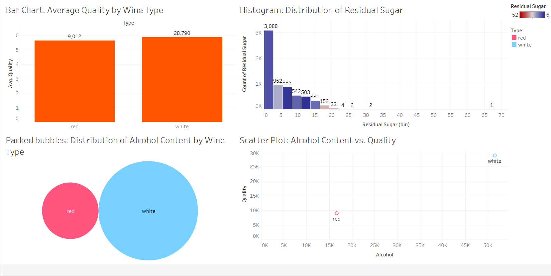
Tableau Visualization

Slide 15

REFERENCES
[1]“The Classification of White Wine and Red Wine According to Their Physicochemical Qualities,” Int. J. Intell. Syst. Appl. Eng., vol. 4, no. SpecialIssue-1, pp. 23–26, 2016.
[2] E. Summary, W. P. Monitoring, W. Quality, W. Safety, and W. Complexity, “Wine Analysis : from ‘Grape to Glass’ An analytical testing digest of the wine manufacturing process,” 2016.
[3] A. Ghosh, “Project Report : -Red Wine Quality Analysis Final 3 . An empirical Red Wine Quality Analysis of the Portuguese ‘ Vinho Verde ’ wine,” no. December 2017, 2018.
[4]Dataset download link:
https://www.kaggle.com/datasets/ruthgn/wine-quality-data-set-red-white-wine/discussion
[5] P. Model, L. Regression, and R. Studio, “Building and Evaluating a Predictive Model w/ Linear Regression in RapidMiner Studio,” 2018.

Slide 16
Thank you

