Slide 1



Sales Forecasting: Business-to-Business Quaterly Sales Prediction
Capstone Project Presentation
-by Krutika Dhananjay Deshpande
Project Advisor: Dr. Prof. Surendra Sarnikar

Slide 2




Goals & Objectives
Goal:
Accurately forecasting sales
Challenges:
Multiple influencing factors: customer-specific attributes and economic indicators
Diverse customer base spanning different industries
Objectives:
Develop a robust predictive model to forecast quarterly sales for each customer
Enable informed decision-making, streamlined operations, and better customer demand management

Slide 3
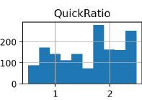
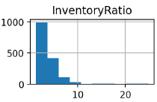
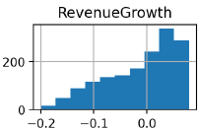
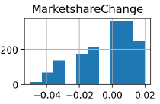
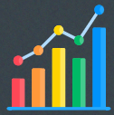

Data Overview & Exploratory Data Analysis
Datasets:
train.csv: 1575 rows, 12 columns
test.csv: 150 rows, 11 columns
EconomicIndicators.csv: 28 rows, 10 columns
We did a lot of Exploratory Data Analysis and visualizations. Following are few insights:
The QuickRatio and InventoryRatio showed skewed distributions, indicating outliers.
The RevenueGrowth and MarketshareChange exhibited a more symmetric distribution, with most values centered

Slide 4


Data Preprocessing & Feature Engineering
Data Preprocessing:
-Handled missing values in InventoryRatio using median imputation
-Dropped rows with missing Sales values in the training dataset
-Addressed duplicate ID values in the test dataset
Feature Engineering Techniques:
-Interaction features to capture interactions between variables: QuickRatio_InventoryRatio, RevenueGrowth_MarketshareChange
-Polynomial features: QuickRatio_Squared
-Binning: QuickRatio_Binned
-One-hot encoding: Company, Region, Industry, QuickRatio_Binned
-Average economic indicators: Avg_Economic_Indicators

Slide 5


Model Development and Evaluation
Model Selection: Random Forest Regressor
After trying different models like Gradient Boost, XGBoost and different methods like ensemble & stacking, Random Forest was providing the best results.
Handled complex relationships and robust to outliers
Hyperparameters: n_estimators=8000, random_state=42
Model Evaluation:
Train-test split: 80% training, 20% validation
Evaluation Metric: Mean Absolute Error (MAE)
Validation MAE: 294.45
Model Implications:
Optimize inventory management, resource allocation, and planning
Identify potential opportunities or risks
Enable proactive decision-making

Slide 6


Key Takeaways & Future Enhancements
Key Takeaways:
Developed a robust sales forecasting model using Random Forest Regressor
Leveraged customer-specific attributes, financial ratios, and economic indicators
Achieved a validation MAE of 294.45
Potential to optimize operations, improve efficiency, and support decision-making
Future Enhancements:
Incorporate additional data sources
Explore advanced feature engineering techniques
Fine-tune model hyperparameters
Regular monitoring and updating of the model

Slide 7

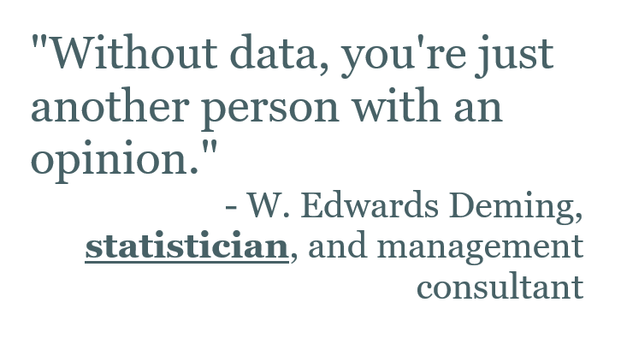





Importance of Data

Slide 8








Thanks!
Have any questions?
Contact Presenter:
Krutika Dhananjay Deshpande
Net ID: L A 8465
Cal State East Bay
Email: kdeshpande2@horizon.csueastbay.edu

